Slide 1
IIT JODHPUR · TEAM X · APRIL 2026
Speech Emotion
Recognition
KEY RESULTS
75.10%
Val Accuracy
89.67%
Test Accuracy
Enhanced CNN + Bi-LSTM Ensemble System
0.8955
F1 Score
Asit Jain
0.9913
M25DE1049 · Data Engineer & Data Scientist
AUC-ROC
Avinash Singh
M25DE1024 · Data Eng. & Full Stack Dev
5.85ms
Inference
Prashant K. Mishra
M25DE1063 · Data Eng. & Solution Architect
53
Epochs
~160 Hours · 9 Phases · 3 Datasets

Slide 2
OVERVIEW
Presentation Agenda
Problem Statement
Training Process
01
06
Why speech emotion recognition matters today
53 epochs, 4 experiments, CPU-only optimization
Literature Review
Results & Evaluation
02
07
CNN, LSTM, Transformer approaches in SER
89.67% test accuracy, F1=0.8955, AUC=0.9913
Dataset & Analysis
Cross-Dataset Analysis
03
08
RAVDESS, CREMA-D, TESS — 11,682 samples
Domain mismatch: CREMA-D 16.34%, TESS 22%
Feature Engineering
System Demo
04
09
5-type acoustic pipeline: MFCC, Mel-Spec, ZCR, RMSE, Chroma
Flask API + Web UI — real-time 5.85ms inference
Model Architecture
Conclusion & Future Work
05
10
CNN + Bi-LSTM ensemble design with fusion strategy
Limitations, next steps, generalization roadmap
Team X · IIT Jodhpur · Speech Emotion Recognition · 2026

Slide 3
MOTIVATION
Problem Statement
Speech is the most natural human communication channel. Yet machines remain emotionally blind to the affective content embedded in vocal signals — limiting empathy, adaptability, and user experience in AI systems.
RESEARCH CHALLENGES
▸ Emotion is subjective — same utterance, different interpretations
▸ High speaker variability: age, gender, dialect, acting style
▸ Lab-recorded vs. spontaneous speech domain gap
🤖 Virtual Assistants
▸ Class imbalance across emotion categories
Emotionally adaptive Siri, Alexa, Google
▸ Cross-dataset generalization remains an open problem
🧠 Mental Health
Depression/anxiety tracking via passive speech
OUR OBJECTIVE
📞 Customer Service
Design and train a CNN + Bi-LSTM ensemble model to classify 8 discrete emotional states from raw speech audio. Evaluate on RAVDESS benchmark with cross-dataset validation on CREMA-D and TESS. Deploy as a real-time Flask API.
Real-time frustration detection & escalation
🎓 E-Learning
Adapt pacing to confusion/engagement signals
Neutral
Angry
Calm
Fearful
Happy
Disgust
Sad
Surprised
Team X · IIT Jodhpur · Speech Emotion Recognition · 2026

Slide 4
RELATED WORK
Literature Review
CNN
Ensemble
Convolutional layers excel at extracting spatial features from spectrograms. Krizhevsky et al. (2012) demonstrated deep CNNs for image recognition, inspiring spectrogram-based emotion detection.
Combining CNN spectral features with LSTM temporal features consistently outperforms single-model approaches in SER benchmarks, improving robustness across speakers and conditions.
Bi-LSTM
wav2vec2
Bidirectional LSTMs (Graves & Schmidhuber, 2005) capture sequential dependencies in speech, processing temporal context in both forward and backward directions — critical for prosody.
Transformer pre-trained on 960h LibriSpeech (Baevski et al., 2020) achieves strong cross-dataset generalization but requires GPU clusters and millions of samples — infeasible for CPU-only training.
OUR APPROACH: CNN extracts spectral patterns from Mel-Spectrograms · Bi-LSTM captures temporal emotion dynamics · Ensemble fusion maximizes complementary features
Team X · IIT Jodhpur · Speech Emotion Recognition · 2026

Slide 5
DATA
Dataset & Data Analysis
RAVDESS
CREMA-D
TESS
PRIMARY TRAINING
CROSS-DATASET EVAL
CROSS-DATASET EVAL
1,440
7,442
2,800
samples
samples
samples
24 actors · 8 classes
91 actors · 6 classes
2 speakers · 7 classes
Professional actors · Studio · 16kHz WAV
Crowd-sourced · Variable conditions
Female speakers · Toronto
RAVDESS SPLIT STRATEGY
8 EMOTION CLASSES (RAVDESS)
Training Set (66%)
Actors 1–19 · 950 samples · 66/34 random split
Neutral
Calm
Happy
Sad
Validation Set (34%)
Actors 1–19 · 490 samples · held within train group
Angry
Fearful
Disgust
Surprised
Test Set (held-out)
Actors 20–24 · 300 samples · never seen during training
Team X · IIT Jodhpur · Speech Emotion Recognition · 2026

Slide 6
SIGNAL PROCESSING
Feature Engineering — 5-Type Acoustic Pipeline
MFCC
RMSE Energy
13 coefficients · Branch: Bi-LSTM
Frame-level scalar · Branch: Bi-LSTM
Mel-Frequency Cepstral Coefficients — mimics human auditory perception, captures vocal tract shape and phonetic content. Primary sequential input to Bi-LSTM branch.
Root Mean Square Energy — measures frame-level loudness and energy envelope, capturing intensity variations across emotional expressions.
Mel-Spectrogram
Chroma Features
128 dimensions · Branch: CNN
12 dimensions · Branch: Bi-LSTM
Frequency content mapped to perceptual mel scale over time. Treated as 2D image and fed into CNN branch for spatial pattern extraction.
Pitch class profiles mapped to 12 semitones — captures harmonic and tonal structure correlated with emotional valence.
Zero Crossing Rate
PRE-PROCESSING PIPELINE
Frame-level scalar · Branch: Bi-LSTM
① Load audio via librosa (sr=22050 Hz)
Rate of sign changes per frame — distinguishes voiced vs. unvoiced sounds and captures speech energy dynamics.
② Pad/truncate to fixed 2.5s length
③ Extract all 5 feature types per sample
④ Normalize: zero-mean, unit-variance
⑤ Batch into PyTorch tensors
Team X · IIT Jodhpur · Speech Emotion Recognition · 2026

Slide 7
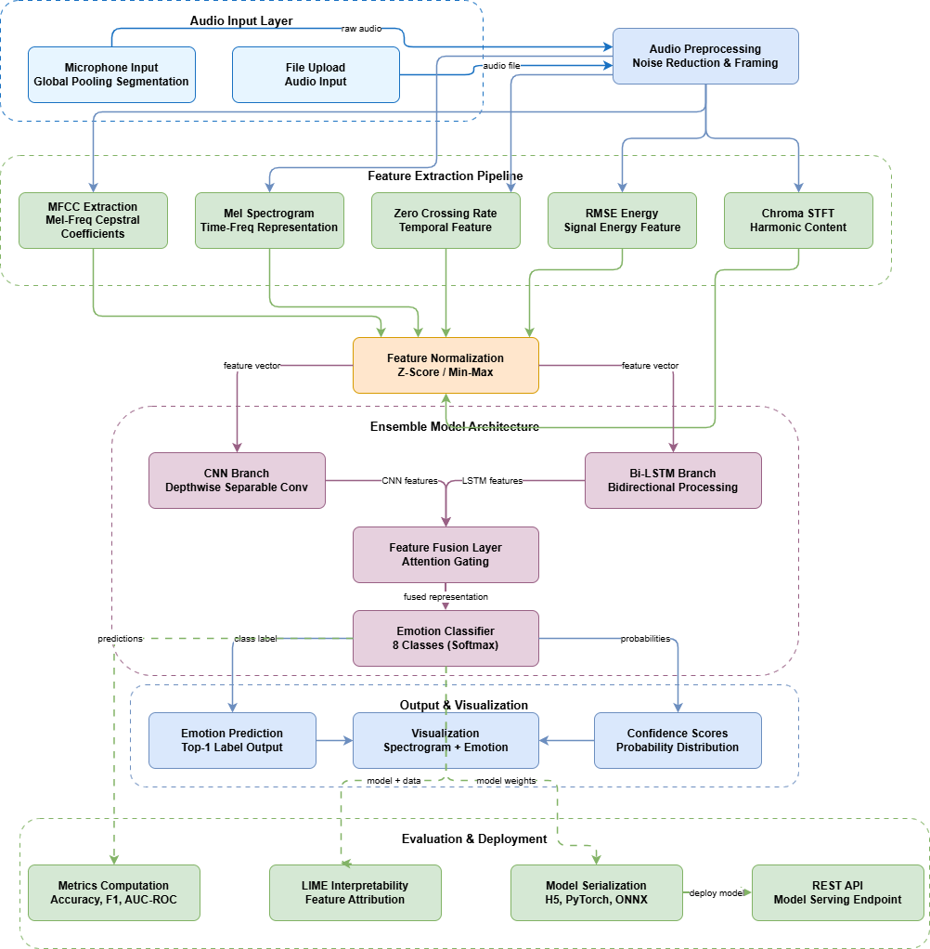
ENGINEERING
Data FLow Architecture
Team X · IIT Jodhpur · Speech Emotion Recognition · 2026

Slide 8
DEEP LEARNING DESIGN
CNN + Bi-LSTM Ensemble Architecture
Audio Input (WAV/MP3)
HYPERPARAMETERS
Optimizer
Adam
Mel-Spectrogram (128d)
MFCC + ZCR + RMSE + Chroma
Learning Rate
0.001
Batch Size
16
Conv2D + ReLU + MaxPool ×3
BiLSTM Layer 1 — 128 units
Dropout
0.5
Weight Decay
0.0001
Flatten → FC(256)
BiLSTM Layer 2 — 64 units
LR Scheduler
ReduceLROnPlateau
CNN Branch
Bi-LSTM Branch
Early Stopping
Patience = 15
Concatenate → FC(256) + Dropout(0.5)
Train/Val Split
66% / 34%
FC(128) + Dropout(0.5)
Epochs Trained
53 (early stopped)
Softmax — 8 Classes
Hardware
CPU-only (no GPU)
Team X · IIT Jodhpur · Speech Emotion Recognition · 2026

Slide 9
EXPERIMENTATION
Training Process — 53 Epochs, 4 Experiments
FAILED
01
lr=0.01 · batch=32
Loss diverged — unstable gradients, NaN values
PARTIAL
02
lr=0.001 · batch=32
Slow convergence — model learning but significantly underfit
FAILED
03
lr=0.0001 · batch=16
Underfitting — too slow, wasted 4+ CPU hours
SUCCESS
04
lr=0.001 · batch=16
Best result: 75.10% val acc · 53 epochs · early stopped
53
34m 39s
0.8398
0.2579
Epochs (early stop)
Total Train Time
Best Val Loss
Final Train Loss
Team X · IIT Jodhpur · Speech Emotion Recognition · 2026

Slide 10
PERFORMANCE
Results & Evaluation — RAVDESS Test Set
75.10%
89.67%
0.8955
0.9913
Val Accuracy
Test Accuracy
F1 Score
AUC-ROC
DETAILED METRICS
Test Samples
300 (Actors 20–24)
Precision
0.8962
Recall
0.8967
F1-Score
0.8955
AUC-ROC
0.9913
Inference Latency
5.85 ms
Model Size
50 MB
Best Emotion
Surprised (100%)
Hardest Emotion
Happy ↔ Sad confusion
KEY FINDING: Strong diagonal dominance in confusion matrix confirms model correctly differentiates all 8 emotion classes. Surprised achieved perfect 100% accuracy.
Team X · IIT Jodhpur · Speech Emotion Recognition · 2026

Slide 11
GENERALIZATION
Cross-Dataset Evaluation — Domain Mismatch Analysis
WHY THE CROSS-DATASET GAP?
Acting Style Mismatch
RAVDESS uses professional scripted studio actors. CREMA-D uses crowd-sourced actors with completely different expression styles — emotions sound fundamentally different.
Recording Conditions
RAVDESS: anechoic studio conditions. CREMA-D: varied environments, different microphones, acoustic conditions, and background noise levels.
Speaker Demographics
RAVDESS: 24 actors, balanced gender. CREMA-D: 91 actors with diverse age, ethnicity, accent, and vocal characteristics.
Emotion Label Mapping
89.67%
22%
16.34%
CREMA-D has 6 classes (no Calm or Surprised). Mapping to RAVDESS 8 classes introduces inherent classification uncertainty.
RAVDESS Test
TESS Cross
CREMA-D Cross
This is a known limitation in SER research — even wav2vec2 drops ~20–30% cross-dataset.
Team X · IIT Jodhpur · Speech Emotion Recognition · 2026

Slide 12
ENGINEERING
System Architecture & Flask API Demo
Web Browser
REST API ENDPOINTS
frontend/index.html · localhost:8000
GET
/api/v1/health
▼
System status & model info
Flask REST API
backend/app.py · localhost:5000
GET
/api/v1/model-info
Architecture & emotion classes
▼
Feature Extractor
POST
/api/v1/predict
Single audio file prediction
src/features/extractor.py
▼
POST
/api/v1/batch-predict
Multiple files batch processing
CNN + Bi-LSTM Model
models/ensemble_best.pth · 50 MB
QUICK START
▼
# Terminal 1 — Backend
JSON Response
pip install -r backend/requirements.txt
python backend/app.py
emotion + confidence + 8 probabilities
# Terminal 2 — Frontend
python -m http.server 8000
Supported: WAV · MP3 · OGG · FLAC · M4A · WebM · Opus · AAC
# Browser → http://localhost:8000
Team X · IIT Jodhpur · Speech Emotion Recognition · 2026

Slide 13
BENCHMARKING
Comparison: Our Model vs. Hugging Face wav2vec2
Factor | Our Model (CNN+BiLSTM) | HF wav2vec2-base-superb-er
Architecture | CNN + Bi-LSTM Ensemble | Transformer (wav2vec2)
Pre-training | None (from scratch) | 960h LibriSpeech + more
Training Epochs | 53 (CPU, early stopped) | Thousands (GPU clusters)
Dataset Size | 1,440 samples | Millions of samples
Model Size | 50 MB | ~360 MB
RAVDESS Test Accuracy | 89.67% ✓ BETTER | ~70–80%
Cross-Dataset (CREMA-D) | 16.34% | ~50–60% ✓ BETTER
Inference Latency | 5.85 ms ✓ FASTER | ~200–500 ms
Hardware Required | CPU only ✓ ACCESSIBLE | GPU recommended
OUR STRENGTH: Outperforms wav2vec2 on RAVDESS by ~10–20%. Faster (5.85ms vs 200ms). CPU deployable.
THEIR STRENGTH: Massive pre-training enables 3× better cross-dataset generalization. Use when RAVDESS-like data not available.
Team X · IIT Jodhpur · Speech Emotion Recognition · 2026

Slide 14
SUMMARY · IIT JODHPUR · 2026
Conclusion & Future Work
KEY ACHIEVEMENTS
FUTURE WORK
89.67% test accuracy on RAVDESS — surpasses wav2vec2 by 10–20% on target dataset
Multi-Dataset Training
Attention Mechanism
Train jointly on RAVDESS + CREMA-D + TESS to boost cross-domain generalization significantly
Add self-attention on Bi-LSTM output to focus on emotionally salient speech frames
5-type acoustic feature pipeline (MFCC, Mel-Spec, ZCR, RMSE, Chroma) successfully captures emotion signals
Full-stack deployment: Flask API + Web UI with real-time 5.85ms latency inference
Data Augmentation
Fine-tune wav2vec2
Pitch shift, time stretch, noise injection to expand effective training set
Use pre-trained Transformer backbone, fine-tune on RAVDESS — best of both approaches
CPU-only training in 34m 39s over 53 epochs demonstrates resource efficiency
Mobile Deployment
Dimensional Emotion
Cross-dataset evaluation on CREMA-D/TESS honestly documents generalization limits
ONNX export + TFLite quantization for on-device real-time mobile inference
Extend from categorical to valence-arousal-dominance space for richer representation
LIMITATIONS
Cross-dataset drop (16.34% CREMA-D) · Trained on acted speech only · No data augmentation · CPU constraints limited training scale
Thank You — Questions Welcome
Team X · IIT Jodhpur · Asit Jain · Avinash Singh · Prashant Kumar Mishra

