Slide 1

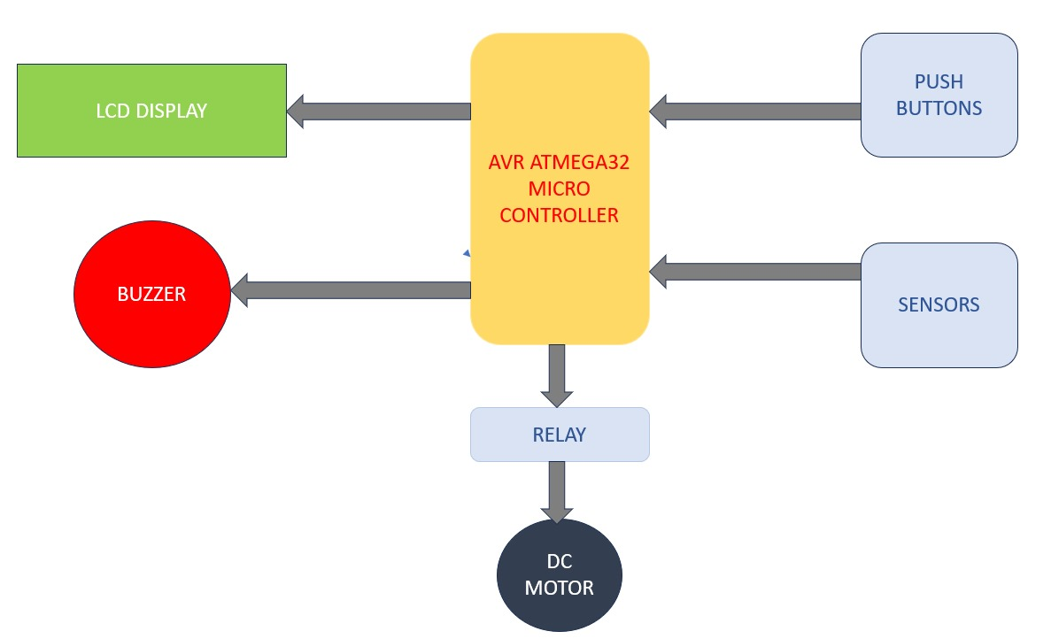
Department of C.S.E and C.S.E. (AI)
Stair Glider
Prashant U. , Chandni , Yukta S. , Wilfred B.
Team No: A 11
Problem statement
Methodology
Components Used
A Civil Contractor wants to facilitate the vertical means of transportation inside the residential building for physically challenging and aged people.
The system utilizes the “ATMEGA32” based on RISC architecture acting as brain of the system Which receives the push buttons reading, sense obstacle as input, serial communication and control sounds using buzzer. LCD display: It received the string from the microcontroller by method called serial communication and displays on the screen. Relay switch: It receives the input commands from the microcontroller that to which pin of DC motor it should make high , so that motor should rotate in desired direction. Where the microcontroller taking this direction input from the push buttons pins.
AVR ATmega32 microcontroller for controlling and commanding the objects
10rpm DC motor for the vertical moment of the chair
Relay switch to control motors rotation direction.
LCD display for to display instructions to the user.
Push buttons for controlling the up and down motions of chair(motor)
IR sensors to sense obstacles
Buzzer to alert when obstacles comes or desired floor reached
Adapters: 5V-2A for motor and 12V-2A for microcontroller
.
Objectives
Make easy for old aged and physically disabled people to step the stairs by utilizing the less space in residential building
Use low power sensors to sense obstacles comes in between so that is should lead any consequences.
Use display screen (LCD display) to give proper instructions to user while using the stair lift.
Automatic buzzer sounds when obstacle is sensed or desired floor is reached.
Block Diagram
Conclusions
This model demonstrates the successful development of stair lift which fit in less space , work semiautomatically for old aged and disabled people. Employing ATMEGA32 making use of motor for vertical movement with button controller. It ensures the safety using the sensors and Buzzer.
Microcontroller: Programming and Interfacing Project Worklet -2023-24

