Slide 1


Comprehensive Analysis of Bollywood movie dataset
Group Members: Shabana Shariff, Prashasti Srivastava, Pradeep V, Sharmila S, Uttam Nandy
Course: SQL
Date: April 2025

Slide 2

PROJECT OBJECTIVE AND OVERVIEW
Overview:
This project is focused on examining the Bollywood industry from multiple perspectives (film, director, and actor) to gain a comprehensive understanding. Analyses include understanding the factors that contribute to a movie's success (hit or flop), the impact of directors and actors on a movie's performance, and the correlation between a director's or an actor's popularity and their professional success.
Movie Performance: By looking at the hitFlop field in MovieDetails dataset, we can determine which movies were successful or not. This could be analyzed further by year (releaseYear), genre (genre), or by the individual actors (actors) or directors (directors) involved.
Actor Performance: Using the BollywoodActor dataset, we can analyze the success of individual actors. Also might look at the total number of movies they've been in (movieCount), their overall ratings (ratingSum and normalizedRating), and their popularity (googleHits and normalizedGoogleRank).
Director Performance: Similarly, the BollywoodDirector dataset can give us insights into the success of individual directors, using similar metrics to those used for actors.
Trends Over Time: By using the releaseYear field in the MovieDetails dataset, we can look at trends over time. This could include changes in movie success, genre popularity, or the prominence of specific actors or directors.
Genre Analysis: We can use the genre field in the MovieDetails dataset to analyze the success and popularity of different genres. This could be further broken down by actor, director, or year.
Correlation Analysis: We could also look at correlations between different variables. For example, is there a relationship between a director's normalizedRating and the success of their movies (hitFlop)? Or between an actor's googleHits and their normalizedMovieRank?

Slide 3
DATA PREPARATION

Slide 4

Dataset Details
BollywoodDirectors Data: This dataset seems to contain information about Bollywood directors
Attribute Description
directorId: A unique identifier for each director.
directorName: The name of the director.
movieCount: This likely indicates the number of movies the director has made.
ratingSum: This could be the sum of the ratings of all movies directed by the director.
normalizedMovieRank: This could be the average ranking for the director's movies, adjusted to a common scale.
googleHits: This could represent the number of Google search results related to the director.
normalizedGoogleRank: This might represent the director's popularity or relevance, based on Google search results, adjusted to a common scale.
normalizedRating: This could be the director's average rating, adjusted to a common scale.

Slide 5
Dataset Details..contd
BollywoodActor Data: This dataset seems to contain information about Bollywood actors
Attribute Description
actorId: A unique identifier for each actor.
actorName: The name of the actor.
movieCount: This likely indicates the number of movies the actor has starred in.
ratingSum: This could be the sum of the ratings of all movies the actor has starred in.
normalizedMovieRank: This could be the average ranking for the actor's movies, adjusted to a common scale.
googleHits: This could represent the number of Google search results related to the actor.
normalizedGoogleRank: This might represent the actor's popularity or relevance, based on Google search results, adjusted to a common scale.
normalizedRating: This could be the actor's average rating, adjusted to a common scale.

Slide 6
Dataset Details..contd
BollyWood Movie Details Data: This dataset appears to contain information related to different aspects of movies
Attribute Description
imdbId: This is likely the unique identifier for each movie, as assigned by the Internet Movie Database (IMDb.
title: The title of each movie.
releaseYear and releaseDate: These fields provide information about when each movie was released.
genre: This column describes the genre or genres of each movie.
writers: This field probably lists the writer or writers of each movie.
actor_id: A unique identifier for the actor or actors in the movie.
actors: This field lists the names of the main actors in the movie.
director_id: A unique identifier for the director of the movie.
directors: This field lists the name of the movie's director.
sequel: This field indicates whether the movie is a sequel or not.
hitFlop: This could be a categorical variable indicating the success or failure of the movie.

Slide 7
Creation of Director and Actor Dataset:
Directors Table:
Actor Table:
CREATE TABLE Director (
directorId INT PRIMARY KEY,
directorName VARCHAR(100) NOT NULL,
movieCount INT,
ratingSum INT,
normalizedMovieRank FLOAT,
googleHits INT,
normalizedGoogleRank FLOAT,
normalizedRating FLOAT
);
LOAD DATA LOCAL INFILE '/Users/u0n000f/Downloads/BollywoodDirectorRanking.csv' INTO TABLE Director
FIELDS TERMINATED BY ','
ENCLOSED BY '"'
LINES TERMINATED BY '\n'
IGNORE 1 LINES;
CREATE TABLE Actor (
actorId INT PRIMARY KEY,
actorName VARCHAR(100) NOT NULL,
movieCount INT,
ratingSum INT,
normalizedMovieRank FLOAT,
googleHits INT,
normalizedGoogleRank FLOAT,
normalizedRating FLOAT
);
LOAD DATA LOCAL INFILE '/Users/u0n000f/Downloads/BollywoodActorRanking.csv' INTO TABLE Actor
FIELDS TERMINATED BY ','
ENCLOSED BY '"'
LINES TERMINATED BY '\n'
IGNORE 1 LINES;

Slide 8
Preparation of Movie Dataset:
Raw Movie Table:
Movie Table:
CREATE TABLE bollywoodmoviedetail (
imdbId VARCHAR(20) PRIMARY KEY,
title VARCHAR(255) NOT NULL,
releaseYear INT,
releaseDate VARCHAR(100),
genre VARCHAR(100),
writers TEXT,
actor_id INT,
actors TEXT,
director_id INT,
directors TEXT,
sequel VARCHAR(255),
hitFlop VARCHAR(50)
);
LOAD DATA LOCAL INFILE '/Users/u0n000f/Downloads/sql/BollywoodMovieDetail.csv' INTO TABLE bollywoodmoviedetail
FIELDS TERMINATED BY ','
ENCLOSED BY '"'
LINES TERMINATED BY '\n'
IGNORE 1 LINES;
CREATE TABLE movie (
imdbId VARCHAR(20) PRIMARY KEY,
title VARCHAR(255) NOT NULL,
releaseYear INT,
releaseDate DATE,
genre VARCHAR(100),
writers TEXT,
actors TEXT,
directors TEXT,
sequel VARCHAR(255),
hitFlop VARCHAR(50),
actor_id INT,
director_id INT,
FOREIGN KEY (actor_id) REFERENCES actor(actorid),
FOREIGN KEY (director_id) REFERENCES director(directorid)
);
INSERT INTO movie (imdbId, title, releaseYear, releaseDate,genre, writers, actors, directors,sequel, hitFlop,actor_id,director_id)SELECTimdbId,title,releaseYear,STR_TO_DATE(NULLIF(releaseDate, 'N/A'), '%d-%b-%y'),genre,writers,actors,directors,sequel,hitFlop,actor_id,director_id FROM bollywoodmoviedetail;

Slide 9
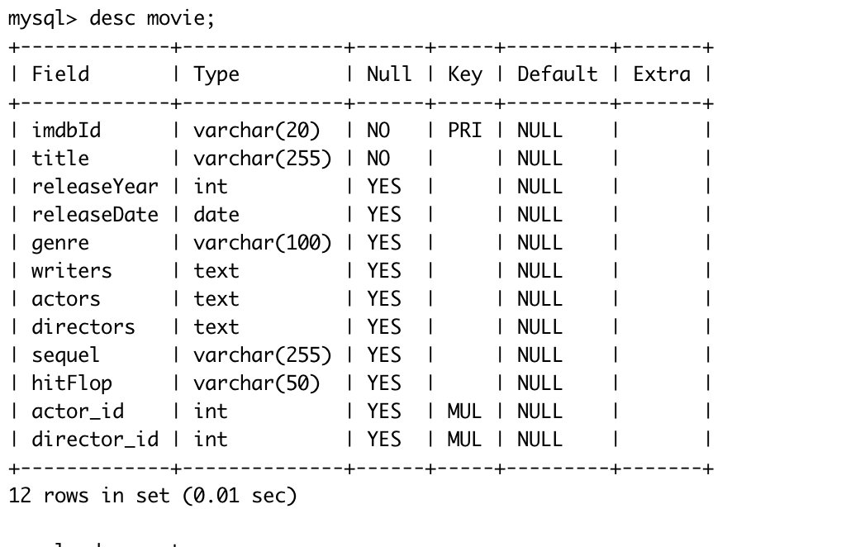
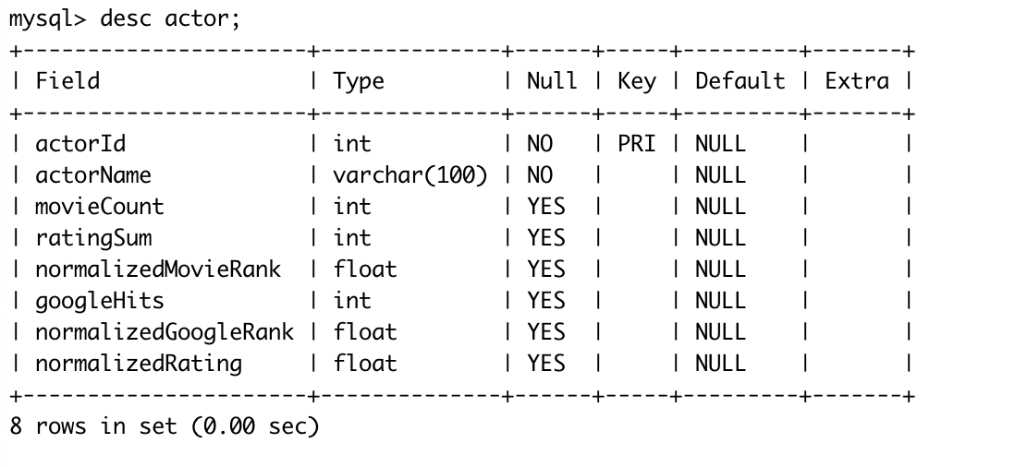
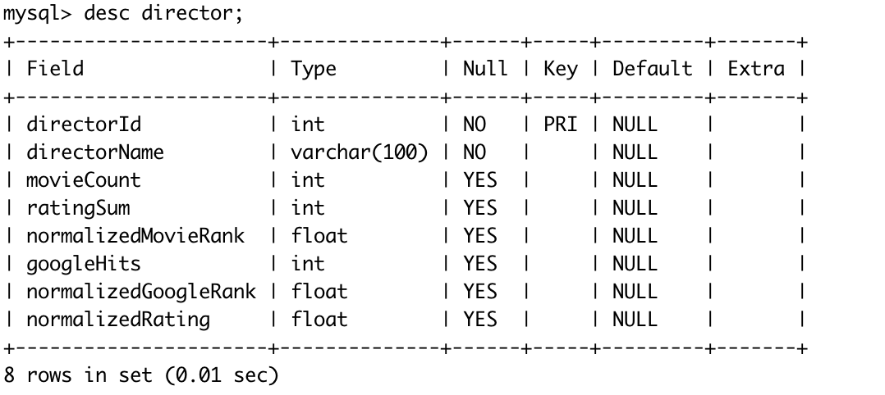
Description of Tables
Movie Table:
Actor Table:
Director Table:

Slide 10
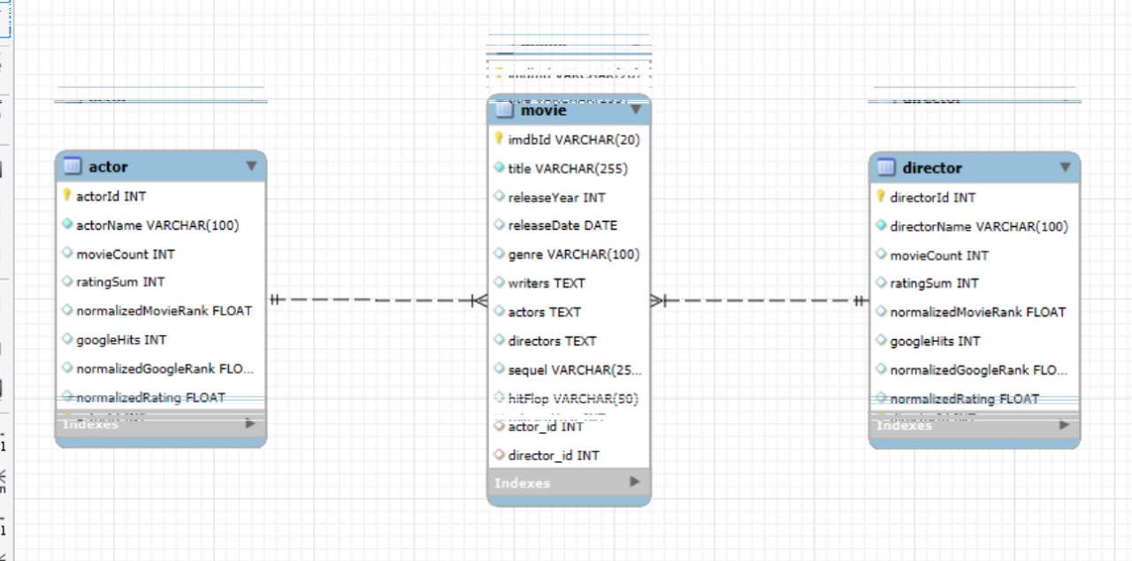
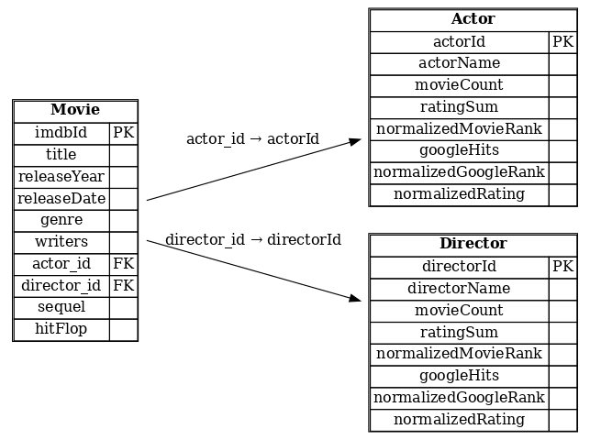
ER Diagram:
Relationship Diagram:

Slide 11
DATA ANALYSIS

Slide 12
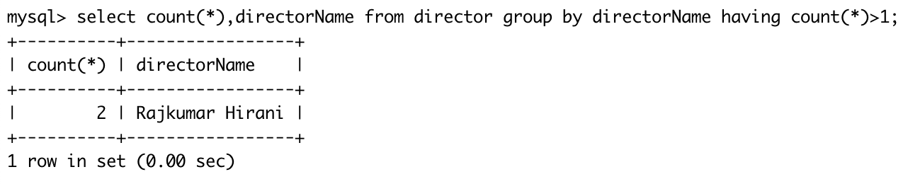
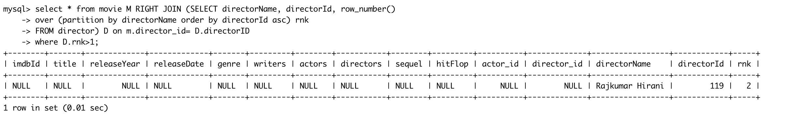
Data Cleansing
Analysis of Director Dataset is done to check if there is any inconsistent data
Data Validation to Identify Duplicate:
Impact Analysis of Duplicate Data In Main Movie:
#checking if matching records exist in master table and deleting that data

Slide 13
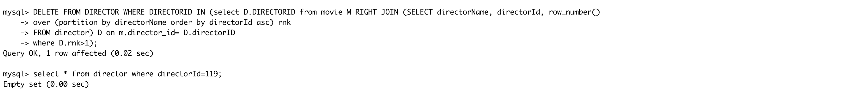
Data Cleansing..contd
Query to Delete Duplicate:
Verify The Deletion :

Slide 14
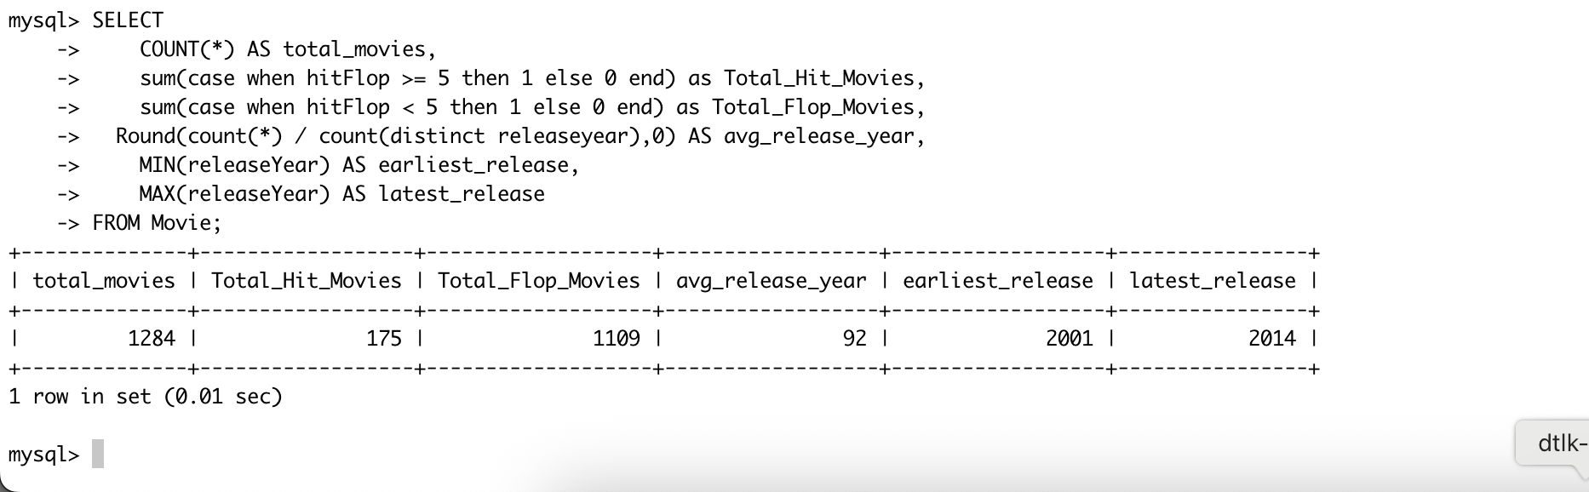
Descriptive Statistics
Generate Descriptive Data of Movie Table like segregating hits and flops, Span of release Years and Average Releases Per Year:

Slide 15
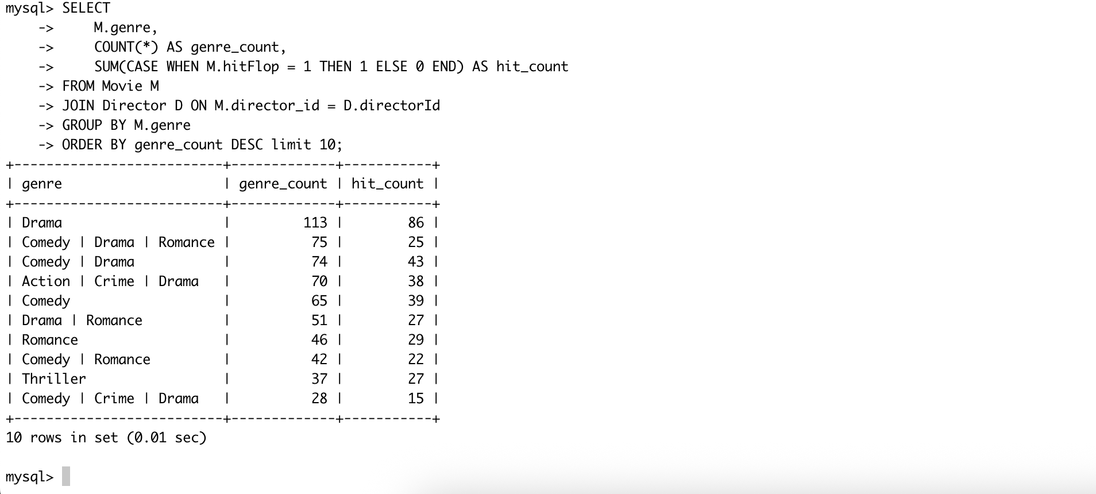
Descriptive Statistics..contd
To track the popularity of each genre based on the hit ratio based on Genre’s Popularity and Distribution:

Slide 16
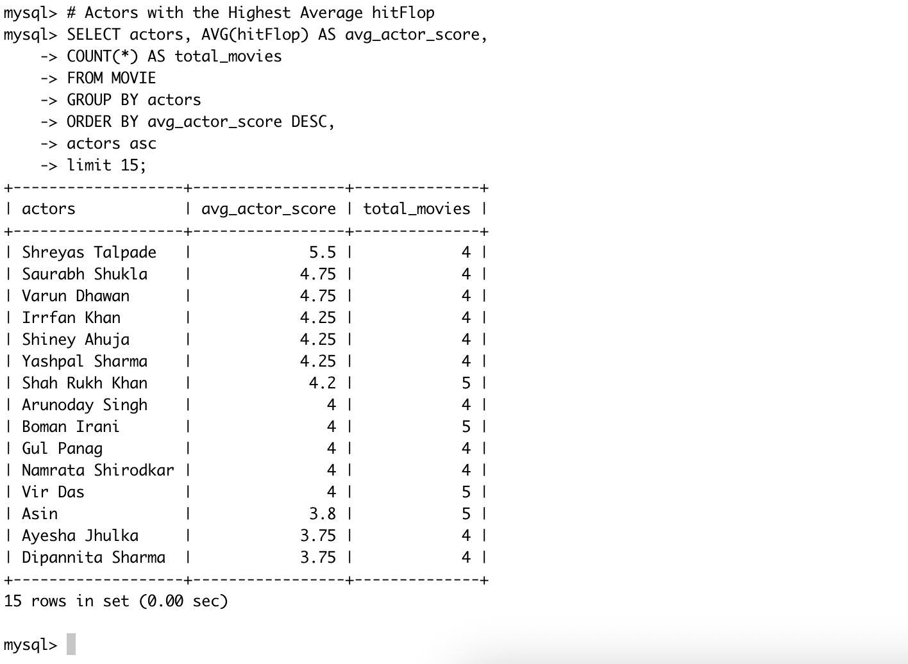
Aggregation and Grouping
15 Topmost Actors with Highest Number Hits:

Slide 17
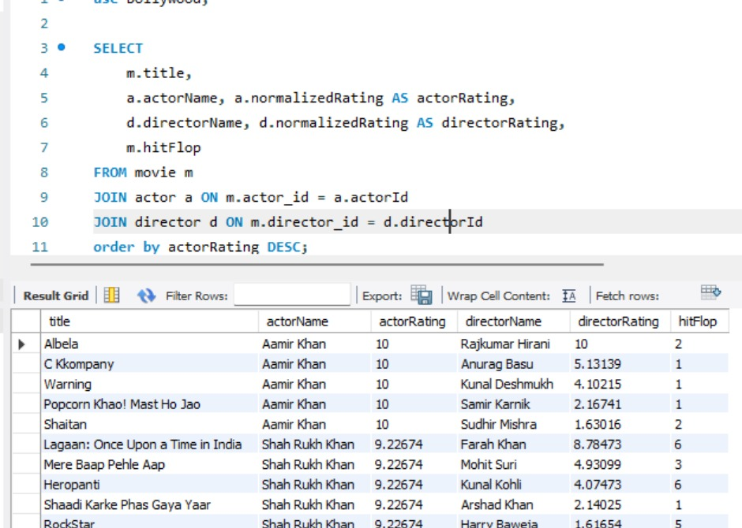
Joins and Relationships
Join Movies with Actor and Director Rankings to List Movies acted by Highest Rated Actors :

Slide 18
SUBQUERIES AND CTE’s

Slide 19
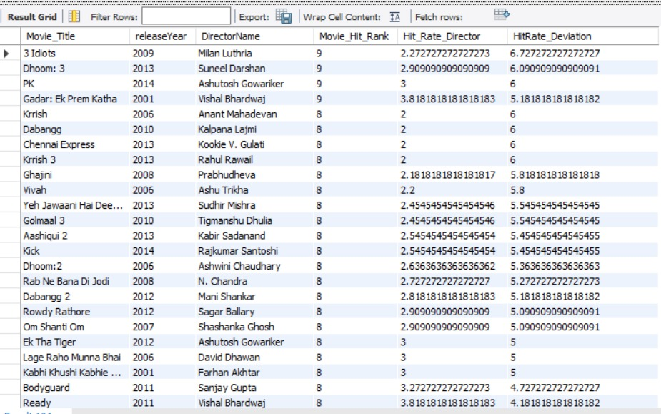
Get the Directors who are probably going to give Hit Movies based on past history:
Query:
Output:
WITH DirectorHitRate AS (
SELECT
d.directorid,
d.directorname AS DirectorName,
#Round(AVG(m.hitFlop),0) AS Avg_HitRate
AVG(m.hitFlop) AS Avg_HitRate
FROM movie m
JOIN director d ON m.director_id = d.directorid
GROUP BY d.directorid, d.directorname
),
MovieWithDeviation AS (
SELECT
m.title as Movie_Title,
m.releaseYear,
d.DirectorName,
m.hitFlop as Movie_Hit_Rank,
d.Avg_HitRate as Hit_Rate_Director,
m.hitFlop - d.Avg_HitRate AS HitRate_Deviation
FROM movie m
JOIN DirectorHitRate d ON m.director_id = d.directorid
)
SELECT *
FROM MovieWithDeviation
WHERE ABS(HitRate_Deviation) > 0.10
ORDER BY Movie_Hit_Rank desc,HitRate_Deviation desc,DirectorName, releaseYear;

Slide 20
ADVANCED SQL FUNCTIONS

Slide 21
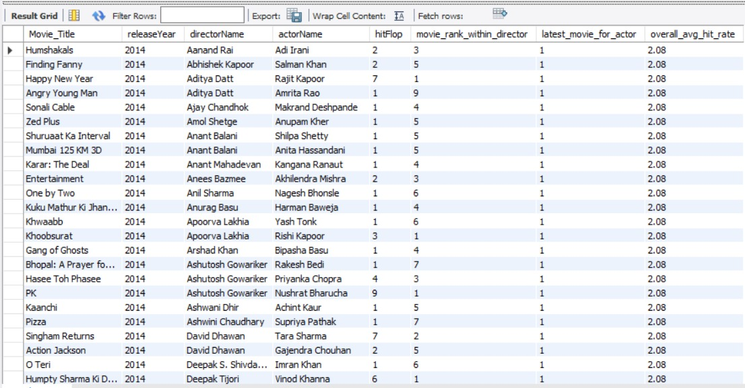
Rank movies by Hit/Flop per director for latest release of actors and calculate movie’s hit status to overall movie hit average
Query:
Output:
SELECT
m.title as Movie_Title,
m.releaseYear,
d.directorName,
a.actorName,
m.hitFlop,
RANK() OVER (PARTITION BY m.director_id ORDER BY m.hitFlop DESC) AS movie_rank_within_director,
ROW_NUMBER() OVER (PARTITION BY m.actor_id ORDER BY m.releaseYear DESC) AS latest_movie_for_actor,
ROUND(AVG(m.hitFlop) OVER (PARTITION BY m.releaseyear), 2) AS overall_avg_hit_rate
FROM movie m
JOIN director d ON m.director_id = d.directorId
JOIN actor a ON m.actor_id = a.actorId order by releaseyear desc,directorName,actorname desc, hitflop;;

Slide 22
Key Insights
🌟 Aamir Khan has the highest normalized actor rating (10.0).
🎥 Rajkumar Hirani stands out as the highest-rated director.
🏆 Gadar:Ek pre katha, 3 Idiots, Pk, Dhoom 3 scored among the top in hitFlop.
⚠️ Data cleaning revealed missing writer entries in some records.

Slide 23
Creating Final data insights utilizing TABLEAU public desktop
We created a stack bar chart for top 5 movies on the basis of hit- flops
We also created a line chart calculating year wise movie trend
We created a heat map chart depicting the best actor and director combo.
Scatter plot is created giving sequel performance as per hit flop score on the basis of release years.
A horizontal bar chart is created depicting average hit flop for top 15 actors.

Slide 24
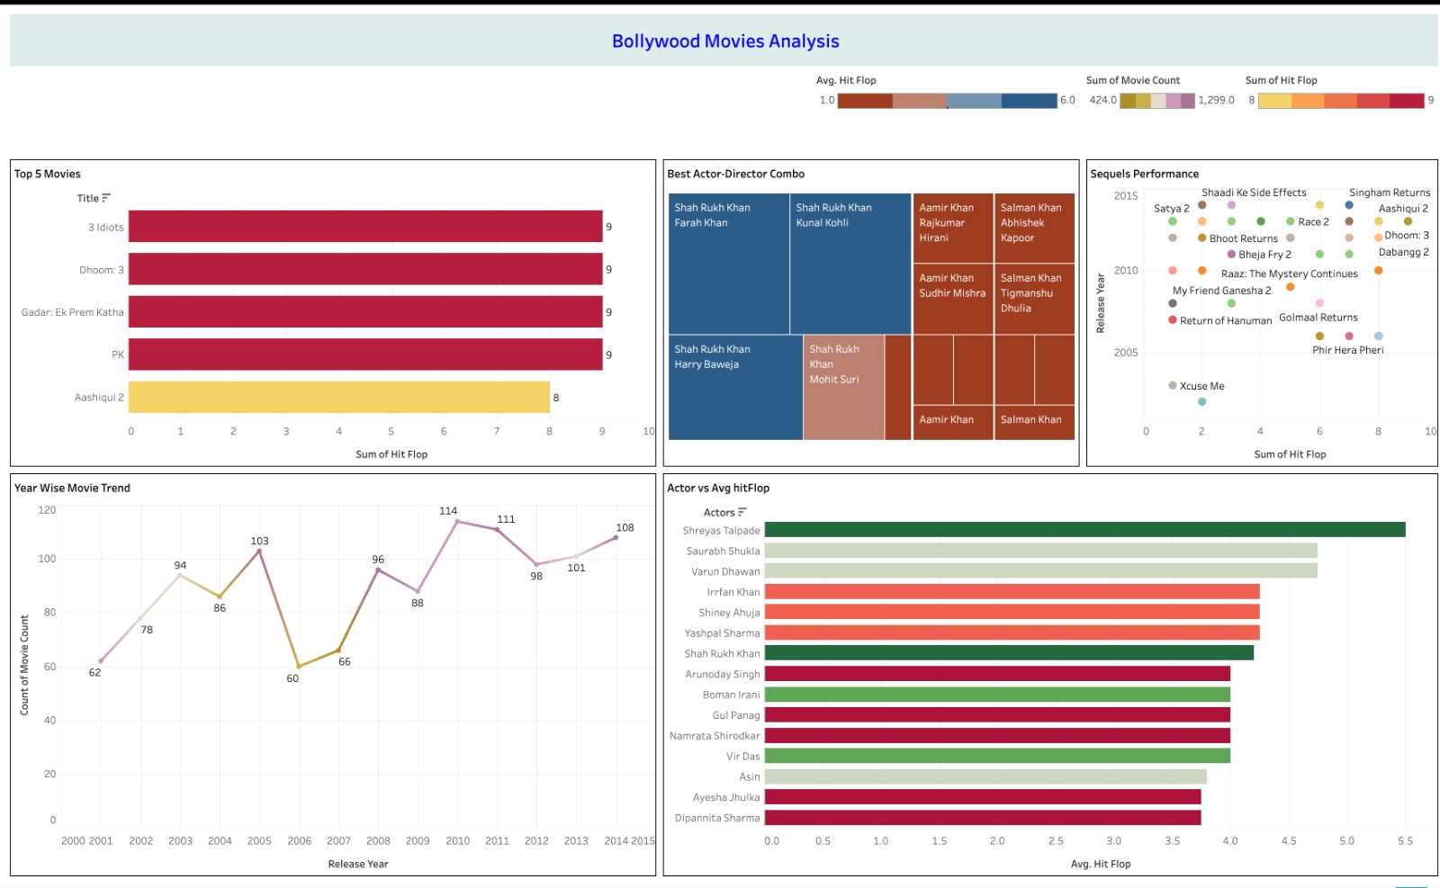
TABLEAU public link - https://public.tableau.com/app/profile/prashasti.srivastava/viz/Bollywood_Movies_Analysis/BollywoodMoviesAnalysis?publish=yes

Slide 25
Conclusion
This project demonstrated how structured SQL queries and interactive visual dashboards can yield powerful insights from raw data.
The combination of SQL for deep analysis and Tableau for storytelling makes this a valuable template for movie analytics or entertainment data analysis in general.

Slide 26
PROJECT LINK (GIT-HUB)
https://github.com/Prashasti9/PES_PDS_Group5_SQL_Project

Slide 27
THANK YOU

