Slide 1
Tutorial - 5
Two-dimensional Random Variables

Slide 2
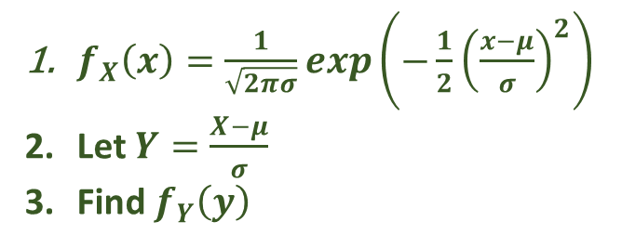
1) If X is a random variable N(μ,σ²), the show that Z=(X- μ)/ σ is a standard normal random variable N(0,1)
$f_{X}\left(x\right)=\frac{1}{\sqrt{2πσ}}exp\left(−\frac{1}{2}{\left(\frac{x−μ}{σ}\right)}^{2}\right)$
Let $Y=\frac{X−μ}{σ}$
Find $f_{Y}\left(y\right)$

Slide 3
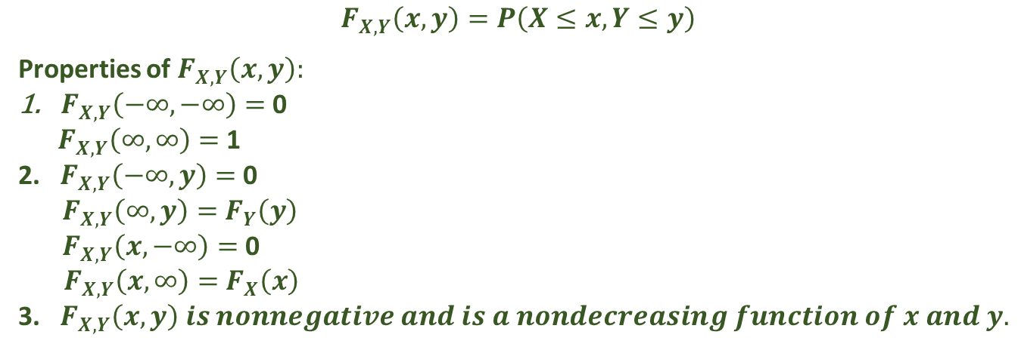

2) Consider a function
$F\left(x,y\right)=1−e^{−(x+y)}$ $0<x<∞, 0<y<∞$
= 0 otherwise
Can this function be a joint cumulative distribution of a bivariate random variable (X,Y)
Hint: Check for the properties of F_{xy}(x,y)
$$F_{X,Y}\left(x,y\right)=P\left(X≤x, Y≤y\right)$$
Properties of $F_{X,Y}\left(x,y\right):$
$F_{X,Y}\left(−∞,−∞\right)=$ 0
$F_{X,Y}\left(∞,∞\right)=$ 1
2. $F_{X,Y}\left(−∞,y\right)=$ 0
$F_{X,Y}\left(∞,y\right)=$ $F_{Y}\left(y\right)$
$F_{X,Y}\left(x,−∞\right)=$ 0
$F_{X,Y}\left(x,∞\right)=$ $F_{X}\left(x\right)$
3. $F_{X,Y}\left(x,y\right) is nonnegative and is a nondecreasing function of x and y.$

Slide 4
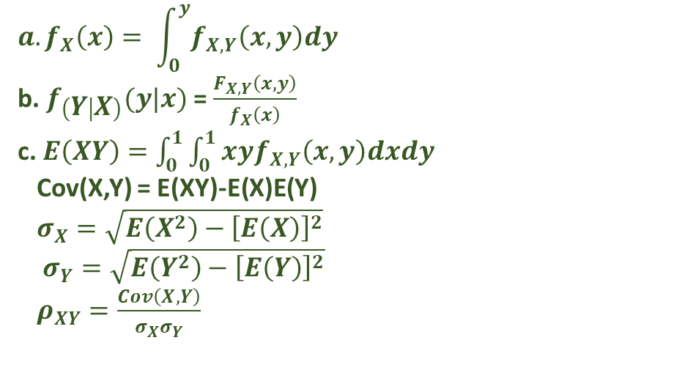
3) The daily water levels (normalised by the respective full condition) of the two reservoirs A and B are denoted by two random variables X and Y having the following joint PDF:
f(x,y)=(6/5)(x+y^2) 0<x<1; 0<y<1
Determine the marginal density function of the daily water level for reservoir A.
If reservoir A is half full on a given day, what is the probability that the water level will be more than half full?
Is there any statistical correlation between the water levels in the two reservoirs?
$$a. f_{X}\left(x\right)= \int_{0}^{y}{f_{X,Y}\left(x,y\right)dy}$$
b. $f_{\left(Y | X\right)}(y|x)$ = $\frac{F_{X,Y}\left(x,y\right)}{f_{X}\left(x\right)}$
c. $E\left(XY\right)=\int_{0}^{1}{\int_{0}^{1}{xyf_{X,Y}\left(x,y\right)dxdy}}$
Cov(X,Y) = E(XY)-E(X)E(Y)
$σ_{X}=\sqrt{E\left(X^{2}\right)−{\left[E\left(X\right)\right]}^{2}}$
$σ_{Y}=\sqrt{E\left(Y^{2}\right)−{\left[E\left(Y\right)\right]}^{2}}$
$ρ_{XY}=\frac{Cov\left(X,Y\right)}{σ_{X}σ_{Y}}$

Slide 5
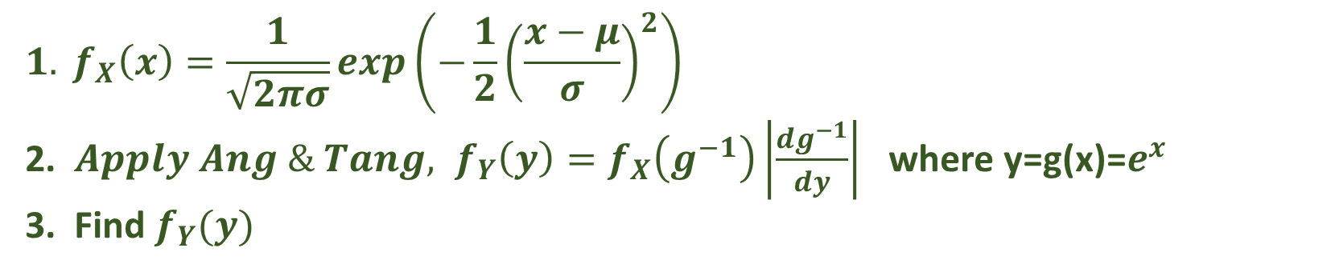
4) Suppose an engineering variable Y is an exponential function of a random variable X as follows:
Y=e^{X}
And X is normally distributed as N(2, 0.4). Derive the PDF of Y and show that it follows a lognormal distribution.
$${1. f}_{X}\left(x\right)=\frac{1}{\sqrt{2πσ}}exp\left(−\frac{1}{2}{\left(\frac{x−μ}{σ}\right)}^{2}\right)$$
2. ${ Apply Ang \& Tang, f}_{Y}\left(y\right)=f_{X}\left(g^{−1}\right)\left|\frac{dg^{−1}}{dy}\right|$ where y=g(x)=$e^{x}$
3. Find $f_{Y}(y)$

