Slide 1
Tutorial -3
Random variables and Distributions

Slide 2
1) A 100-kg load is equally likely to be placed anywhere along the span of a beam of 10 m. If X denotes the position of the load along the beam, X is uniformly distributed in 0 < x ≤ 10.
(a) Determine the constant c such that f_{X}(x) = c for 0 < x ≤ 10, and hence write down the PDF of X.
(b) Determine and sketch the corresponding CDF of X.
(c) Determine the probability that the position of the load will be between 2 m and 5 m on the beam.

Slide 3
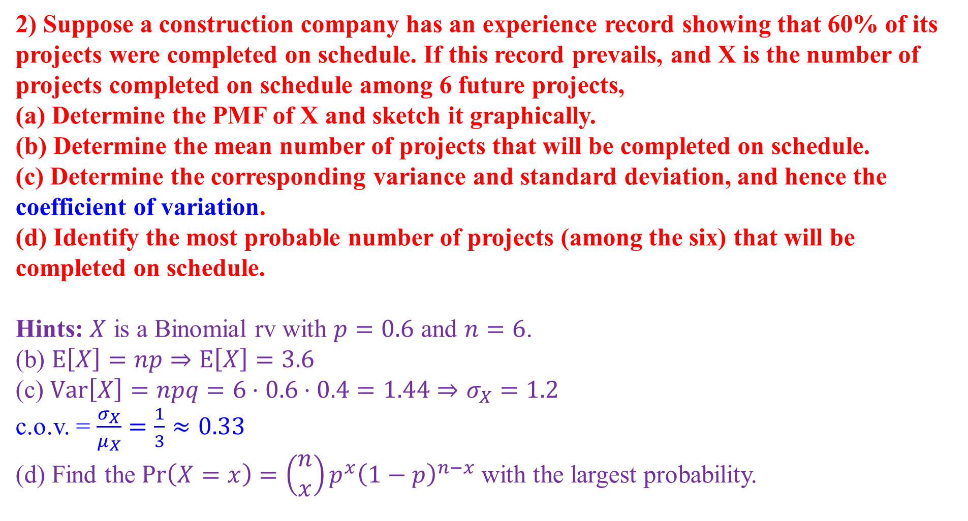
2) Suppose a construction company has an experience record showing that 60% of its projects were completed on schedule. If this record prevails, and X is the number of projects completed on schedule among 6 future projects,
(a) Determine the PMF of X and sketch it graphically.
(b) Determine the mean number of projects that will be completed on schedule.
(c) Determine the corresponding variance and standard deviation, and hence the coefficient of variation.
(d) Identify the most probable number of projects (among the six) that will be completed on schedule.
Hints: $X$ is a Binomial rv with $p=0.6$ and $n=6$.
(b) $E\left[X\right]=np⇒E\left[X\right]=3.6$
(c) $Var\left[X\right]=npq=6⋅0.6⋅0.4=1.44⇒σ_{X}=1.2$
c.o.v. = $\frac{σ_{X}}{μ_{X}}=\frac{1}{3}≈0.33$
(d) Find the $\operatorname{Pr}\left(X=x\right)=\left(\begin{aligned}n \\ x\end{aligned}\right)p^{x}{\left(1−p\right)}^{n−x}$ with the largest probability.

Slide 4
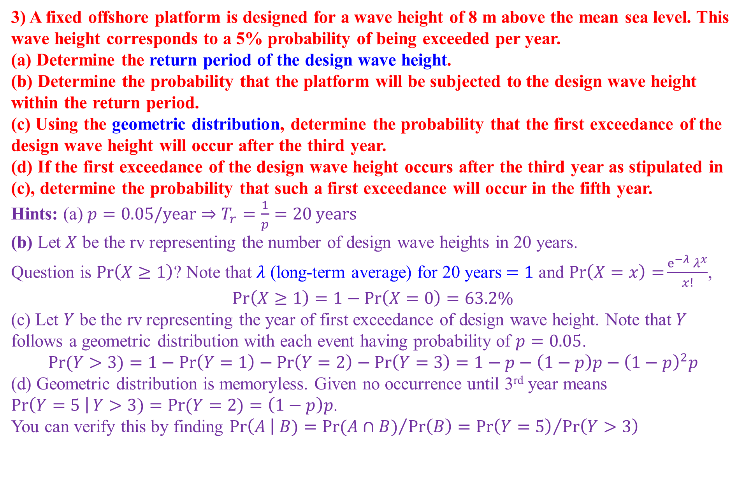
3) A fixed offshore platform is designed for a wave height of 8 m above the mean sea level. This wave height corresponds to a 5% probability of being exceeded per year.
(a) Determine the return period of the design wave height.
(b) Determine the probability that the platform will be subjected to the design wave height within the return period.
(c) Using the geometric distribution, determine the probability that the first exceedance of the design wave height will occur after the third year.
(d) If the first exceedance of the design wave height occurs after the third year as stipulated in (c), determine the probability that such a first exceedance will occur in the fifth year.
Hints: (a) $p=0.05/year$ $⇒T_{r}=\frac{1}{p}=20 years$
(b) Let $X$ be the rv representing the number of design wave heights in 20 years.
Question is $\operatorname{Pr}\left(X≥1\right)$? Note that $λ$ (long-term average) for 20 years$=1$ and $\operatorname{Pr}\left(X=x\right)=\frac{e^{−λ}{λ^{x}}}{x!}$,
$$\operatorname{Pr}\left(X≥1\right)=1−\operatorname{Pr}\left(X=0\right)=63.2\%$$
(c) Let $Y$ be the rv representing the year of first exceedance of design wave height. Note that $Y$ follows a geometric distribution with each event having probability of $p=0.05$.
$$\operatorname{Pr}{(Y>3)}=1−\operatorname{Pr}\left(Y=1\right)−\operatorname{Pr}\left(Y=2\right)−\operatorname{Pr}\left(Y=3\right)=1−p−\left(1−p\right)p−{\left(1−p\right)}^{2}p$$
(d) Geometric distribution is memoryless. Given no occurrence until 3rd year means
$\operatorname{Pr}\left(Y=5 \right|Y>3)=\operatorname{Pr}{(Y=2)}=\left(1−p\right)p$.
You can verify this by finding $\operatorname{Pr}\left(A \right| B)={\operatorname{Pr}{(A∩B)}}/{\operatorname{Pr}\left(B\right)}={\operatorname{Pr}\left(Y=5\right)}/{\operatorname{Pr}\left(Y>3\right)}$

Slide 5
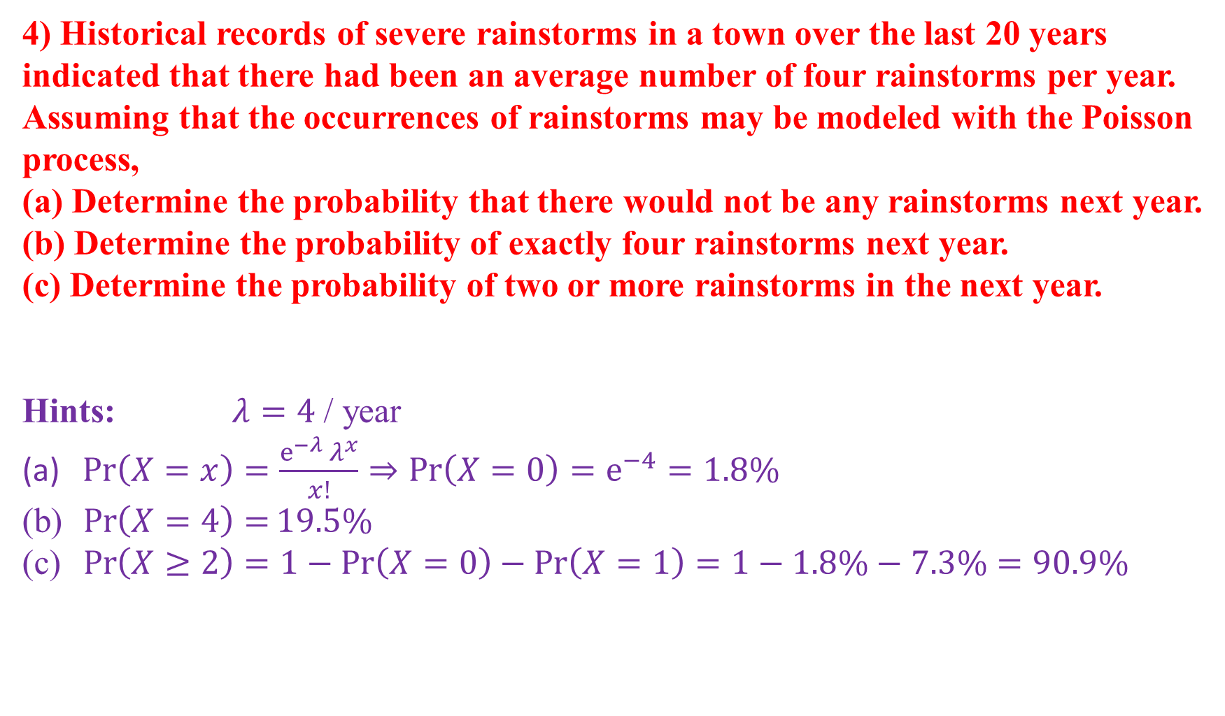
4) Historical records of severe rainstorms in a town over the last 20 years indicated that there had been an average number of four rainstorms per year. Assuming that the occurrences of rainstorms may be modeled with the Poisson process,
(a) Determine the probability that there would not be any rainstorms next year.
(b) Determine the probability of exactly four rainstorms next year.
(c) Determine the probability of two or more rainstorms in the next year.
Hints: $λ=4$ / year
$\operatorname{Pr}\left(X=x\right)=\frac{e^{−λ}{λ^{x}}}{x!}⇒\operatorname{Pr}\left(X=0\right)=e^{−4}=1.8\%$
$\operatorname{Pr}\left(X=4\right)=19.5\%$
$\operatorname{Pr}\left(X≥2\right)=1−\operatorname{Pr}\left(X=0\right)−\operatorname{Pr}\left(X=1\right)=1−1.8\%−7.3\%=90.9\%$

