Slide 1
Tutorial - 4
Random Variables and Distributions (contd…)

Slide 2
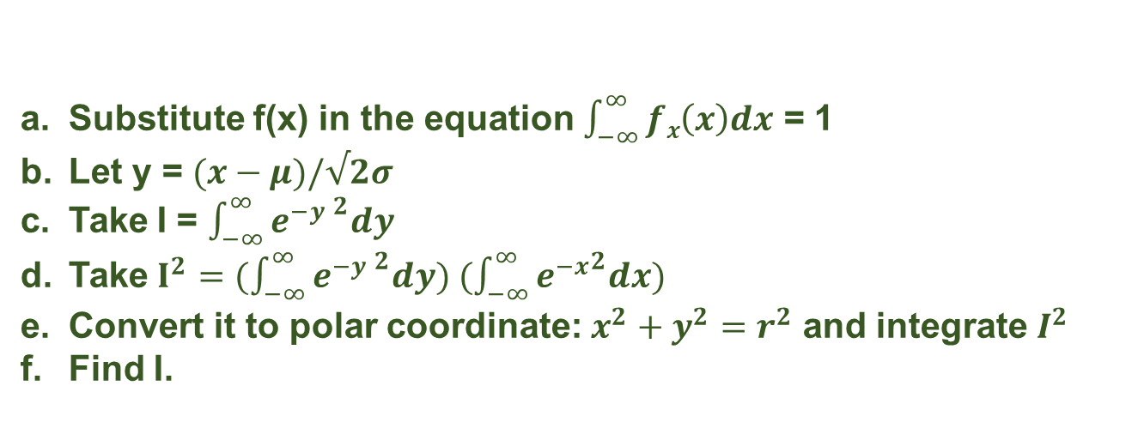

1) Show that the probability density function of a normal random variable X given by Eq.
$$fx(x)=\left(\frac{1}{\sqrt{2π}σ}\right){e^{−((x−μ)/√2σ) }}^{2}$$
Satisfies the equation $\int_{−∞}^{∞}{fx\left(x\right)dx}$ = 1
Substitute f(x) in the equation $\int_{−∞}^{∞}{fx\left(x\right)dx}$ = 1
Let y = $(x−μ)/√2σ$
Take I = $\int_{−∞}^{∞}{{e^{−y }}^{2}dy}$
Take $I^{2}=(\int_{−∞}^{∞}{{e^{−y }}^{2}dy) (\int_{−∞}^{∞}{{e^{−x}}^{2}dx})}$
Convert it to polar coordinate: $x^{2}+y^{2}=r^{2}$ and integrate $I^{2}$
Find I.

Slide 3
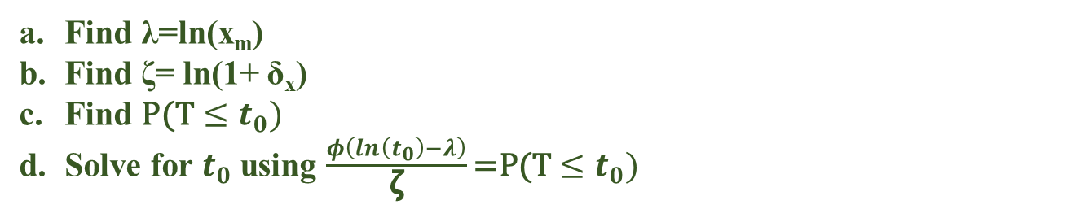
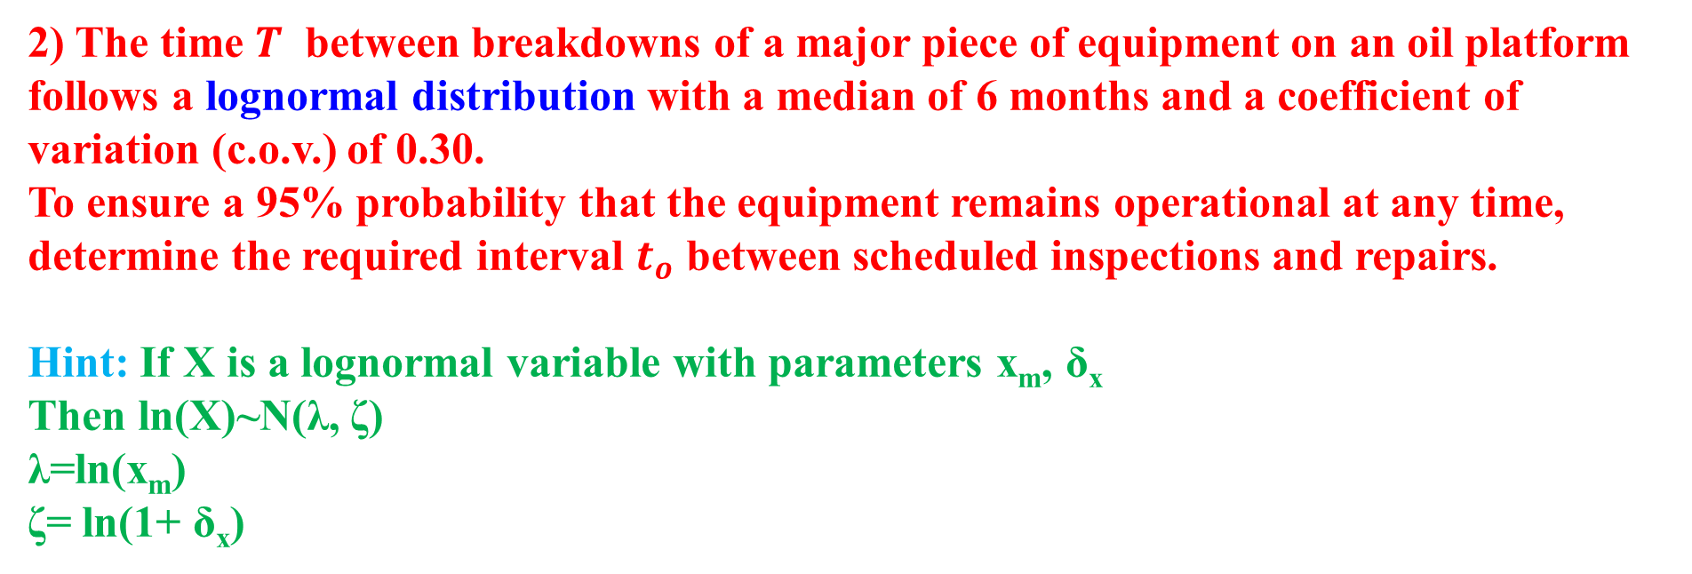
2) The time $T$ between breakdowns of a major piece of equipment on an oil platform follows a lognormal distribution with a median of 6 months and a coefficient of variation (c.o.v.) of 0.30.
To ensure a 95% probability that the equipment remains operational at any time, determine the required interval $t_{o}$​ between scheduled inspections and repairs.
Hint: If X is a lognormal variable with parameters x_{m}, δ_{x}
Then ln(X)~N(λ, ζ)
λ=ln(x_{m})
ζ= ln(1+ δ_{x})
Find λ=ln(x_{m})
Find ζ= ln(1+ δ_{x})
Find $\text{P}\text{(}\text{T}≤t_{0})$
Solve for $t_{0}$ using $\frac{φ\left(ln\left(t_{0}\right)−λ\right)}{\text{ζ}}\text{=}\text{P}\text{(}\text{T}≤t_{0})$

Slide 4
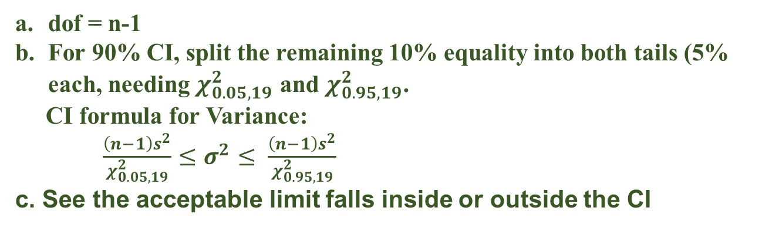
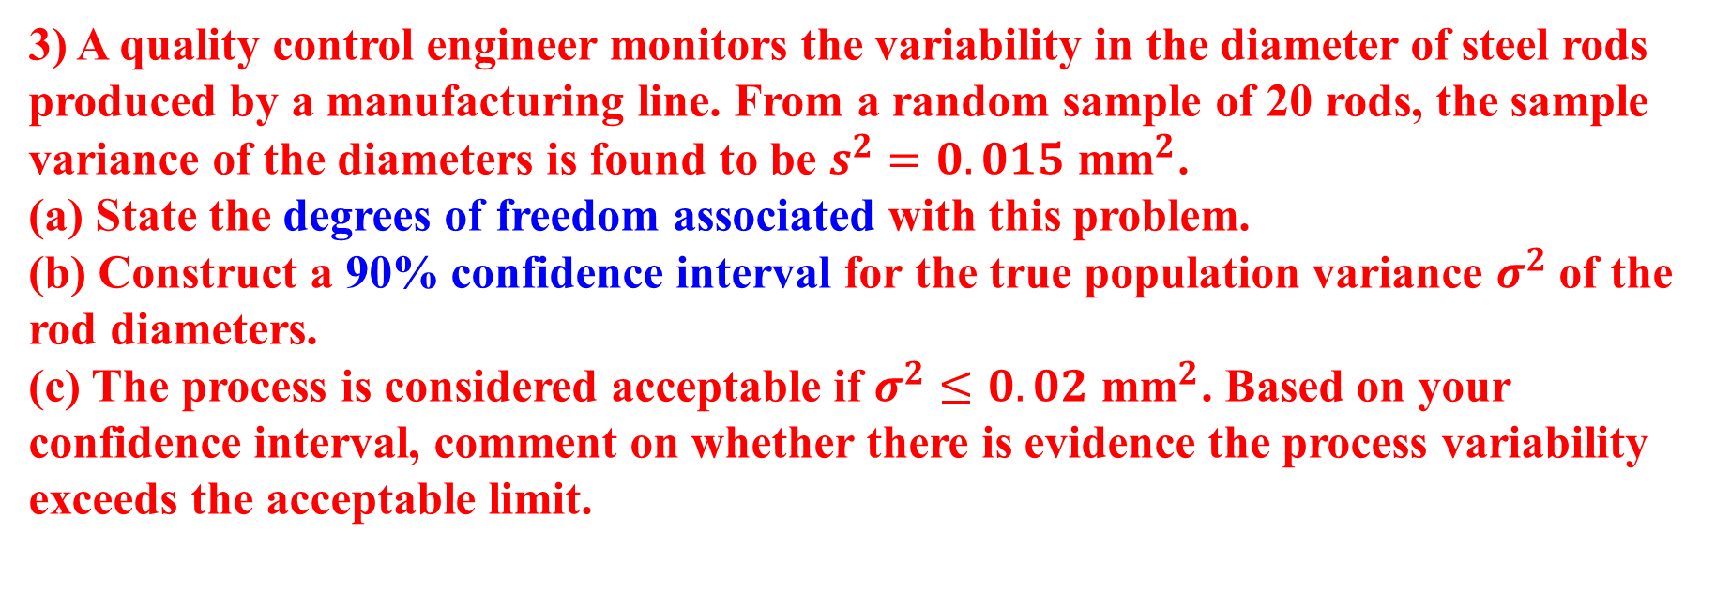
3) A quality control engineer monitors the variability in the diameter of steel rods produced by a manufacturing line. From a random sample of 20 rods, the sample variance of the diameters is found to be $s^{2}=0.015 {\text{mm}}^{2}$.
(a) State the degrees of freedom associated with this problem.
(b) Construct a 90% confidence interval for the true population variance $σ^{2}$ of the rod diameters.
(c) The process is considered acceptable if $σ^{2}≤0.02 {\text{mm}}^{2}$. Based on your confidence interval, comment on whether there is evidence the process variability exceeds the acceptable limit.
dof = n-1
For 90% CI, split the remaining 10% equality into both tails (5% each, needing $χ_{0.05,19}^{2}$ and $χ_{0.95,19}^{2}$.
CI formula for Variance:
$\frac{\left(n−1\right)s^{2}}{χ_{0.05,19}^{2}}≤σ^{2}≤ \frac{\left(n−1\right)s^{2}}{χ_{0.95,19}^{2}}$
c. See the acceptable limit falls inside or outside the CI

Slide 5
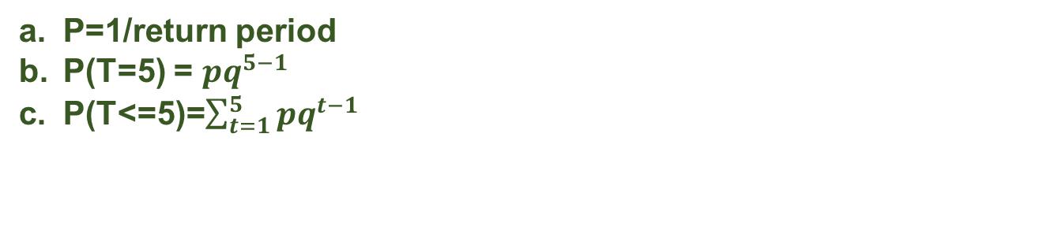
4) Suppose that the building code for the design of buildings in a coastal region specifies the 50-year wind as the "design wind"; that is, a wind velocity with a return period of 50 years.
(a) Determine the probability of encountering the 50-year wind velocity in any 1 year.
(b) Determine the probability that a newly completed building in the region will be subjected to the design wind velocity for the first time on the fifth year after its completion.
(c) Determine the probability that the first such wind velocity will occur within 5 years after completion of the building.
P=1/return period
P(T=5) = $pq^{5−1}$
P(T<=5)=$\sum_{t=1}^{5}{pq^{t−1}}$

