Slide 1
PLANT DISEASE CLASSIFICATION AND
WEED DETECTION
SWE3999 TARP
18MIS1010 - S Amith
18MIS1046 - M Suresh
18MIS1047 - M Sai Prasheel
18MIS1065 - K Nikhil Kumar
18MIS1021 - E Venkatesh

Slide 2
Introduction
In country like India whose major Population is involved in Agriculture It is very important to find the disease at early stages. Faster and precise prediction of plant disease could help reducing the losses.
Weeding and pest control are both critical aspects of plant maintenance. Farmer needs alternatives for weed control due to the desire to reduce chemicals used in farming.
Early Disease Detection and weed detection is important for better yield and quality of crops.
In our project, we are planning to use an Image Processing algorithms for automatic weed detection. To remove the detected weed plants we are using the Robot

Slide 3
Problem Statement
In conventional weed control systems, herbicides are sprayed uniformly all over the field. Apart from the damaging consequences like negative impacts on plants, soil and underground aquifers, large number of herbicides will be wasted, as only some parts of fields are covered with weeds.
To prevent these consequences from happening a smart weed control system should be employed. These systems must be capable of locating weed parts of the field.
For detecting the diseased part of the plant leaf, convolutional neural networks are implemented in order to classify the diseased part.

Slide 4
OBJECTIVE
Our objective is to increase the yield of the crop and decrease the use of harmful chemicals to get rid of weeds and diseases.Through early detection of diseases and weeds on the field,Farmers can reduce spending money on chemicals and save the environment and it also helps in getting profit to them.
Detecting weeds in the initial stages of crop growth with Image Processing technique can minimize the usage of herbicides and maximize the crop yield for farmers.

Slide 5
Motivation
Mainly for farmer it reduces the labor cost.
Farmers will come to know about this and they will expect more products like this in every crop.
Weed identification will also reduce the weed control costs such as herbicide and aerial spraying.
With no chemicals, we will have good environment with native wildlife habitat and also increase the natural food supplies and good water quality.

Slide 6
Software Requirements
MATLab
Python
Google collab/Jupyter Notebook
Ngrok server
Streamlit Framework

Slide 7
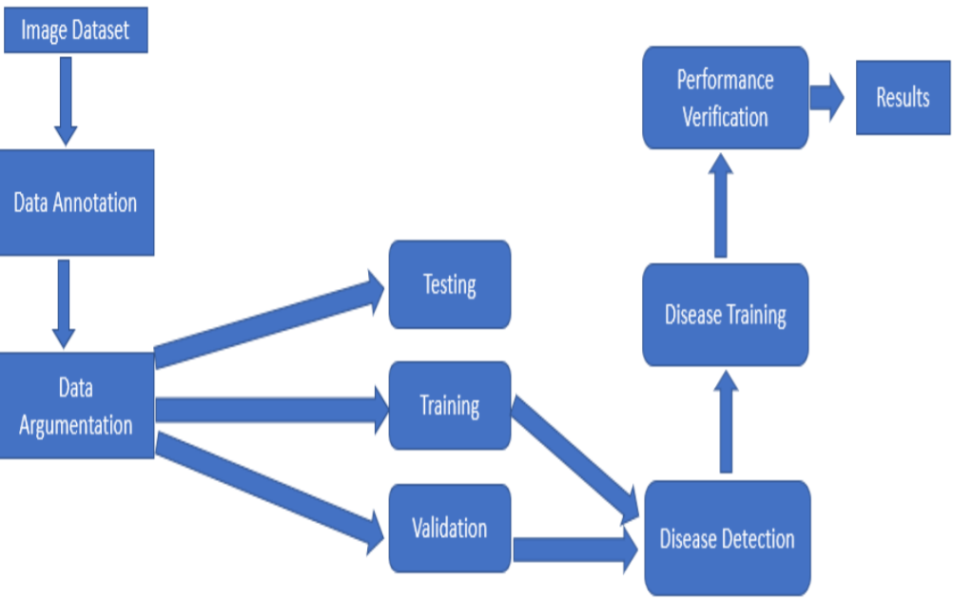
Overview of Plant Disease Classification

Slide 8
Plant Disease Classification: STEPS
Image Preprocessing : Using ImageDataGenerator we apply different transformations on training image.
Image Segmentation : First, the digital image of the image is enhanced with a filter. Then convert each image into an array.
Training the model : using pretrained model vgg19 , CNN classifiers are trained to identify diseases in each plant class

Slide 9
Description
Using ImageDataGenerator we expand the size of your dataset.It applies different transformations on training image like randomly rotate images through any degree between 0 and 360.Flipping the image along the vertical or the horizontal axis.Randomly changes the brightness of the image because most of the time our image will not be having good lighting condition.
Validation dataset is used to evaluate the performance of the model and tune the parameters of a classifier.
Earlystopping-training is implemented that is triggered as soon as the performance decreases as compared to the performance at the previous training iteration.
Keras categorical_crossentropy is used as a loss function for multi-class classification model since there more than two output labels.
Adam optimization is used to train the neural network in less time and more efficiently.Finally accuracy for both train and validation dataset is plotted.And deployed using Streamlit and ngrok server.

Slide 10
Methodology
WEED DETECTION:
The first step is Image Acquisition which is taken with our camera or mobile phone . Those images are copied to a separate folder .
The Next Step is the Processing of the Image which is subjected to Morphological Methods. Convert Original Image to Grayscale Image then to Binary Image and subject the same to Sharpening, Global Thresholding and Area Thresholding to detect the Plants in the Region of Interest determining whether it is a Weed or not.

Slide 11
Module Description
RGB To Grayscale
When converting an RGB image to grayscale, we have to take the RGB values for each pixel and make as output a single value reflecting the brightness of that pixel. One such approach is to take the average of the contribution from each channel: (R+B+C)/3.
In the applet above, the "optimal projection" calculates how we should combine the RGB channels in the selected image to make a grayscale image that has the most variance.
Grayscale To Binary
A binary image is a digital image that has only two possible values for each pixel. Typically, the two colors used for a binary image are black and white. The color used for the object(s) in the image is the foreground color while the rest of the image is the background color.
Binary images are produced from color images by segmentation. Segmentation is the process of assigning each pixel in the source image to two or more classes. If there are more than two classes then the usual result is several binary images.

Slide 12
Image Sharpening
In contrast, enhancing the high-frequency components of an image leads to an improvement in the visual quality. Image sharpening refers to any enhancement technique that highlights edges and fine details in an image. Image sharpening is widely used in printing and photographic industries for increasing the local contrast and sharpening the images.
Area Thresholding
Thresholding often provides an easy and convenient way to perform this segmentation on the basis of the different intensities or colours in the foreground and background regions of an image.
Area thresholding is a great way to extract useful information encoded into pixels while minimizing background noise.
The input to a thresholding operation is typically a grayscale or colour image. In the simplest implementation, the output is a binary image representing the segmentation. Black pixels correspond to background and white pixels correspond to foreground (or vice versa). In simple implementations, the segmentation is determined by a single parameter known as the intensity threshold.

Slide 13
The idea is to separate the image into two parts; the background and foreground.
1. Select initial threshold value, typically the mean 8-bit value of the original image.
2. Divide the original image into two portions;
3. Pixel values that are less than or equal to the threshold; background
4. Pixel values greater than the threshold; foreground
5.Find the average mean values of the two new images
6.Calculate the new threshold by averaging the two means.
7. If the difference between the previous threshold value and the new threshold value are below a specified limit, you are finished. Otherwise apply the new threshold to the original image keep trying.

Slide 14
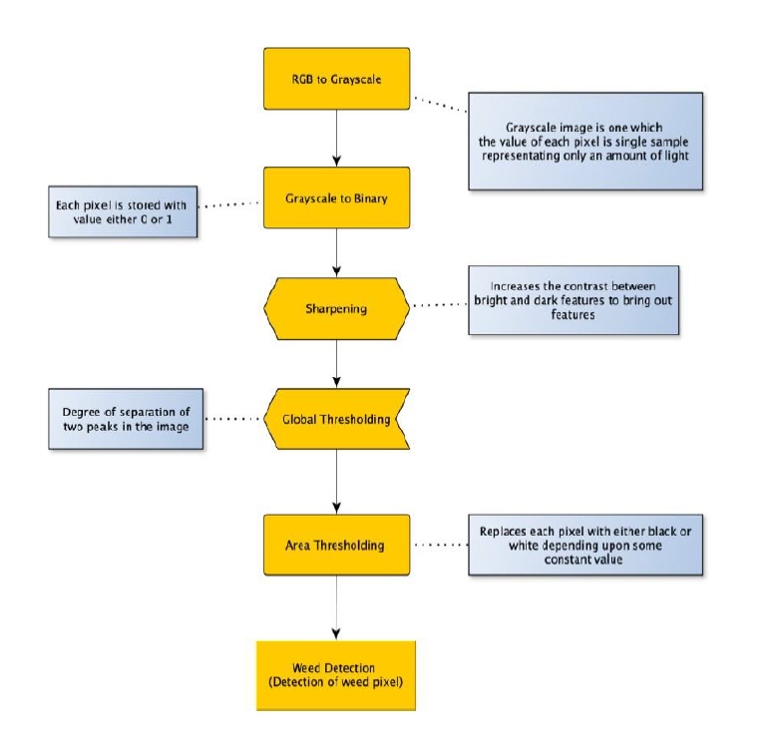
Image Processing Algorithm Flow chart

Slide 15
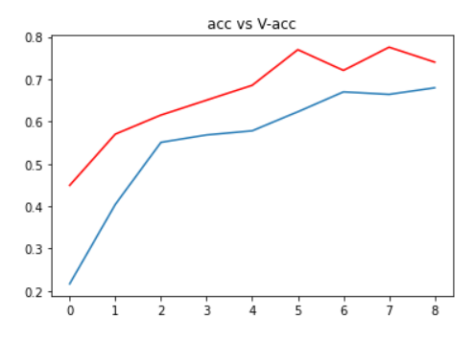
Plant Disease Classifier : Model Accuracy
The accuracy of the model is = 82 %

Slide 16
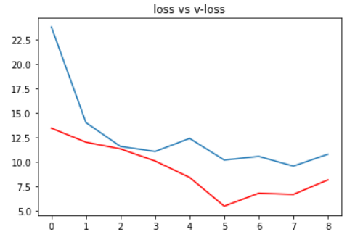
Log-loss plot

Slide 17
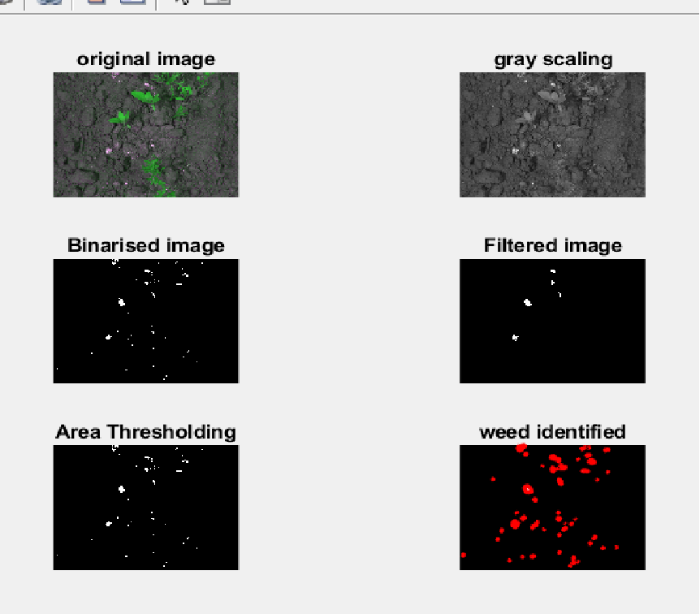
Weed Detection Output

