Slide 1

Fathom: Causal Tracing & Visual Debugging Infrastructure for Multi-Step AI Agents
Submitted By:
Swastika Chakraborty (24WU0103023)
Prashlesh Pratap Singh (24WU0101118)
Rushikesh Amol(24WU0103023)
Abhishek Kumar Tiwari (24WU0102719)
Mahesh()
Under the mentorship of:
Prof ()

Slide 2
Table Of Contents
Problem Statement
Objectives
Literature Review/Competitive Analysis
Proposed Methodology
Design & Implementation
Technology Stack
Expected Outcomes
References

Slide 3
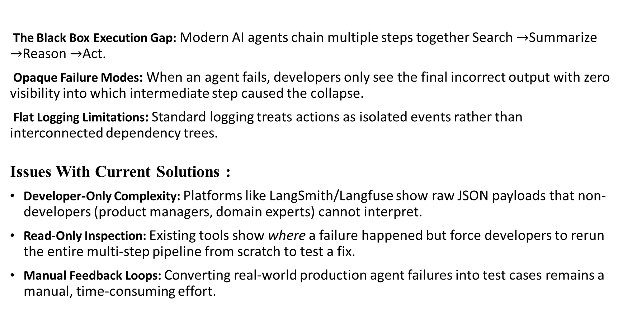
Problem Statement
The Black Box Execution Gap: Modern AI agents chain multiple steps together Search $→$Summarize $→$Reason $→$Act.
Opaque Failure Modes: When an agent fails, developers only see the final incorrect output with zero visibility into which intermediate step caused the collapse.
Flat Logging Limitations: Standard logging treats actions as isolated events rather than interconnected dependency trees.
Issues With Current Solutions :
Developer-Only Complexity: Platforms like LangSmith/Langfuse show raw JSON payloads that non-developers (product managers, domain experts) cannot interpret.
Read-Only Inspection: Existing tools show where a failure happened but force developers to rerun the entire multi-step pipeline from scratch to test a fix.
Manual Feedback Loops: Converting real-world production agent failures into test cases remains a manual, time-consuming effort.

Slide 4
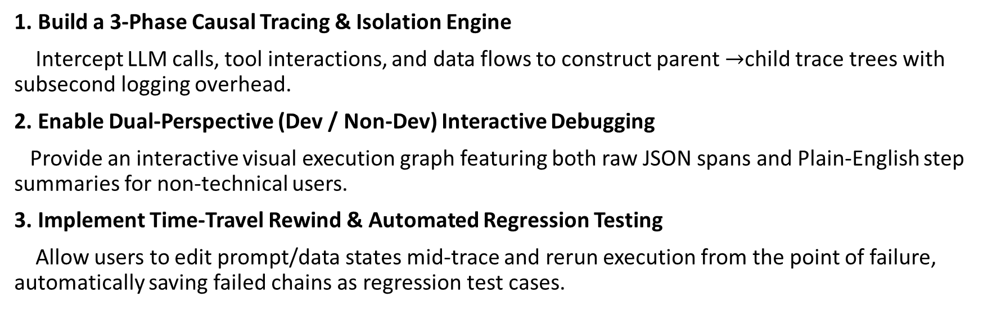
Objectives
1. Build a 3-Phase Causal Tracing & Isolation Engine
Intercept LLM calls, tool interactions, and data flows to construct parent $→$child trace trees with subsecond logging overhead.
2. Enable Dual-Perspective (Dev / Non-Dev) Interactive Debugging
Provide an interactive visual execution graph featuring both raw JSON spans and Plain-English step summaries for non-technical users.
3. Implement Time-Travel Rewind & Automated Regression Testing
Allow users to edit prompt/data states mid-trace and rerun execution from the point of failure, automatically saving failed chains as regression test cases.

Slide 5
Literature Review
Paper / Author | Key Methodology | Research Gap Identified | How We Address It
LangSmith (LangChain, 2024) | Step execution spans & evaluation datasets | Complex JSON UI; non-developers struggle to diagnose root causes . | We provide dual-mode views with plain-English failure translations
Langfuse (Open Source, 2024) | Open-Telemetry based LLM tracing | Structural Vulnerability: Detectors placed inside the prompt can be bypassed by logic. | We implement "Time-Travel" state editing & point-of-failure reruns
Arize Phoenix (2024) | Embedding-based hallucination detection | Read-only execution logs; requires full pipeline re-execution | Auto-Evaluator converts failed trace branches directly into unit tests

Slide 6
Proposed Methodology
1. Capture & Isolation Layer (Phase 1)
Intercepts all LLM inputs/outputs, tool executions, and API parameters.
Formats events using OpenTelemetry-compliant hierarchical schemas.
2. Hybrid Evaluation & Scoring Engine (Phase 2)
Phase 1 (Tool Verification): Validates API payloads, schema types, and response status codes.
Phase 2 (Semantic Consistency): Uses vector embeddings to detect logic drift or hallucinations between parent and child steps.
Phase 3 (Confidence Scoring): Computes a composite risk score for each node (Pass, Warning, Critical Failure).
3. Time-Travel & Regression Layer (Phase 3)
Isolates bad state nodes and allows state mutation directly within the visual interface.
Automatically exports confirmed failures to the system’s test suite to prevent recurring errors.

Slide 7
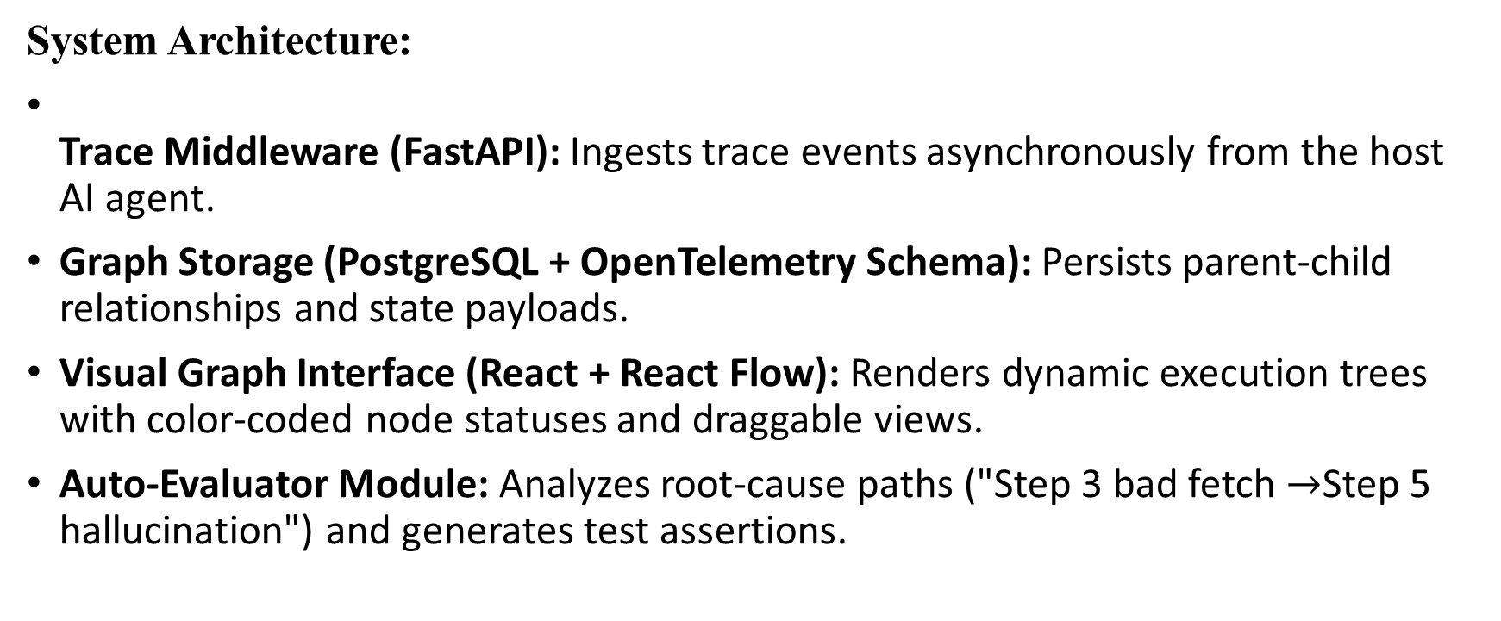
Design & Implementation
System Architecture:
Trace Middleware (FastAPI): Ingests trace events asynchronously from the host AI agent.
Graph Storage (PostgreSQL + OpenTelemetry Schema): Persists parent-child relationships and state payloads.
Visual Graph Interface (React + React Flow): Renders dynamic execution trees with color-coded node statuses and draggable views.
Auto-Evaluator Module: Analyzes root-cause paths ("Step 3 bad fetch $→$Step 5 hallucination") and generates test assertions.

Slide 8
Technology Stack
Core Backend Framework: Python & FastAPI (asynchronous, high-throughput trace ingestion).
Tracing Standards & DB: OpenTelemetry specification with PostgreSQL / ClickHouse for low-latency tree storage.
Frontend Visualization: React.js with React Flow (@xyflow/react) for interactive node graphs.
AI & Evaluation Engine:
Embeddings: all-MiniLM-L6-v2 for step-by-step semantic drift analysis.
Judge LLM: Lightweight LLM API for producing Plain-English failure explanations.

Slide 9
Expected Outcomes
1. Rapid Root-Cause Diagnostics
Reduces debugging time for multi-step agent workflows by pinpointing the exact step where bad context was introduced.
2. Accessible Debugging for Non-Developers
Empowers non-technical team members to audit, understand, and fix agent behavior without reading raw logs.
3. Self-Improving Agent Reliability
Automatically transforms edge-case failures into automated regression tests, systematically reducing failure rates over time.

Slide 10
References
AlSayyad, A., Deshpande, R., & Zhang, Y. (2026). AgentTrace: Operational, Cognitive, and Contextual Observability for Multi-Agent Workflows. arXiv preprint arXiv:2602.10133.
Zhang, H., Chen, X., & Liu, M. (2026). AgentTrace: Causal Graph Tracing for Root Cause Analysis in Deployed Multi-Agent Systems. arXiv preprint arXiv:2603.14688.
Deshpande, K., & Subramanian, S. (2026). Causal Agent Replay: Counterfactual Attribution for LLM-Agent Failures. arXiv preprint arXiv:2606.08275.
Sequeira, R., & Kumar, P. (2026). From Agent Traces to Trust: Evidence Tracing and Execution Provenance in LLM Agents. arXiv preprint arXiv:2606.04990.
OpenTelemetry Project (2026). OpenTelemetry Semantic Conventions for Generative AI & Agentic Systems. Cloud Native Computing Foundation (CNCF).
LangChain & LangSmith Team (2024–2026). Execution Spans and Automated Evaluation Datasets for Agent Pipelines. LangChain Whitepaper.
Langfuse Open Source Community (2024–2026). Open-Source Telemetry Engine and Visual Trace Infrastructure for LLM Applications. GitHub Repository Documentation.

