Slide 1
CRYPTOGRAPHY & NETWORK SECURITY · PROJECT BASED LEARNING
Signatures vs. Anomalies
Comparing two network intrusion detection systems
Approach 1: Signature-based Approach 2: ML anomaly-based (Isolation Forest)
Team: [Member 1] · [Member 2] · [Member 3] · [Member 4] · [Member 5]
Guide: [Faculty Name] · [Institute Name] · September 2026
Notes:
Introduce the team: Sub-group A built the signature engine, Sub-group B the anomaly detector; together we compared them on identical data.

Slide 2
PROBLEM STATEMENT & OBJECTIVES
Which detection method protects a network better?
Firewalls allow traffic — they can't see if it is being abused
A NIDS watches traffic and raises alerts
Goal: build both methods and compare them on the same data
Compared on
Accuracy
False alarms
Unseen attacks
Speed & memory
Security
2
Notes:
Full metric list: accuracy, precision, recall, F1, false-positive rate, zero-day detection, processing time, memory, scalability, security, usability, implementation effort.

Slide 3
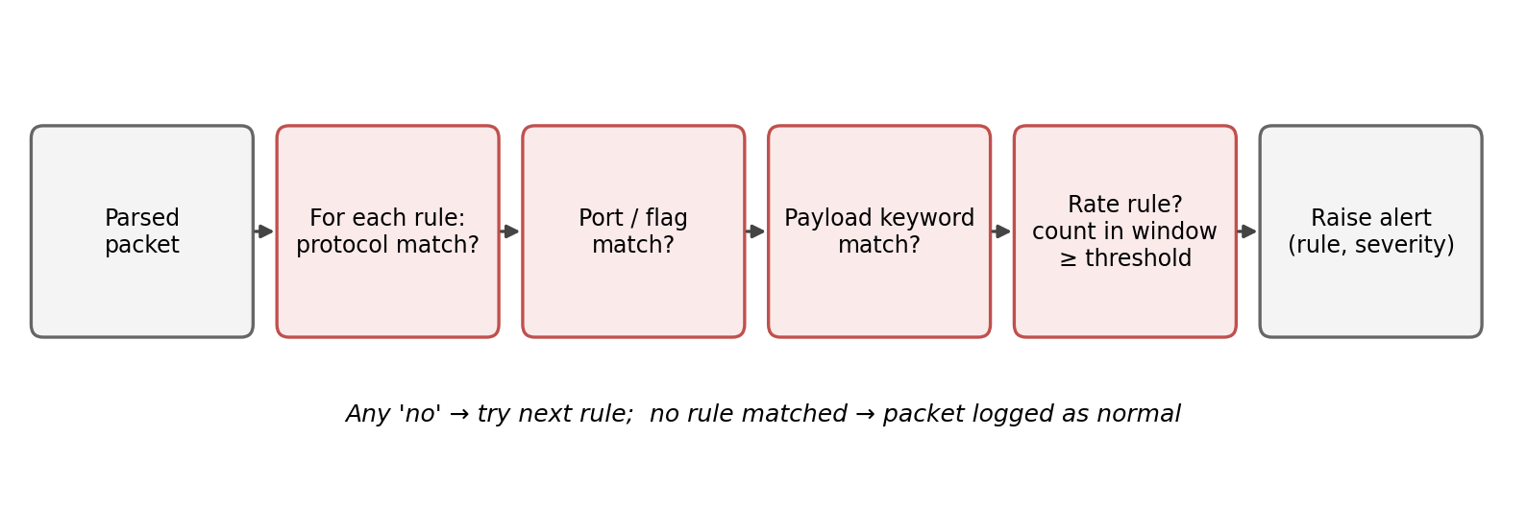
SIGNATURE-BASED DETECTION
Approach 1: match traffic to known attack rules
Port scans
Floods
Brute force
Web attacks
23 rules · every alert names the attack that triggered it
3
Notes:
Static checks on protocol, port, flags and payload keywords, plus rate rules with a sliding window per source IP. For NSL-KDD the rules were translated to 16 connection rules: FULL, and STRICT (behaviour rules only).

Slide 4
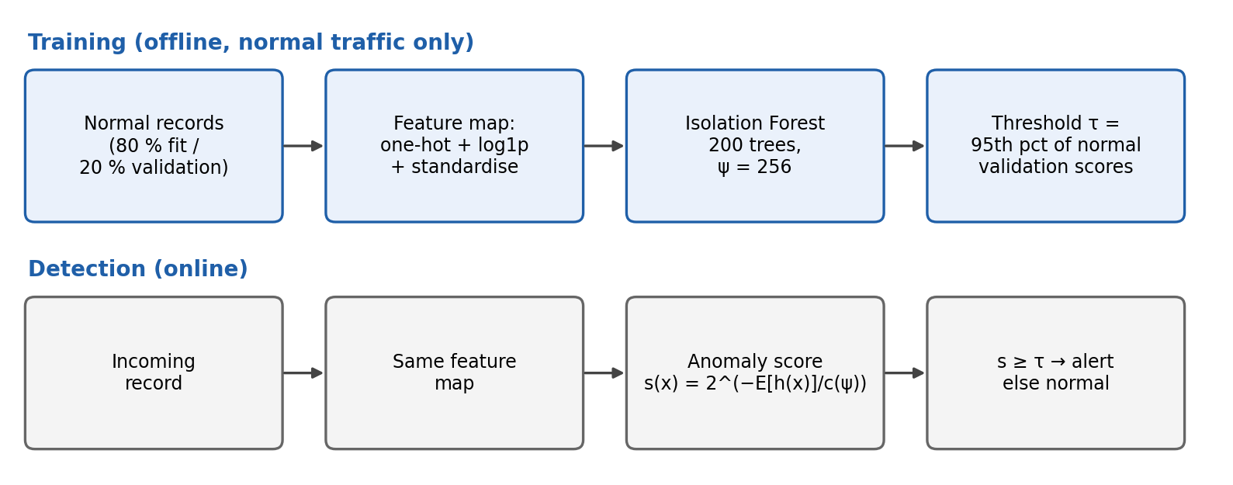
ML ANOMALY-BASED DETECTION
Approach 2: learn normal traffic, flag the outliers
Trained on normal traffic only
Outliers are isolated in fewer random splits
Alert threshold fixed at a 5 % false-alarm budget
4
Notes:
Isolation Forest, 200 trees, subsample 256. Score s(x) = 2^(-E[h(x)]/c(psi)). Threshold = 95th percentile of scores on held-out normal data.

Slide 5
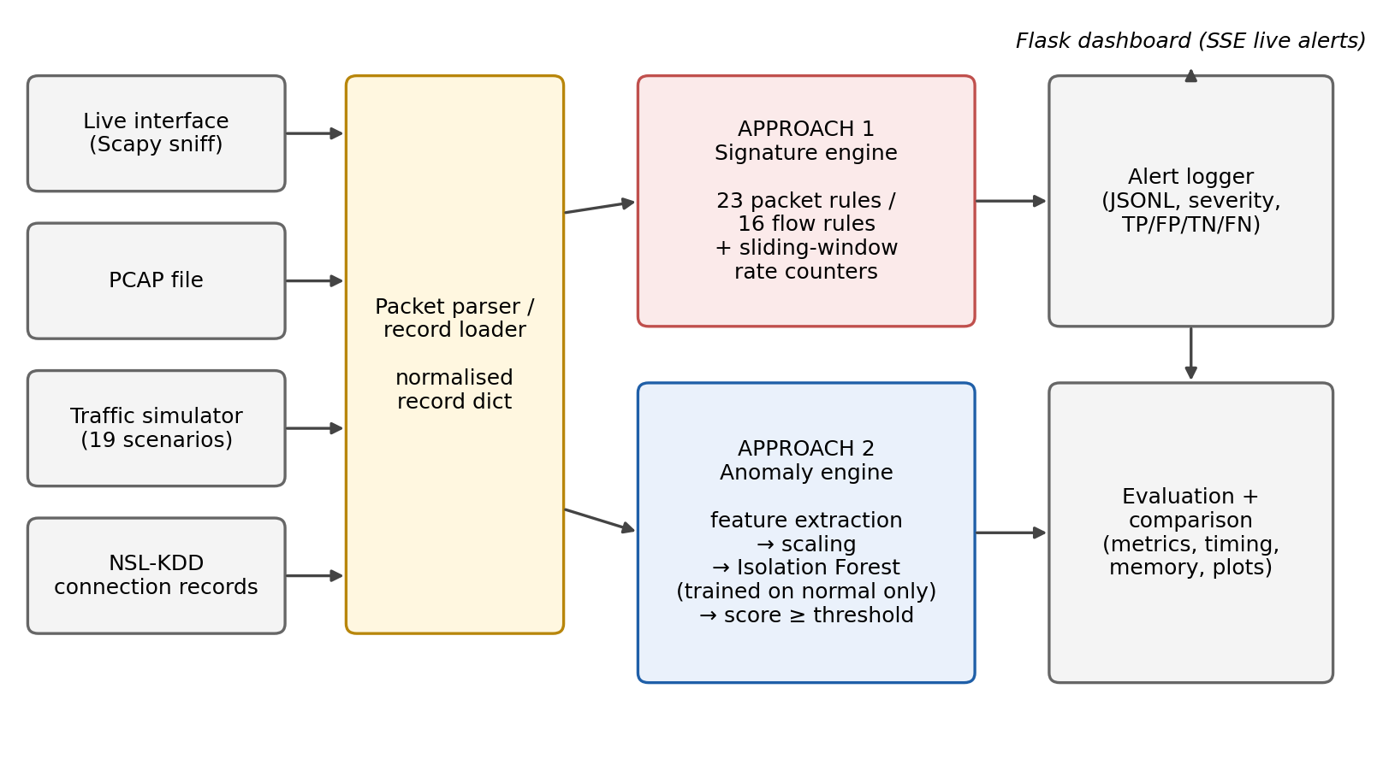
SYSTEM ARCHITECTURE
One pipeline, two interchangeable engines
Both engines share the same input, parser, logger and evaluation — so the comparison is fair.
5
Notes:
Inputs: live Scapy capture, PCAP, simulator, NSL-KDD. Flask dashboard streams alerts live.

Slide 6
EXPERIMENTAL SETUP
Same data, same machine for both approaches
22,544
17
5
test records from the NSL-KDD benchmark
attack types never seen in training
repeated runs for reliable results
Plus a packet-level simulator with 19 traffic scenarios to test Approach 1 exactly as coded.
6
Notes:
A2 trained on 67,343 normal records only; no tuning on the test set. Simulator: 5 seeds x 1,000 packets, 40% attacks. Intel Xeon 2.1 GHz, 1 core, 4 GB.

Slide 7
RESULTS
Same F1-score — ten times fewer false alarms
2.5 %
false alarms with Approach 2 (vs 25.8 %)
97 %
of Approach 2's alerts were real attacks
7
Notes:
Approach 1 = full rule set. Accuracy 75.0 vs 79.0; precision 79.5 vs 97.1; recall 75.7 vs 65.0. Behaviour-only rules (STRICT): F1 69.6, FPR 10.3. The DNS rule alone caused 892 false alarms against 2 real attacks. A2 AUC 0.948.

Slide 8
RESULTS BY ATTACK TYPE
Each approach catches different attacks
Approach 2 wins scans and unseen attacks
Approach 1 wins login and privilege attacks
8
Notes:
With the full rule set Approach 1 reaches 55.4% on unseen attacks and 100% on U2R, but mostly because it alerts on any Telnet/FTP use, not by recognising the attack.

Slide 9
COMPARATIVE ANALYSIS
Head-to-head comparison
 | Approach 1 | Approach 2 | Better
False alarms | 25.8 % | 2.5 % | A2
Unseen attacks | 19.9 % | 63.5 % | A2
Web / payload attacks | 100 % | 1–5 % | A1
Speed | 11× faster | — | A1
Memory | < 1 MB | 35 MB | A1
Explains the alert | Yes | No | A1
9
Notes:
Other parameters: accuracy 75% vs 79%; precision 80% vs 97%; processing 0.026 s vs 0.285 s per 22.5k records; both scale linearly; A2 stable across seeds; A1 rate rules depend on replay speed.

Slide 10
SECURITY ANALYSIS
How an attacker could beat each one
Approach 1
Approach 2
Disguise or encrypt the payload
Attack slowly, under the thresholds
Flood it with fake IPs to crash it
Make attacks look like normal traffic
Poison the normal training data
Alerts give only a score
Even small false-alarm rates swamp analysts on a busy network — so the false-positive rate matters most.
10
Notes:
Base-rate check (Axelsson): 1M connections/day with 0.1% attacks gives about 258,000 false alarms/day for A1-FULL, 25,000 for A2, and 4,900 for A2 at a 0.5% budget.

Slide 11
CONCLUSION & FUTURE SCOPE
Approach 2 is the better standalone NIDS
10× fewer
false alarms
3× better
on unseen attacks
Tunable
false-alarm budget
Keep signatures too: faster, lighter and explainable. Combined, F1 rises to 83.4 %.
Next: test on newer datasets · fix Approach 1 rule bugs · build the hybrid
11
Notes:
Future scope in full: CIC-IDS2017 / UNSW-NB15; packet-timestamp rate windows and a better DNS rule; unseen-value guard for A2; adversarial testing.

Slide 12
Thank you
Questions?
github.com/PrashleshPratapSingh/Network-Security-Project-

