Slide 1
Explainable Stock Recommendation System with Volatility Analysis, Forecasting, and Confidence-Interval-Based Suggestions
Prashu
Roll No. - 242123022
M.Sc. Mathematics and computing
IIT Guwahati
prashu@iitg.ac.In

Slide 2
Problem Statement
Problem Statement:
Retail investors face major challenges while selecting suitable stocks from thousands of available options. The key problems are:
1.] Lack of personalization : Different investors have different • risk appetites (Conservative / Balanced / Aggressive) • sector interests • return expectations
2.] Traditional recommender systems lack transparency: Investors don’t trust automated recommendations because they don’t understand the reasoning behind them.
3.] Forecast uncertainty is ignored: Systems typically show only point predictions without conveying volatility or confidence intervals.
Therefore: We need a recommendation system that is
personalized + forecast - driven + volatility - aware + explainable

Slide 3
Datasets
Stock Price Data & Company Fundamentals
Stock price data fetched trough Yahoo Finance (yfinance), covering 60+ frequently traded NSE stocks across major Indian market sectors such as Information Technology, Financial Services, Health care, Consumer Goods, Manufacturing, and Energy.
&
Multiple features were Extracted :
• Daily and log returns
• Volatility
• Sharpe Ratio
• CAGR (compounded annual growth rate)
Companies Data
Key fundamental features were extracted using the Yahoo Finance ticker metadata:
• Market capitalization
• Beta (systematic risk)
• Price-to-Earnings (P/E) ratio
• Dividend yield
• Profit margins
• Return on Equity (ROE) and Return on Assets (ROA)

Slide 4
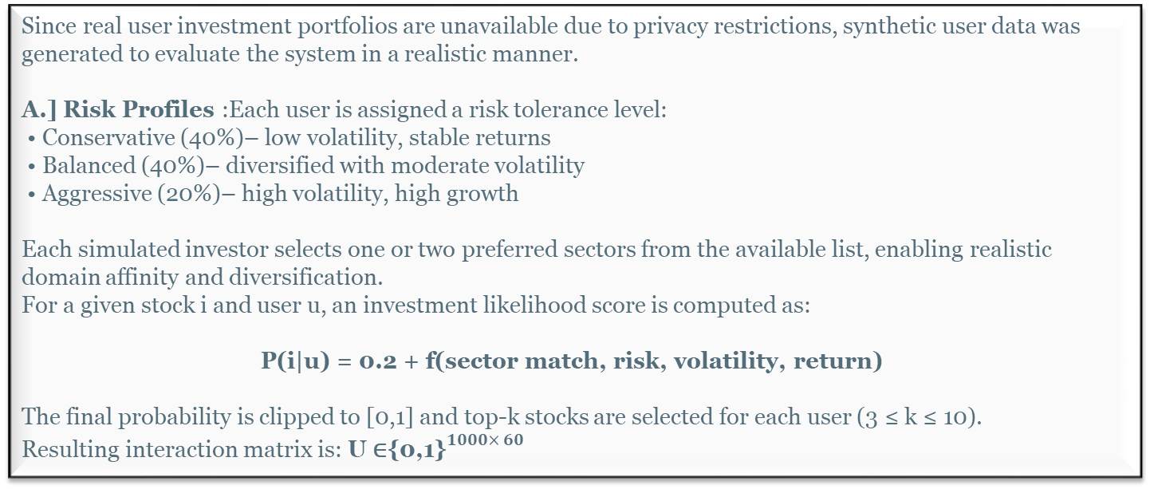
User Modeling And Synthetic Investment Data
Since real user investment portfolios are unavailable due to privacy restrictions, synthetic user data was generated to evaluate the system in a realistic manner.
A.] Risk Profiles :Each user is assigned a risk tolerance level:
• Conservative (40%)– low volatility, stable returns
• Balanced (40%)– diversified with moderate volatility
• Aggressive (20%)– high volatility, high growth
Each simulated investor selects one or two preferred sectors from the available list, enabling realistic domain affinity and diversification.
For a given stock i and user u, an investment likelihood score is computed as:
P(i|u) = 0.2 + f(sector match, risk, volatility, return)
The final probability is clipped to [0,1] and top-k stocks are selected for each user (3 ≤ k ≤ 10).
Resulting interaction matrix is: U ∈${\text{\{0,1\}}}^{1000× 60}$

Slide 5
Forecasting Pipeline
ARIMA
We fit an ARIMA(p,d,q) model to the stationary log-return series of each stock. A grid search isperformed over:
p ∈{0,1,2,3}, d ∈ {0,1,2}, q ∈ {0,1,2,3},
Residual Diagnostics and GARCH Enhancement
ARIMA/LSTM capture the mean structure but not the volatility structure. Residuals may contain the remaining heteroscedastic behavior, to check that we includes:
• Ljung–Box: autocorrelation
• Engle ARCH: heteroskedasticity
If ARCH effect exists (p < 0.05), GARCH(1,1) is fitted.
And Confidence Interval predicted using this with Predictions.
LSTM-based Nonlinear Forecasting
build an LSTM regression model using the Keras Functional API. Input features are multi-horizon differenced log-returns:
r(k) t =log(Pt) −log(Pt−k), k ∈ {5,15,30,60}
The architecture is tuned via grid search:
• Units: {64,86,128}
• Dropout: {0.1,0.2}
• Epochs: 50–100
• Batch size: 16

Slide 6
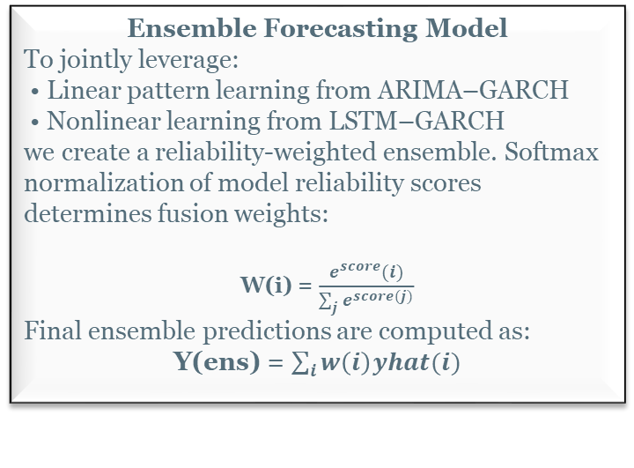
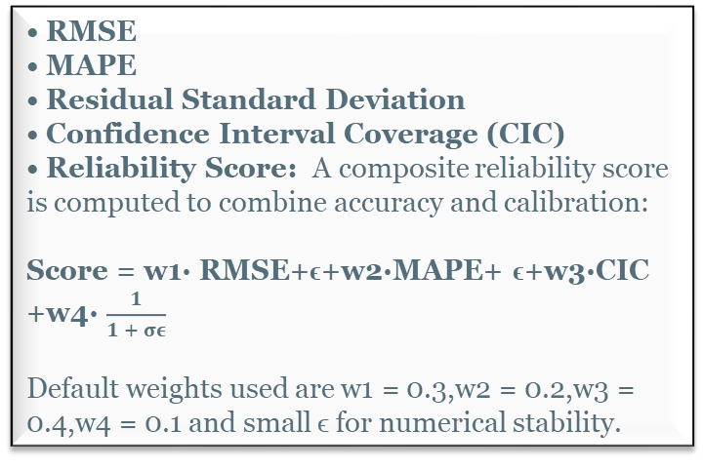
Ensemble Model And Evaluation Metrics
• RMSE
• MAPE
• Residual Standard Deviation
• Confidence Interval Coverage (CIC)
• Reliability Score: A composite reliability score is computed to combine accuracy and calibration:
Score = w1· RMSE+ϵ+w2·MAPE+ ϵ+w3·CIC +w4· $\frac{1}{1 + σε}$
Default weights used are w1 = 0.3,w2 = 0.2,w3 = 0.4,w4 = 0.1 and small ϵ for numerical stability.
Ensemble Forecasting Model
To jointly leverage:
• Linear pattern learning from ARIMA–GARCH
• Nonlinear learning from LSTM–GARCH
we create a reliability-weighted ensemble. Softmax normalization of model reliability scores determines fusion weights:
W(i) = $\frac{e^{score}(i)}{\sum_{j}{e^{score(j)}}}$
Final ensemble predictions are computed as:
Y(ens) = $\sum_{i}{w\left(i\right)yhat(i)}$
Model Selection and Export: The model with highest Reliability Score per stock is saved for:
• Live prediction • Recommendation ranking
• Streamlit visualization Metadata is serialized to datasets/models_data.pkl.

Slide 7
Hybrid Explainable Recommendation Engine
Content-Based Filtering
Content-based filtering recommends stocks with similar f inancial, sectoral, and risk characteristics to those already in the user portfolio.
Feature Space Design:To generate meaningful stock similarity and recommendations, following comprehensive set of features is used to construct the similarity vector:
• marketCap • returnOnEquity (ROE)
• returnOnAssets • debtToEquity
• profitMargins, grossMargins, ebitdaMargins
• beta • CAGR • Volatility
• auditRisk, boardRisk, compensationRisk, shareHold erRightsRisk, overallRisk
• Mean Return • Sharpe Ratio
• Sector
• Industry
Collaborative Filtering
User-stock binary interaction matrix supports item-item similarity-based collaborative filtering
Risk-Adjusted Forecast Ranking
Ensure personalized investment suitability, each stock is ranked using a scoring function integrating forecasts and volatility. The score blends predicted mean returns and CI bounds with volatility and user risk profile.
Scoring Logic
• Conservative: prioritize downside protection
Pred Scorei = 0.5 ˆRi +0.35 ˆLi +0.15 ˆUi ·(1−Vi)
• Balanced: prefer moderate volatility
Pred Scorei = Pred Scorei ·(1−|Vi −0.5|)
• Aggressive: reward growth potential and volatility Pred Scorei = 0.5 ˆRi +0.15 ˆLi +0.35 ˆUi ·Vi

Slide 8
Final Recommendations
Hybrid Recommendation Pipeline
Integrates all parts into one recommendation flow:
Content-based candidates → find similar stocks.
Collaborative filtering candidates → find behaviorally similar stocks.
Merge both candidate sets.
Rank them using predicted performance and risk adjustment.
Return top recommendations
Cold-Start Handling
If a user has not previously invested in any stocks, the model ranks all available stocks according to the user’s selected risk profile.
If the user does not select any risk profile, the system automatically defaults to the Balanced profile.
This approach effectively addresses the cold-start problem for new users, ensuring that even without historical data, the user receives personalized recommendations based on risk preference.
Similarly, for a newly listed company or stock (with limited user interaction data), the content-based filtering module handles the cold-start issue by recommending it to users with similar feature-based preferences.

Slide 9
Results
Outcomes | Observation
Forecasting Stability | Ensemble improved RMSE & CI coverage
Personalization Quality | Aggressive vs Conservative users received different recommendations
Explainability | Visual charts and future metrics increased trust & interpretability
Latency | Near real-time performance due to caching
Cold Start Handling | Content-based and balanced profile recommendations worked successfully
Visual insight:
Radar chart → summaries of risk-return fitness
Volatility vs CAGR → quadrant-based decision support
Users receive not just which stocks but why they are recommended.
Confidence Interval influence in ranking — improves risk-adjusted suggestions.

Slide 10
Conclusion
This project successfully demonstrates an explainable AI based stock recommendation system that integrates:
• Hybrid forecasting using ARIMA-LSTM-GARCH ensemble models
• Personalized recommendations based on user risk profiles
• Interactive visual analytics for explainability
• Real-time system response through precomputed metrics
The system effectively bridges the gap between advanced predictive modeling and transparent investment guidance. By incorporating volatility-aware forecasting and confidence interval-based ranking, the proposed solution enhances user trust and informed decision-making in retail finance.

