Slide 1
CS724 Project
HAND GESTURE CONTROLLED CAR
Team Number 12
Abinash Choudhary (231110004)
Agrim pandey(200061)
Nitya Aggarwal(200651)
Prashant Kumar(231110036)
Tushar Dupga(231110053)

Slide 2
01
PROBLEM STATEMENT
02
SIGNIFICANCE
03
REQUIRED RESOURCES
LIST OF CONTENTS
04
TIMELINE
05
IMPLEMENTATION OVERVIEW
06
FUTURE IMPROVEMENTS
07
CONCLUSION
08
QUESTIONS AND DISCUSSION

Slide 3
Issue: Traditional remote controls for cars are often cumbersome and require physical buttons, limiting ease of use.
Solution: Introduce a Hand Gesture Controlled Car to provide a more intuitive and interactive driving experience.
PROBLEM STATEMENT AND SIGNIFICANCE
Notes:
Traditional car remote controls have been the standard for years, but they come with a significant drawback.
The main issue is that they rely heavily on physical buttons, which can be cumbersome and complex for users to navigate.
To address these limitations, we propose a solution: the Hand Gesture Controlled Car.
With this technology, we aim to provide a more intuitive and interactive driving experience.
Instead of pressing buttons, users can control the car's functions simply by making hand gestures.

Slide 4
01
ENTERTAINMENT AND FUN
PROBLEM STATEMENT AND SIGNIFICANCE
02
ENHANCED
ACCESSIBILITY
03
EXPLORATION OF FUTURE POSSIBILITIES

Slide 5
Hardware Components:
ESP32 WROOM
L298N Motor driver
MPU6050 Gyroscope and Accelerometer
Lithium Ion Battery 3.7V 2500mAh 18650
DC Gearbox Motor
Wheel for DC Gearbox Motors
Caster Bearing Wheel
12V Rechargeable Lithium Iron Battery
Breadboard
Programming Tools:
Arduino IDE for code development and upload.
REQIRED RESOURCES

Slide 6
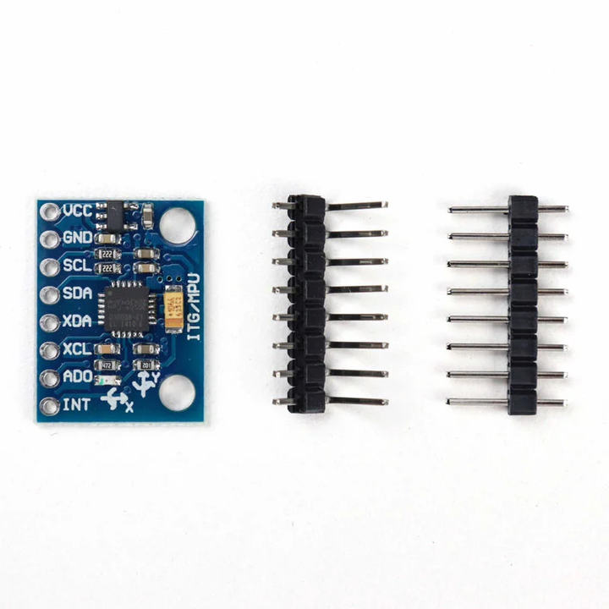
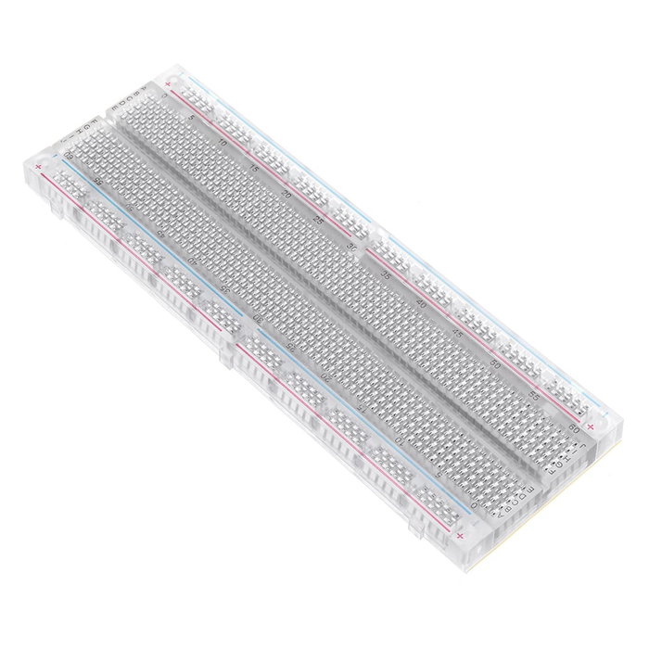
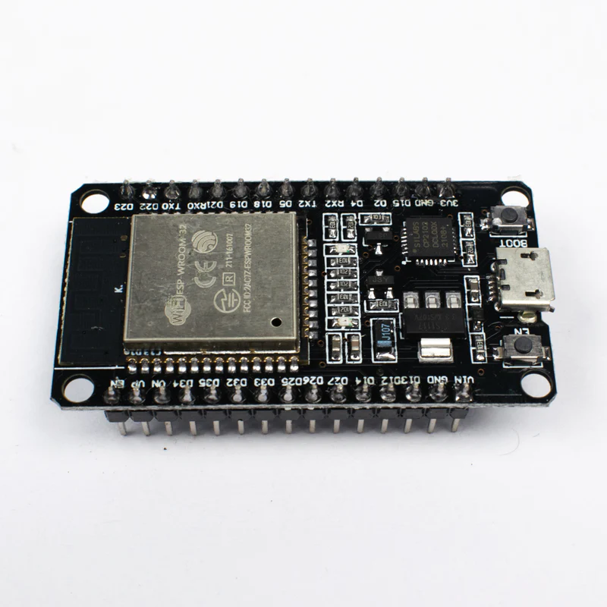
Resources Reqd.
Fig[2]: MPU6050 Gyroscope and
Accelerometer
Fig[3]: Breadboard
Fig[1]: ESP32 WROOM

Slide 7
COST ANALYSIS
Component | Cost (In rupees)
ESP32 WROOM | 409*2 /-
L298N Motor driver | 143 /-
MPU6050 Gyroscope and Accelerometer | 279 /-
Lithium Ion Battery 3.7V 2500mAh 18650 | 329*2 /-
DC Gearbox Motor | 240*2 /-
Component | Cost (In rupees)
Caster Bearing Wheel | 160 /-
12V Rechargeable Lithium Iron Battery | 800 /-
Breadboard | 140*2 /-
Wheel for DC Gearbox Motors | 80*2 /-
TOTAL | 3778 /-

Slide 8
01
Setting up Arduino IDE for ESP32
06
Developing an app to enhance functionality (add-on for controlling car other than hand gestures)
02
Getting the MAC Address of ESP32 (for wireless transfer of data)
Implementation
Overview
05
Writing code for self defined gestures and their responses
03
Setting up the Transmitter (i.e. Remote control)
04
Setting up the Receiver (i.e. Car)

Slide 9
TIMELINE
Week -1 | Gathering all of the project's components
Week -2 | Connecting the circuit of the car and the controller
Week - 3 | To finish the code layout and upload it to the microcontroller and begin work on integrating additional modules and functionalities
Week - 4 | Making an app to operate the car
Week - 5 | To enhance the original code and perform final checks and debugging

Slide 10
Setting up the transmitter and receiver:
Nitya Agrawal
Agrim Pandey
Setting up the Arduino and writing codes for car:
Prashant Mishra
Tushar Dupga
TEAM WORK DISTRIBUSION
Developing App:
Abiansh Choudhary

Slide 11
The introduction of a Hand Gesture Controlled Car represents a significant step forward in the evolution of automotive technology. By addressing the limitations of traditional remote controls, this innovative solution offers a more intuitive and interactive driving experience.
Through the use of hand gestures, we can simplify the way we interact with our vehicles, making it more user-friendly and accessible to a wider range of individuals, including those with physical limitations.
CONCLUSION

Slide 12
Fig[1]: https://robu.in/product/esp-wroom-32-wifi-bluetooth-networking-smart-component-development-board/
Fig[2]: https://robu.in/product/mpu-6050-gyro-sensor-2-accelerometer/
(accessed on Sept 10,2023)
REFERENCES
Fig[3]:
https://robu.in/product/transparent-830-points-solderless-breadboard/

Slide 13
THANK
YOU
Any Questions
are welcomed

