Slide 1
METRO SLOT BOOKING PORTAL
TEAM :
WEBMINERS
RITVIK CHHAWAL
PRASHUBH ATRI
NEHA GOYAL
RISHABH GADHIA

Slide 2
Objective:
To build an easy-to-use and reliable system for booking slots in Metro to avoid huge crowds at the Ticket Counters, keeping in mind the present situation of CoVid-19 which makes social distancing a necessity. Metro being a need of time where the country is unlocking in various stages, this can turn out to be a good option to resume the activity of Delhi Metro.

Slide 3
Implementation:
A registration/Login page using the unique DMRC SmartCard Number or a random string in case of Token Users
Charging the people who vacate 2 seats consecutively to avoid any ruckus caused by frauds - Limiting the seats occupied in a metro to easily implement social distancing
Automatic deduction of Amount from the card according to the journey
A pre charge feature for those travelling by tokens to avoid any frauds misusing the services
Not allowing more that 50 people in a particular slot to avoid crowding

Slide 4
Applications:
Easy and safe way for getting a comfortable ride in Metro
Avoid long lines and saving a lot of time spent in queues
Helping the people get back to a normal life post Covid Pandemic in a safe and secure way
Reassuring the safety of a pre-existing reliable source of transportation
Tech Stack:
ExpressJS and NodeJS for backend
Git and Github for VCS
BootStrap for UI
PassportJS for maintaining sessions
MongoDB for Database
Delhi metro API

Slide 5
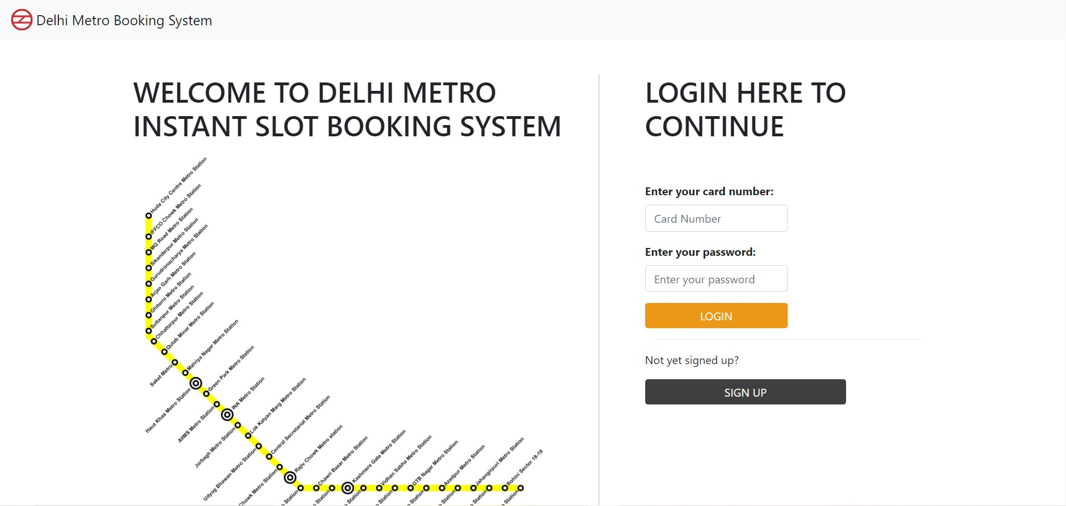
Login and Sign Up using existing smart card number

Slide 6
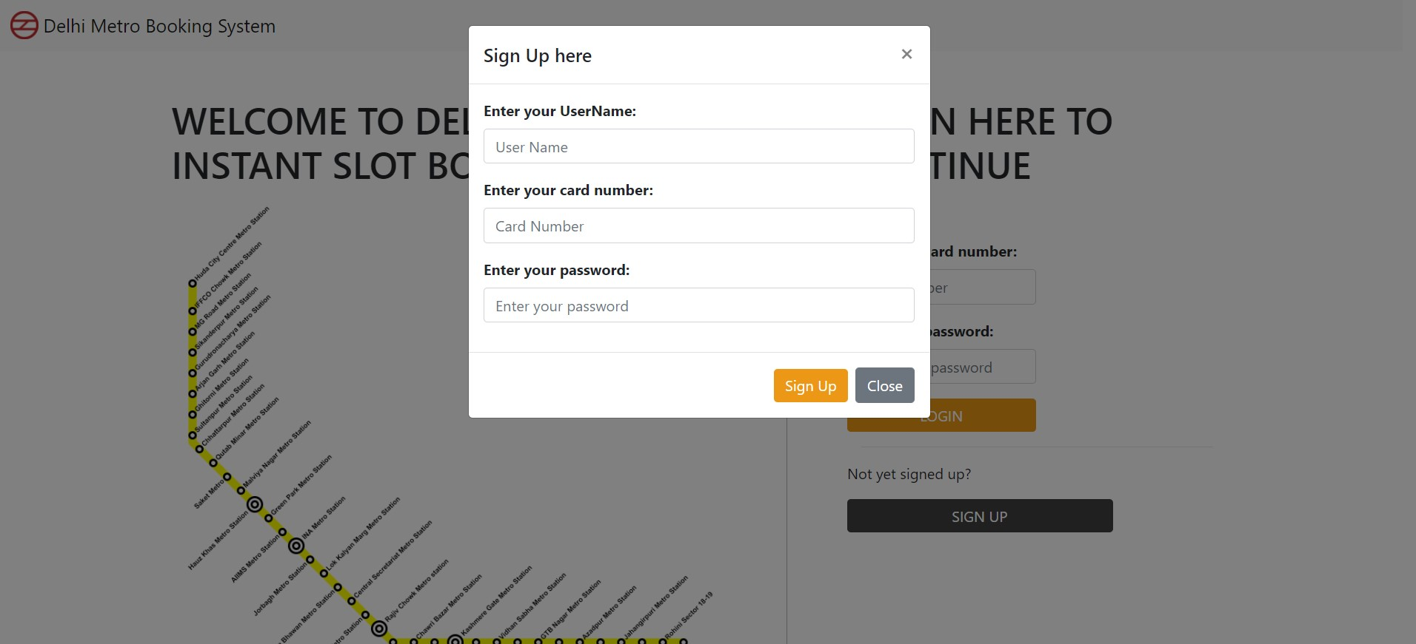
Sign Up portal for a new user

Slide 7
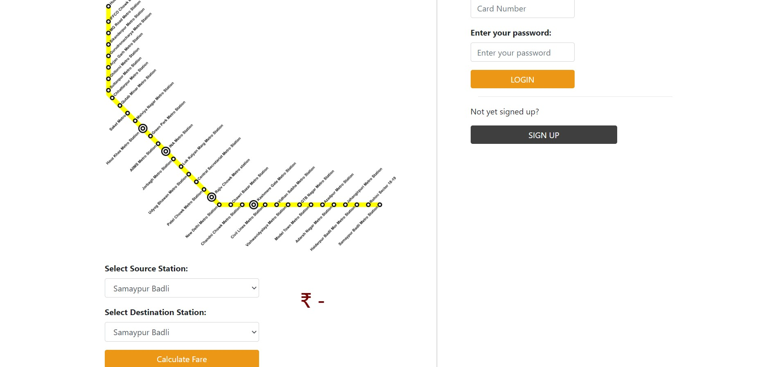
Fare calculator
Fare Display

Slide 8
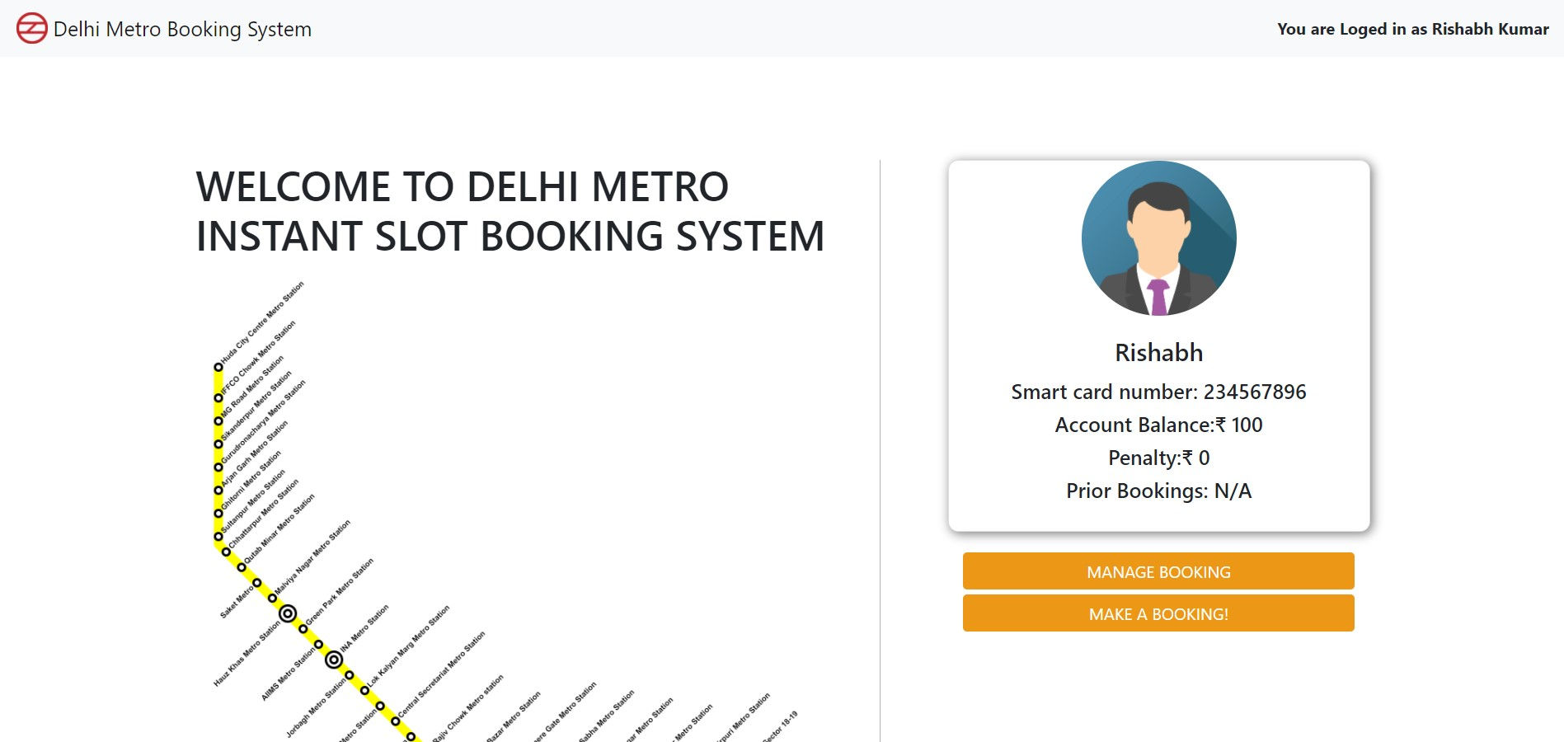
Account information display
Manage existing booking and make new booking

Slide 9
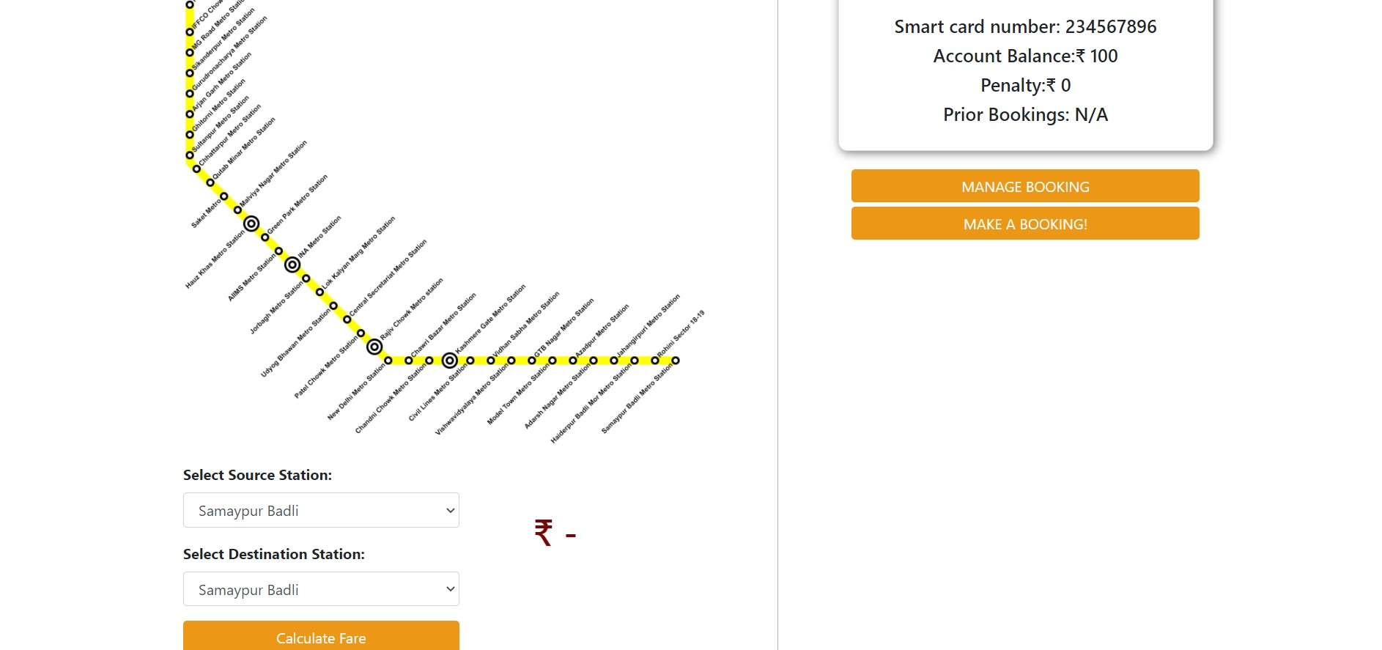
Fare calculator and display

Slide 10
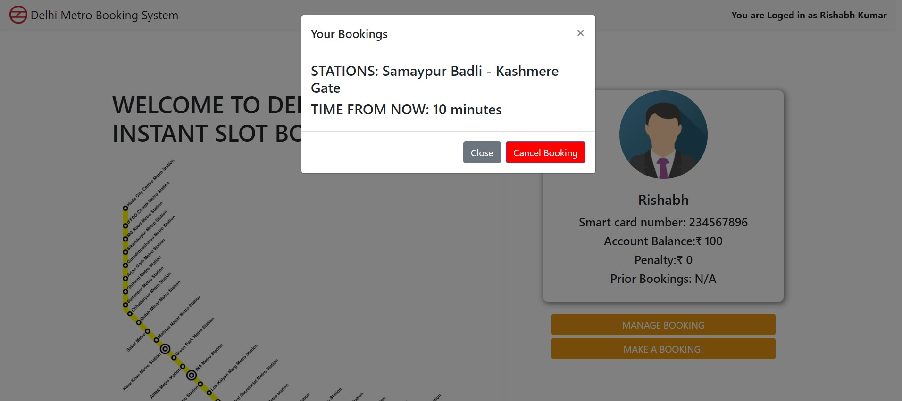
Existing booking display and cancel option

Slide 11
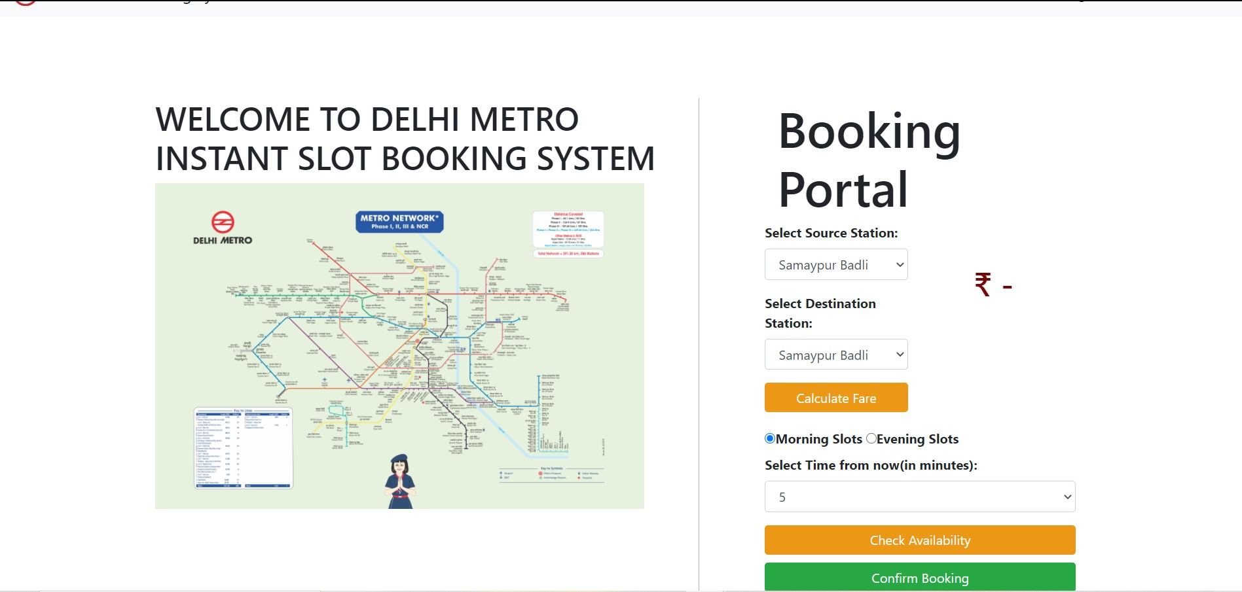
Fare calculator, fare display, slot selector, time selector,
availability checker and confirmation button on booking portal
This application does not allow more than specified number of people (e.g. – 50) to book in a particular slot

Slide 12
FURTHER DEVELOPMENTS LIKE METRO LINE CHANGES, DISPLAY OF METRO ROUTES,
INCREASE IN NUMBER OF TIME SLOTS, UI IMPROVEMENTS, ETC. CAN BE MADE USING THE SAME API THAT IS BEING USED IN THIS PROJECT.
END !!

