Slide 1
Hospital Performance Dashboards
Power BI

Slide 2
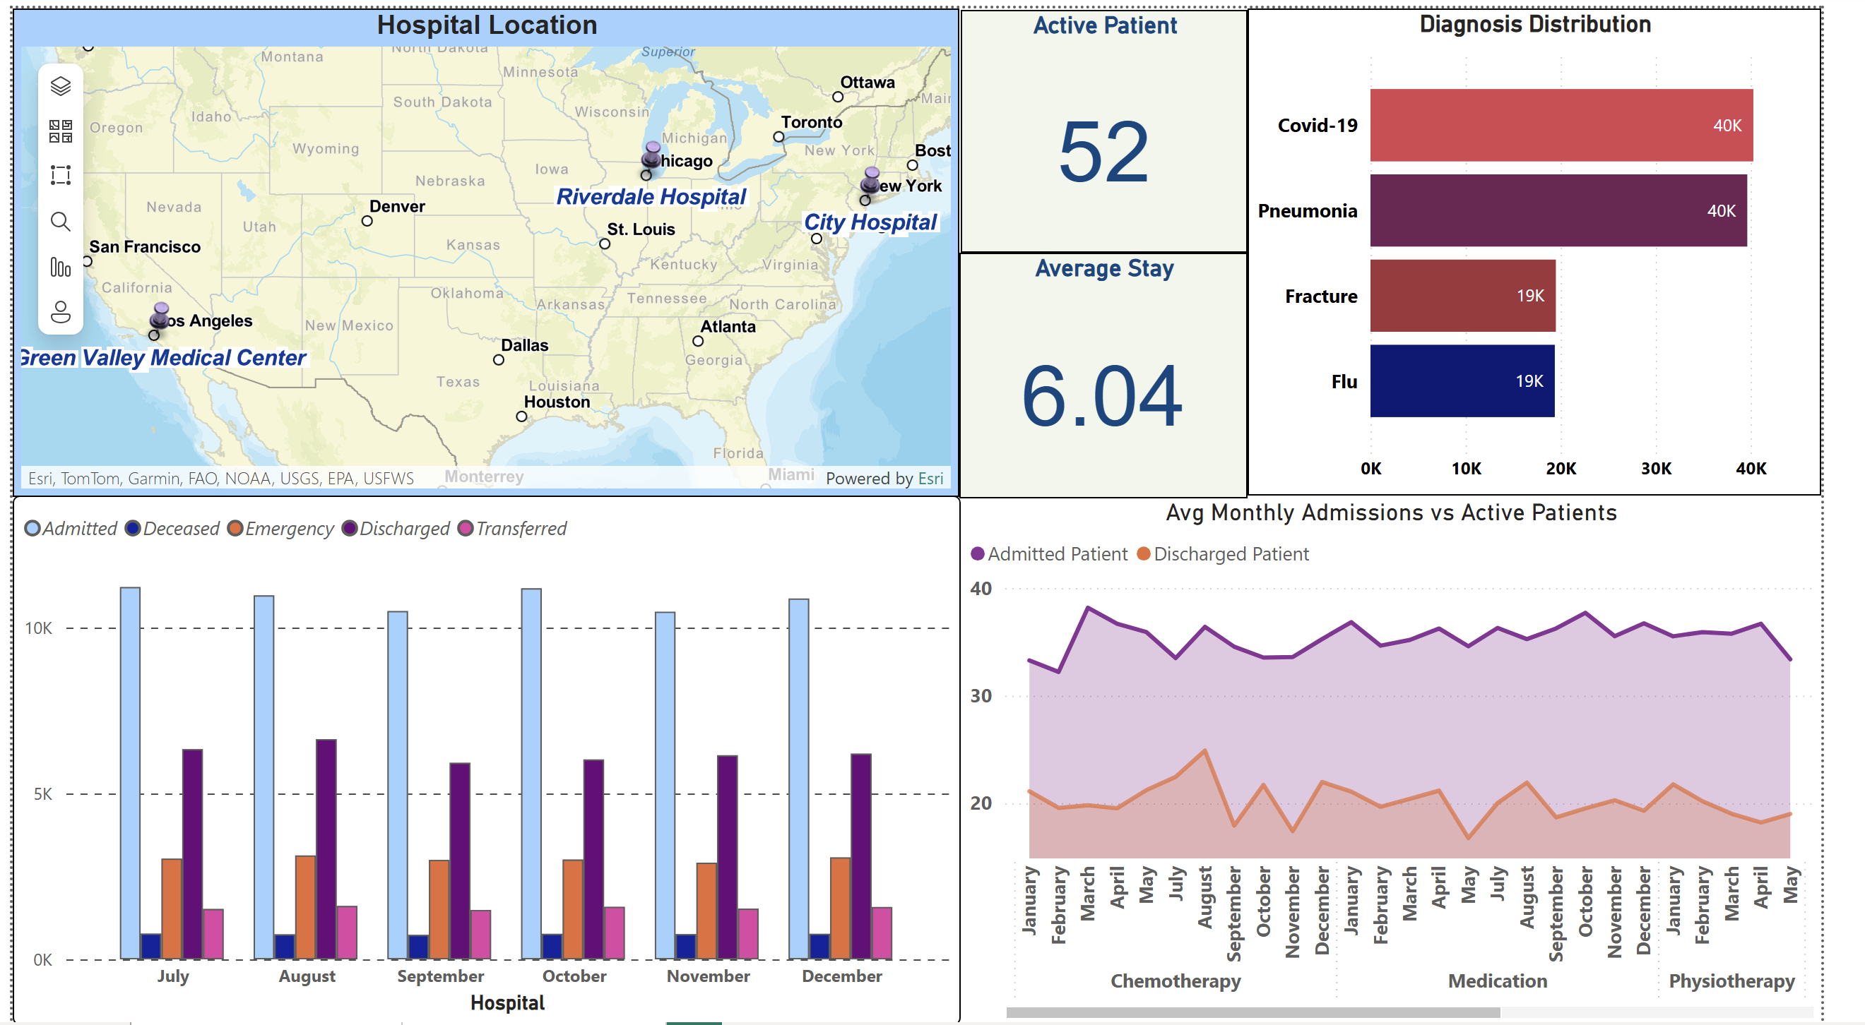
All Hospitals – Overview

Slide 3
All Hospitals
Map (top‑left) shows the locations of all three hospitals. Each dot’s size reflects admissions volume.
“Active Patient” card tells how many patients are currently admitted across the chain.
“Average Stay” shows the typical length of stay (days) for all patients.
Diagnosis bars rank the most common conditions – longer bar = more cases.
Bottom charts track admissions, discharges and other flows month‑by‑month, plus a purple vs orange area showing average admissions against active patients.

Slide 4
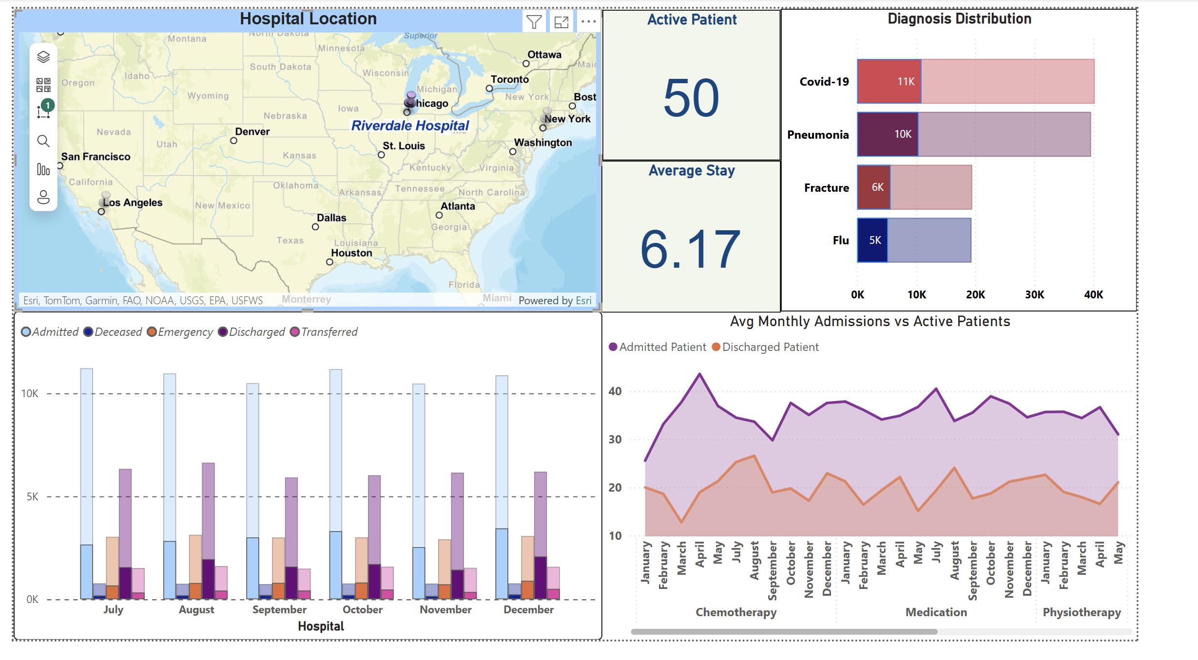
Riverdale Hospital – Focus View

Slide 5
Riverdale Hospital
Dashboard is filtered to **Riverdale Hospital** only (see single dot on the map).
KPI cards update to Riverdale’s current active patients and average stay.
Diagnosis bars reveal Riverdale’s top conditions (Covid‑19, Pneumonia, etc.).
Monthly columns compare how many patients were admitted, discharged, etc. in Riverdale.
Purple area vs orange line shows whether admissions are out‑pacing active patients over time.

Slide 6
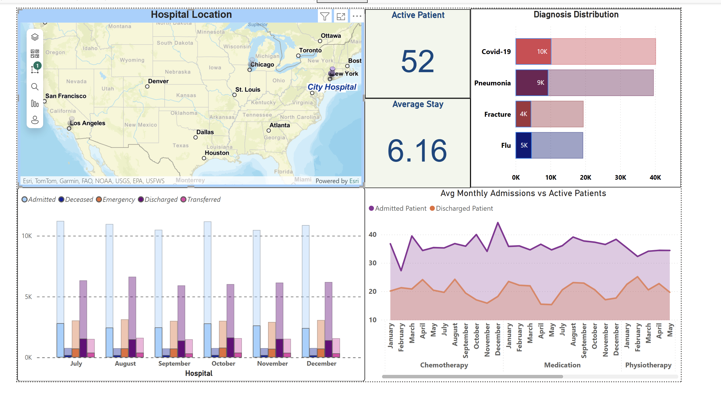
City Hospital – Focus View

Slide 7
City Hospital
View now focuses on **City Hospital** (East Coast). Only its map marker is visible.
Active Patient and Average Stay cards refresh for City Hospital numbers.
Diagnosis distribution highlights City’s main case mix.
Monthly column chart lets you see seasonal swings (e.g., winter Covid uptick).
Area chart compares average admissions to active patients – helps spot capacity pressure.

Slide 8
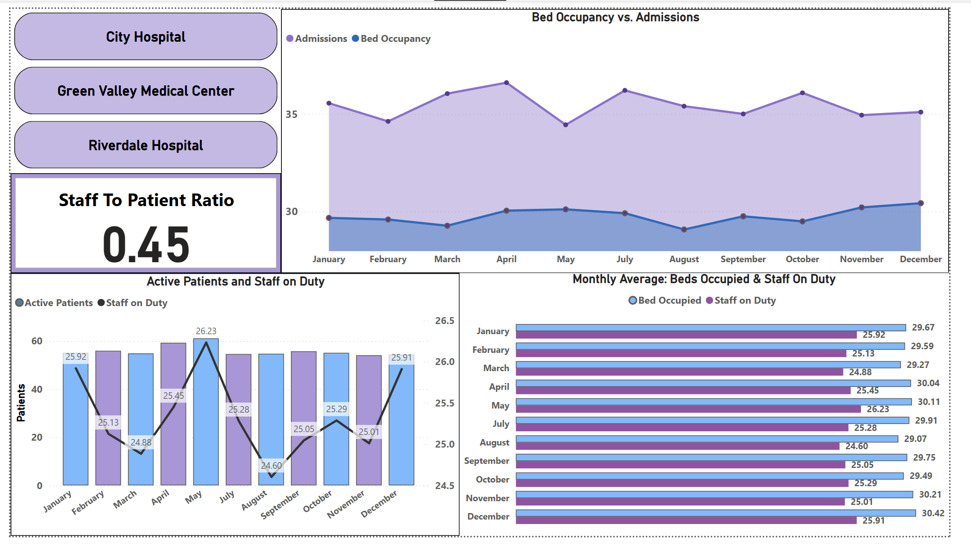
All Hospitals – Capacity & Staffing

Slide 9
All Hospitals
Top left buttons show all three hospitals; each chart aggregates chain‑wide.
Purple area = admissions; blue line = bed occupancy. Gap shows unused capacity.
Staff‑to‑patient ratio card (0.45) signals moderate staffing – aim for ≥ 0.5.
Column + line chart compares monthly active patients (bars) to staff on duty (black line).
Horizontal bars list average beds occupied vs staff per month – easy to spot seasonal peaks.

Slide 10
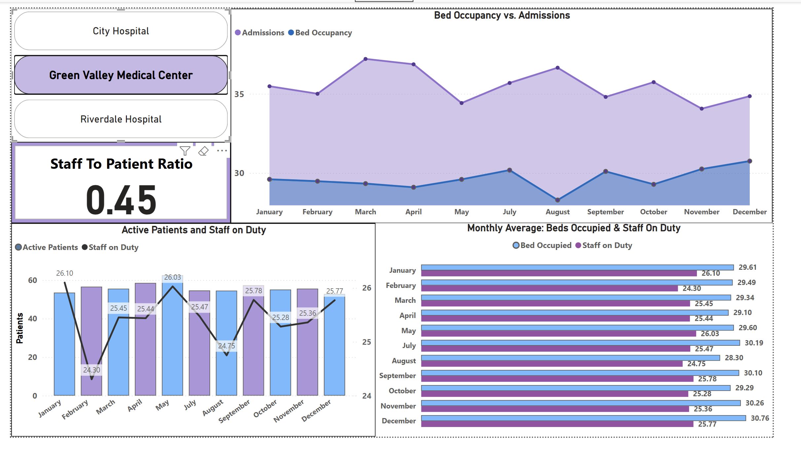
Green Valley Medical Center – Focus View

Slide 11
Green Valley Medical Center
Selector highlights Green Valley in purple; other hospitals dimmed.
Admissions vs beds chart shows July & August surge (purple peak) while beds dip.
Staff‑to‑patient ratio unchanged (0.45) → Green Valley mirrors chain average.
Active‑vs‑Staff chart reveals staffing dip in August – possible overtime need.
Monthly averages: Beds and Staff nearly parallel, but September staff slightly low.

Slide 12
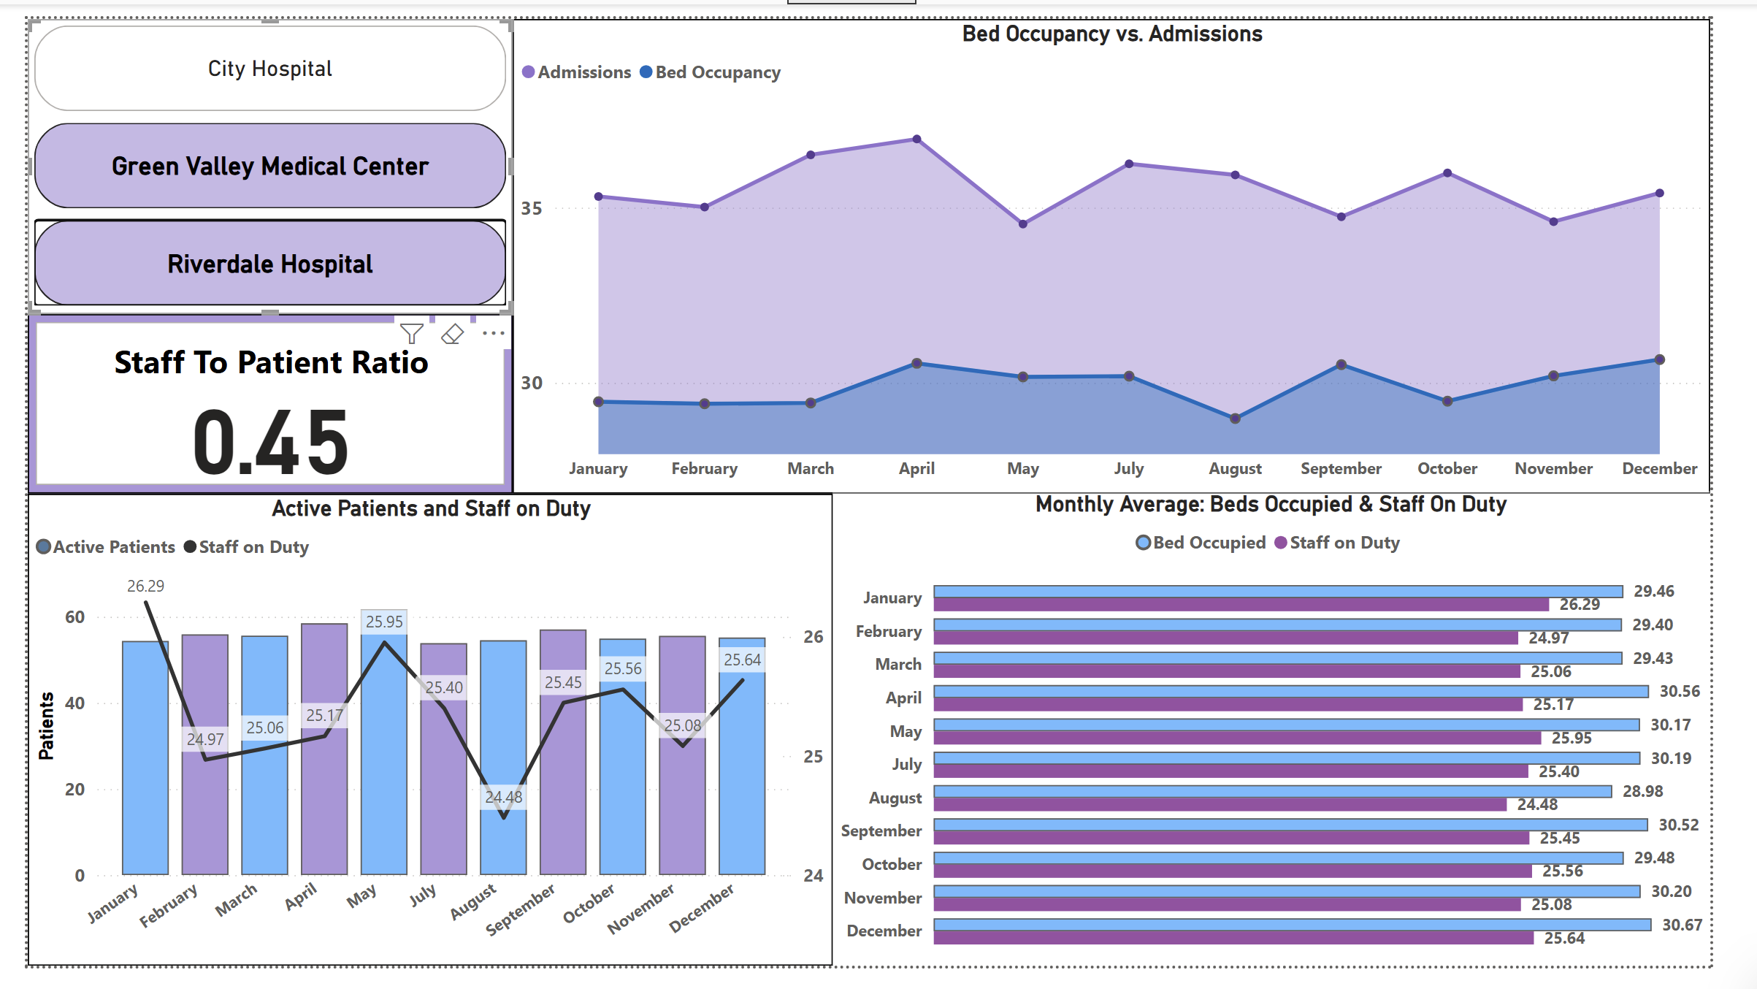
Green Valley + Riverdale – Dual View

Slide 13
Green Valley + Riverdale
Both Green Valley & Riverdale selected (two purple buttons).
Admissions area higher than single‑site view; beds line rises too.
Ratio card still 0.45 (combined). Use it to gauge staffing adequacy across two sites.
Bar/line chart: Riverdale’s staffing boosts combined totals mid‑year.
Horizontal bars show how extra Riverdale staff raises averages, smoothing capacity gap.

