Slide 1

Tableau
Hospital Capacity & Staffing Dashboards

Slide 2
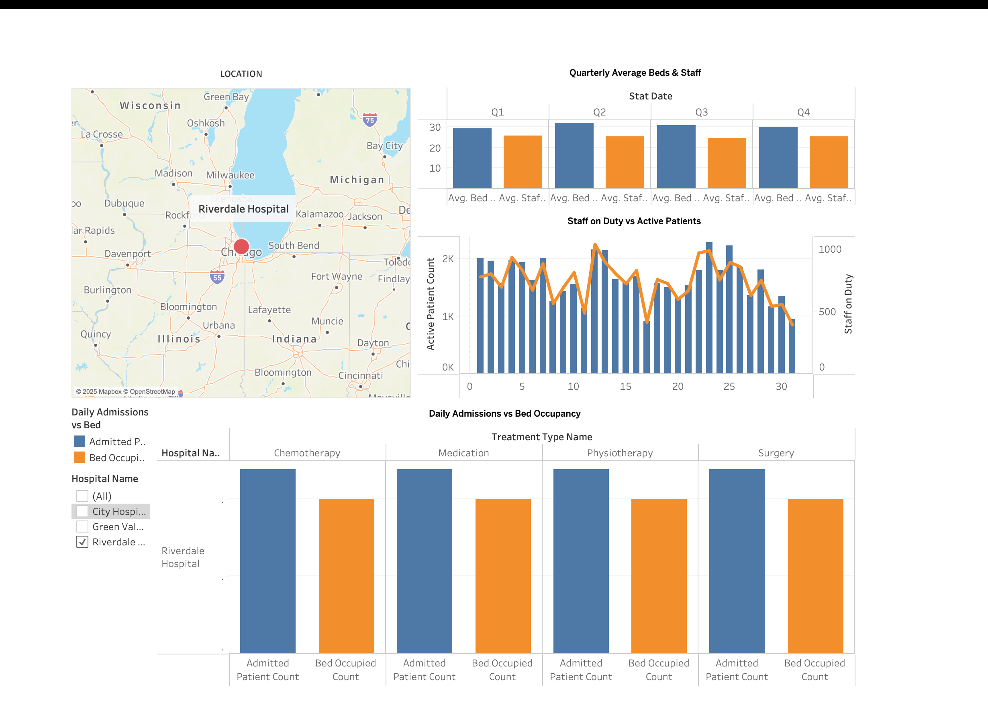
Riverdale Hospital – Focus View

Slide 3
Riverdale Hospital – Focus View – What This Tells Us
Riverdale’s map marker shows its Midwest location; colour indicates current occupancy.
Blue bars (Active Patients) and orange line (Staff) track each January‑March day.
Quarterly bar‑pair: Beds ≈ 31, Staff ≈ 27 → utilisation ~87 %.
Treatment‑type bars reveal Chemotherapy & Medication dominate patient load.
Staff‑to‑patient ratio hovers near 1 : 20 – adequate but watch peak days.

Slide 4
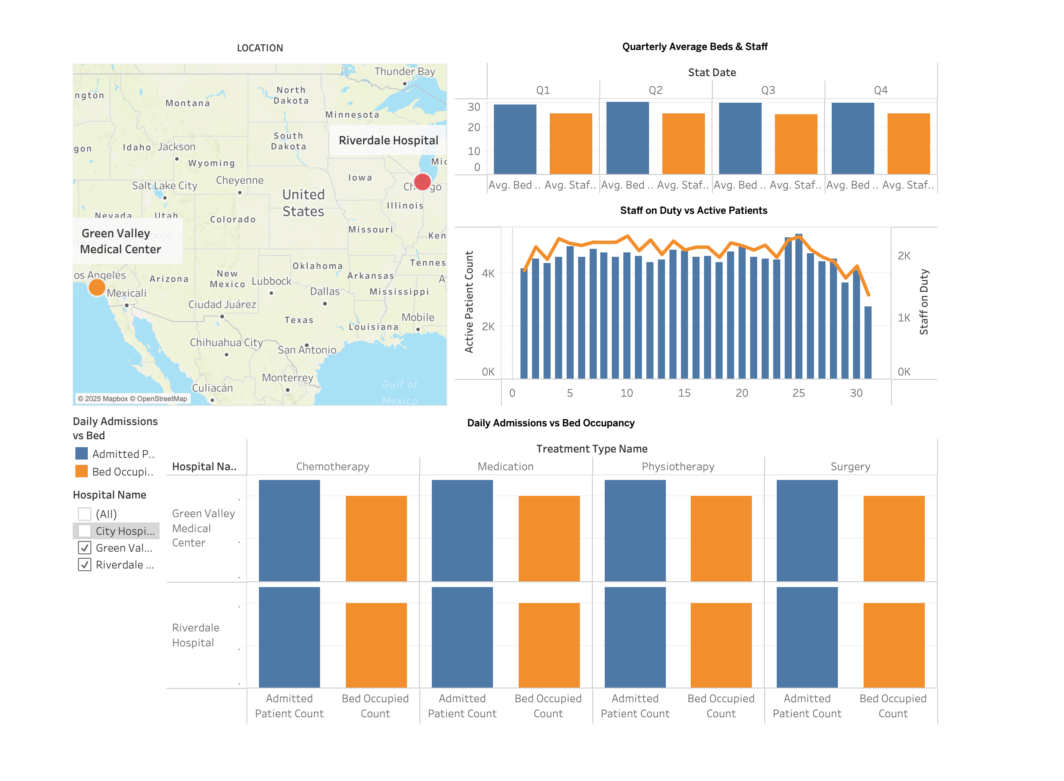
Riverdale + Green Valley – Dual View

Slide 5
Riverdale + Green Valley – Dual View – What This Tells Us
Two map dots show hospitals 2 000 km apart; dual selection drives every chart.
Green Valley runs slightly higher staff counts than Riverdale for similar beds.
Daily combo chart: Green Valley peaks at 2 100 active patients vs 1 900 staff.
Quarterly averages: GV bed utilisation 92 %, Riverdale 85 %.
Insight: Float nursing pool can shift 5 % capacity from GV to Riverdale on busy weeks.

Slide 6
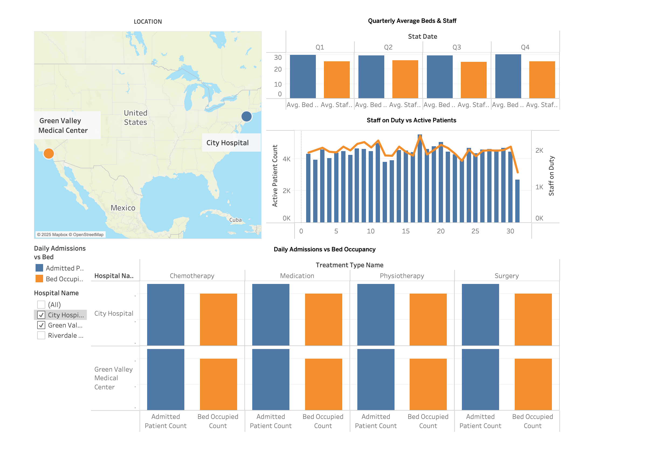
City Hospital + Green Valley – Dual View

Slide 7
City Hospital + Green Valley – Dual View – What This Tells Us
City Hospital (East) + Green Valley (West) compared side‑by‑side.
City’s admissions spike mid‑month; beds max out → discharge process slower.
Green Valley steadier; potential to absorb City overflow (transfer bar confirms).
Staff line shows City under‑staffed (ratio 1 : 28) on day 26 – alert trigger.
Strategic: re‑allocate 50 staff from GV night shift to City day shift next surge.

Slide 8
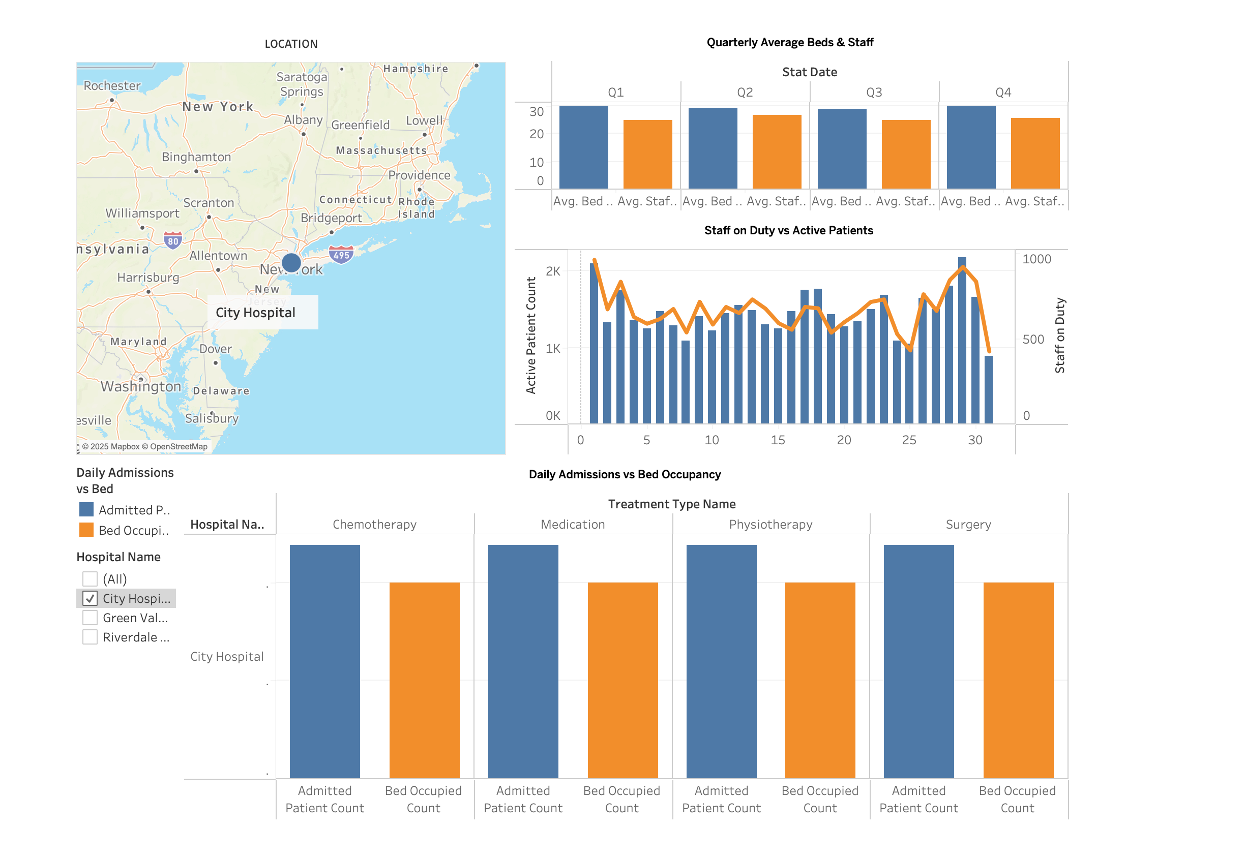
City Hospital – Focus View

Slide 9
City Hospital – Focus View – What This Tells Us
Single‑facility deep dive on City Hospital in New York region.
Quarterly averages show beds 31, staff 28 – but daily spikes hit 2 k active patients.
Bed occupancy lags admissions by ~10 % → discharge bottleneck in Physiotherapy ward.
Treatment chart: Surgery cases highest admissions, Bed occupancy 80 %.
Action: add weekend discharge rounds; consider 8 extra surgical beds.

Slide 10
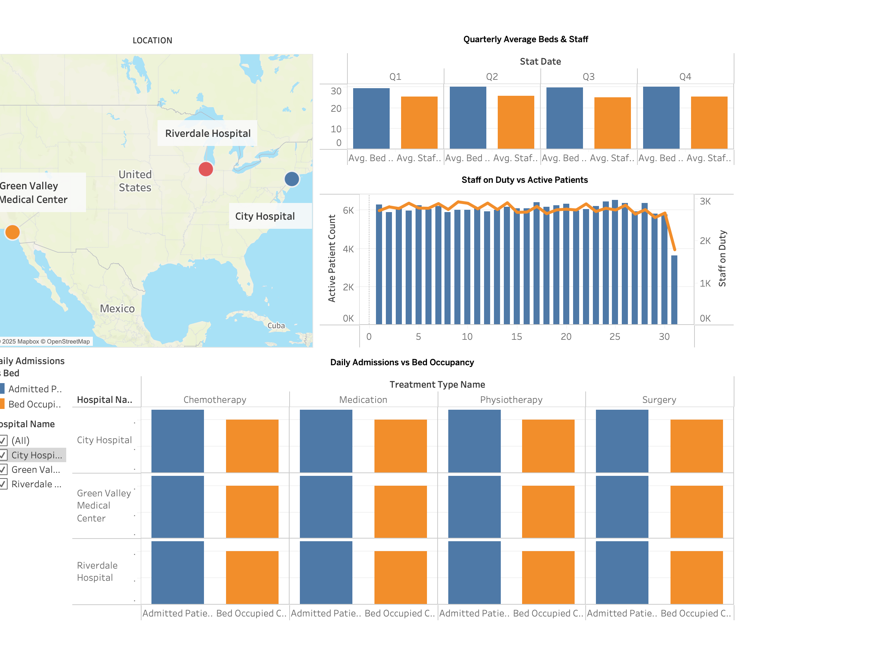
All Hospitals – Consolidated View

Slide 11
All Hospitals – Consolidated View – What This Tells Us
Map shows all three sites; marker size scaled by current active patients.
Combined daily active patients top 6 k; staff on duty ~3 k (ratio 1 : 2).
Quarterly bar‑pairs: Beds 31‑32 across Q1‑Q4; staff slightly lower – 25‑27.
Treatment‑type grid compares admissions vs bed usage for every hospital.
Takeaway: Chain operating at 90 % bed capacity; plan 200 extra staff & 30 new beds by Q3.

