Slide 1


Group 5
Solar Power Predictions
Using ML/DL SC 407
Prof. Yash Vasavada

Slide 2
Contents
1) Introduction
2) Motivation
3) About Dataset
4) Model Architecture
5) Feature Selection and Correlation
6) Conclusion

Slide 3
Introduction
Solar Power is a vital renewable source of energy which can be easily harnessed.
The transition towards renewable energy sources is crucial for addressing global energy demands sustainably.
There are many factors that determine the energy production of a solar panel.
Thus, forecasting the output of solar panel becomes crucial for smooth operation
Forecasting the output of solar power remains essential for optimizing energy generation, despite ongoing efforts to improve the efficiency of solar cells.

Slide 4
Motivation
The amount of solar radiation that hits the panel, dust accumulation, humidity, temperature, solar panel materialistic factors, and solar irradiance varies throughout the day.
The objective is to improve the precision of predicting PV module production; we measure the average of these parameters received within a set time interval.
With machine learning, especially ANN, a prominent tool, we can improve accuracy; these models consider various factors such as temperature, cloud cover, wind speed, and humidity.
Precise forecasting is essential for grid stability and effective energy management. ANN models are adequate for handling non-linear data and learning from examples. Studies show that ANN models provide better prediction accuracy than traditional methods.
Problem Statement: We aim to predict the forthcoming solar energy output at precise points. This involves scrutinizing past solar power production records in conjunction with relevant meteorological data, encompassing factors like irradiance, temperature, and humidity. The ultimate goal is to minimize forecasting errors and enhance the reliability and efficiency of solar power integration into the grid, thereby contributing to a more sustainable energy landscape.

Slide 5
About Dataset
The dataset includes various meteorological and atmospheric variables such as wind gust, wind speed, cloud cover etc.
It also contains solar-specific variables such as zenith, azimuth and angle of incidence.
There are a total of 20 variables which describe the environmental conditions that affect solar power generation.

Slide 6
Model Configuration:
Input Layer: The model takes input with a dimensionality corresponding to the number of features in the dataset
Hidden Layers: There are two hidden layers with 32 and 64 neurons.
Output Layer: The single dense output dense layer with 1 neuron.
Model Architecture
01.
Optimization & training:
The model uses the optimizer with the learning rate of 0.001 and decay exponentially with a decay rate of 0.90 every 1000 steps. MSE as loss function and RMSE as metric to evaluate model.
To prevent overfitting, early stopping is employed and trained with a batch size of 32 and for a maximum of 150 epochs,
02.
Our model involves the construction of a neural network using TensorFlow and Keras for predicting solar power generation.
This neural network architecture is tailored for regression tasks, specifically for predicting solar power generation based on historical data. The use of feature scaling, early stopping, and a learning rate schedule are indicative of a model designed to converge effectively while preventing overfitting
Visualization & Evaluation:
The model architecture includes plotting of training history and evaluation metrics to visually assess the training process and the model's performance on both training and testing data.
03.

Slide 7
Model Configuration
Input Layer:
Temperature at 2 meters above ground level
Relative humidity at 2 meters above ground level
Mean sea-level pressure
Total precipitation at the surface
Snowfall amount at the surface
High, medium, and low cloud cover at different layers
Shortwave radiation at the surface
Wind speed and direction at 10 meters and 80 meters above ground level
Wind speed and direction at 900 mb
Wind gust speed at 10 meters above ground level
Angle of incidence, zenith, azimuth (related to solar position)
Hidden Layers:
The model architecture includes multiple
hidden layers with ReLU (Rectified Linear Unit) activation
functions. The number of neurons in each hidden layer is
specified as [32, 64]. Dropout layers are used for regularization
to prevent overfitting during training.
Output Layer:
The output layer is a single neuron with a
linear activation function, as this is a regression task aiming
to predict continuous values (solar power generation).

Slide 8
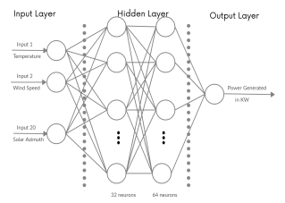
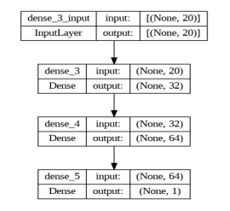
Model Configuration

Slide 9
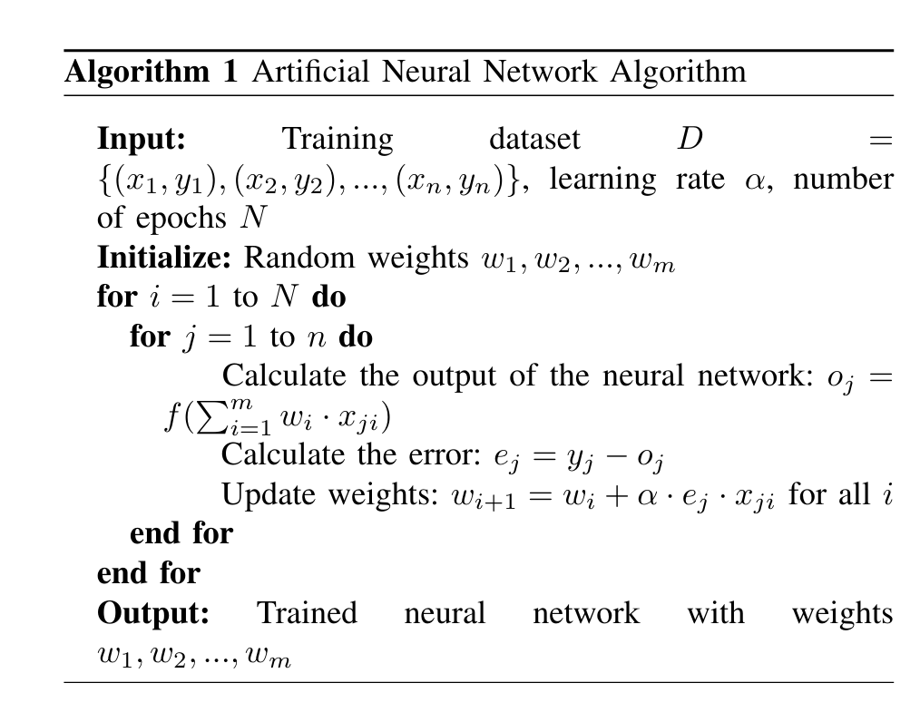
Training & Optimization :
The "early stopping" concept is a technique used in machine learning, particularly in the training of neural networks, to prevent overfitting and improve generalization performance. Overfitting occurs when a model learns to fit the training data too closely, capturing noise or random fluctuations rather than underlying patterns. This can lead to poor performance on unseen data.
Notes:
Input: The algorithm takes three inputs:
A training dataset D. This dataset consists of n data points, where each data point is a pair (xᵢ, yᵢ). Here, xᵢ is the input vector and yᵢ is the corresponding target output vector.
A learning rate α. This is a small value that controls how much the weights of the network are updated during training.
The number of epochs N. An epoch is one iteration through the entire training dataset.
Initialize: The algorithm starts by initializing the weights of the network to random values. These weights represent the strength of the connections between the neurons in the network.
For loop: The algorithm then iterates for a specified number of epochs (N).
Inner for loop: Within each epoch, the algorithm iterates over all the data points in the training dataset (n).
Calculate the output: For each data point, the algorithm calculates the output of the neural network (oⱼ) using an activation function f. The activation function is a mathematical function that introduces non-linearity into the network.
Calculate the error: The algorithm then calculates the error (eⱼ) for each data point. The error is the difference between the target output (yⱼ) and the actual output (oⱼ) of the network.
Update weights: The algorithm updates the weights of the network based on the calculated error. The update rule is based on the backpropagation algorithm, which is a gradient descent optimization algorithm. The learning rate (α) controls the step size of the update.
Output: After N iterations through the training dataset, the algorithm outputs the trained neural network with the final weights.

Slide 10
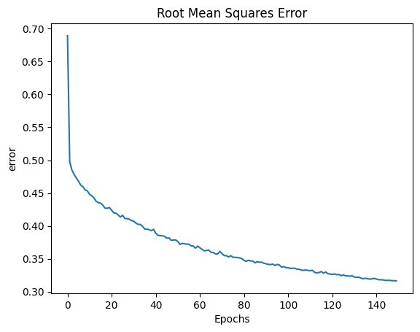
Training & Optimization :
The model is trained using Mean Squared Error (MSE) as the loss function, which measures the average squared difference between predicted and actual values.
The evaluation metric used during training is Root Mean Squared Error (RMSE), which provides a measure of the model’s prediction accuracy.

Slide 11
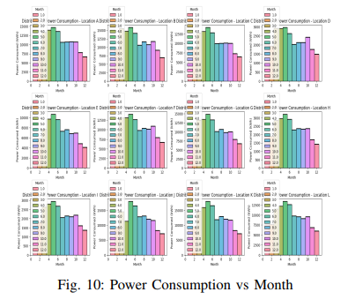
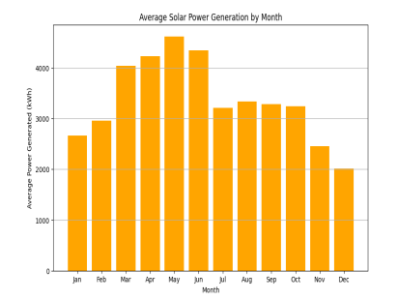
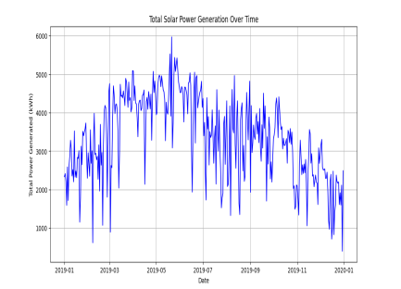
Visualization & Evaluation
Analysis of 12 locations (A-L) solar power consumption by each location along the duration of an year.
Analysis of average power generated by all locations over an year
Analysis of average power generation by all the location over the due time

Slide 12
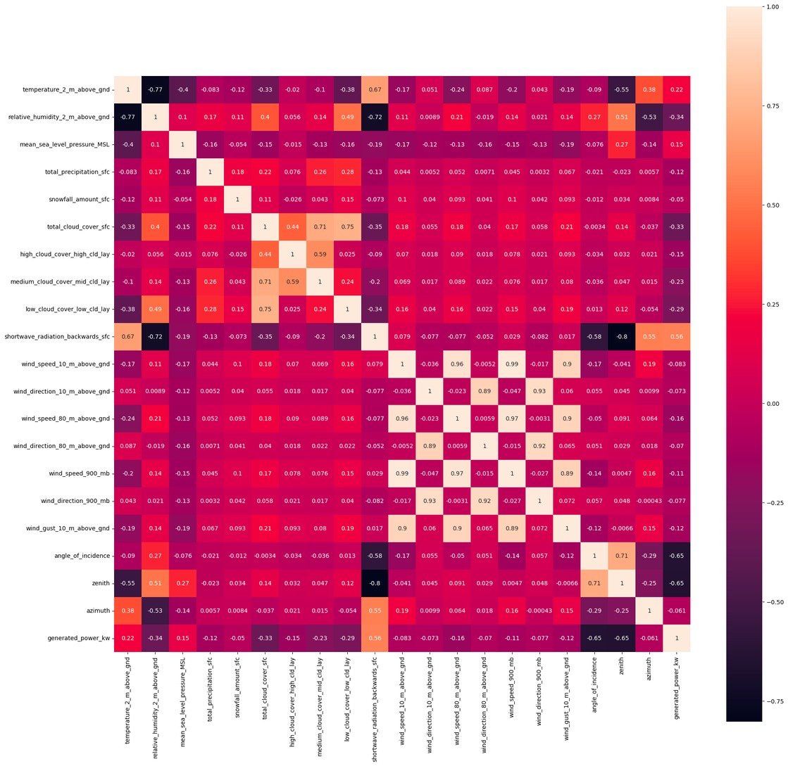
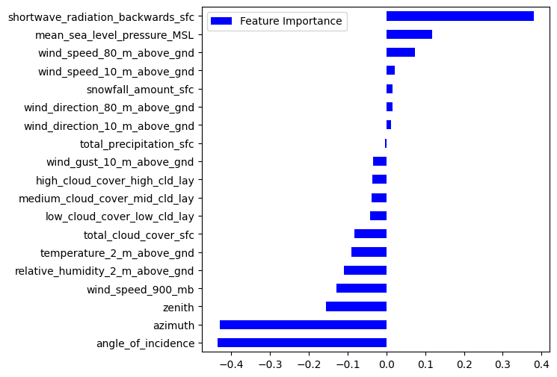
Feature Importance and Correlation
Feature Importance based on Lasso Coefficients
Correlation Heatmap using Seaborn

Slide 13
Conclusion
Our study has significantly contributed to advancing solar power forecasting accuracy through the utilization of machine learning techniques, particularly Artificial Neural Networks (ANN). By incorporating factors such as temperature, angle of incidence, zenith, and azimuth into our models, we have enhanced the prediction accuracy compared to previous methodologies.
One of the key highlights of our approach is the comprehensive evaluation framework we have employed, utilizing the Pearson Correlation Coefficient (PCC) and Hyperband optimization. These evaluation metrics provide a deeper understanding of model accuracy and efficiency, surpassing traditional methods used in previous studies.
This progress contributes significantly to a more sustainable energy landscape by offering a reliable and efficient approach to solar power forecasting, vital for grid stability and effective energy management.

Slide 14

Presented by Group-5
Thank you very much!

