Slide 1
TASK-2 (ETHICAL HACKING INTERNSHIP)
INTERNSHIP STUDIO

Slide 2
SECURITY VULNERABILITY REPORT
Title: Cross site scripting.
Domain: Vulnweb.com .
Sub-domain: http://testasp.vulnweb.com/

Slide 3
Steps to Reproduce:
1)Visit http://testasp.vulnweb.com/.
2)On the top menu, locate the search option.
3)Click on the search option to be prompted with a search box.
4)Click on the search box and input the following JavaScript payloads one by one:
<script>alert(document.cookie)</script>
<script>prompt(8)</script>
>&#x000003c<script>alert(2)</script>
5)Observe the resulting behavior where the payloads trigger alerts and prompts in the browser, indicating successful execution of the scripts.

Slide 4
Impact:
Cross Site Scripting (XSS) vulnerabilities can have severe consequences, including:
Data Theft: Malicious scripts can steal user data, such as cookies, session tokens, and personal information.
User Impersonation: Attackers can hijack user sessions, leading to unauthorized actions on behalf of the user.
Phishing Attacks: XSS can be used to redirect users to malicious websites, potentially capturing sensitive information.
Loss of User Trust: Repeated XSS attacks can damage the reputation of a web application and reduce user trust.

Slide 5
Mitigation: Mitigating XSS requires a combination of strategies tailored to the web application. The following measures are recommended:
Prohibit HTML Code in Inputs: Prevent users from entering HTML code into form inputs to reduce the risk of XSS attacks.
Validate Inputs: Implement strict validation to ensure form inputs meet specific criteria and reject any potentially harmful data.
Secure Your Cookies: Set secure attributes for cookies to prevent access through JavaScript. Use flags such as HttpOnly, Secure, and SameSite.
Sanitize Data: Sanitize all user inputs and outputs to remove or escape any harmful content. Utilize libraries like DOMPurify for sanitizing HTML.
Web Application Firewall (WAF): Deploy a WAF to detect and block abnormal server requests that may indicate an XSS attack. A WAF can also protect against other threats like SQL injection and DDoS attacks.

Slide 6
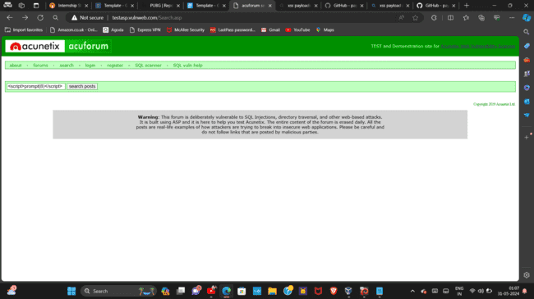
POC

Slide 7
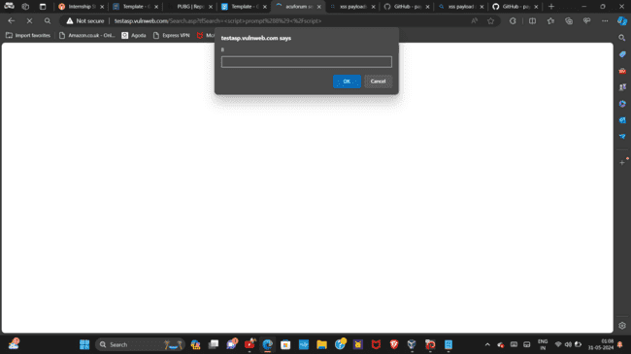

Slide 8
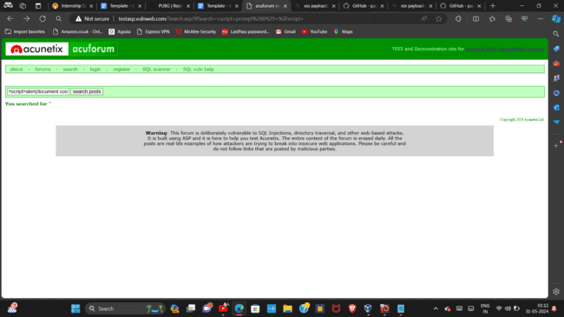

Slide 9
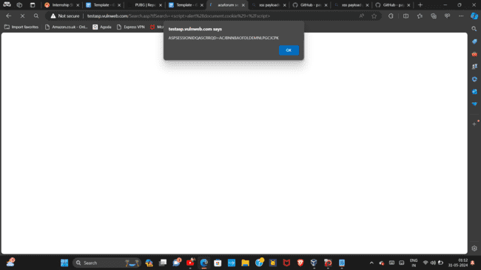

Slide 10
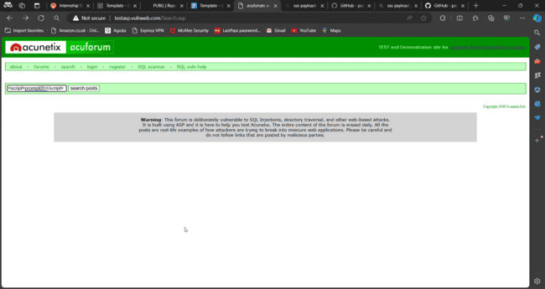

Slide 11
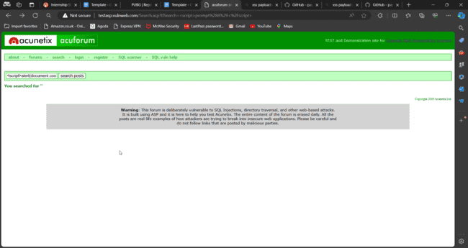

Slide 12
Conclusion:
This report outlines the presence of Cross Site Scripting (XSS) vulnerabilities on the sub-domain http://testasp.vulnweb.com/. By following the provided mitigation strategies, the risk of XSS attacks can be significantly reduced, enhancing the security and trustworthiness of the web application.

