Slide 1
Project 1: Data processing, analysis and visualization
Prashun Kafle

Slide 2

Introduction
The problem statement for this project is : Can different aircrafts land at Sioux Falls Regional Airport (KFSD) given their physical constraints?
The end goal is to find time periods when a given aircraft can land at the airport.

Slide 3
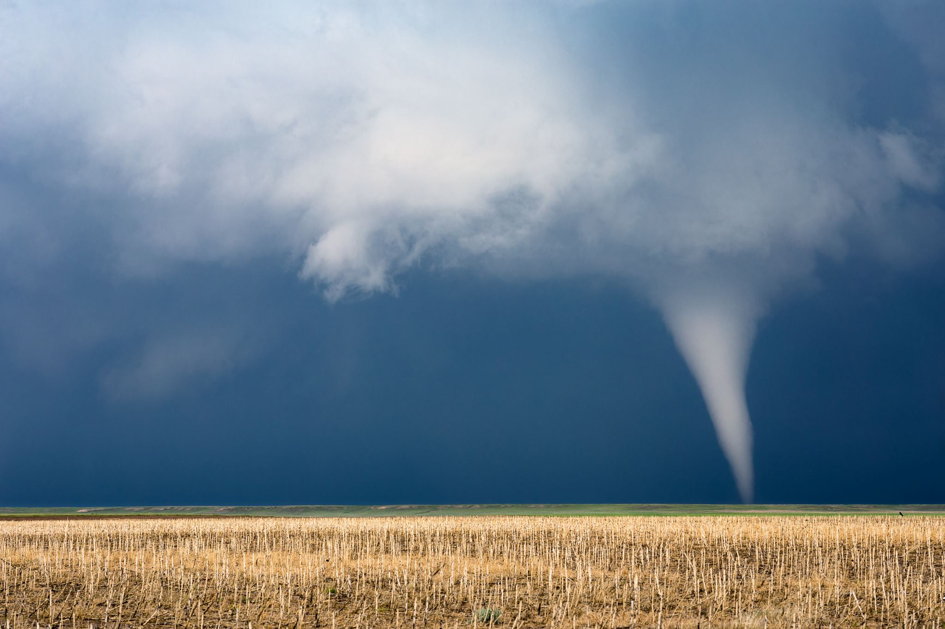
Data & Source
Source: Open-Meteo Forecast API(Hourly)
Coverage:
- 5 past days + next 16 days
Local timezone, temperature in F, wind in knots
Key Fields:
- Time(primary key), Temperature, Rain, Wind Gusts, Visibility, Cloud cover, Wind Speed, Wind Direction
Location: Sioux Falls Regional Airport (KFSD)

Slide 4
Methodology
Fetch hourly data using requests
Make a pandas DataFrame
Rename fields for better understanding
Safety classification function
Inputs: aircraft name + thresholds (wind warning, no-fly, snowfall, cloud, visibility, rain)
Output columns: Wind Gusts, Snowfall, Could Cover, Visibility, Rain, Classification

Slide 5

Aircraft Thresholds(Examples)
Aircraft limits vary; thresholds for the two examples are listed below:
Cessna 172
Warning when wind gusts > 17kts; No Fly > 20kts
Visibility limit: <5,000m No Fly
No precipitation (rain/snow) allowed
Schweizer SGS 2-23 (glider)
Warning when wind gusts > 15kts; No fly > 18kts
Stricter cloud cover constraints (cloud limit: 3)
No precipitation (rain/snow) allowed

Slide 6

Results & Interpretation
Cessna 172: Mostly Safe across the sample day; a few Warning or No Fly hours when gusts exceed limits
Schweizer SGS 2‑33: More frequent Warnings; several No-Fly periods under higher gusts
Wind gusts were the dominant driver; visibility/rain/snow rarely binding in the sample shown

Slide 7

Takeaways
Weather variability directly impacts small-aircraft landing feasibility
Approach is modular: plug in additional aircraft with custom limits
What else can be added for future additions:
Crosswind and runway orientation
METAR/TAF data from the airport for verification
Multi-day statistics

