Slide 1
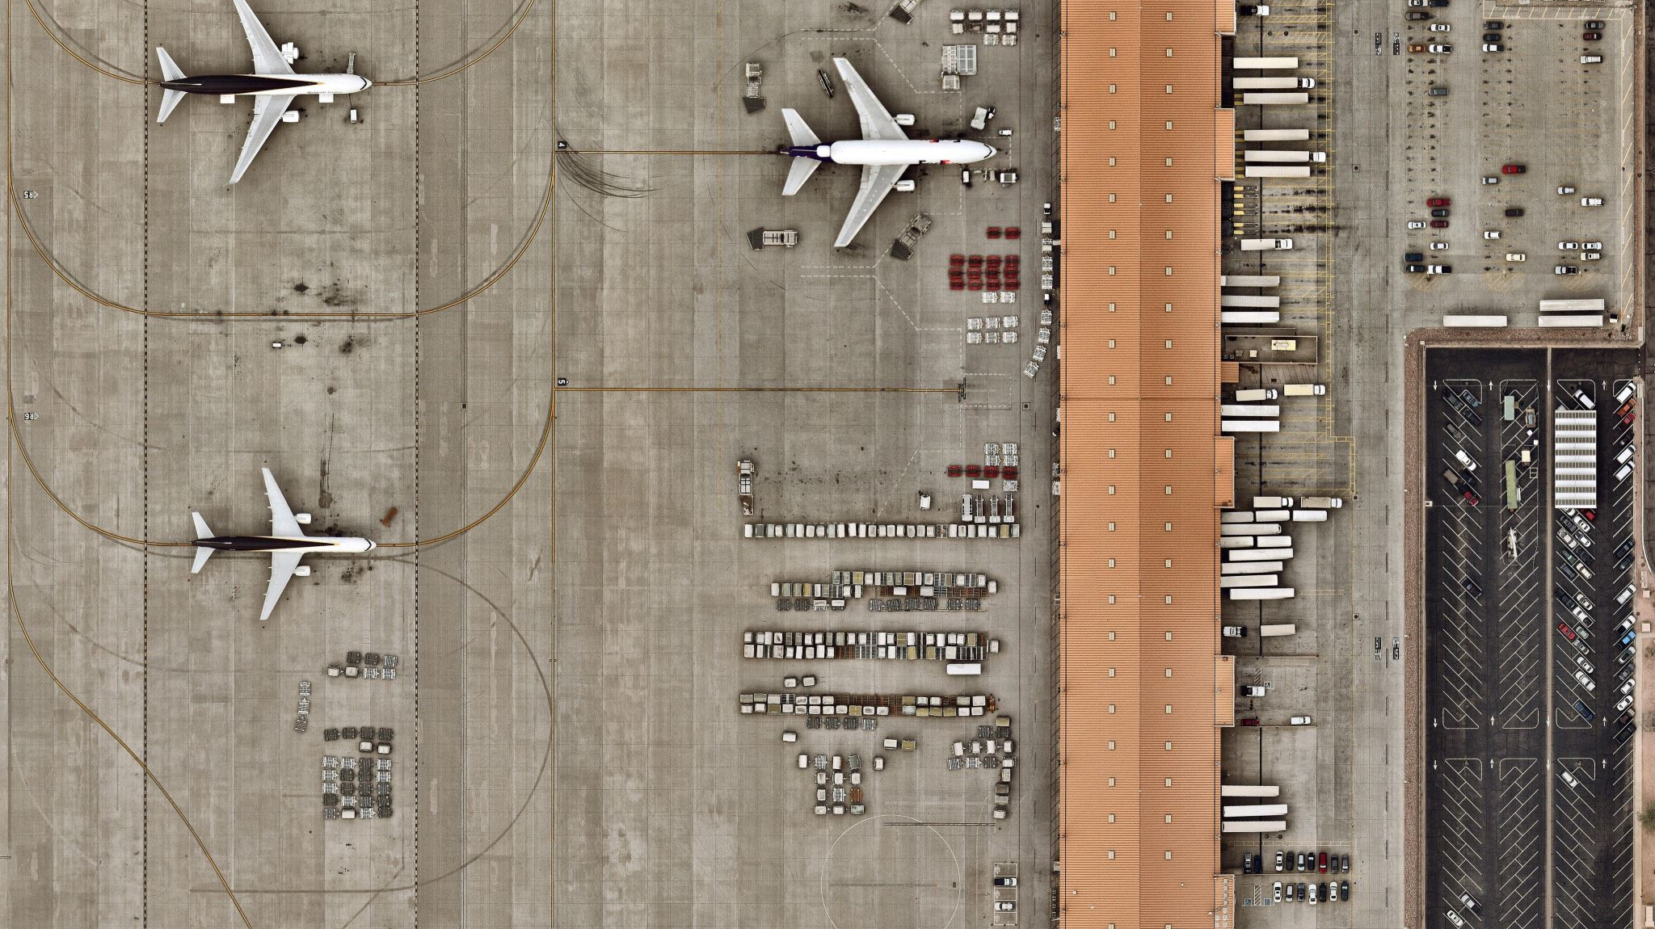
Project 2: Delta Air Lines Arrival Delay Analysis at San Francisco International Airport(SFO) (2024)
- Prashun Kafle
Notes:
Explain project focus: Delta arrival delays at SFO
Goal: understand delay patterns + financial impact

Slide 2
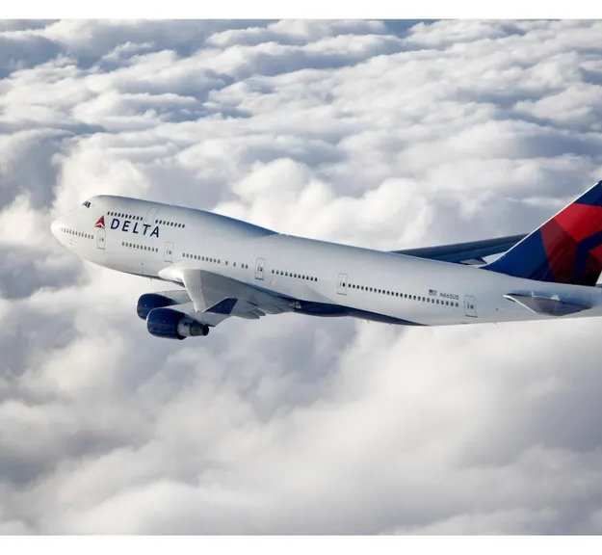
Problem statement
Analyze arrival delays at SFO
Identify major causes
See how delays change by month and time of day
Estimate the cost of avoidable delays
Notes:
What causes Delta delays at SFO?
Do delays vary by month or hour?
Which delays are avoidable?
How much would vouchers cost Delta?

Slide 3
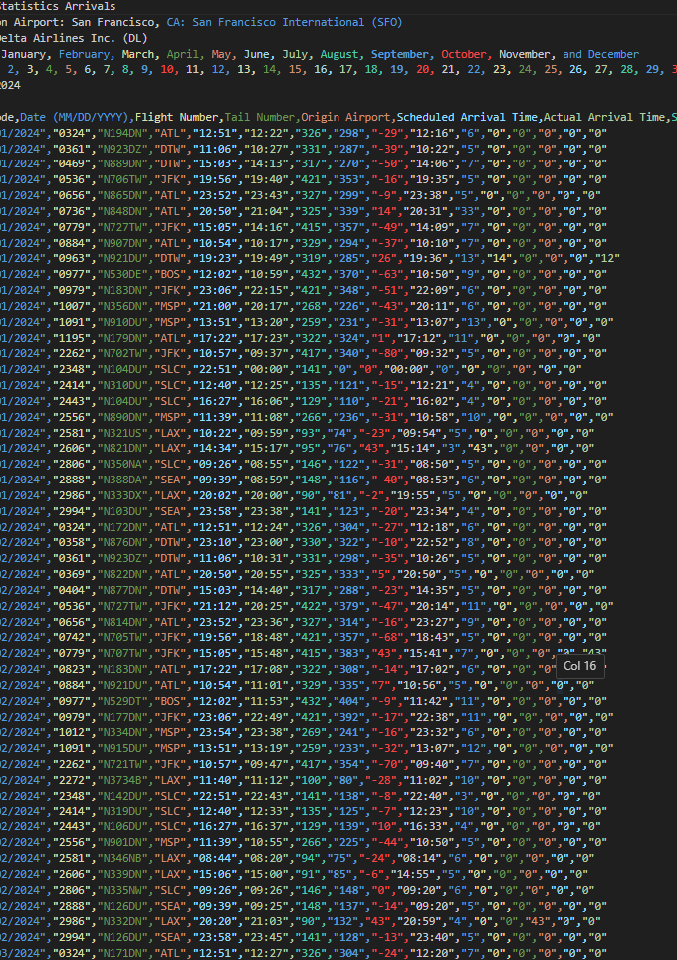
Dataset
Source: BTS Detailed Statistics – Arrivals
Filters: Delta (DL), San Francisco International Airport(SFO),2024
Includes arrival times, delays, and delay causes
Contains about 12880 rows of data after removing the metadata and cleaning.
Notes:
Data from the US Bureau of Transportation Statistics
Filters: delta, sfo, 2024 full year
Includes all the arrival times, delays, and delay causes
Contains about 12880 rows of data after removing the metadata and cleaning.

Slide 4
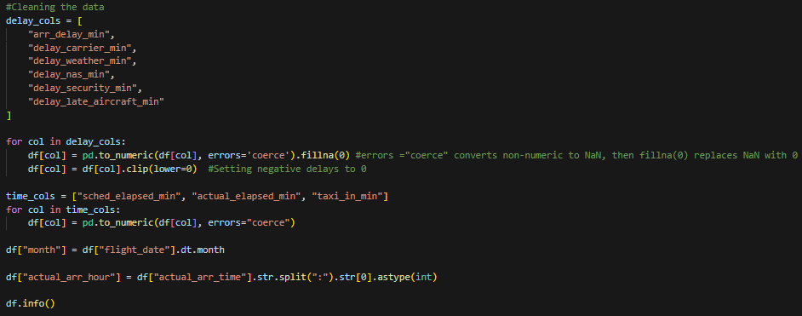
Data Cleaning
Removed metadata row
Renamed columns
Converted dates/times
Fixed delay values
Added month and hour fields
Notes:
Removed 7 metadata rows + bottom row
Renamed columns
Converted dates/times to usable formats
Fixed numeric delay fields
Added month + arrival hour columns

Slide 5
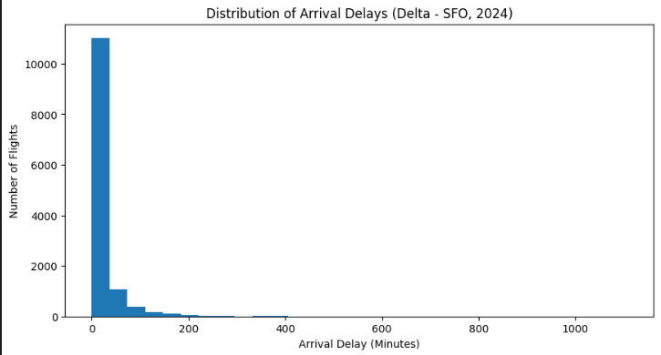
Data Analysis
Most delays are small
Some extreme outliers
Average delay = 18 min
Heavy right-skew
Notes:
Most delays are small
Average delay ≈ 18 minutes (1106minutes/18 hours outlier)
Delay distribution is highly skewed
A few extreme delays inflate the average

Slide 6
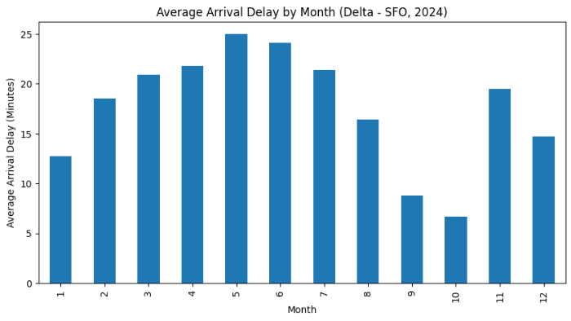
Monthly Trends
Delays are highest in May-June
Lowest in early fall
Notes:
Highest delays in May–June makes sense as San Francisco sees a lot of traffic during summer
Lowest delays in fall
Clear seasonal pattern

Slide 7
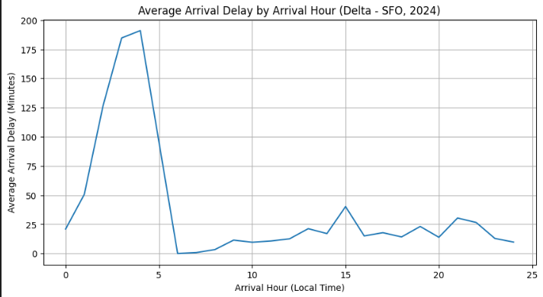
Hour-of-Day Trends
Huge delays in early morning (1-4 AM)
Due to spillover from overnight disruptions
Notes:
Large delays from 1–4 AM
Caused by overnight spillover delays
Daytime delays are moderate

Slide 8
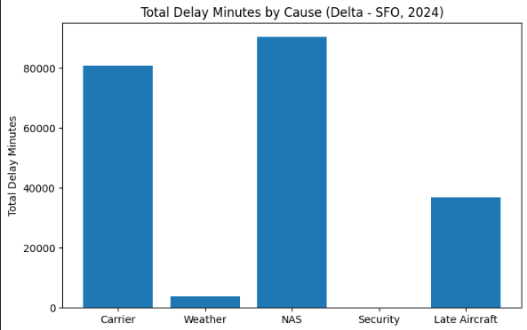
Delay Causes
Biggest Contributors:
NAS(National Airspace System) Delays
Carrier delays
Late aircraft
Minimal Contributors:
Weather
Security
Notes:
Top contributors: NAS, Carrier, Late Aircraft
Weather delays minimal
Operational issues dominate

Slide 9
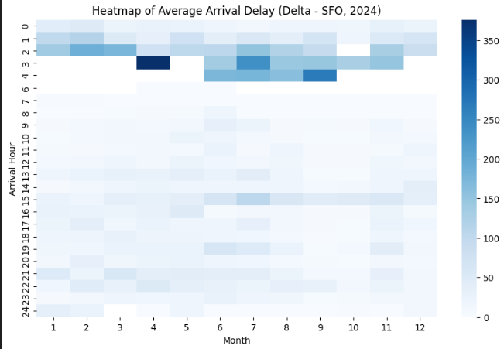
Heatmap Summary
Confirms morning delay spikes
Mid-year months show the highest intensity
Notes:
Confirms early-morning delay spike
Mid-year months show higher intensity
Supports previous visuals

Slide 10
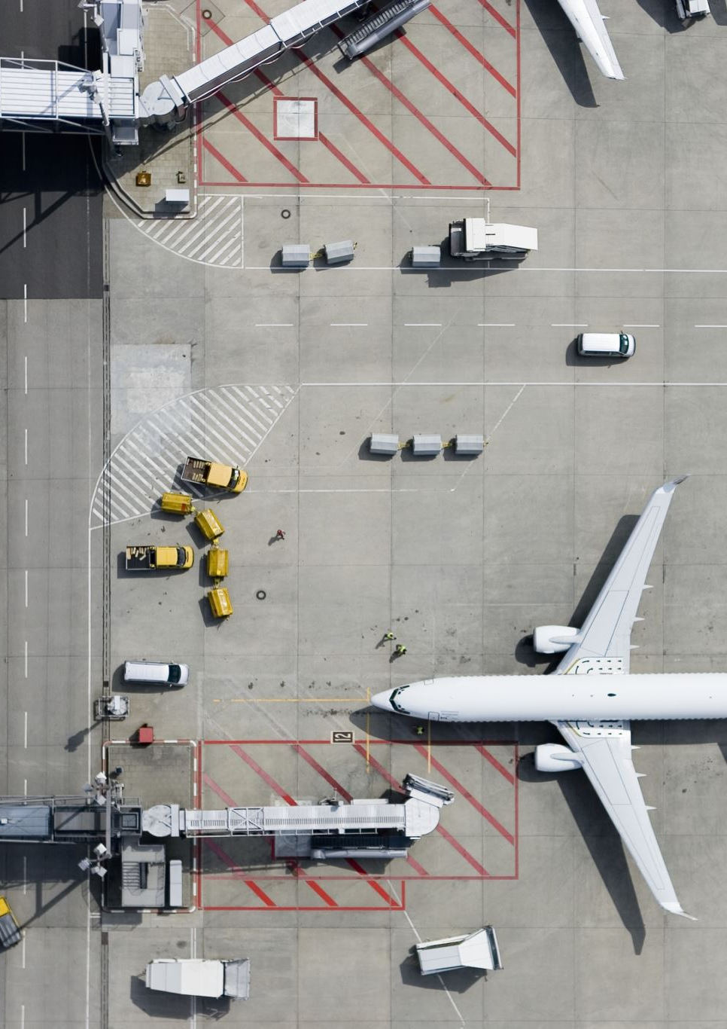
Avoidable Delay Cost
Avoidable = carrier + late aircraft
3+ hour delay = meal voucher
6+ hour delay = meal + hotel
Average of 140 passengers per flight
Food: $30 and Hotel: $150
Notes:
Avoidable = Carrier + Late Aircraft
3 hrs → meal voucher
6 hrs → meal + hotel
Avg 140 passengers/flight
Food = $30, Hotel = $150

Slide 11
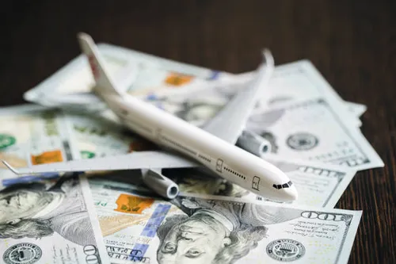
Cost Results
Estimated compensation total ≈ $1,012,000
Most costs come from long carrier/late aircraft delays
Notes:
Total estimated cost ≈ $1,012,000
Driven by long controllable delays
Financial impact is significant

Slide 12
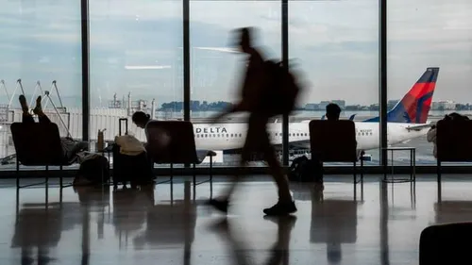
Overall Insights
Delays spike in summer and early mornings
Operational delays dominate
Avoidable delays are costly
Over $1M in compensation due to ill and unforeseen management
Notes:
Delay peaks in summer
Worst delays occur early morning
Operational delays dominate causes
Avoidable delays exceed $1M in costs

