Slide 1
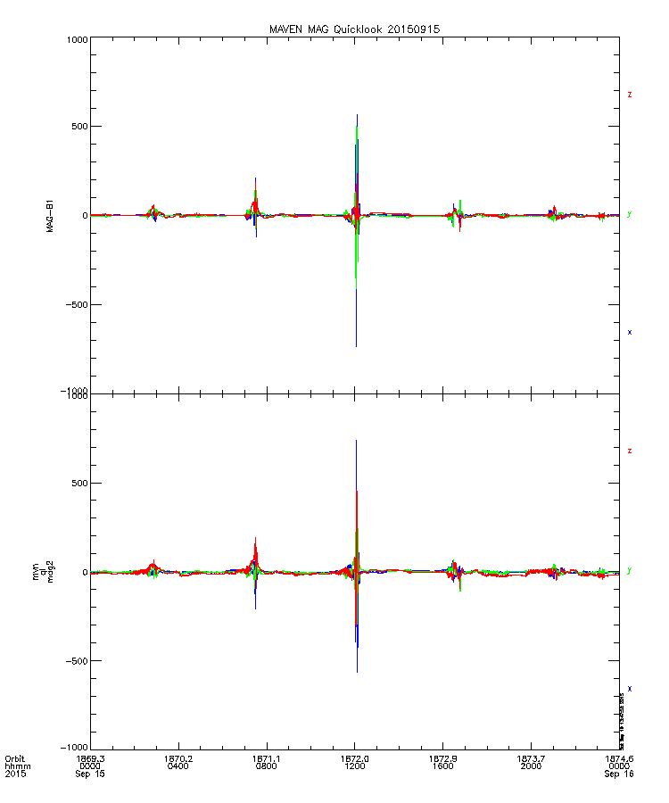
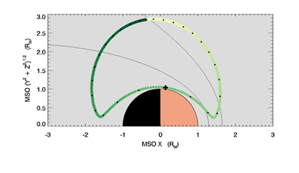
https://lasp.colorado.edu/maven/sdc/public/pages/plots/ql_is/ql_is.html
https://lasp.colorado.edu/maven/sdc/public/pages/plots/ql_orb/index.html
Night-side orbit within magnetosphere
Data base with magnetic field measurements:
https://pds-ppi.igpp.ucla.edu/search/view/?f=yes&id=pds://PPI/maven.mag.calibrated/data/pc/1sec/2015/09/mvn_mag_l2_2015258pc1s_20150915_v01_r01&o=1
We are interested in X,Y,Z components in Spacecraft position X-component in Planetocentric coordinate system.
Dayside magnetic barrier

