Slide 1

Industrial Training Presentation
Student Record Management System Using Blockchain Technology
Presented by
PRASOON KUMAR
Reg. No.: 202400706
B.Tech — Computer Science and Engineering
Sikkim Manipal Institute of Technology
Industrial Training Provider: Udemy
Academic Year: 2026

Slide 2
ABSTRACT
Developed a basic blockchain-based Student Record Management System as part of industrial training.
Combined HTML, CSS, JavaScript, Solidity, Ethers.js, and MetaMask.
Designed a website to store and retrieve student academic information through a smart contract.
Implemented student record fields such as name, roll number, registration number, department, semester, CGPA, and wallet address.
Tested the basic record storage and retrieval functionality through the website.
Gained practical knowledge of web development, smart contracts, blockchain interaction, and debugging.

Slide 3
Table of Content
S.NO. | TITLE | PAGE NO.
1. | Project Introduction | 4
2. | Problem Statement and Objective | 5
3. | Technologies Used | 6
4. | System Architecture | 7
5. | Working Methodology | 8
6. | Project Implementation | 9
7. | Smart Contract and Blockchain Interaction | 10
8. | Project Demonstration | 11-12
9. | Testing and Results | 13-14
10. | Challenges and Solutions | 15
11. | Learning Outcomes and Limitations | 16
12. | Conclusion | 17

Slide 4
Project Introduction
Project Title
Student Record Management System Using Blockchain Technology
Project Overview
A basic website for storing and retrieving student academic records.
Uses a Solidity smart contract for record management.
The frontend is developed using HTML, CSS, and JavaScript.
Ethers.js connects the website with the smart contract.
MetaMask is used for wallet connection and transaction authorization.
Stored Information
Student name
Roll number
Registration number
Department
Semester
CGPA
Wallet address

Slide 5
Problem Statement and Objectives
Problem Statement
To develop a simple web-based system that stores and retrieves student academic information using a Solidity smart contract.
Objectives
Develop a basic student record management website.
Understand the fundamentals of Solidity programming.
Connect the website with a smart contract.
Store student academic information.
Retrieve previously stored student records.
Gain practical experience in blockchain application development.

Slide 6
Technologies Used
Technology | Purpose
HTML | Website structure
CSS | Website styling
JavaScript | Website functionality
Solidity | Smart contract development
Ethers.js | Website–contract communication
MetaMask | Wallet connection and authorization
Remix IDE | Smart contract development and testing
Ethereum-compatible blockchain | Smart contract execution and record storage

Slide 7
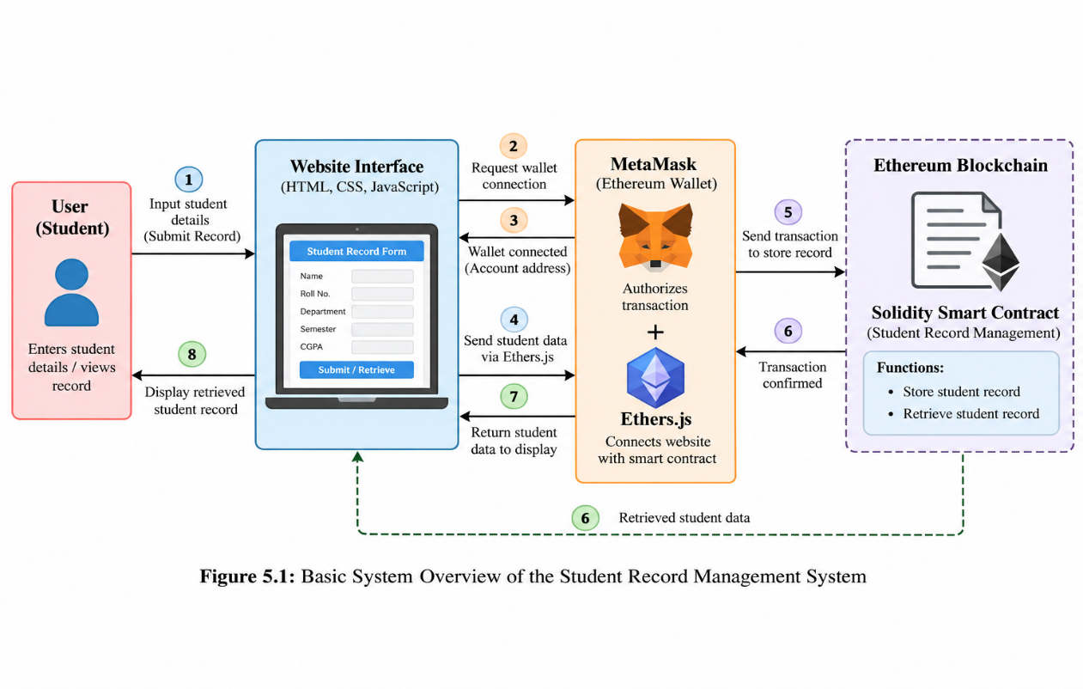
System Architecture
Main Components
Website Interface
JavaScript Functionality
MetaMask
Ethers.js
Solidity Smart Contract
Blockchain Storage
System Flow
User → Website Interface → Ethers.js / MetaMask → Solidity Smart Contract → Record Storage / Retrieval

Slide 8
Working Methodology
Development Process
Studied basic web development concepts.
Learned Solidity and smart contract fundamentals.
Designed the website interface.
Developed the student record smart contract.
Connected the frontend with the smart contract.
Tested record storage and retrieval.
Reviewed the working application.
Methodology
Learning → Development → Integration → Testing → Review

Slide 9
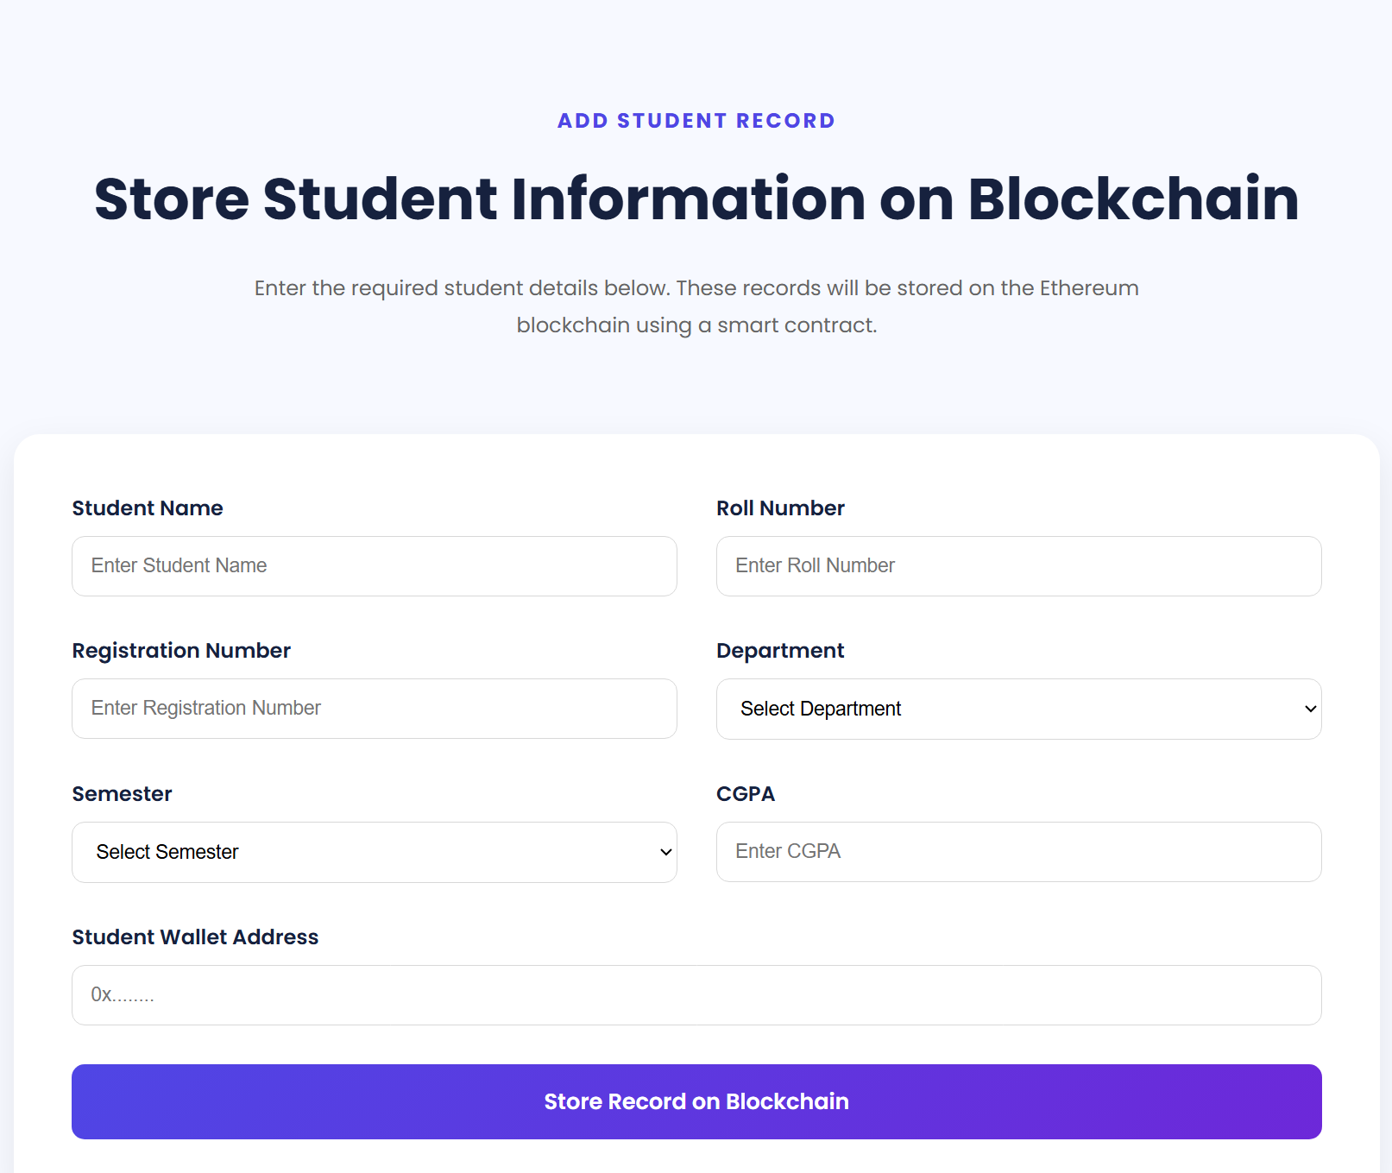
Project Implementation
Website Interface
Developed using HTML and CSS.
Provides the basic project interface.
Includes wallet connection functionality.
Provides access to student record operations.
Student Record Form
The form accepts:
  Student name
  Roll number
  Registration number
  Department
  Semester
  CGPA
  Wallet address

Slide 10
Smart Contract and Blockchain Interaction
Smart Contract
Developed using Solidity.
Provides functionality for adding student records.
Provides functionality for retrieving stored records.
Manages student information through contract functions.
Blockchain Interaction
User enters student information.
JavaScript collects the form data.
Ethers.js communicates with the smart contract.
MetaMask authorizes the transaction.
The smart contract processes the record.
The website displays the relevant result.

Slide 11
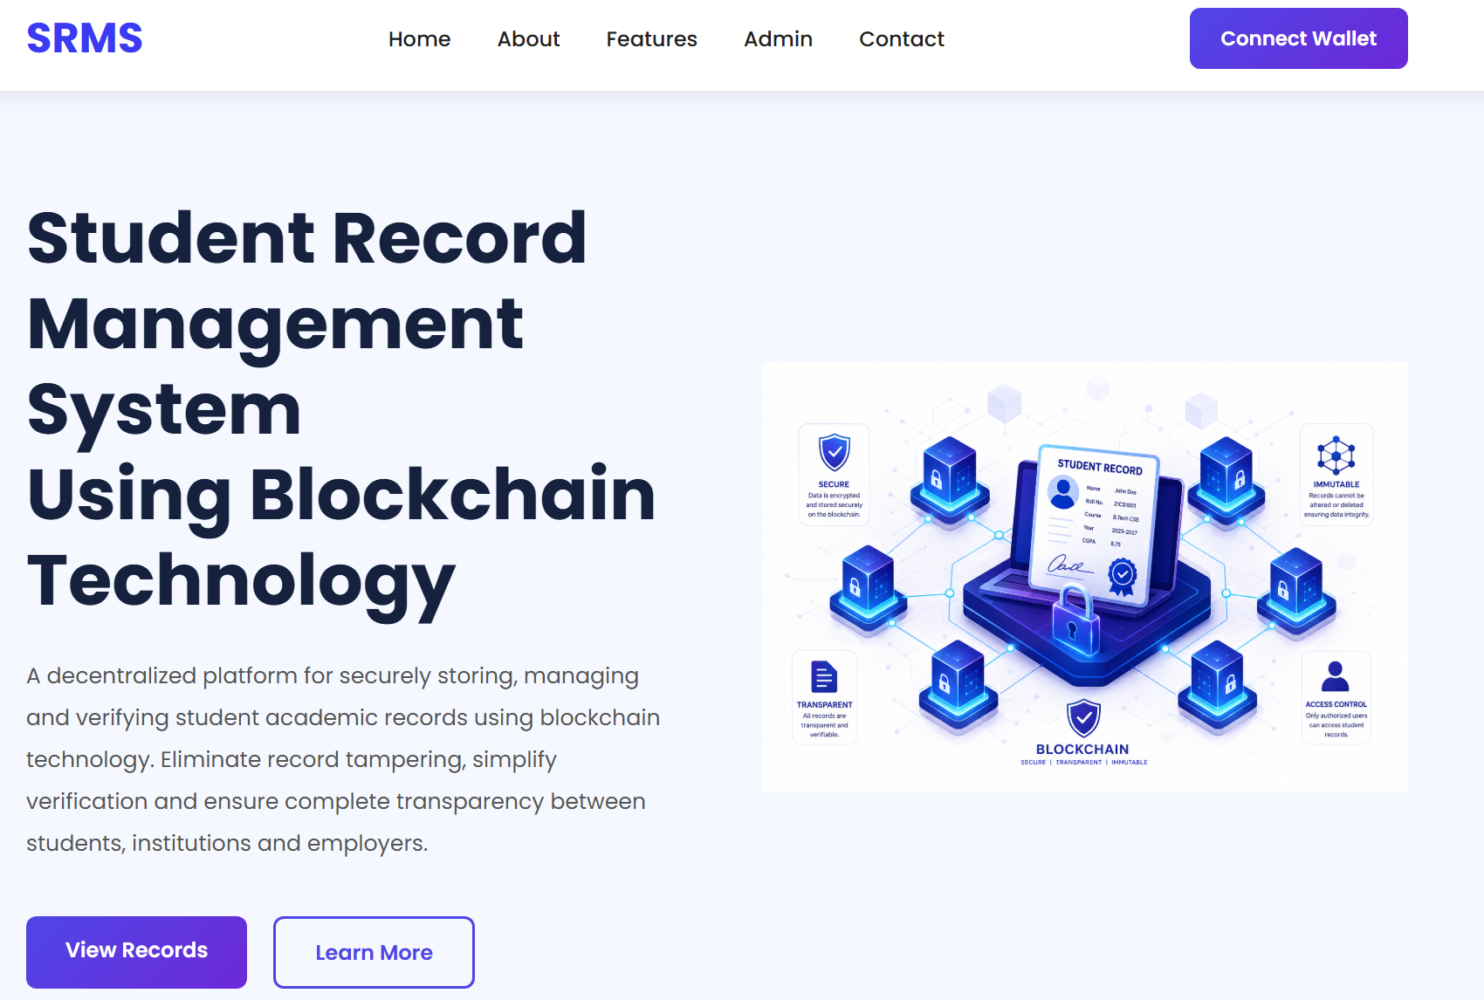
Project Demonstration
Fig 1: Website homepage.
Fig 2: Student record input form.

Slide 12
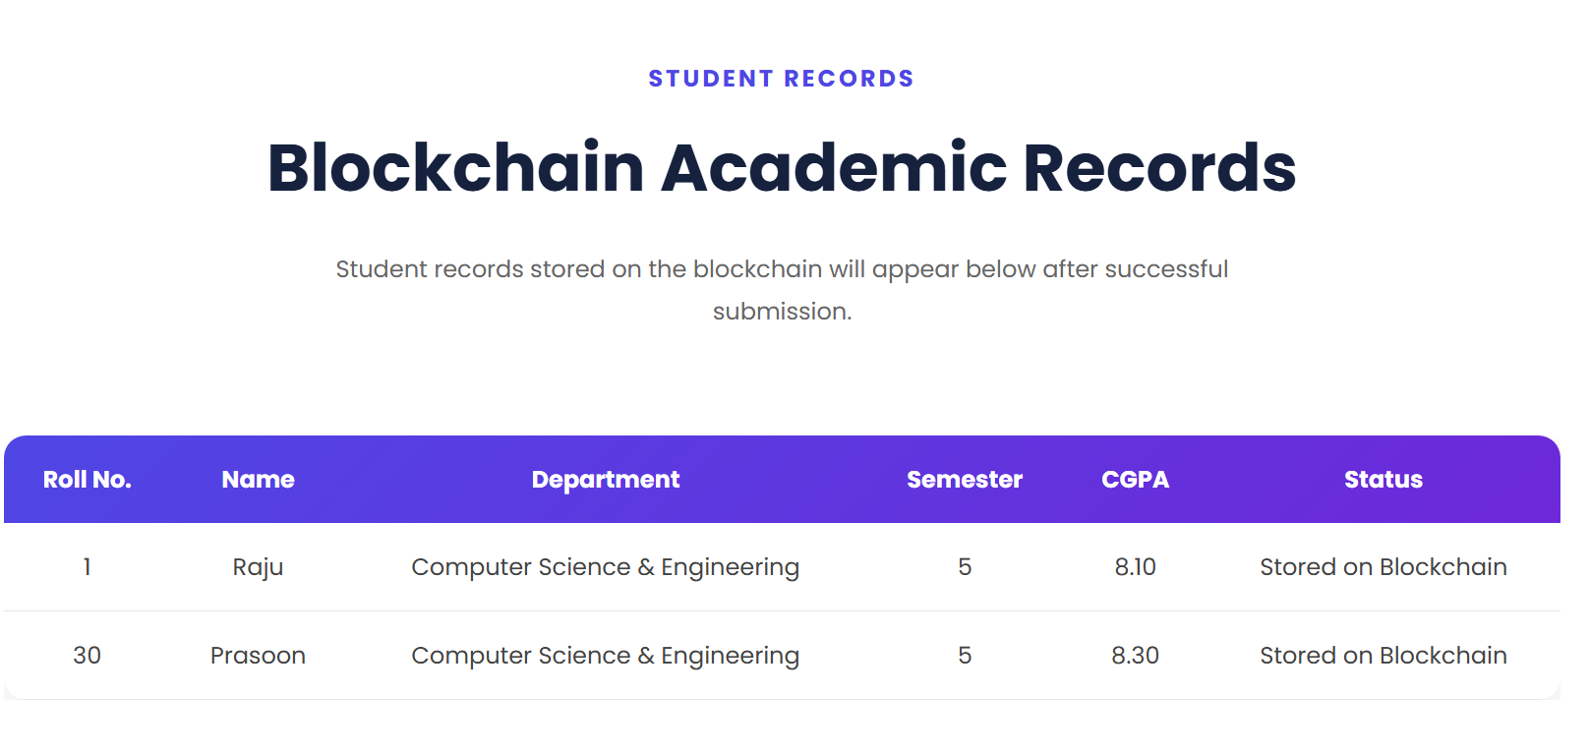
Fig 3: Retrieved student record.

Slide 13
Testing and Results
Testing Performed
Website opening.
MetaMask connection.
Student detail entry.
Student record submission.
Smart contract record storage.
Retrieval of existing records.
Display of retrieved information.
Testing Summary
Test Area | Result
Website interface | Pass
MetaMask connection | Pass
Record submission | Pass
Record storage | Pass
Record retrieval | Pass
Data display | Pass

Slide 14
Testing Results
The testing process focused on the main functionality of the website.
The wallet connection was tested to verify that the website could interact with MetaMask. The record storage functionality was checked by submitting student information through the form. The retrieval functionality was tested by requesting a previously stored student record.

Slide 15
Challenges and Solutions
Challenge | Solution
Connecting the website with MetaMask | Verified wallet connection and network settings
Configuring the smart contract | Checked contract address and ABI
Frontend–contract communication | Reviewed JavaScript and Ethers.js integration
Understanding transaction processing | Tested the submission and confirmation process
Retrieving stored records | Checked the retrieval function and displayed results

Slide 16
Learning Outcomes and Limitations
Learning Outcomes
Improved HTML, CSS, and JavaScript knowledge.
Learned basic Solidity programming.
Understood smart contract functionality.
Learned to connect a website with a blockchain.
Gained experience using MetaMask and Ethers.js.
Improved debugging and testing skills.
Project Limitations
Basic demonstration system.
Limited record management functionality.
No advanced authentication system.
Not a complete university-level student database.
Limited privacy and institutional integration features.

Slide 17
Conclusion
The industrial training provided practical knowledge of web development and Solidity programming.
The acquired knowledge was applied to develop a basic blockchain-based student record management system.
The project demonstrates student record storage and retrieval through a website and smart contract.
The training improved practical skills in frontend development, blockchain interaction, debugging, and testing.

Slide 18
THANKYOU

