Slide 1
On Reorienting Linked Rigid Bodies Using Internal Motions
Gregory C. Walsh and S. Shankar Sastry

Slide 2





3 Link System
Configuration Space Q= ${SO(3)}^{3}×R^{3}$
$$SO(3)$$
$$SO(3)$$
z
$$SO(3)$$
$$\vec{c}$$
y
x

Slide 3
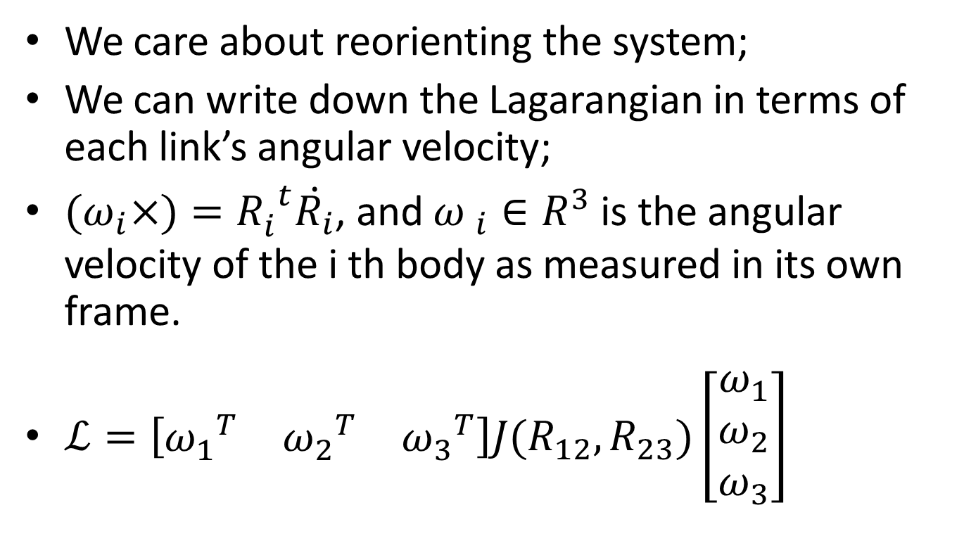
Linear and Angular Momentum Conservation
We care about reorienting the system;
We can write down the Lagarangian in terms of each link’s angular velocity;
${(ω}_{i}×)={R_{i}^{}}_{}^{t}\dot{R_{i}}$, and ${ω }_{i}∈R^{3}$ is the angular velocity of the i th body as measured in its own frame.
$ℒ=\left[\begin{matrix}{ω_{1}}^{T} & {ω_{2}}^{T} & {ω_{3}}^{T}\end{matrix}\right]J(R_{12},R_{23})\left[\begin{matrix}ω_{1} \\ ω_{2} \\ ω_{3}\end{matrix}\right]$

Slide 4
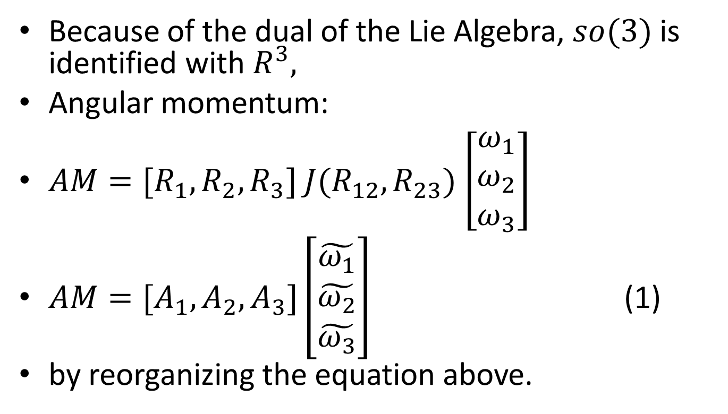
Angular Momentum
Because of the dual of the Lie Algebra, $so(3)$ is identified with $R^{3},$
Angular momentum:
$AM=[R_{1},R_{2},R_{3}]$ $J(R_{12},R_{23})$ $\left[\begin{matrix}ω_{1} \\ ω_{2} \\ ω_{3}\end{matrix}\right]$
$AM=[A_{1},A_{2},A_{3}]\left[\begin{matrix}\tilde{ω_{1}} \\ \tilde{ω_{2}} \\ \tilde{ω_{3}}\end{matrix}\right]$ (1)
by reorganizing the equation above.

Slide 5
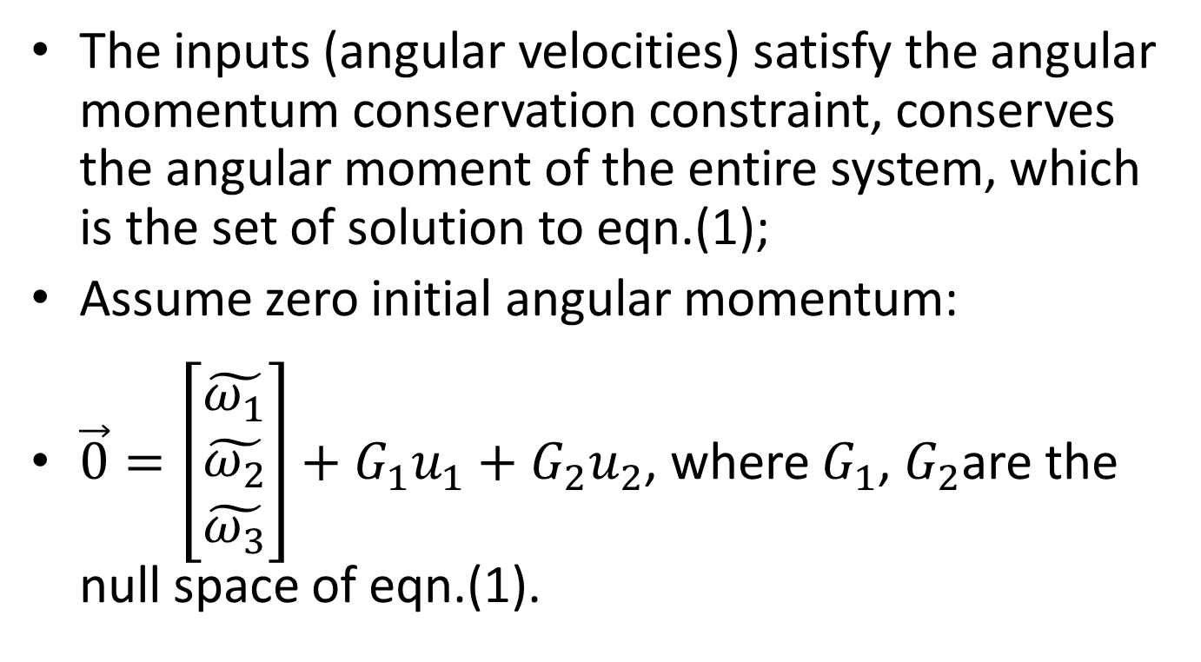
Angular Momentum Conservation Constraint
The inputs (angular velocities) satisfy the angular momentum conservation constraint, conserves the angular moment of the entire system, which is the set of solution to eqn.(1);
Assume zero initial angular momentum:
$\vec{0}=\left[\begin{matrix}\tilde{ω_{1}} \\ \tilde{ω_{2}} \\ \tilde{ω_{3}}\end{matrix}\right]+G_{1}u_{1}+G_{2}u_{2}$, where $G_{1}$, $G_{2}$are the null space of eqn.(1).

Slide 6



The Planar Skater
$$u_{1}=\dot{{ψ }_{1}}$$
$$u_{2}=\dot{{ψ }_{2}}$$
$$\dot{{ψ }_{3}}$$
$u_{1}$ and $u_{2}$ are two scalars for the planar skater case.

Slide 7
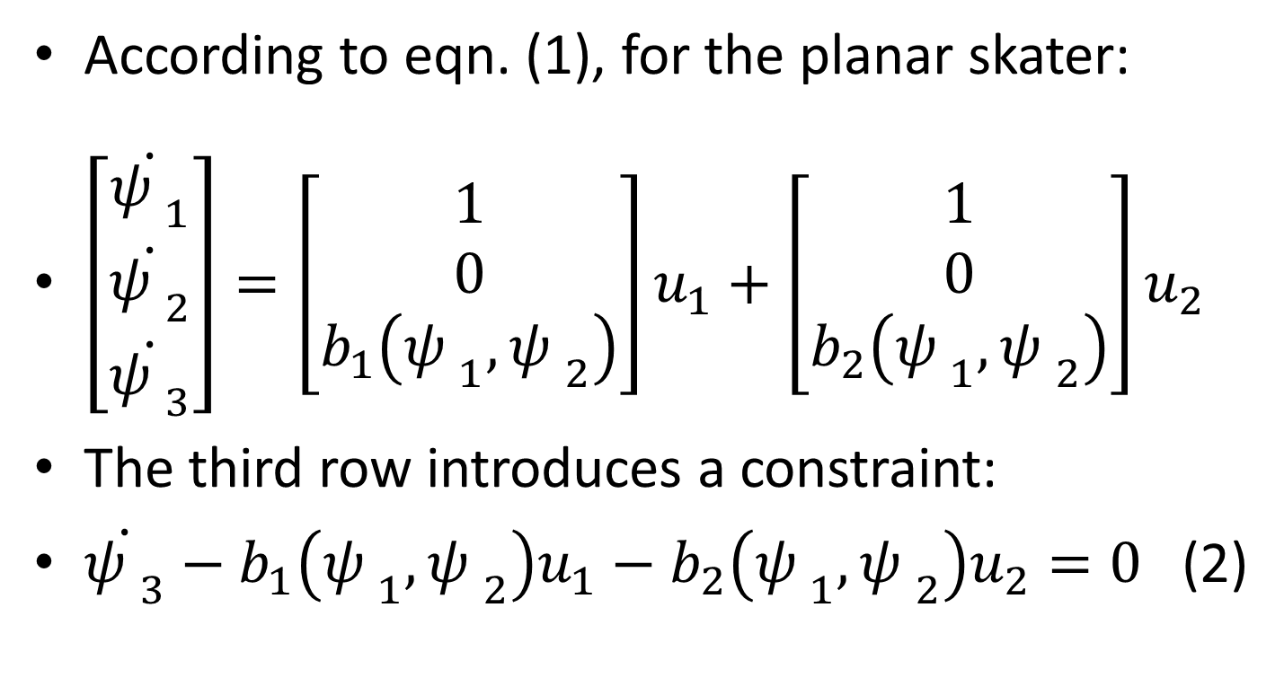
Movement in the Plane
According to eqn. (1), for the planar skater:
$\left[\begin{matrix}\dot{{ψ }_{1}} \\ \dot{{ψ }_{2}} \\ \dot{{ψ }_{3}}\end{matrix}\right]=\left[\begin{matrix}1 \\ 0 \\ b_{1}\left({ψ }_{1},{ψ }_{2}\right)\end{matrix}\right]u_{1}+\left[\begin{matrix}1 \\ 0 \\ b_{2}\left({ψ }_{1},{ψ }_{2}\right)\end{matrix}\right]u_{2}$
The third row introduces a constraint:
$\dot{{ψ }_{3}}−b_{1}\left({ψ }_{1},{ψ }_{2}\right)u_{1}−b_{2}\left({ψ }_{1},{ψ }_{2}\right)u_{2}=0$(2)

Slide 8
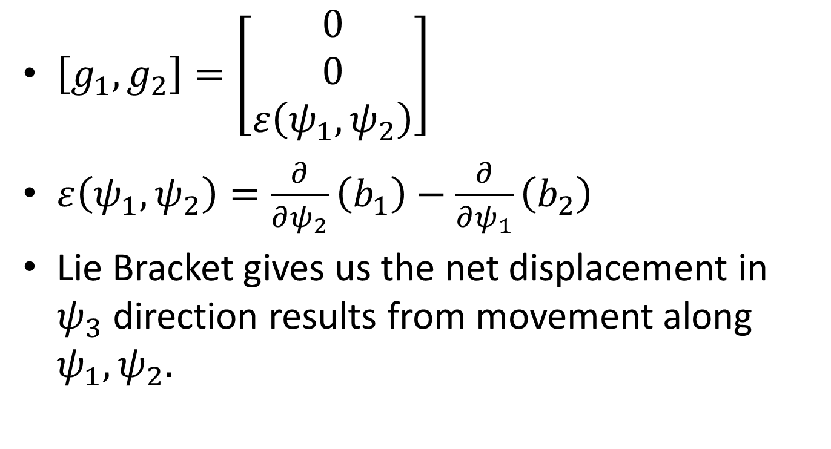
Lie Bracket
$\left[g_{1},g_{2}\right]=\left[\begin{matrix}0 \\ 0 \\ ε\left(ψ_{1},ψ_{2}\right)\end{matrix}\right]$
$ε\left(ψ_{1},ψ_{2}\right)=\frac{∂}{∂ψ_{2}}\left(b_{1}\right)−\frac{∂}{∂ψ_{1}}\left(b_{2}\right)$
Lie Bracket gives us the net displacement in $ψ_{3}$ direction results from movement along $ψ_{1},ψ_{2}.$

Slide 9
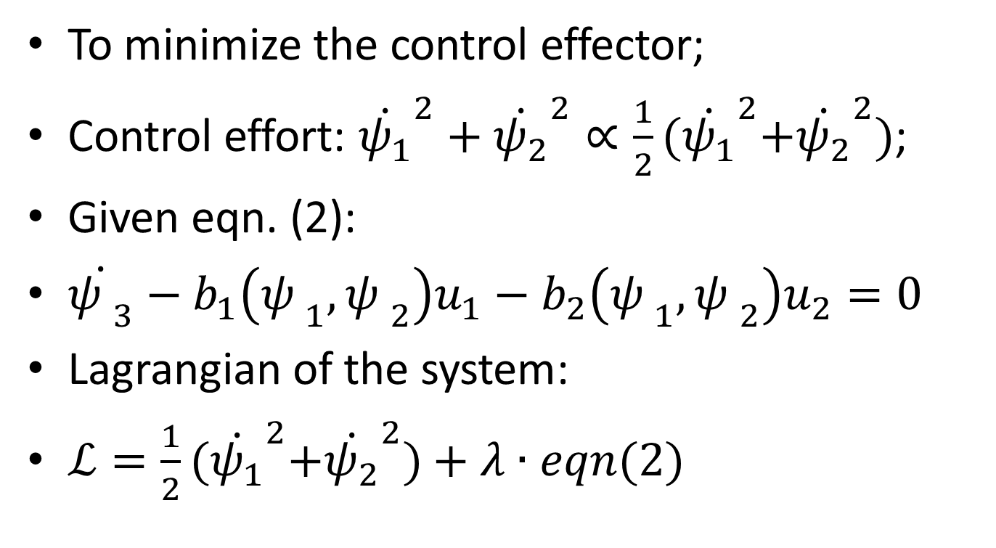
Optimal Control Inputs
To minimize the control effector;
Control effort: ${\dot{ψ_{1}}}^{2}+{\dot{ψ_{2}}}^{2}∝\frac{1}{2}{(\dot{ψ_{1}}}^{2}+{\dot{ψ_{2}}}^{2})$;
Given eqn. (2):
$\dot{{ψ }_{3}}−b_{1}\left({ψ }_{1},{ψ }_{2}\right)u_{1}−b_{2}\left({ψ }_{1},{ψ }_{2}\right)u_{2}=0$
Lagrangian of the system:
$ℒ=\frac{1}{2}{(\dot{ψ_{1}}}^{2}+{\dot{ψ_{2}}}^{2})+λ∙eqn(2)$

Slide 10
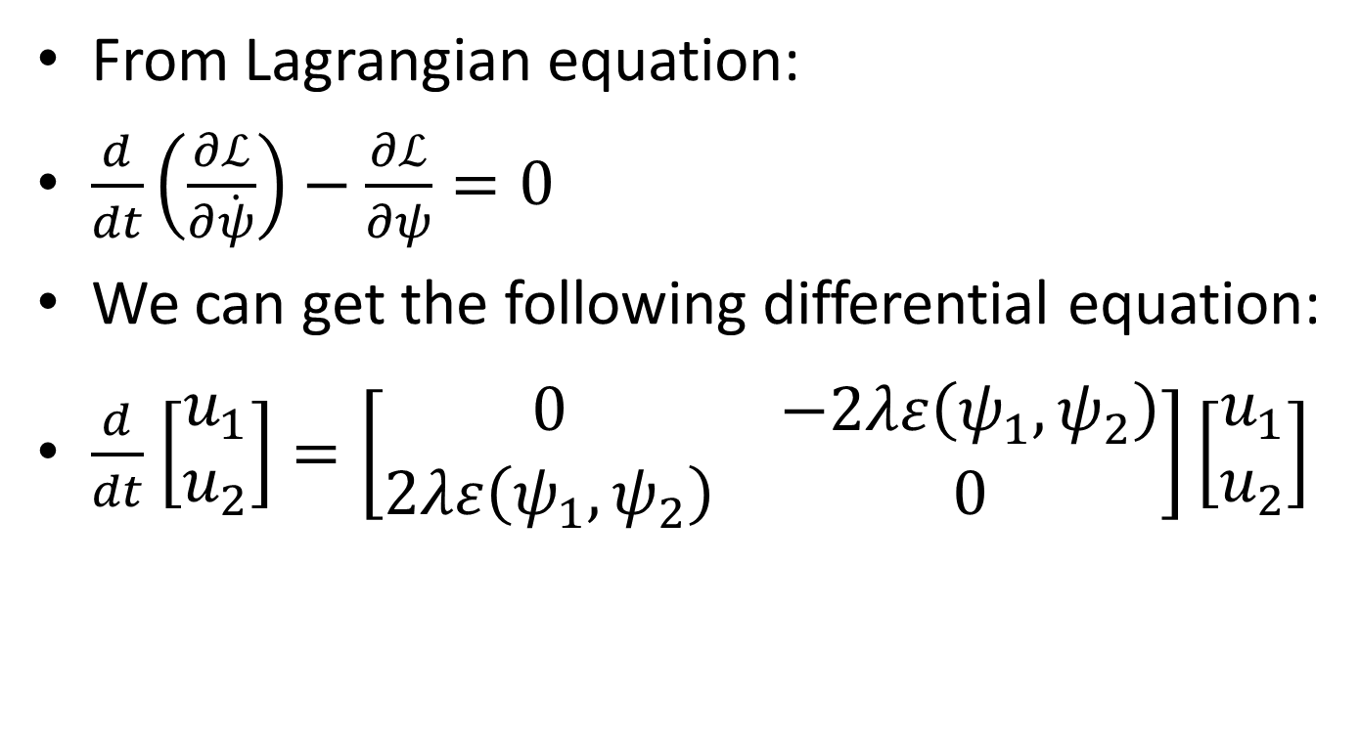
Optimal Control
From Lagrangian equation:
$\frac{d}{dt}\left(\frac{∂ℒ}{∂\dot{ψ}}\right)−\frac{∂ℒ}{∂ψ}=0$
We can get the following differential equation:
$\frac{d}{dt}$ $\left[\begin{matrix}u_{1} \\ u_{2}\end{matrix}\right]=\left[\begin{matrix}0 & −2λε\left(ψ_{1},ψ_{2}\right) \\ 2λε\left(ψ_{1},ψ_{2}\right) & 0\end{matrix}\right]\left[\begin{matrix}u_{1} \\ u_{2}\end{matrix}\right]$

Slide 11
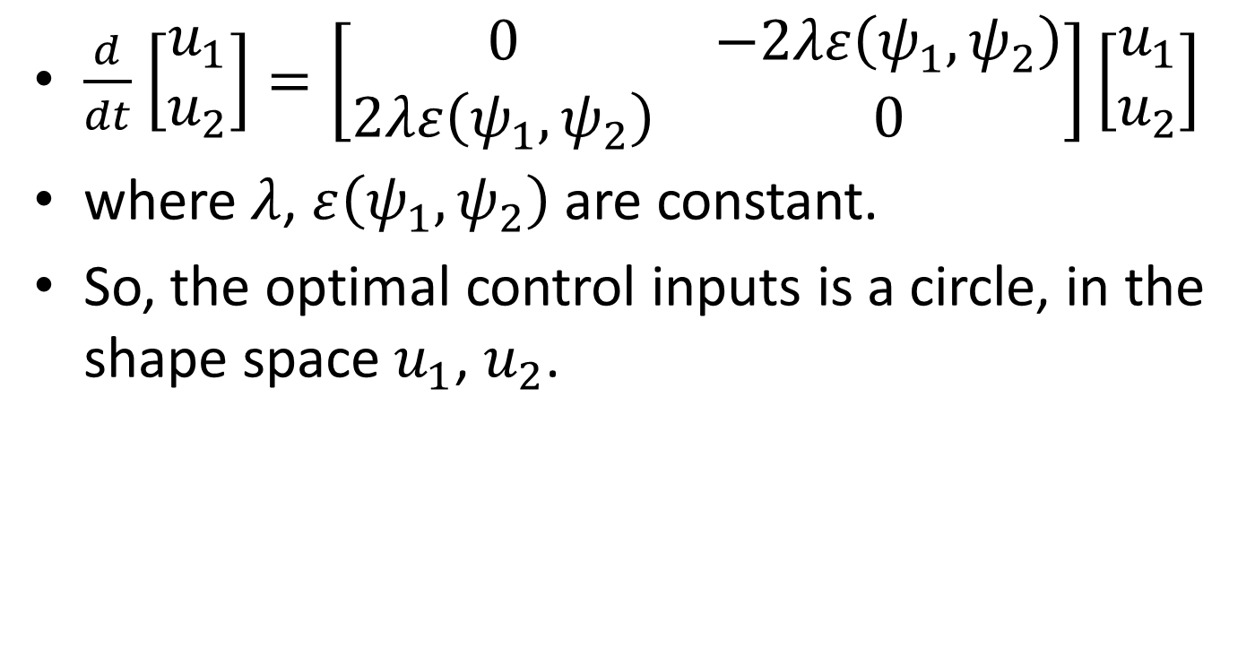
$\frac{d}{dt}$ $\left[\begin{matrix}u_{1} \\ u_{2}\end{matrix}\right]=\left[\begin{matrix}0 & −2λε\left(ψ_{1},ψ_{2}\right) \\ 2λε\left(ψ_{1},ψ_{2}\right) & 0\end{matrix}\right]\left[\begin{matrix}u_{1} \\ u_{2}\end{matrix}\right]$
where $λ$, $ε\left(ψ_{1},ψ_{2}\right)$ are constant.
So, the optimal control inputs is a circle, in the shape space $u_{1}$, $u_{2}$.

