Slide 1





PRESENTATION 2026
Prassiddhi Sachdeva
Student Email
Prassiddhi Sachdeva
prassiddhisachdeva@ilc.du.ac.in
Mentor Name
Sagar Chetan Mehta

Slide 2

Outline
Abstract of the Project
Problem Statement
Proposed Solution
System Architecture
Live Demo of the Project
Embedded Video of Project
Conclusion
Future Scope

Slide 3
Abstract
This project analyzes 3,028 residential apartment listings in Gurgaon, Haryana, using Power BI to build an interactive real estate market dashboard.
Objective: To clean raw listing data and visualize pricing patterns, sector-wise trends, and property configuration insights for buyers and investors.
Tools used: Microsoft Excel (Power Query for data cleaning), Power BI Desktop (DAX measures, interactive dashboard), and AI Chatbot for analysis support.
Outcome: An interactive dashboard with KPI cards, sector-wise price comparison, BHK distribution, area vs. price scatter plot, and dynamic slicers.
Key highlight: Price columns were stored as mixed text (Lac/Crore) — successfully extracted and unified into numeric INR values via Power Query transformations.

Slide 4

Problem Statement
Gurgaon’s real estate market generates thousands of listings across platforms, but the data is raw, inconsistent, and difficult to compare without manual effort.
Property prices vary enormously across sectors and configurations. Without structured data and visualization, buyers and investors cannot make informed decisions.
Target users: first-time homebuyers, real estate investors, property consultants, and researchers studying the Gurgaon residential market.
Existing listing portals show individual properties but offer no cross-sector aggregation, price-per-sqft comparison, or configuration-wise market analysis.
Scope: 3,028 apartment listings from Gurgaon, covering price, area, BHK type, society, sector, facing direction, and property age — analyzed as a point-in-time snapshot.

Slide 5

Proposed Solution
This project transforms raw Gurgaon apartment listing data into a structured, interactive Power BI dashboard. Raw text fields (prices in Lac/Crore, area in mixed formats, bedroom counts as text) were cleaned using Power Query in Power BI Desktop.
DAX measures calculate key KPIs: Average Price, Median Price, Average Price per Sq.Ft., and Total Listings. The dashboard features dynamic slicers (BHK type, Sector, Property Age, Facing), a sector-wise price bar chart, BHK distribution donut chart, area vs. price scatter plot, and a Sector x BHK matrix table.
AI Chatbot assistance was used for data interpretation, Power Query formula writing, and DAX measure design. The result is a self-service analytics tool that helps stakeholders answer real estate questions in seconds.

Slide 6
System Architecture
Data Input / Source
Processing / Analysis
The Foundation: The system ingests a raw CSV dataset containing 3,028 unique Gurgaon apartment listings.
Attributes: The input includes 13 primary fields, most notably unstructured price strings (mixing Lac/Crore), text-encoded area descriptions, BHK configurations, and location addresses.
Sourcing: Data is derived from Kaggle
Normalization: Converting text-based pricing (e.g., "1.25 Crore") into a standardized numeric INR (Lakhs) format.
Extraction: Isolating numerical values for Carpet Area, BHK count, and Bathroom count from complex text strings.
Categorization: Bucketing 49 disparate "Property Age" descriptions into 6 logical groups to enable meaningful filtering.
Geospatial Cleaning: Extracting clean Sector identifiers from long-form address strings for regional benchmarking.
AI / Tool Integration
Output / Dashboard
Computational Logic: Implementing advanced DAX measures to calculate Total Listings, Average/Median Pricing, and Price per SqFt.
AI Collaboration: Using AI Chatbots (Gemini) to generate complex M-code for the ETL pipeline and to design the "Deal Status" logic that identifies market anomalies.
Interpretation: Leveraging AI to validate statistical choices, such as prioritizing Median Price over Mean to mitigate the impact of luxury outliers.
Visual Elements: A multi-page interface featuring KPI cards, sector-wise bar charts, configuration donuts, and property-age distributions.
The Value Finder: A high-density Area vs. Price scatter plot that uses automated color-coding to highlight investment opportunities.
Interactive Control: 5 dynamic slicers (Sector, BHK, Price Band, Area Type, and Deal Status) allow users to drill down into specific sub-markets in real-time.

Slide 7
Live Demo of Project
Here's the list of some demo screenshots / features of the project:
Demo 1
Demo 2
Demo 3
Key Performance Indicators (KPIs): Four high-visibility cards provide an instant pulse on the market, tracking Total Listings (3,028), Average Price (Lakhs), Average Price per SqFt, and Average Area (SqFt).
A descending bar chart ranks sectors by average price, allowing users to identify premium zones versus affordable pockets at a glance.
A donut chart visualizes the concentration of BHK types across the city, supported by dynamic slicers that allow the user to filter the entire market by location or price band simultaneously.
Value Discovery Scatter Plot: A high-density visual that plots every property by Area vs. Price. By color-coding markers (BHK Type / Deal Status), users can instantly spot anomalies—such as a large 3BHK priced significantly lower than the sector trend.
The Sector × BHK Matrix: An interactive lookup table that acts as a "Market Price Index." It allows a user to identify the exact average price for a 2BHK in any specific sector (e.g., Sector 54) without browsing individual listings.
Currency Normalization: Demonstrates the logic used to unify "Lakhs" and "Crore" notations into a single numeric field, enabling mathematical summation and averaging.
Attribute Parsing: Shows how complex text strings in the areaWithType and Configuration columns were parsed to extract clean, numeric values for "Carpet Area" and "BHK Count."
Result: This transformation process turns thousands of inconsistent text entries into a high-performance data model ready for real-time query and visualization.

Slide 8
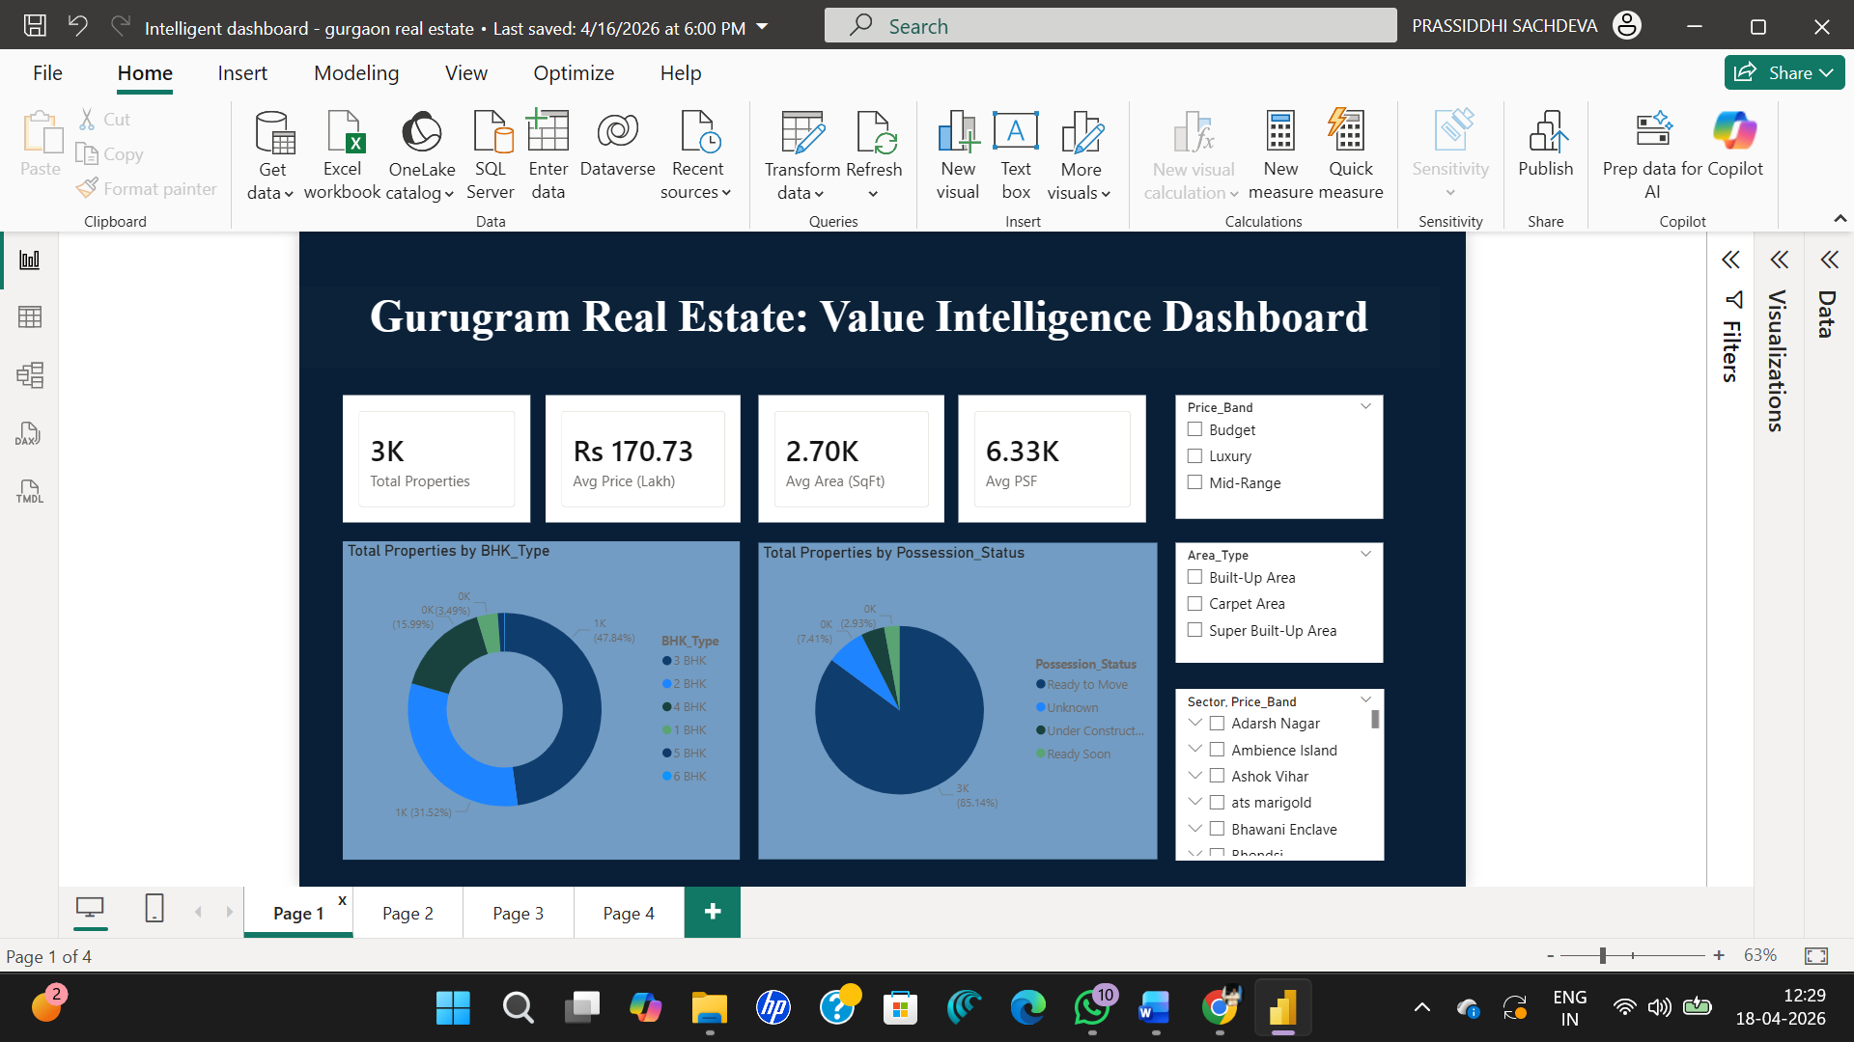

Slide 9
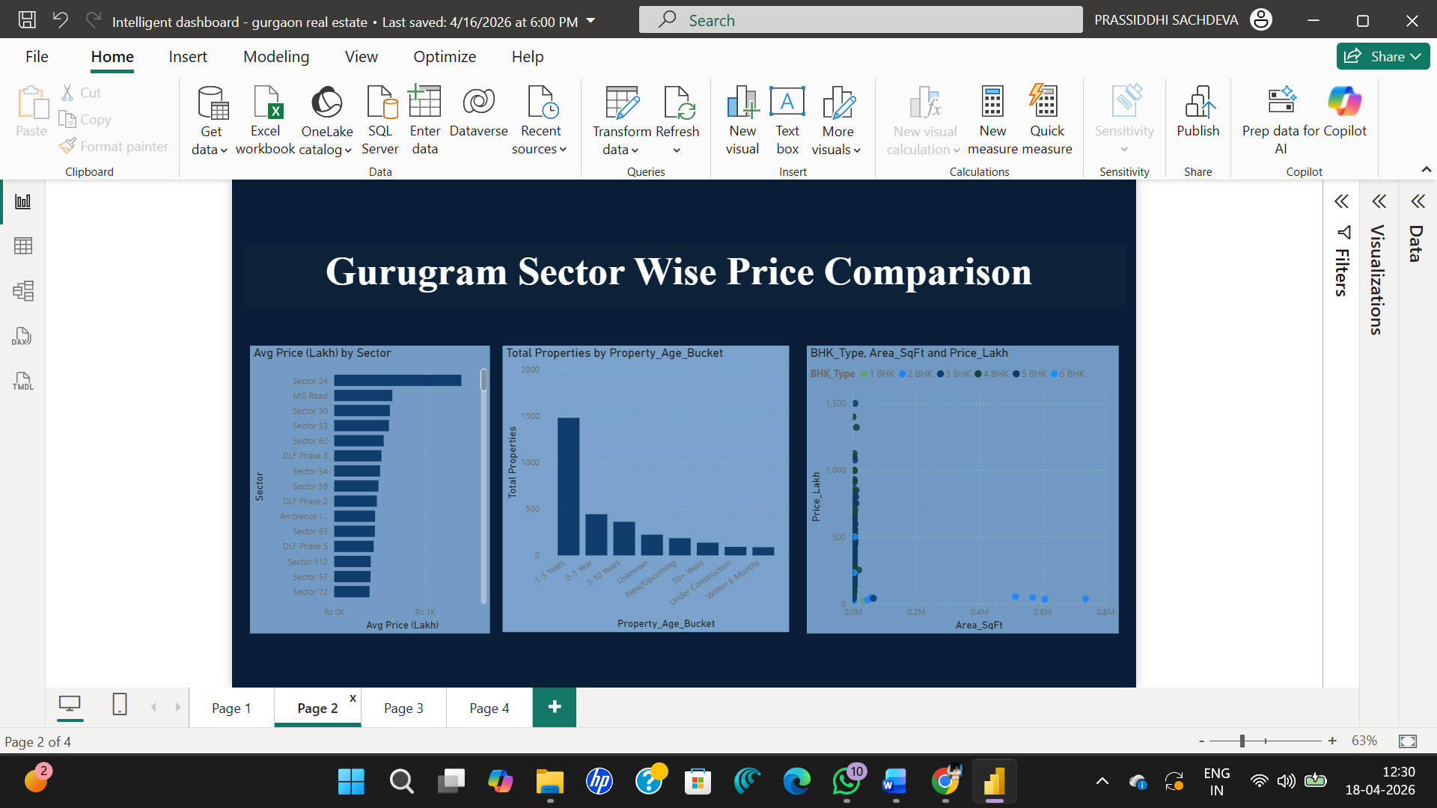

Slide 10
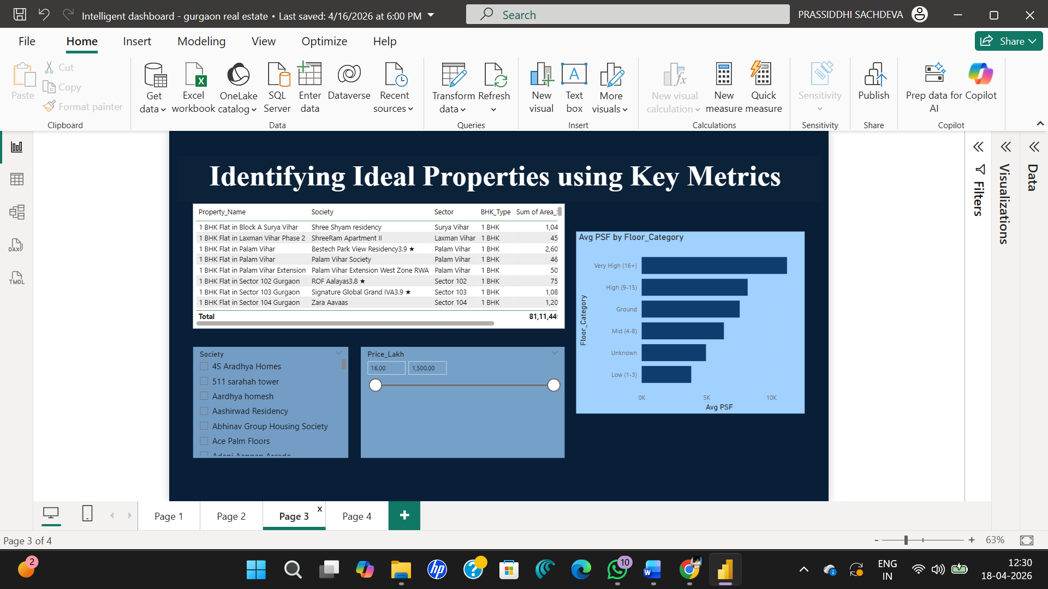

Slide 11
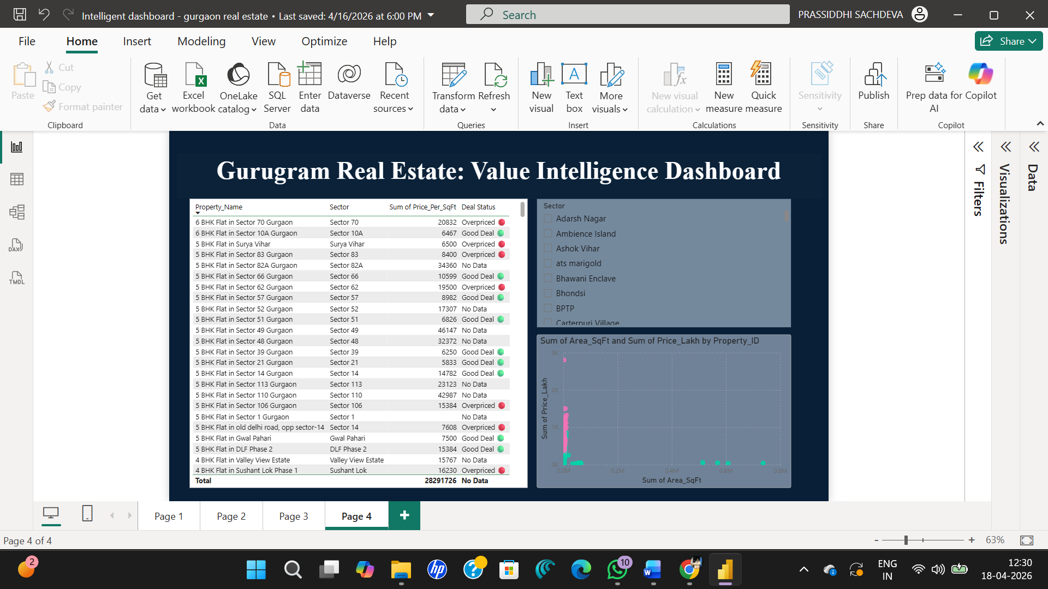

Slide 12

Conclusion
Data Processing: Cleaned and standardized 3,028 property records, resolving inconsistencies across 13 raw columns using AI-assisted ETL pipelines.
Inventory Insight: Identified that 47% of the market is concentrated in 3 BHK units, while 15.9% represents 4+ BHK luxury segments.
Benchmarking Intelligence: Developed a "Sector-Value" logic that automatically flags properties priced significantly above or below the median sector rate, providing instant "Buy/Avoid" signals.
Productivity Gains: Reduced the technical development cycle by approximately 75% by leveraging Human-AI collaboration for complex DAX and M-code generation.
User Empowerment: Created a 4-page interactive dashboard that reduces market research time from hours of manual browsing to under 10 seconds of filtered queries.
CONCLUSION

Slide 13

Future Scope
Connect to a live data feed via Power Automate or an API from property listing platforms to enable real-time price tracking across Gurgaon sectors.
Add a predictive pricing model using Azure Machine Learning integrated into Power BI, allowing estimated price predictions based on BHK, sector, and area inputs.
Expand coverage to NCR (Noida, Faridabad, Delhi) for a comparative multi-city dashboard.
Build a Power Apps front-end for non-technical users to query price estimates without accessing Power BI directly.

Slide 14
Thank You
AICW Fellowship | Student Project Presentation 2026
LinkedIn | Edunet Foundation

