Slide 1


UCS310 - DATABASE MANAGEMENT SYSTEM PROJECT

Slide 2

Virtual Trading Platform
Made By :-
Vashistha - 102203447
Samarth Singh - 102203487
Gautam - 102203498
Vidhi Goyal - 102203659

Slide 3
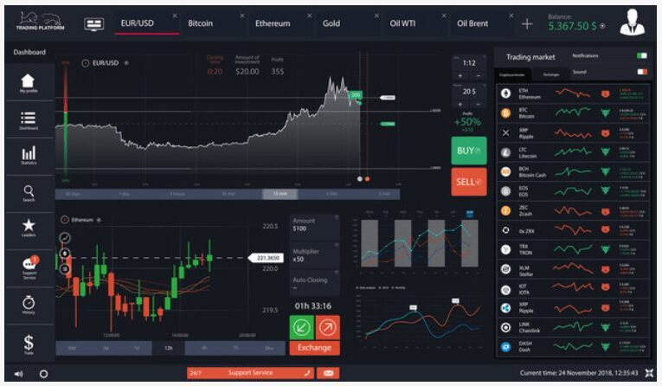
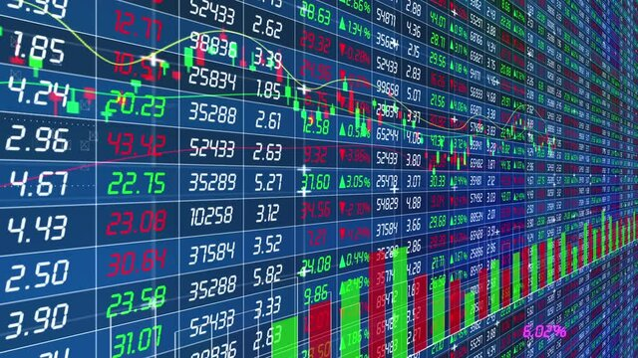
Introduction
A trading platform is a software or online interface that enables traders to buy and sell financial instruments such as stocks, bonds, commodities, currencies, and derivatives. These platforms provide access to various financial markets and facilitate trading activities for individual investors, institutional investors, and traders.
Our project aims to simulate a part of the above complex tasks using Python 3.0 and MySQL as our programing languages.
We randomize our stock data to simulate the random nature of the stock which generally occurs due to other traders, supply & demand, etc.

Slide 4
Project Overview
Our project focuses on the development of a virtual trading platform, providing users with a simulated environment to trade stocks without real financial risk.
The platform aims to educate users about trading strategies, market dynamics, and investment principles in a risk-free manner.

Slide 5
Technologies Used
SQL: Utilized for managing the database, storing user information, transaction history, and stock data.
Python: Implemented for backend logic, including data processing, transaction handling, and interaction with the database.

Slide 6
Key Features
Virtual Trading: Users can trade stocks using virtual currency, allowing them to practice trading strategies without financial risk.
Portfolio Management: Users can track their investments, view portfolio performance, and analyze trading history.
Real-time Stock Data: Access to real-time or delayed stock quotes, charts, and market news to make informed trading decisions.

Slide 7
Future Enhancements
Social Features: Introduce social networking elements, such as user forums, leaderboards, and collaboration tools.
Advanced Analytics: Implement advanced analytics and visualization tools to help users analyze market trends, identify patterns, and improve trading strategies.
Mobile App: Develop a mobile application to extend platform accessibility and provide on-the-go trading capabilities.

Slide 8
ER Diagram
qty
BALANCE
bal
%_r
COMP_RETURNS
t_amt
b_s_prc
PORTFOLIO
Has
Gives
u_id
c_id
Has
u_dob
Invests
c_name
u_name
USER
COMPANY
c_add
qty
P/L
LTP
u_pass
Reg_date
u_add
Maintain
b_prc
p/l
Records
LAST_TRANSACT
BRKG_DETAILS
PREVIOUS_PRICE
LTP
CURRENT_PRICE
t_amt
br_amt
p_prc

Slide 9
ER TO Tables
User Related Tables:
USER
u_id | u_name | u_dob | u_add | u_pass
BALANCE
u_id | bal
BRKG_DETAILS
br_amt | u_id
LAST_TRANSACT
lt_amt | u_id

Slide 10
ER TO Tables
Company Related Tables:
COMPANY
c_id | c_name | c_add | Reg_date
PREVIOUS_PRICE
p_prc | c_id
P_prc
p_prc | c_id
COMP_RETURNS
%_r | c_id
CURRENT_PRICE
ltp | c_id
COMPANY-INVESTS
c_id | c_name | c_add | Reg_date | u_id

Slide 11
ER TO Tables
Portfolio Related Tables:
PORTFOLIO
u_id | t_amt | c_id | qty | b_s_prc
P/L
u_id | pyl | c_id | qty | B_prc | ltp

Slide 12

Functions and it’s uses
add_user() : To add new user
mod_user() : To modify existing user
add_company() : To add company’s stock available for trading
mod_company() : To modify company’s details
add_balance() : To add balance available for trading
withdraw_bal() : To withdraw balance available for trading
update_ltp() : To update the live trading price
chart() : To display a chart of previous prices of a stock
buy_share() : To buy a available stock
sell_share() : To sell a purchased stock
comp_return() : To view profit/losses due to a specified company
disp_pr_price() : To display all previous prices the stock had
login() : To login to an account

Slide 13
THANK YOU

