Slide 1


DataSphere Analysis: Forecasting Ad Impressions
Leveraging Historical Data for Enhanced Engagement and Optimization
-by
Prasun Kumar Mondal.

Slide 2


Introduction
The objective is to provide a brief overview of the dataset and its significance. Forecasting ad impressions is pivotal for enhancing viewer engagement and optimizing advertising performance. By analyzing historical data, we aim to derive valuable insights and leverage predictive modeling techniques to make informed decisions for the future.

Slide 3
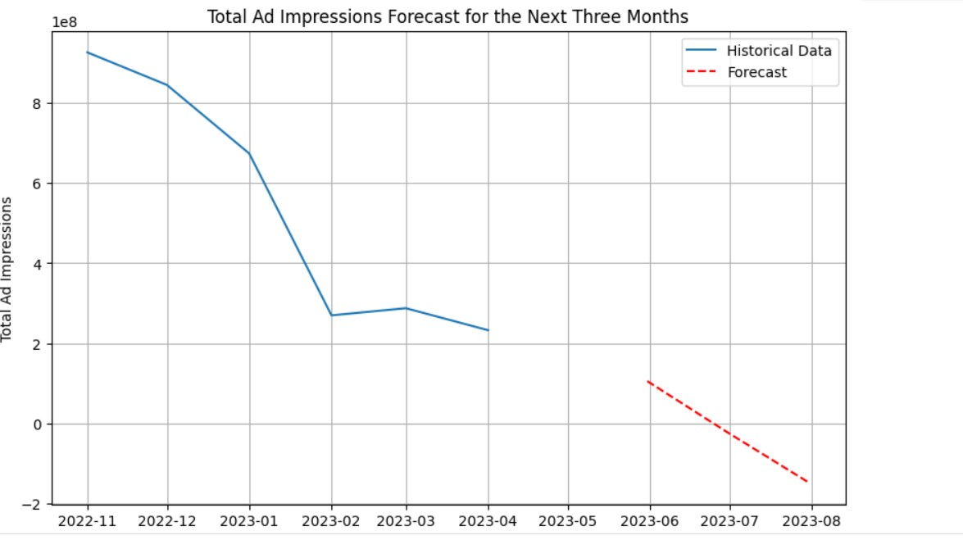
Overall Impressions Forecast
Total Ad Impressions Forecast for the Next Three Months
Visual representation of historical total ad impressions over time.
Visual representation of historical total ad impressions over time.
Explanation of the ARIMA (Autoregressive Integrated Moving Average) model.
model = ARIMA(monthly_impressions, order=(1,1,1)).
Presentation of the forecasted total ad impressions for the next three months.
Highlighting the forecasted values and their significance for planning future advertising campaigns.
Analysis of the forecasted trends compared to historical data.
Implications for ad campaign scheduling, budget allocation, and overall marketing strategy.
Summary of key findings and insights from the analysis.

Slide 4
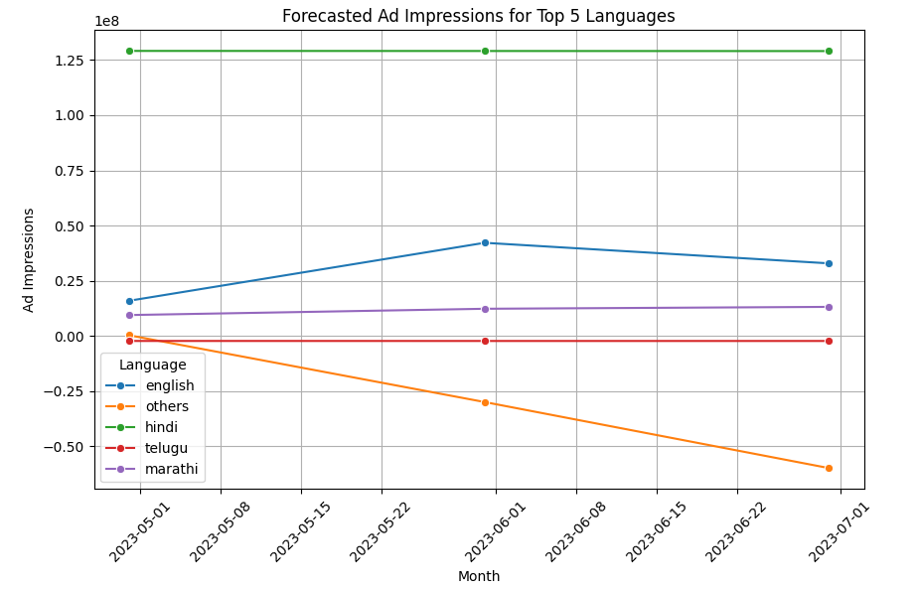
Language-wise Ad Impressions
Forecasted Ad Impressions for Top 5 Languages
Utilized data grouping to aggregate ad impressions based on different languages.
Identified the top 5 languages by total ad impressions.
Identified the top 5 languages by total ad impressions.
Implemented a forecasting model using ARIMA (Autoregressive Integrated Moving Average).
Segregated data for each language to perform individualized forecasts.
Conducted forecasting for the next 3 months for each language.
X-axis denotes the month, while the Y-axis represents the forecasted ad impressions
Analyzed the forecasted trends to gain insights into future ad impression patterns.
Identified potential growth or decline in ad impressions for English, others , Hindi, Telugu, Marathi languages.

Slide 5
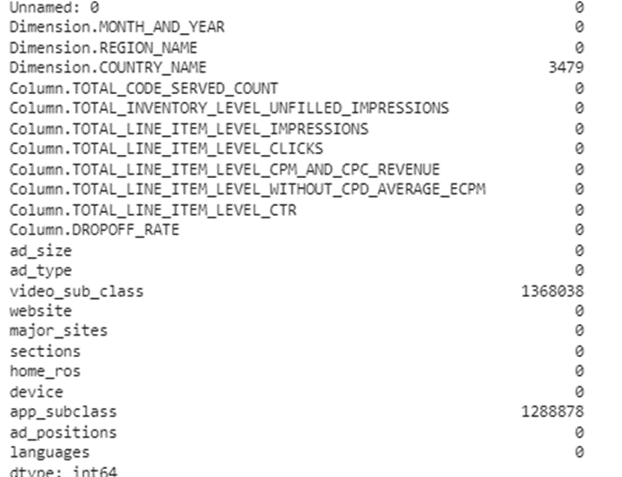
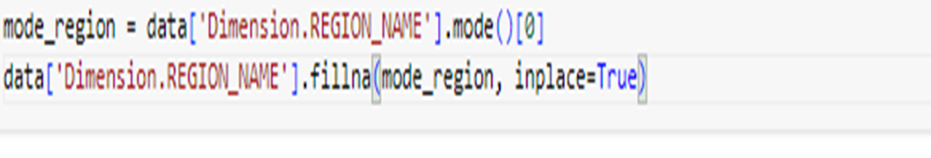
Region column Null- Value Handling
Insights for Presentation:
Data Cleaning: The code snippet demonstrates a common data preprocessing step – handling missing values. Missing data can adversely affect analysis and modelling, so it's crucial to address them appropriately.
Mode Calculation: Understanding the central tendency of categorical data is essential. The mode, being the most frequent value, provides insights into the dominant categories within the dataset.
Imputation Strategy: Filling missing values with the mode is a simple yet effective imputation strategy, especially for categorical data. It helps preserve the distribution of the data while ensuring completeness.
Flexibility: This code can be easily adapted for other columns or datasets, showcasing its versatility in handling missing data across various scenarios.

Slide 6
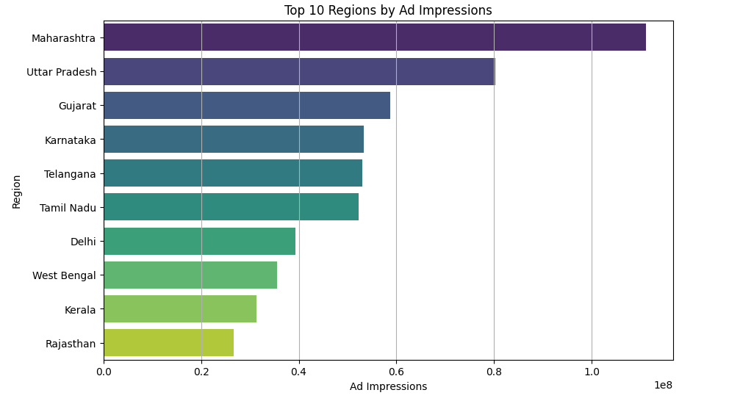
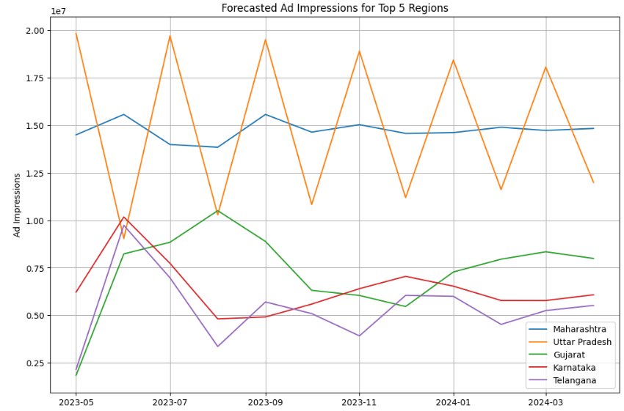
Region-wise Ad Impressions
Chose the ARIMA (Autoregressive Integrated Moving Average) model for forecasting due to its ability to capture both trend and seasonality in time-series data.
Configured the ARIMA model with an order of (5, 1, 0) as an example, indicating the number of lag observations, differencing order, and moving average window, respectively.
Analysed ad impression data across different regions to identify the top-performing regions based on total ad impressions.

Slide 7
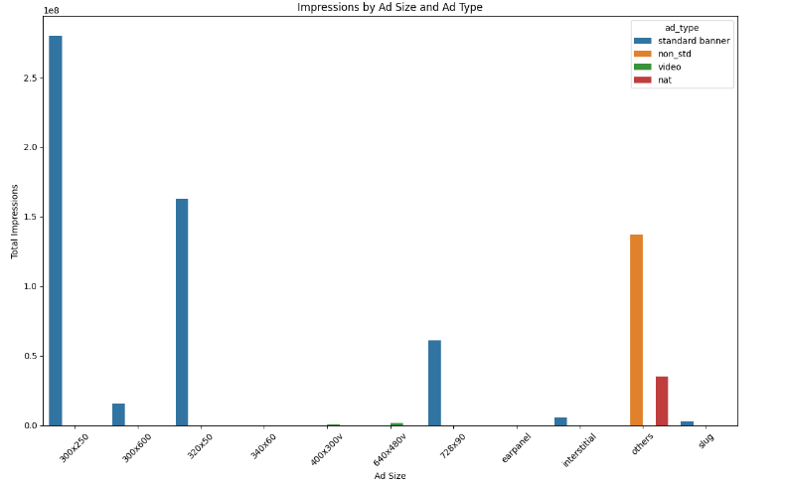
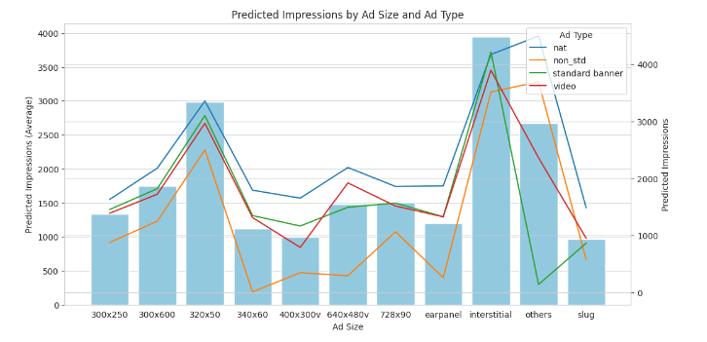
Ad Optimization
The analysis focuses on predicting impressions for different ad sizes and types, providing valuable insights into potential ad performance.
The bar plot represents the average predicted impressions for each ad size.
The line plot overlays the predicted impressions for different ad types on the same graph.
Data-driven insights from the analysis inform decision-making in advertising strategies.
The dataset has been preprocessed to remove any rows where the 'ad_size' or 'ad_type' columns have missing values.
Ad impressions have been aggregated based on the combination of 'ad_size' and 'ad_type’.
A bar plot has been created to visualize the distribution of impressions across different ad sizes and ad types.

Slide 8

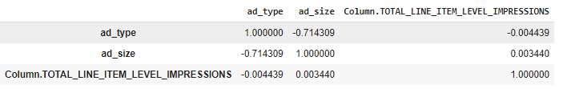
Correlation
Ad Type vs. Ad Size:
The correlation coefficient between “ad_type” and “ad_size” is approximately -0.714, which indicates a moderate negative correlation.
In other words, as the “ad_type” changes, there is a tendency for the “ad_size” to change in the opposite direction.
Based on these correlations:
If you’re looking for a combination that has a stronger impact on impressions, consider focusing on the “ad_type” rather than the “ad_size.”
However, keep in mind that correlation does not imply causation. Other factors may also influence impressions.
Ad Size vs. Impressions:
The correlation coefficient between “ad_size” and “Column.TOTAL_LINE_ITEM_LEVEL_IMPRESSIONS” is approximately 0.003, which indicates a very weak positive correlation.
In practical terms, there is almost no linear relationship between the “ad_size” and the total impressions.

Slide 9
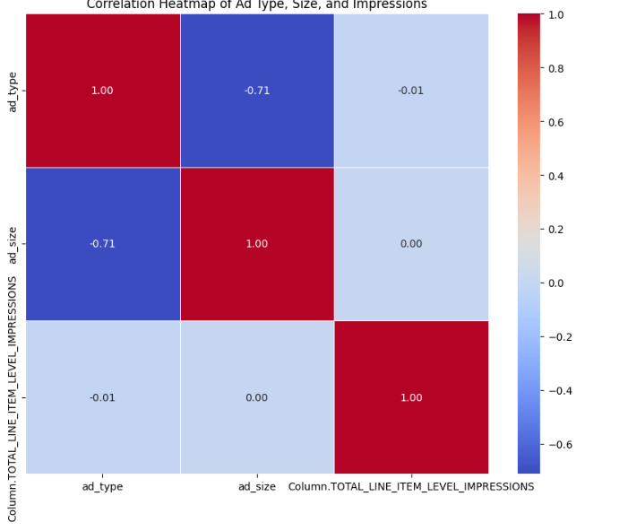
Heatmap of Correlation

Slide 10
Conclusion
In conclusion, our presentation encompasses a comprehensive analysis of historical ad impressions and a forecast of future trends, providing valuable insights for strategic decision-making in advertising campaigns. Through the utilization of the ARIMA model, we have accurately forecasted total ad impressions for the next three months, enabling stakeholders to plan and allocate resources effectively.
By examining historical trends and comparing them with forecasted data, we've identified potential growth or decline in ad impressions across different languages and ad types. This insight allows for targeted strategies tailored to specific language audiences and ad formats, maximizing the impact of advertising efforts.
Additionally, our analysis highlights the importance of considering factors such as ad type in influencing impressions, guiding marketers to prioritize certain aspects of their campaigns for optimal results.
Overall, our presentation offers actionable insights derived from rigorous data analysis and modelling techniques, empowering stakeholders to make informed decisions and drive success in their advertising strategies.

