Slide 1
BATTLE OF NEIGHBOURHOOD Analysis of the Popular Restaurants in Bangalore based on its Location and Mode of Delivery
Introduction
Bangalore is one of the largest city in India and the fastest growing city in the world
Diversity and a Migrant Population
Software , IT and Innovation Hub
Varied Demography and Population
Food Variety and Destinations
Problem Statement
Identify Localities and its choices for food or popular Venues
Insights to entrepreneurs who want to set up restaurant
Food choices , places for food loving public

Slide 2
Sources of Data
Data source: Kaggle Dataset
Description: This data set contains the required information. And we will use this data set to explore various locality of Bangalore city.
Nearby places in each locality of Bangalore city.
Data source: Foursquare API
Description: By using this API, we will get all the venues in each neighborhood.
Neighborhood coordinates of each locality of Bangalore city.
Data source: Geocoder python
51,717 samples and 17 features
Features include - online_order, book_table, rate, location, cuisines, approx_cost(for two people) ,listed_in(type), listed_in(city), rest_type.

Slide 3
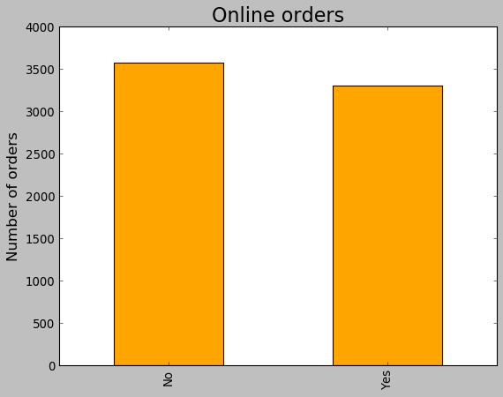
Exploratory Data Analysis
Online Ordering is the choice available, however it would depend on the arrangement and availability of the restaurant

Slide 4
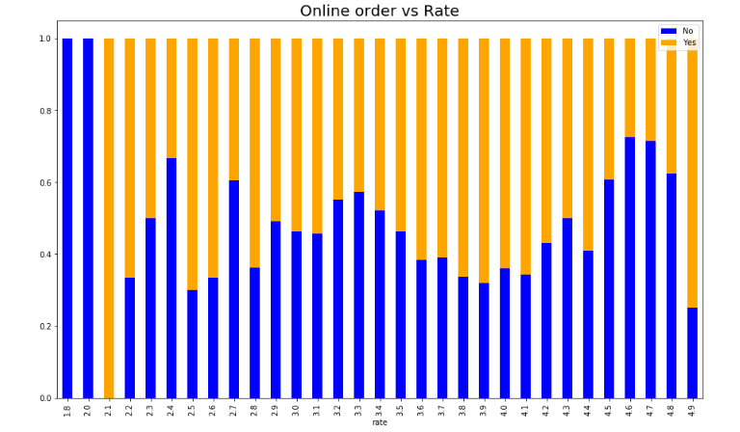
Online Ordering – Users Rating
Online Ordering and deliveryimproves the User rating

Slide 5
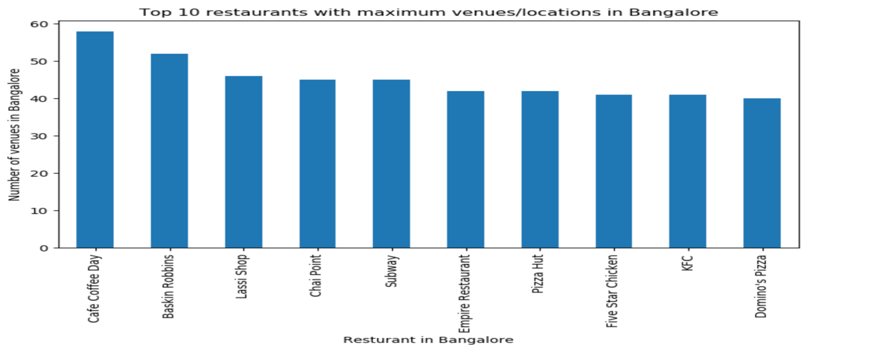
Restaurants with Maximum Venues
Coffe Day has the maximum venues followed by Baskin Robins

Slide 6
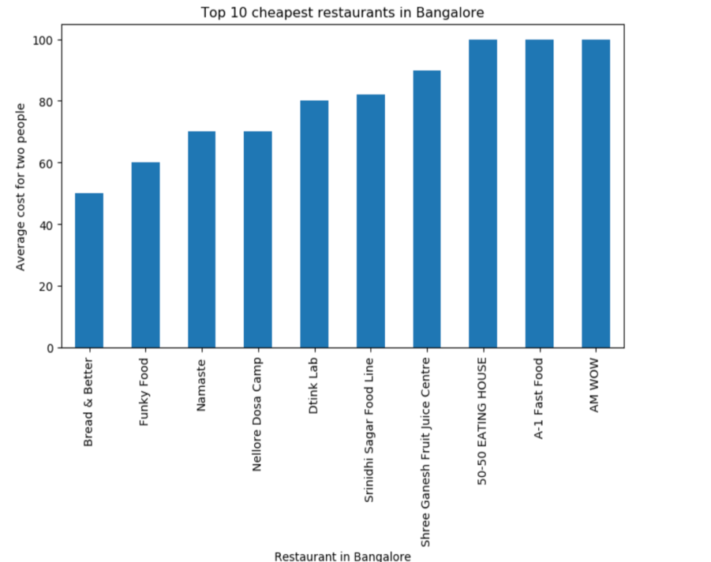
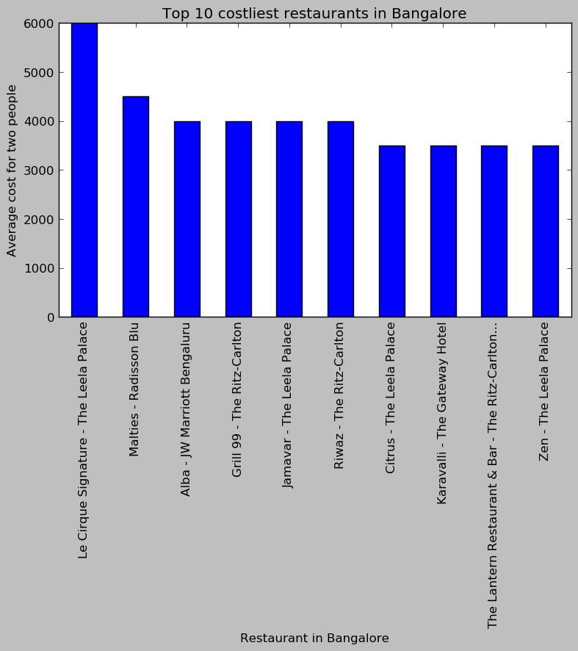
Costlier and Cheaper Restaurants
Locality and Demography plays a major role in the location

Slide 7
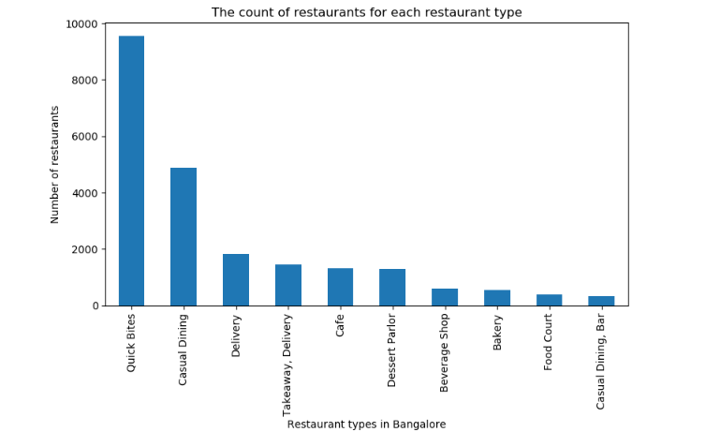
Types of Restaurant in Bangalore

Slide 8
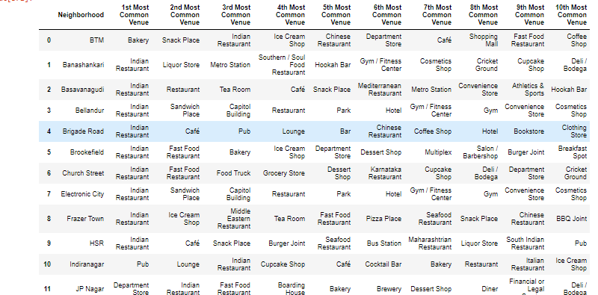
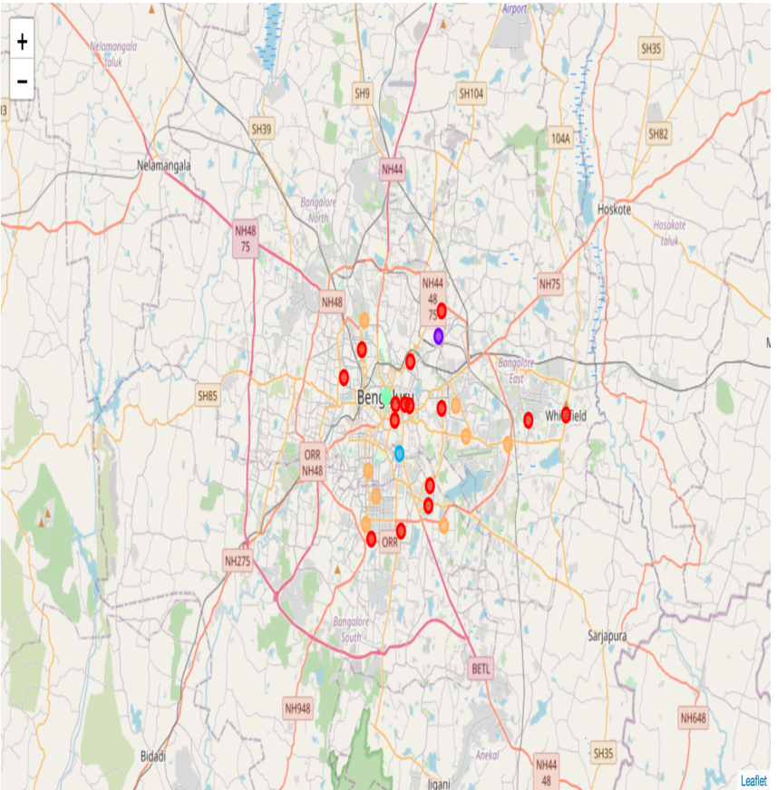
Top Venues and its Clusters

Slide 9
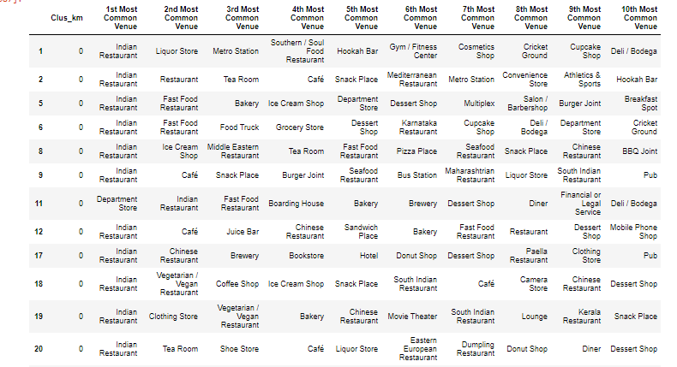
CLUSTERING
GYM AND FITNESS Centre are recommended around these locations – Cluster 0

Slide 10
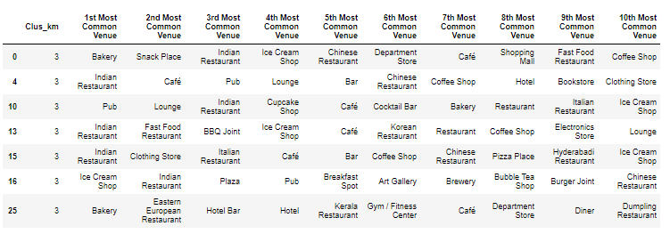
Cluster 3
Sports Bar will have to be located next to these centres

