Slide 1

EASY JABBER
~The Clever World

Slide 2






PROGRESS REPORT
Changes made in any proposed features.
Extra added features
Features TO BE SHOWED till final evaluation

Slide 3
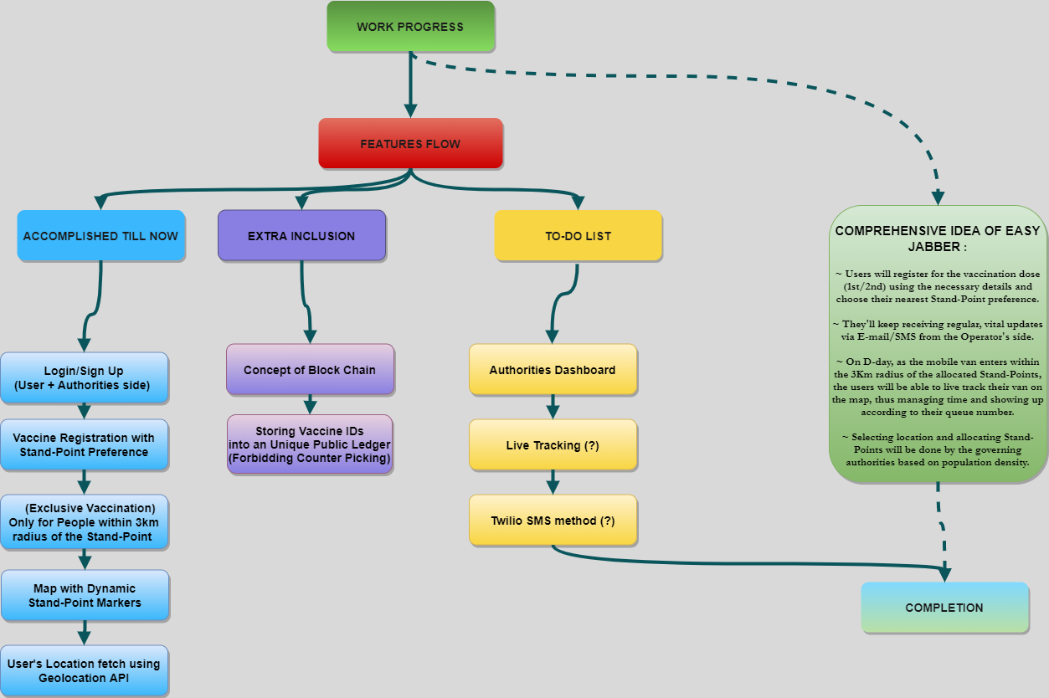
INTERMEDIATE
STAGE REPRESENTATION

Slide 4

THANK YOU

