Slide 1
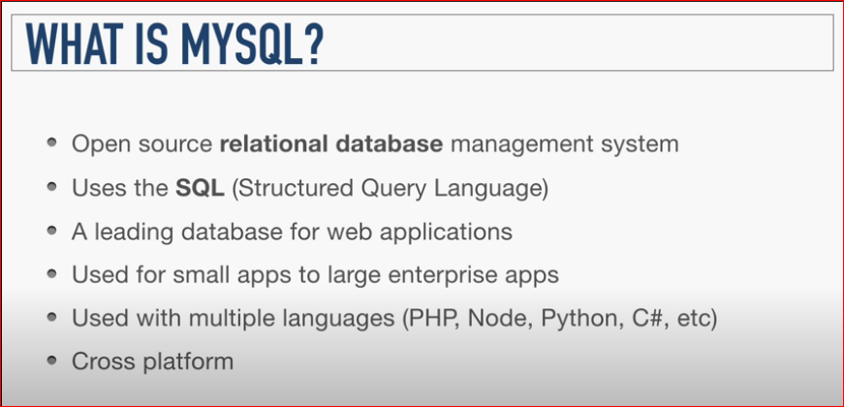

Slide 2
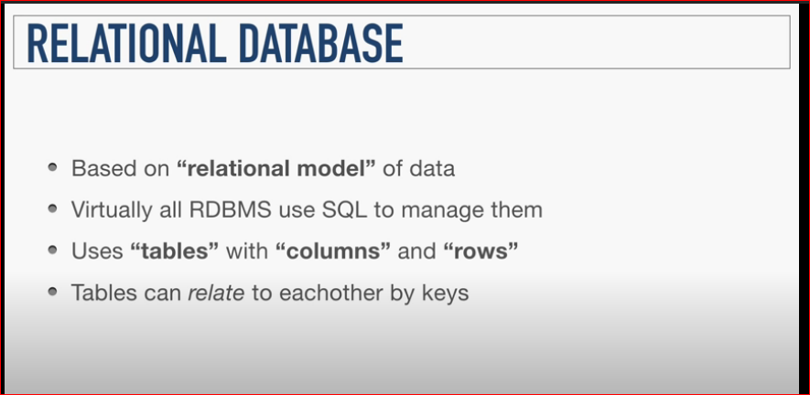

Slide 3
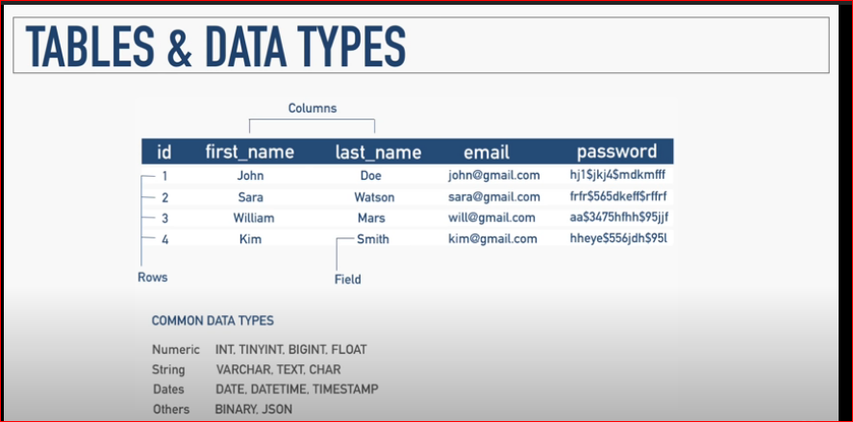

Slide 4
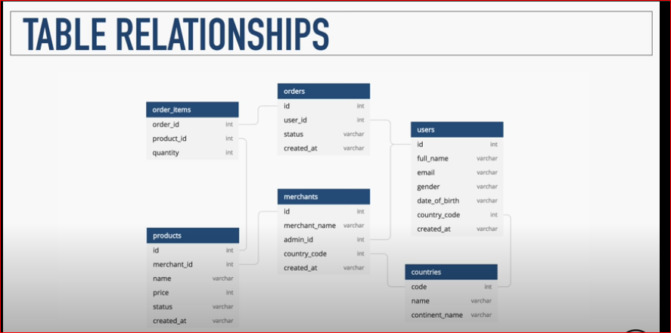

Slide 5
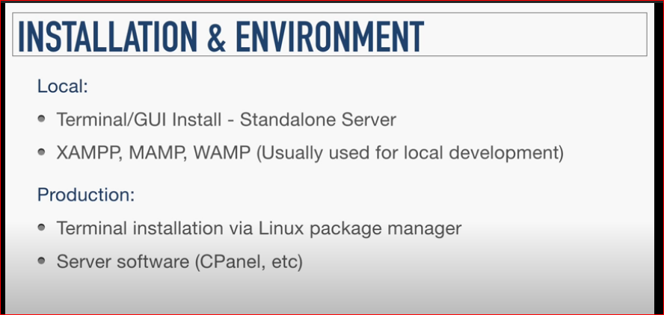

Slide 6
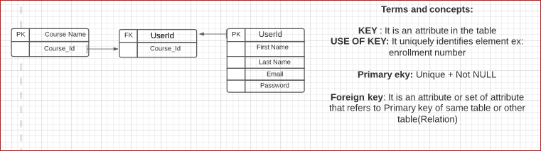

Slide 7
Cheatsheet:
https://gist.github.com/Prasundas99/c9abf1ef904ca5f35f970147d0d615a7

