Slide 1
Projects
Vipul Arora

Slide 2
Problem 1: Audio Event Detection
https://dcase.community/challenge2022/task-sound-event-detection-in-domestic-environments
Dataset: see link above
Approaches:
Select an existing paper on ML
Apply it to this problem

Slide 3
Transformer Based Models
https://dcase.community/documents/workshop2021/proceedings/DCASE2021Workshop_Park_39.pdf
https://arxiv.org/abs/2110.02011
https://dcase.community/documents/challenge2020/technical_reports/DCASE2020_Miyazaki_108.pdf

Slide 4
Few Shot Learning
https://arxiv.org/pdf/2002.09143.pdf
https://www.justinsalamon.com/uploads/4/3/9/4/4394963/wang_continual_fewshot_audio_icassp_2021.pdf

Slide 5
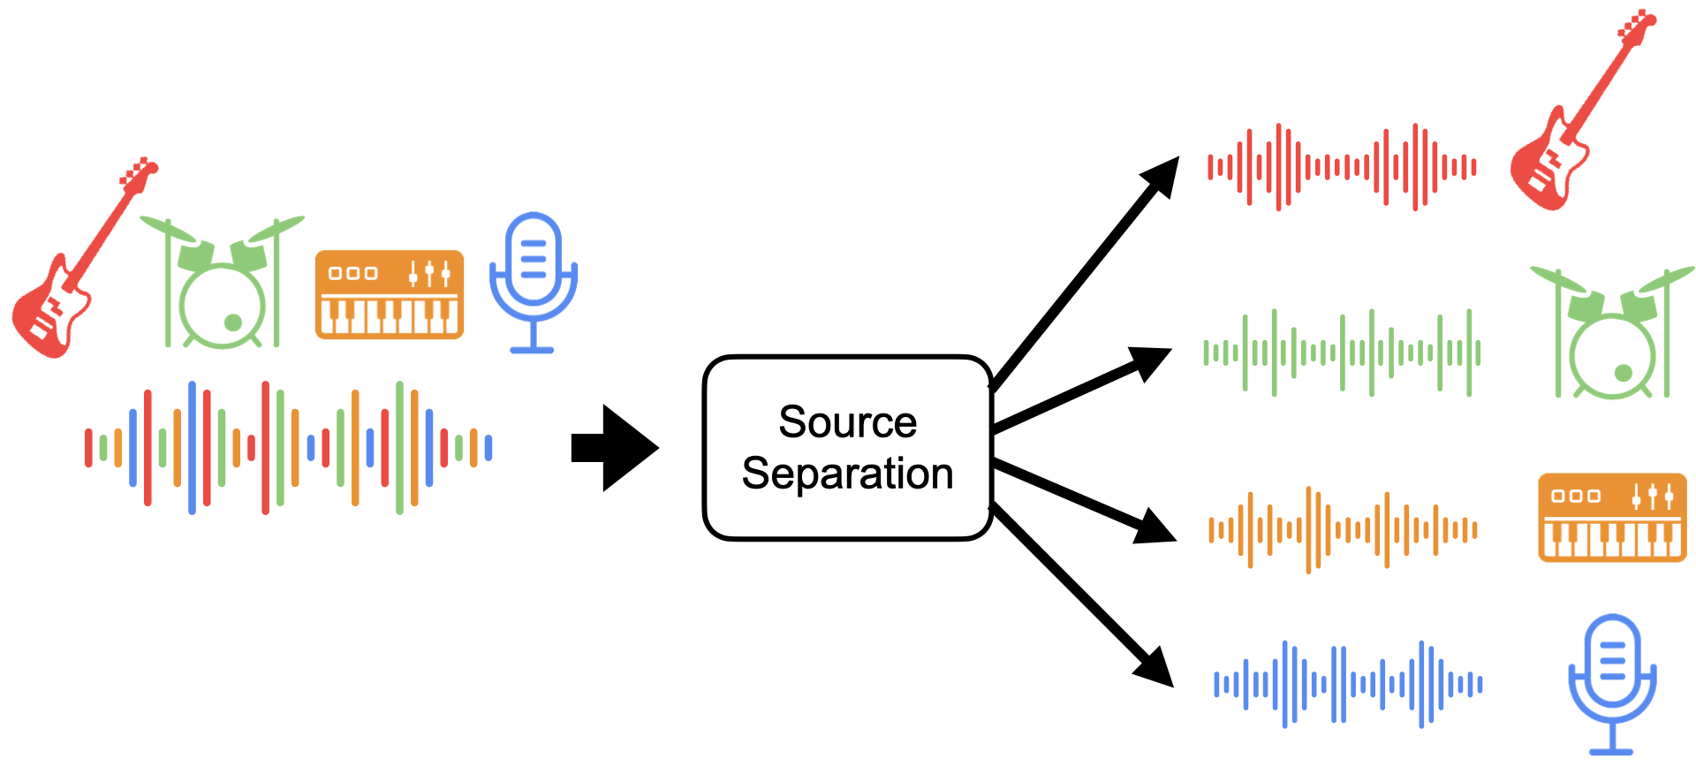
Problem 2: Audio Source Separation
https://source-separation.github.io/tutorial/landing.html
Dataset: MIR-1k data

Slide 6
Using GANs
http://proceedings.mlr.press/v119/jayaram20a/jayaram20a.pdf

Slide 7
Problem 3: Music Generation
Goal: Generate music
Resources:
https://www.tensorflow.org/tutorials/audio/music_generation
https://openai.com/blog/jukebox/
https://magenta.tensorflow.org/

Slide 8
Papers
GANSynth: Adversarial Neural Audio Synthesis https://openreview.net/forum?id=H1xQVn09FX

Slide 9
Evaluation
Submit your
Report
Codes
Present your report

