Slide 1
Economy data visualization
A tool to visualize the economy

Slide 2
objective
The main objective of this project is to create a software which can explain the complex parameters of economy to normal people easily using data visualization technology.
This project will have many function to compare data of different economies as well as of different era.
Apart from visualization this project will have many functions to add, delete and modify data.

Slide 3
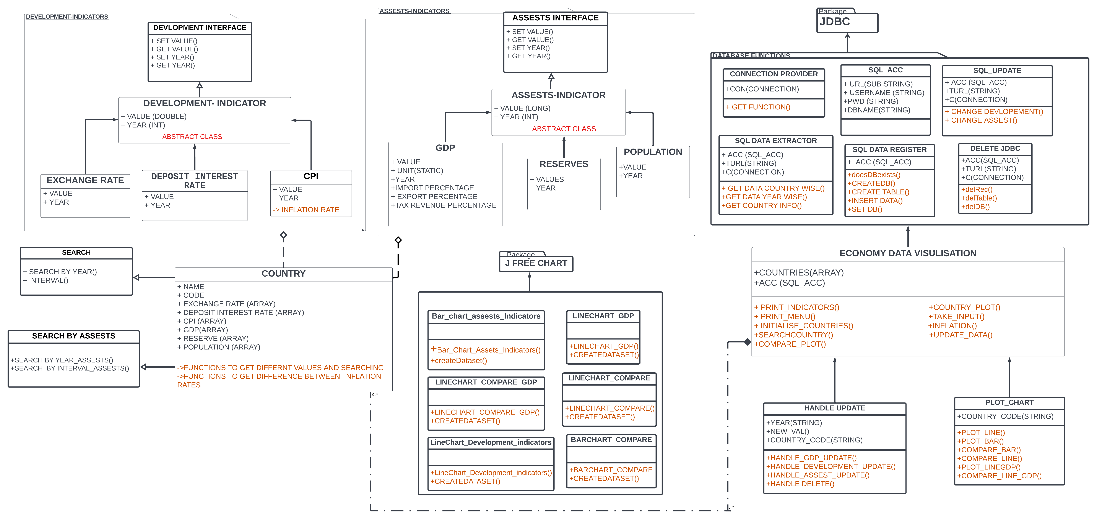
Uml diagram of project

Slide 4
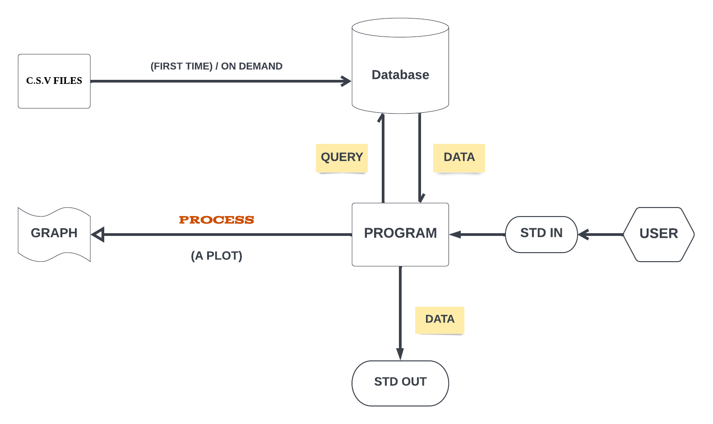
WORKING OF PROGRAM

