Slide 1
PRATAP V M 2021503536
NM Final Project

Slide 2
PROJECT TITLE
Disease Prediction from Symptoms

Slide 3


AGENDA
PROBLEM STATEMENT
PROJECT OVERVIEW
WHO ARE THE END USERS?
SOLUTION AND ITS VALUE PROPOSITION
MODELLING
RESULTS
3/21/2024 Annual Review

Slide 4

PROBLEM STATEMENT
The Smart Health Disease Prediction project addresses the critical need for early detection and prediction of medical conditions using machine learning techniques. Despite advancements in healthcare, there remains a significant challenge in accurately identifying and forecasting the onset of diseases based on patient symptoms and medical history. This project seeks to bridge this gap by developing a virtual intelligent healthcare system that can effectively predict the development of medical conditions, thereby enabling healthcare professionals to make informed decisions and provide timely interventions.

Slide 5

PROJECT OVERVIEW
Objective: The project aims to employ machine learning techniques to predict the development of medical conditions based on patient details and symptoms. It seeks to facilitate early disease detection and assist healthcare professionals in making informed decisions for timely interventions.
Key Components:
Virtual Intelligent Healthcare System: Guides users through the disease prediction process and facilitates interaction with the model.
Decision Tree Model: Utilized for training and predicting medical conditions based on input symptoms and patient information.
Comprehensive Dataset: Contains relevant medical features including symptoms, medical history, and diagnostic test results.
Data Preprocessing: Involves handling missing values and encoding categorical variables to ensure dataset integrity.
Model Evaluation Metrics: Accuracy, precision, recall, and F1-score are used to assess the effectiveness of the mode

Slide 6

WHO ARE THE END USERS?
Healthcare Professionals: This includes doctors, nurses, and other medical personnel who will utilize the predictive model to assist in diagnosing and treating patients.
Patients: Individuals seeking medical care who may benefit from early disease detection and timely interventions enabled by the predictive model.
Healthcare Organizations: Hospitals, clinics, and healthcare facilities that aim to improve patient care and outcomes through the adoption of advanced predictive analytics technology.
Researchers and Academia: Professionals in the medical and healthcare research field who may use the project's findings and methodologies for further study and development of similar predictive models.

Slide 7

SOLUTION AND ITS VALUE PROPOSITION
The solution proposed by the Smart Health Disease Prediction project is a machine learning-based system that predicts the development of medical conditions using patient details and symptoms. The value proposition lies in its ability to facilitate early disease detection, thereby enabling timely interventions and improving patient outcomes.
Benefits:
Early Disease Detection: By analyzing patient symptoms and medical data, the system can identify potential medical conditions at an early stage, allowing healthcare professionals to intervene promptly and prevent the progression of diseases.
Informed Decision-Making: Healthcare professionals can make informed decisions regarding patient care and treatment plans based on the predictions generated by the system, leading to more personalized and effective healthcare delivery.
3/21/2024 Annual Review

Slide 8

Timely Interventions: The system enables timely interventions by alerting healthcare providers to potential medical conditions before they escalate, thereby reducing the risk of complications and improving patient prognosis.
Improved Patient Outcomes: By facilitating early detection and timely interventions, the system contributes to improved patient outcomes, including faster recovery times, reduced hospitalizations, and better overall health outcomes.
Enhanced Healthcare Efficiency: The predictive model streamlines the diagnostic process and optimizes resource allocation within healthcare facilities, leading to improved efficiency and cost-effectiveness in healthcare delivery.
3/21/2024 Annual Review
8

Slide 9
MODELLING
Data Collection | Data Preprocessing
Gather a dataset containing relevant medical features such as symptoms, medical history, and diagnostic test results. This dataset should include both historical data and current patient information. | Clean the dataset by handling missing values and encoding categorical variables. This ensures that the data is of high quality and suitable for training the model.
Feature Selection/Engineering | Model Selection
Identify the most relevant features that contribute to disease prediction. This may involve techniques such as feature selection, dimensionality reduction, or creating new features based on domain knowledge. | Choose an appropriate machine learning algorithm for disease prediction. Decision tree algorithms are commonly used due to their interpretability and ability to handle categorical data.
9

Slide 10
MODELLING
Model Training | Model Evaluation
Train the selected model using the preprocessed dataset. This involves feeding the model with input features (e.g., symptoms, medical history) and corresponding labels (indicating the presence or absence of a particular disease). | Evaluate the trained model's performance using metrics such as accuracy, precision, recall, and F1-score. This helps assess how well the model predicts diseases based on the input data.
10

Slide 11
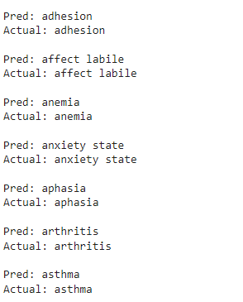
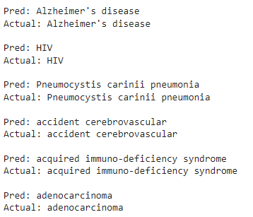
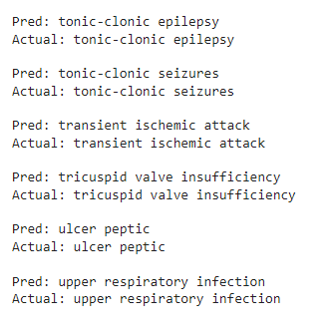
RESULTS
11

Slide 12
THANK YOU

