Slide 1
ETL Project in AWS using AWS Glue

Slide 2

We have used following AWS services in our project:
Simple Storage Service (S3)
AWS Glue
AWS Athena
PG-DBDA IACSD

Slide 3
Simple Storage Service (S3):
Cloud-Based Object Storage Service
Files, Images, Videos, and Documents, etc
Object storage (up to 5 TB in size)
Organize data into buckets
Versioning (Store multiple versions of an object)
Commonly use for
Data archiving
Disaster recovery
Big data analytics
AWS Glue:
is Extract, Transform, and Load (ETL) service provided by Amazon Web Services (AWS)
With AWS Glue, we can:
Discover data
Transform data
Load data

Slide 4
AWS Athena:
is query service
allows users to analyze data stored in Amazon S3 using SQL
Athena's key features include:
Serverless: No infrastructure to set up or manage.
SQL support: Use standard SQL to query data.
S3 integration: Query data stored in S3, without needing to move or transform it.
Fast performance: Get query results quickly, even on large datasets.
Cost-effective: Pay only for the queries you run, based on the amount of data scanned.

Slide 5
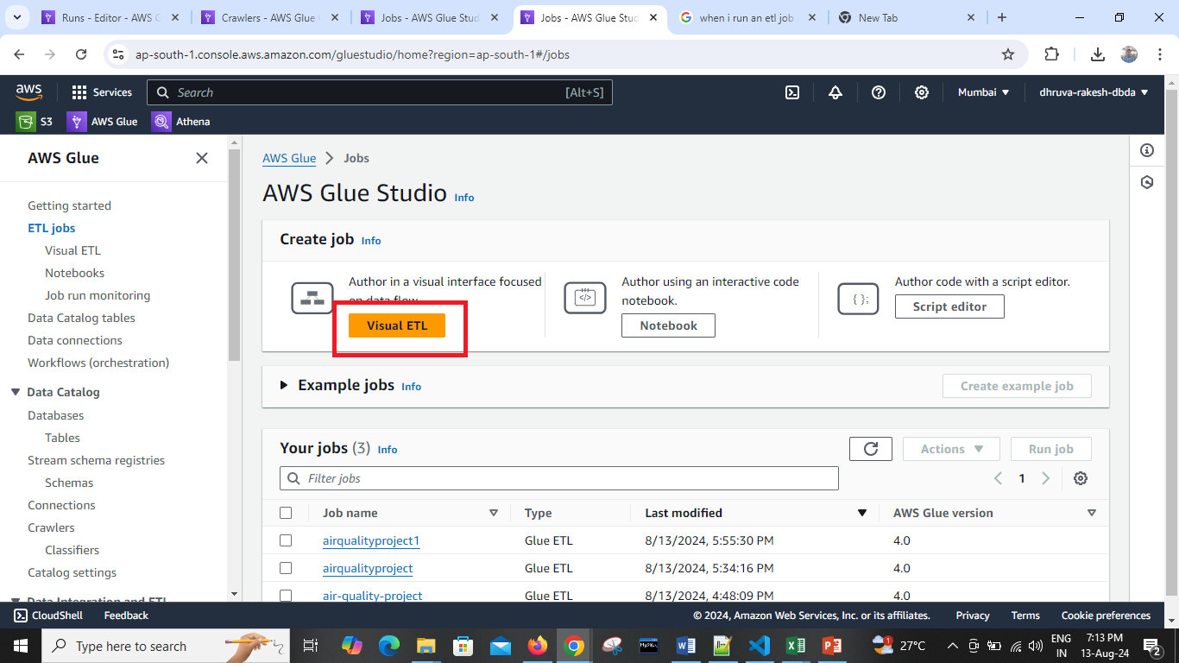

Slide 6
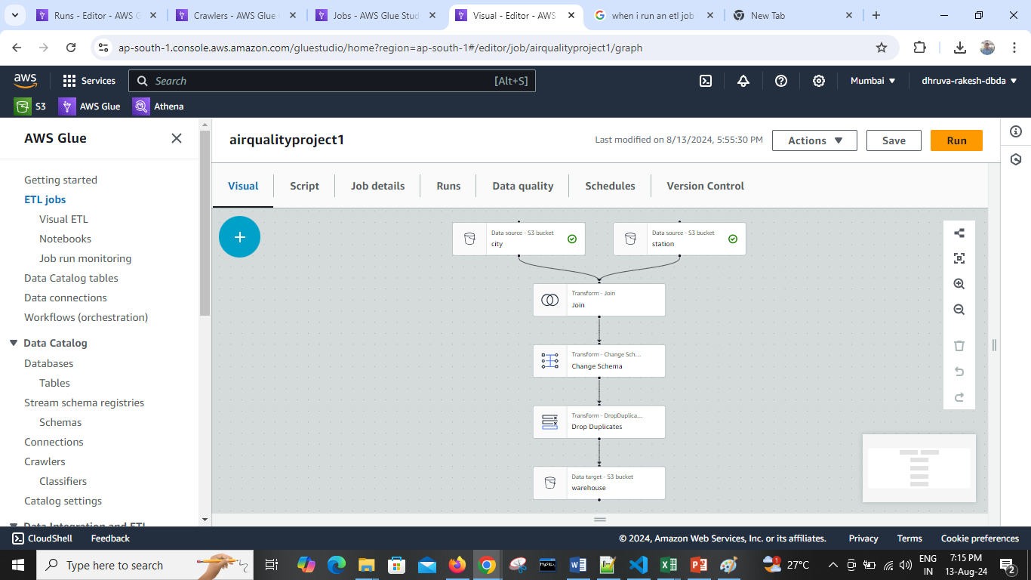

Slide 7
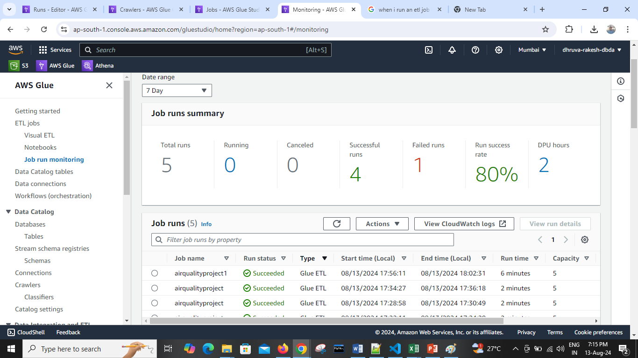

Slide 8
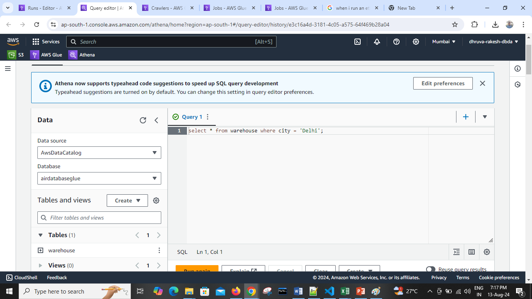

Slide 9
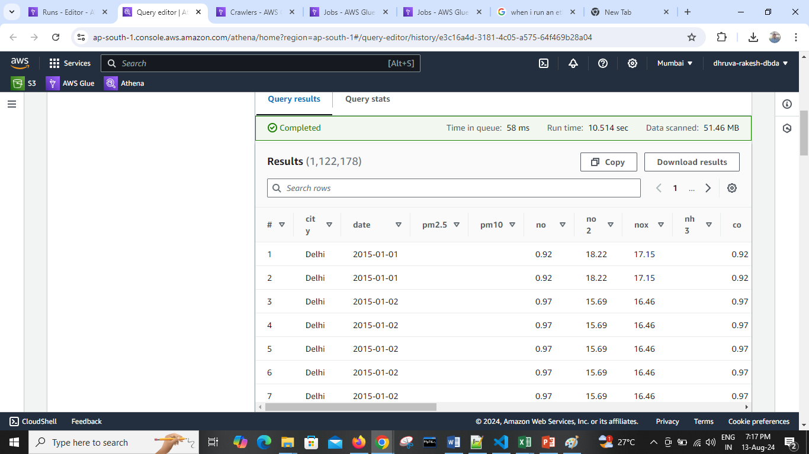

Slide 10
Thank You
PG-DBDA IACSD

