Slide 1
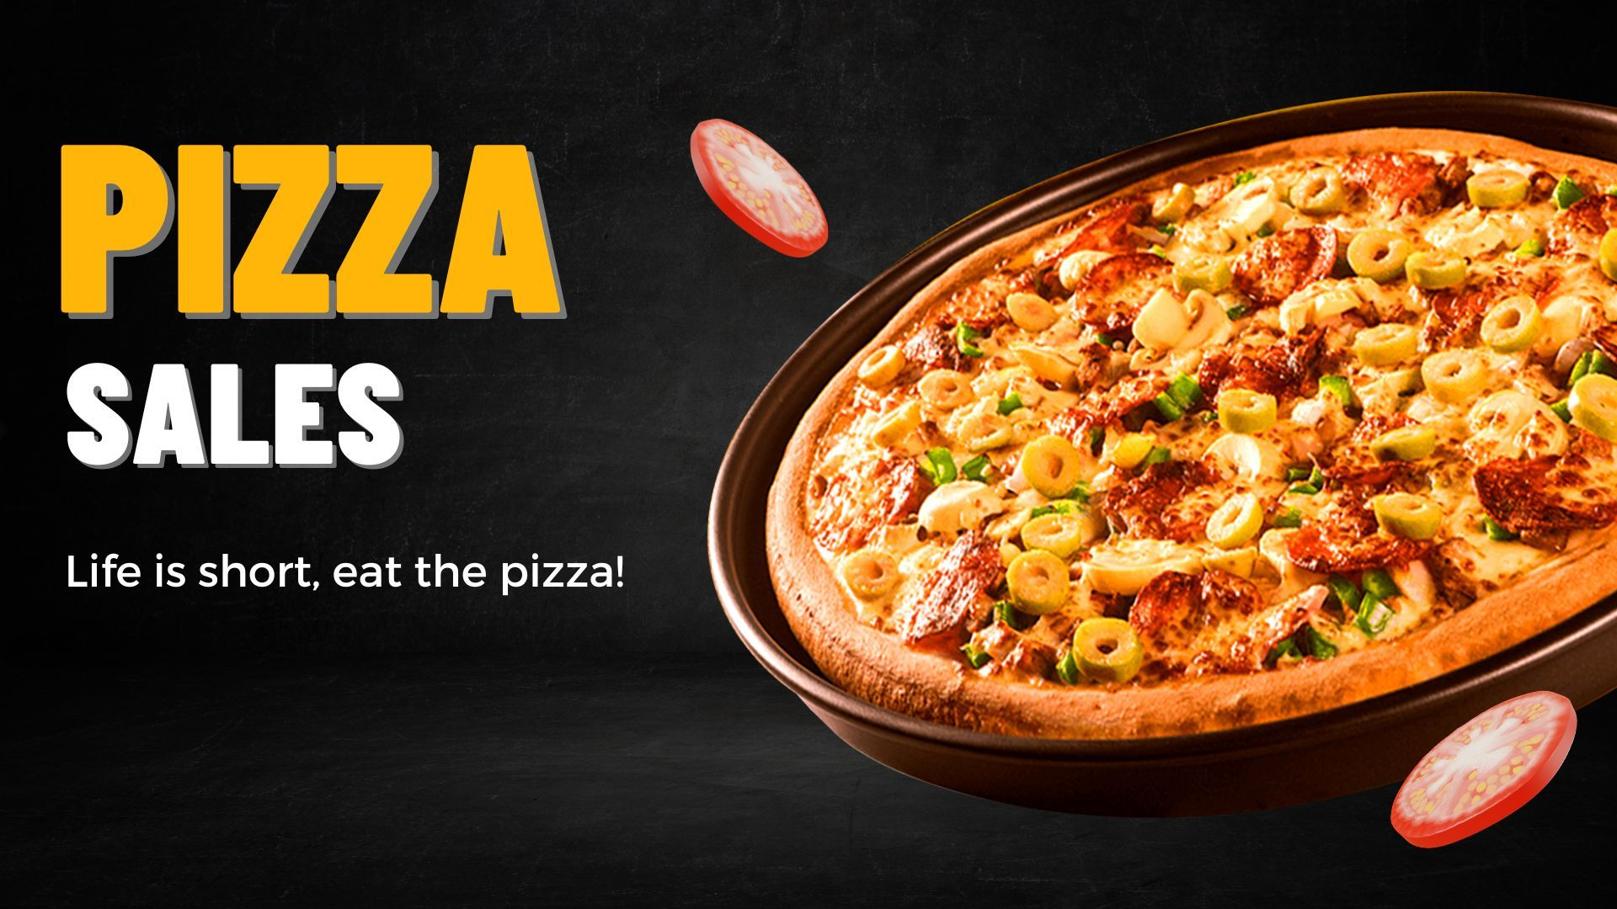
PIZZA SALES ANALYSIS

Slide 2
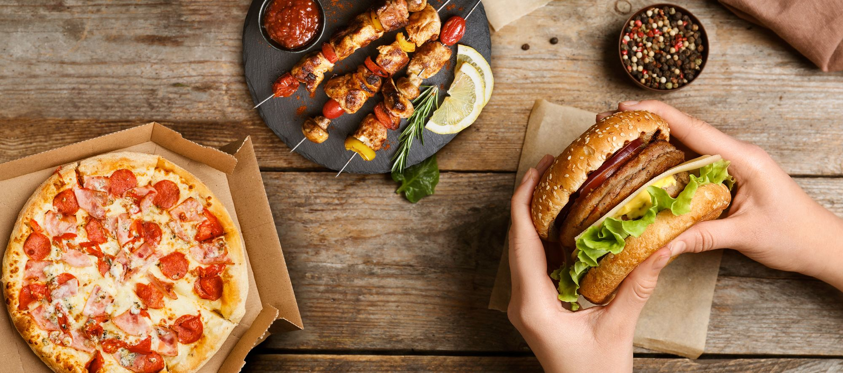
Zomato is a leading Indian food delivery and restaurant discovery platform, founded in 2008. It offers services like online ordering, reviews, and table reservations. Operating across several countries, Zomato connects millions with restaurants through a seamless digital experience.
ABOUT ZOMATO

Slide 3
AGENDA
01 Problem Statement : Understand data
02 Overview : Overview of Zomato and the purpose of the sales Analysis
03 Sales Performance Overview : Revenue trends, order volume across time periods
04 Opportunities & Recommendations : Area for improvement, strategic suggestions

Slide 4
PROBLEM STATEMENT
You are hired as a Data Analyst at Zomato with the responsibility of analyzing sales
data to support strategic decision-making. By examining order volumes, revenue trends,
restaurant performance, and category sales patterns,
your goal is to uncover insights that will:
Increase the sales revenue
Improve customer retention
Drive new user acquisition

Slide 5
DATA DESCRIPTION
Pizzas Table: Information about different pizzas including their type, size, and price.
Pizza_Types Table: Details about each pizza type, including name, category, and ingredients.
Orders Table: Records of customer orders with order ID, date, and time.
Order_Details Table: Contains detailed info on pizzas ordered in each order, including quantity.
pizza_id: is the unique identifier for each pizza. Includes pizza_type_id, size, and price.
pizza_type_id: is the unique identifier for each pizza type. Includes name, category, and ingredients.
order_id: is the unique identifier for each order. Includes date and time.
order_details_id: is the unique identifier for each entry. Includes order_id, pizza_id, and quantity.

Slide 6
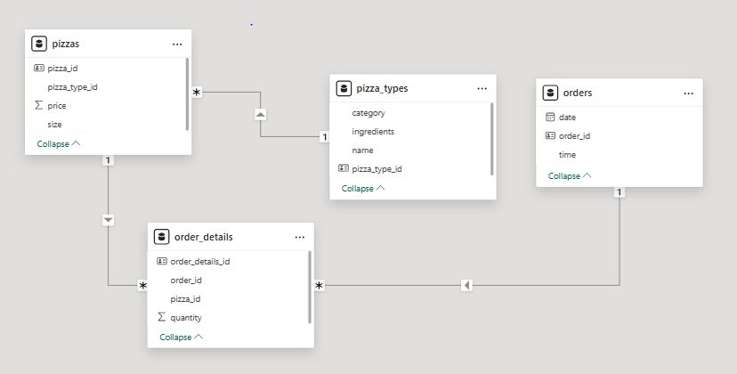
DATABASE SCHEMA

