Slide 1
https://stackoverflow.com/questions/38684175/how-to-click-allow-on-show-notifications-popup-using-selenium-webdriver
Handling notification Alert come at the Time of Automation Testing
For Old Chrome Version (<50) :
//Create a instance of ChromeOptions class
ChromeOptions options = new ChromeOptions();
//Add chrome switch to disable notification - "**--disable-notifications**"
options.addArguments("--disable-notifications");
//Set path for driver exe
System.setProperty("webdriver.chrome.driver","path/to/driver/exe");
//Pass ChromeOptions instance to ChromeDriver Constructor
WebDriver driver =new ChromeDriver(options);

Slide 2
For New Chrome Version (>50) :
//Create a map to store preferences
Map<String, Object> prefs = new HashMap<String, Object>();
//add key and value to map as follow to switch off browser notification
//Pass the argument 1 to allow and 2 to block
prefs.put("profile.default_content_setting_values.notifications", 2);
//Create an instance of ChromeOptions
ChromeOptions options = new ChromeOptions();
// set ExperimentalOption - prefs
options.setExperimentalOption("prefs", prefs);
//Now Pass ChromeOptions instance to ChromeDriver Constructor to initialize chrome driver which will switch off this browser notification on the chrome browser
WebDriver driver = new ChromeDriver(options);

Slide 3
For Firefox :
WebDriver driver ;
FirefoxProfile profile = new FirefoxProfile();
profile.setPreference("permissions.default.desktop-notification", 1);
DesiredCapabilities capabilities=DesiredCapabilities.firefox();
capabilities.setCapability(FirefoxDriver.PROFILE, profile);
driver = new FirefoxDriver(capabilities);
driver.get("http://google.com");

Slide 4
For Chrome browser :
//Create prefs map to store all preferences
Map<String, Object> prefs = new HashMap<String, Object>();
//Put this into prefs map to switch off browser notification
prefs.put("profile.default_content_setting_values.notifications", 2);
//Create chrome options to set this prefs
ChromeOptions options = new ChromeOptions();
options.setExperimentalOption("prefs", prefs);
//Now initialize chrome driver with chrome options which will switch off this browser notification on the chrome browser
WebDriver driver = new ChromeDriver(options);
//Now do your further steps
Also Do it
chrome_options = webdriver.ChromeOptions()
prefs = {"profile.default_content_setting_values.notifications": 2}
chrome_options.add_experimental_option("prefs", prefs)
driver = webdriver.Chrome(chrome_options=chrome_options)

Slide 5
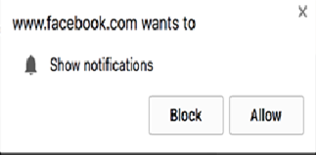
Facebook authentication window displays an overlay that covers the continue as [username] button.
This makes the continue button un-clickable. To circumvent that problem, you can hide those layers programmatically using JavaScript (not recommended) using this code (don't do this).
// DO NOT USE THIS CODE.
function forceClickSetup(targetSelector) {
return browser.selectorExecute("div",
function(divs, targetSelector) {
var button = document.querySelector(targetSelector);
for(var i = 0; i < divs.length; i++) {
if(!divs[i].contains(button)) {
divs[i].remove();
}
}
return i;
}, targetSelector);
}

Slide 6
Or instead, you can dismiss the notifications dialog, after which facebook will uncover the continue button. But before wildly hitting Escape at the browser, first make sure that the continue button has been shown.
// USE THIS CODE.
browser.waitForVisible("[name=__CONFIRM__]");
browser.keys("Escape"); // Dismiss "notifications" dialog box.
var confirmButtonSelector = "[name=__CONFIRM__]";
This solution is really Matthijs' (see comments above)

Slide 7
https://www.browserstack.com/docs/automate/selenium/handle-permission-pop-ups#Chrome
Handle pop-ups, permissions, and notifications
Learn how to manage pop-ups, permissions, and notifications in different browsers when running your Selenium tests on BrowserStack Automate.
Introduction
When testing any web application, you might encounter certain advertisement pop-ups, notifications, or permission pop-ups for camera or microphones. This guide provides code samples and solutions to handle such pop-ups when testing your application.
Some of the most common pop-ups seen in both desktop and mobile devices are as follows –
Type of pop-up | Description | Reference
Web pop-ups | These are pop-ups that appear as a separate browser window. | Web pop-ups
JS Alerts | These alerts are native browser pop-ups and are classified as an alert, a confirm alert, or a prompt alert. Check out Selenium documentation to learn more about these alerts. | JS alerts
Permission pop-ups | These alerts are raised by some applications that might need permission to access native device features, such as camera or microphone. | Permission pop-ups
Location pop-ups | These alerts are raised by applications that want to show their customers region-specific offers, currency, or other information. | Location pop-ups
Notification pop-ups | These alerts are raised by applications for permission to push notifications to the foreground of the user’s screen. | Notification pop-ups

Slide 8
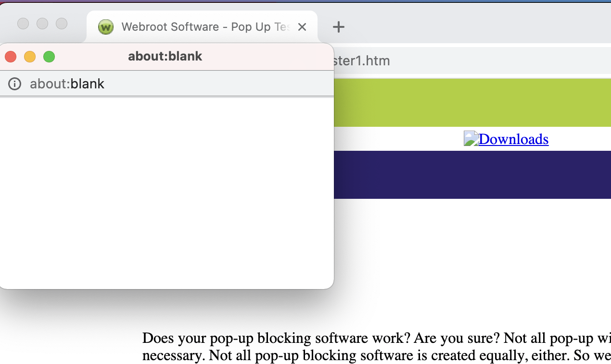
In this guide, you will also learn how to:
Handle switching tabs in iOS devices
Handle any app permission pop-up using Native context
Web pop-ups
The web pop-ups appear as a separate window when accessing a website as shown in the following image. Apart from closing the pop-up, sometimes, these pop-ups require you to click a button as acceptance optionally. These workflows are mostly related to advertising, subscription, opt-in, etc. You can handle such pop-ups, as explained in this section.

Slide 9
The default pop-up behavior in different browsers on desktop devices is as follows:
Note: You can handle most pop-ups that appear in mobile devices using NATIVE_APP context. Check out how to handle pop-ups in native context to learn about managing web pop-ups in mobile devices.
Enable all pop-ups in Safari or IE for desktop devices
To test if the pop-ups appear in Safari or IE, you can enable pop-ups as follows:
• Internet Explorer Safari
To enable the pop-ups in IE, use the browserstack.ie.enablePopups capability.
Java Ruby C# Python Node.js PHP Perl
caps.setCapability("browserstack.ie.enablePopups", "true");
Browser | Pop-ups enabled by default
Chrome | Yes
Safari | No
Edge | Yes
Firefox | Yes

Slide 10
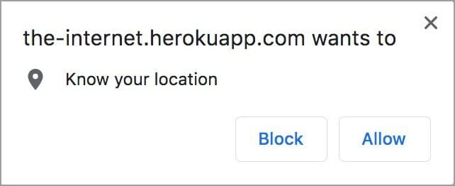
Disable all pop-ups in Chrome, Firefox, and Edge for desktop devices
Use the sample code snippets to disable pop-ups in the following browsers.
Chrome Edge Firefox
Java Ruby C# Python Node.js PHP Perl
ChromeOptions options = new ChromeOptions();
options.setExperimentalOption("excludeSwitches",Arrays.asList("disable-popup-blocking"));
caps.setCapability(ChromeOptions.CAPABILITY, options);
Know your location pop-up
Use the sample code snippets to disable the know your location pop-up in the following devices.
Desktop Mobile
If your web application requests access to your location, the following pop-up appears on the desktop where the test is running:

Slide 11
The snippet below lets you automate an Allow or Block interaction when the remote browser requests the location.
Java Node.js C# Python Ruby
import org.openqa.selenium.By;
import org.openqa.selenium.WebDriver;
import org.openqa.selenium.chrome.ChromeOptions;
import org.openqa.selenium.remote.DesiredCapabilities;
import org.openqa.selenium.remote.RemoteWebDriver;
import java.net.URL;
import java.util.HashMap;
import java.util.Map;
public class AllowGeoLocationPopup {
public static final String AUTOMATE_USERNAME = "YOUR_USERNAME";
public static final String AUTOMATE_KEY = "YOUR_ACCESS_KEY";
public static final String URL = "https://" + AUTOMATE_USERNAME + ":" + AUTOMATE_KEY + "@hub-cloud.browserstack.com/wd/hub";
public static void main(String[] args) throws Exception {
DesiredCapabilities caps = new DesiredCapabilities();
caps.setCapability("browser", "Chrome");
caps.setCapability("browser_version", "75.0");
caps.setCapability("os", "Windows");
caps.setCapability("os_version", "10");
// INIT CHROME OPTIONS
ChromeOptions options = new ChromeOptions();
Map < String, Object > prefs = new HashMap < String, Object > ();
Map < String, Object > profile = new HashMap < String, Object > ();
Map < String, Object > contentSettings = new HashMap < String, Object > ();
// SET CHROME OPTIONS
// 0 - Default, 1 - Allow, 2 - Block
contentSettings.put("geolocation", 1);
profile.put("managed_default_content_settings", contentSettings);
prefs.put("profile", profile);
options.setExperimentalOption("prefs", prefs);
// SET CAPABILITY
caps.setCapability(ChromeOptions.CAPABILITY, options);
WebDriver driver = new RemoteWebDriver(new URL(URL), caps);
driver.get("https://the-internet.herokuapp.com/geolocation");
driver.findElement(By.xpath("//*[@id='content']/div/button")).click();
Thread.sleep(5000);
driver.quit();
}
}

Slide 12
Know your location pop-up
Use the sample code snippets to disable the know your location pop-up in the following devices.
Desktop Mobile
If your web application requests access to your location, the following pop-up appears on the desktop where the test is running:
The snippet below lets you automate an Allow or Block interaction when the remote browser requests the location.
Java Node.js C# Python Ruby
import org.openqa.selenium.By;
import org.openqa.selenium.WebDriver;
import org.openqa.selenium.chrome.ChromeOptions;
import org.openqa.selenium.remote.DesiredCapabilities;
import org.openqa.selenium.remote.RemoteWebDriver;
import java.net.URL;
import java.util.HashMap;
import java.util.Map;
public class AllowGeoLocationPopup {
public static final String AUTOMATE_USERNAME = "YOUR_USERNAME";
public static final String AUTOMATE_KEY = "YOUR_ACCESS_KEY";
public static final String URL = "https://" + AUTOMATE_USERNAME + ":" + AUTOMATE_KEY + "@hub-cloud.browserstack.com/wd/hub";
public static void main(String[] args) throws Exception {
DesiredCapabilities caps = new DesiredCapabilities();
caps.setCapability("browser", "Chrome");
caps.setCapability("browser_version", "75.0");
caps.setCapability("os", "Windows");
caps.setCapability("os_version", "10");
// INIT CHROME OPTIONS
ChromeOptions options = new ChromeOptions();
Map < String, Object > prefs = new HashMap < String, Object > ();
Map < String, Object > profile = new HashMap < String, Object > ();
Map < String, Object > contentSettings = new HashMap < String, Object > ();
// SET CHROME OPTIONS
// 0 - Default, 1 - Allow, 2 - Block
contentSettings.put("geolocation", 1);
profile.put("managed_default_content_settings", contentSettings);
prefs.put("profile", profile);
options.setExperimentalOption("prefs", prefs);
// SET CAPABILITY
caps.setCapability(ChromeOptions.CAPABILITY, options);
WebDriver driver = new RemoteWebDriver(new URL(URL), caps);
driver.get("https://the-internet.herokuapp.com/geolocation");
driver.findElement(By.xpath("//*[@id='content']/div/button")).click();
Thread.sleep(5000);
driver.quit();
}
}

Slide 13
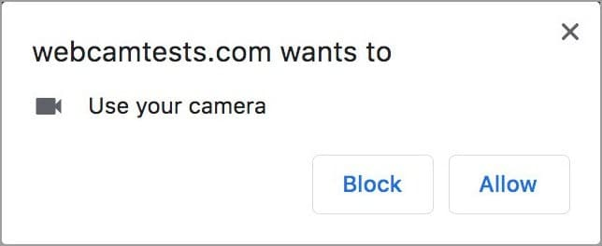
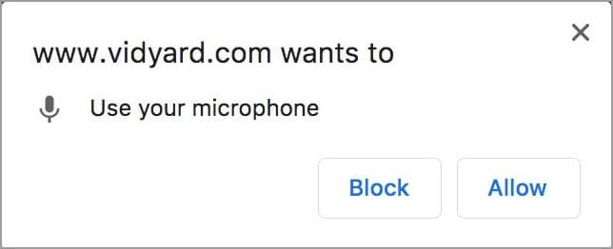
Camera and microphone pop-ups
Use the sample code snippets to disable the camera and microphone pop-ups on the following devices.
Desktop Mobile
When a web application requires access to the camera and microphone, the following pop-ups appear on the desktop:
The snippet below lets you automate an Allow or Block interaction when your web app requests access to a camera or microphone.

Slide 14
Java Node.js C# Python Ruby
import org.openqa.selenium.By;
import org.openqa.selenium.WebDriver;
import org.openqa.selenium.chrome.ChromeOptions;
import org.openqa.selenium.remote.DesiredCapabilities;
import org.openqa.selenium.remote.RemoteWebDriver;
import java.net.URL;
public class AllowCameraPopupChrome {
public static final String AUTOMATE_USERNAME = "YOUR_USERNAME";
public static final String AUTOMATE_KEY = "YOUR_ACCESS_KEY";
public static final String URL = "https://" + AUTOMATE_USERNAME + ":" + AUTOMATE_KEY + "@hub-cloud.browserstack.com/wd/hub";
public static void main(String[] args) throws Exception {
//Configure ChromeOptions to pass fake media stream
ChromeOptions options = new ChromeOptions();
options.addArguments("use-fake-device-for-media-stream");
options.addArguments("use-fake-ui-for-media-stream");
DesiredCapabilities caps = new DesiredCapabilities();
caps.setCapability("browser", "Chrome");
caps.setCapability("browser_version", "75.0");
caps.setCapability("os", "Windows");
caps.setCapability("os_version", "10");
caps.setCapability(ChromeOptions.CAPABILITY, options);
WebDriver driver = new RemoteWebDriver(new URL(URL), caps);
//WebCam Test
driver.get("https://webcamtests.com/check");
Thread.sleep(5000);
driver.findElement(By.id("webcam-launcher")).click();
Thread.sleep(2000);
//Mic Test
driver.get("https://www.vidyard.com/mic-test/");
Thread.sleep(2000);
driver.findElement(By.xpath("//a[@id='start-test']")).click();
Thread.sleep(2000);
driver.quit();
}
}

Slide 15
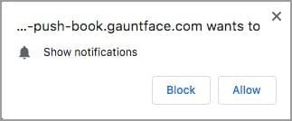
Show notifications pop-ups
Use the sample code snippets to disable the notification pop-up in the following devices.
Desktop Mobile
When your web application requests permission to show notifications, the following pop-up appears on desktop devices:
The snippet below lets you automate an Allow or Block interaction when your web app requests permission to show notifications.
Java Node.js C# Python Ruby
import org.openqa.selenium.By;
import org.openqa.selenium.WebDriver;
import org.openqa.selenium.chrome.ChromeOptions;
import org.openqa.selenium.remote.DesiredCapabilities;
import org.openqa.selenium.remote.RemoteWebDriver;
import java.net.URL;
import java.util.HashMap;
import java.util.Map;
public class AllowNotificationPopupDesktop {
public static final String AUTOMATE_USERNAME = "YOUR_USERNAME";
public static final String AUTOMATE_KEY = "YOUR_ACCESS_KEY";
public static final String URL = "https://" + AUTOMATE_USERNAME + ":" + AUTOMATE_KEY + "@hub-cloud.browserstack.com/wd/hub";
public static void main(String[] args) throws Exception {
DesiredCapabilities caps = new DesiredCapabilities();
caps.setCapability("browser", "Chrome");
caps.setCapability("browser_version", "75.0");
caps.setCapability("os", "Windows");
caps.setCapability("os_version", "10");
// INIT CHROME OPTIONS
ChromeOptions options = new ChromeOptions();
Map<String, Object> prefs = new HashMap<String, Object>();
Map<String, Object> profile = new HashMap<String, Object>();
Map<String, Object> contentSettings = new HashMap<String, Object>();
// SET CHROME OPTIONS
// 0 - Default, 1 - Allow, 2 - Block
contentSettings.put("notifications", 1);
profile.put("managed_default_content_settings", contentSettings);
prefs.put("profile", profile);
options.setExperimentalOption("prefs", prefs);
// SET CAPABILITY
caps.setCapability(ChromeOptions.CAPABILITY, options);
WebDriver driver = new RemoteWebDriver(new URL(URL), caps);
driver.get("https://web-push-book.gauntface.com/demos/notification-examples/");
driver.findElement(By.xpath("//body/main[1]/p[3]/input[1]")).click();
Thread.sleep(2000);
driver.quit();
}
}

