Slide 1
SQL Commands for MySQL and CMD prompt
CMD Prompt Commands
Show databases; -> for showing all databases in database
use <database_name>; -> changing database or choose particular database
show tables; -> list of selected database tables
select * from <table_name>; -> see data from selected database

Slide 2
SQL Commands
DDL (Data Definition Language) :-
CREATE, ALTER, Drop, TRUNCATE, RENAME
DML (Data Manipulation Language) :-
- INSERT, UPDATE, DELETE
DRL/DQL (Data Retrieval / Data Query Language) :-
- SELECT
TCL (Transaction Control Language) ;-
- COMMIT, ROLLBACK, SAVE POINT
DCL (Data Control Language) ;-
- GRANT, REVOKE

Slide 3
Create Data base / Schema
create database <name>; -> for creating new database use in CMD and GUI also
drop database <name> -> for deleting particular database from database use in CMD & GUI
create schema <name>; -> for creating new schema in list use in CMD & GUI
drop schema <name>; for deleting selected schema from list use in CMD & GUI
create database if not exists <name>; -> it doesn’t showing any error just given a warning use in CMD & GUI

Slide 4
Creating Table
----------------------------------------------------------------------------------------------------------------------
create table <TABLE_NAME>(col1 datatype, col2 datatype, col3 datatype…….);
Example :
use pd;
create table pd (SNO int (5), SNAME varchar (20), SMARKS int (3));
describe <table_name>; -> it shows all the fields, field entry type, and all details
Example :
describe candi;

Slide 5
Inserting data into table
Insert into <table_name> values(VAL1, VAL2, VAL3,………);
Example :
use pd;
insert into candi values(101,’KARAN’,85);
insert into candi values(102,’PARAM’,95);
insert into candi values(103,’RAM’,null); -> its use for when any value doesn’t know
If want to pass data into table by changing order then use command like
insert into candi (SNAME,SNO,SMARKS) values(‘RAJ’,104,55);
SQL
Created database
Created Table > candi
Inserted data in to the candi

Slide 6
Selecting/Retrieve Rows from a table
USE world;
SELECT * from country;
SELECT Code,Name,Continent,Region from country;
SELECT Code C,Name N,Continent C,Region R from country;
- in the red colour means we can change the Row name as we want its called as alias.
USE world;
SELECT * from city;
SELECT ID id,Name N,CountryCode CC,Population+5000 P from city;
-If want to increase value with 5000

Slide 7
SQL Databases
Numeric
Text
Data / Time
Numeric
Data type | Description
BIT(size) | A bit-value type. The number of bits per value is specified in size. The size parameter can hold a value from 1 to 64. The default value for size is 1.
TINYINT(size) | A very small integer. Signed range is from -128 to 127. Unsigned range is from 0 to 255. The size parameter specifies the maximum display width (which is 255)
BOOL | Zero is considered as false, nonzero values are considered as true.
BOOLEAN | Equal to BOOL
SMALLINT(size) | A small integer. Signed range is from -32768 to 32767. Unsigned range is from 0 to 65535. The size parameter specifies the maximum display width (which is 255)
MEDIUMINT(size) | A medium integer. Signed range is from -8388608 to 8388607. Unsigned range is from 0 to 16777215. The size parameter specifies the maximum display width (which is 255)
INT(size) | A medium integer. Signed range is from -2147483648 to 2147483647. Unsigned range is from 0 to 4294967295. The size parameter specifies the maximum display width (which is 255)
INTEGER(size) | Equal to INT(size)
BIGINT(size) | A large integer. Signed range is from -9223372036854775808 to 9223372036854775807. Unsigned range is from 0 to 18446744073709551615. The size parameter specifies the maximum display width (which is 255)
FLOAT(size, d) | A floating point number. The total number of digits is specified in size. The number of digits after the decimal point is specified in the d parameter. This syntax is deprecated in MySQL 8.0.17, and it will be removed in future MySQL versions
FLOAT(p) | A floating point number. MySQL uses the p value to determine whether to use FLOAT or DOUBLE for the resulting data type. If p is from 0 to 24, the data type becomes FLOAT(). If p is from 25 to 53, the data type becomes DOUBLE()
DOUBLE(size, d) | A normal-size floating point number. The total number of digits is specified in size. The number of digits after the decimal point is specified in the d parameter
DOUBLE PRECISION(size, d)
DECIMAL(size, d) | An exact fixed-point number. The total number of digits is specified in size. The number of digits after the decimal point is specified in the d parameter. The maximum number for size is 65. The maximum number for d is 30. The default value for size is 10. The default value for d is 0.
DEC(size, d) | Equal to DECIMAL(size,d)

Slide 8
Data type | Description | Storage
bit | Integer that can be 0, 1, or NULL
tinyint | Allows whole numbers from 0 to 255 | 1 byte
smallint | Allows whole numbers between -32,768 and 32,767 | 2 bytes
int | Allows whole numbers between -2,147,483,648 and 2,147,483,647 | 4 bytes
bigint | Allows whole numbers between -9,223,372,036,854,775,808 and 9,223,372,036,854,775,807 | 8 bytes
decimal(p,s) | Fixed precision and scale numbers. Allows numbers from -10^38 +1 to 10^38 –1. The p parameter indicates the maximum total number of digits that can be stored (both to the left and to the right of the decimal point). p must be a value from 1 to 38. Default is 18. The s parameter indicates the maximum number of digits stored to the right of the decimal point. s must be a value from 0 to p. Default value is 0 | 5-17 bytes
numeric(p,s) | Fixed precision and scale numbers. Allows numbers from -10^38 +1 to 10^38 –1. The p parameter indicates the maximum total number of digits that can be stored (both to the left and to the right of the decimal point). p must be a value from 1 to 38. Default is 18. The s parameter indicates the maximum number of digits stored to the right of the decimal point. s must be a value from 0 to p. Default value is 0 | 5-17 bytes
smallmoney | Monetary data from -214,748.3648 to 214,748.3647 | 4 bytes
money | Monetary data from -922,337,203,685,477.5808 to 922,337,203,685,477.5807 | 8 bytes
float(n) | Floating precision number data from -1.79E + 308 to 1.79E + 308. The n parameter indicates whether the field should hold 4 or 8 bytes. float(24) holds a 4-byte field and float(53) holds an 8-byte field. Default value of n is 53. | 4 or 8 bytes
real | Floating precision number data from -3.40E + 38 to 3.40E + 38 | 4 bytes

Slide 9
Text / String
Data type | Description
BIT(size) | A bit-value type. The number of bits per value is specified in size. The size parameter can hold a value from 1 to 64. The default value for size is 1.
TINYINT(size) | A very small integer. Signed range is from -128 to 127. Unsigned range is from 0 to 255. The size parameter specifies the maximum display width (which is 255)
BOOL | Zero is considered as false, nonzero values are considered as true.
BOOLEAN | Equal to BOOL
SMALLINT(size) | A small integer. Signed range is from -32768 to 32767. Unsigned range is from 0 to 65535. The size parameter specifies the maximum display width (which is 255)
MEDIUMINT(size) | A medium integer. Signed range is from -8388608 to 8388607. Unsigned range is from 0 to 16777215. The size parameter specifies the maximum display width (which is 255)
INT(size) | A medium integer. Signed range is from -2147483648 to 2147483647. Unsigned range is from 0 to 4294967295. The size parameter specifies the maximum display width (which is 255)
INTEGER(size) | Equal to INT(size)
BIGINT(size) | A large integer. Signed range is from -9223372036854775808 to 9223372036854775807. Unsigned range is from 0 to 18446744073709551615. The size parameter specifies the maximum display width (which is 255)
FLOAT(size, d) | A floating point number. The total number of digits is specified in size. The number of digits after the decimal point is specified in the d parameter. This syntax is deprecated in MySQL 8.0.17, and it will be removed in future MySQL versions
FLOAT(p) | A floating point number. MySQL uses the p value to determine whether to use FLOAT or DOUBLE for the resulting data type. If p is from 0 to 24, the data type becomes FLOAT(). If p is from 25 to 53, the data type becomes DOUBLE()
DOUBLE(size, d) | A normal-size floating point number. The total number of digits is specified in size. The number of digits after the decimal point is specified in the d parameter
DOUBLE PRECISION(size, d)
DECIMAL(size, d) | An exact fixed-point number. The total number of digits is specified in size. The number of digits after the decimal point is specified in the d parameter. The maximum number for size is 65. The maximum number for d is 30. The default value for size is 10. The default value for d is 0.
DEC(size, d) | Equal to DECIMAL(size,d)

Slide 10
Data type | Description | Max size | Storage
char(n) | Fixed width character string | 8,000 characters | Defined width
varchar(n) | Variable width character string | 8,000 characters | 2 bytes + number of chars
varchar(max) | Variable width character string | 1,073,741,824 characters | 2 bytes + number of chars
text | Variable width character string | 2GB of text data | 4 bytes + number of chars
nchar | Fixed width Unicode string | 4,000 characters | Defined width x 2
nvarchar | Variable width Unicode string | 4,000 characters
nvarchar(max) | Variable width Unicode string | 536,870,912 characters
ntext | Variable width Unicode string | 2GB of text data
binary(n) | Fixed width binary string | 8,000 bytes
varbinary | Variable width binary string | 8,000 bytes
varbinary(max) | Variable width binary string | 2GB
image | Variable width binary string | 2GB

Slide 11
Date / Time Datatype
Data type | Description
DATE | A date. Format: YYYY-MM-DD. The supported range is from '1000-01-01' to '9999-12-31'
DATETIME(fsp) | A date and time combination. Format: YYYY-MM-DD hh:mm:ss. The supported range is from '1000-01-01 00:00:00' to '9999-12-31 23:59:59'. Adding DEFAULT and ON UPDATE in the column definition to get automatic initialization and updating to the current date and time
TIMESTAMP(fsp) | A timestamp. TIMESTAMP values are stored as the number of seconds since the Unix epoch ('1970-01-01 00:00:00' UTC). Format: YYYY-MM-DD hh:mm:ss. The supported range is from '1970-01-01 00:00:01' UTC to '2038-01-09 03:14:07' UTC. Automatic initialization and updating to the current date and time can be specified using DEFAULT CURRENT_TIMESTAMP and ON UPDATE CURRENT_TIMESTAMP in the column definition
TIME(fsp) | A time. Format: hh:mm:ss. The supported range is from '-838:59:59' to '838:59:59'
YEAR | A year in four-digit format. Values allowed in four-digit format: 1901 to 2155, and 0000. MySQL 8.0 does not support year in two-digit format.

Slide 12
Data type | Description
DATE | A date. Format: YYYY-MM-DD. The supported range is from '1000-01-01' to '9999-12-31'
DATETIME(fsp) | A date and time combination. Format: YYYY-MM-DD hh:mm:ss. The supported range is from '1000-01-01 00:00:00' to '9999-12-31 23:59:59'. Adding DEFAULT and ON UPDATE in the column definition to get automatic initialization and updating to the current date and time
TIMESTAMP(fsp) | A timestamp. TIMESTAMP values are stored as the number of seconds since the Unix epoch ('1970-01-01 00:00:00' UTC). Format: YYYY-MM-DD hh:mm:ss. The supported range is from '1970-01-01 00:00:01' UTC to '2038-01-09 03:14:07' UTC. Automatic initialization and updating to the current date and time can be specified using DEFAULT CURRENT_TIMESTAMP and ON UPDATE CURRENT_TIMESTAMP in the column definition
TIME(fsp) | A time. Format: hh:mm:ss. The supported range is from '-838:59:59' to '838:59:59'
YEAR | A year in four-digit format. Values allowed in four-digit format: 1901 to 2155, and 0000. MySQL 8.0 does not support year in two-digit format.

Slide 13
Other Datatype
Data type | Description
DATE | A date. Format: YYYY-MM-DD. The supported range is from '1000-01-01' to '9999-12-31'
DATETIME(fsp) | A date and time combination. Format: YYYY-MM-DD hh:mm:ss. The supported range is from '1000-01-01 00:00:00' to '9999-12-31 23:59:59'. Adding DEFAULT and ON UPDATE in the column definition to get automatic initialization and updating to the current date and time
TIMESTAMP(fsp) | A timestamp. TIMESTAMP values are stored as the number of seconds since the Unix epoch ('1970-01-01 00:00:00' UTC). Format: YYYY-MM-DD hh:mm:ss. The supported range is from '1970-01-01 00:00:01' UTC to '2038-01-09 03:14:07' UTC. Automatic initialization and updating to the current date and time can be specified using DEFAULT CURRENT_TIMESTAMP and ON UPDATE CURRENT_TIMESTAMP in the column definition
TIME(fsp) | A time. Format: hh:mm:ss. The supported range is from '-838:59:59' to '838:59:59'
YEAR | A year in four-digit format. Values allowed in four-digit format: 1901 to 2155, and 0000. MySQL 8.0 does not support year in two-digit format.

Slide 14
MS Access Data Types
Data type | Description | Storage
Text | Use for text or combinations of text and numbers. 255 characters maximum
Memo | Memo is used for larger amounts of text. Stores up to 65,536 characters. Note: You cannot sort a memo field. However, they are searchable
Byte | Allows whole numbers from 0 to 255 | 1 byte
Integer | Allows whole numbers between -32,768 and 32,767 | 2 bytes
Long | Allows whole numbers between -2,147,483,648 and 2,147,483,647 | 4 bytes
Single | Single precision floating-point. Will handle most decimals | 4 bytes
Double | Double precision floating-point. Will handle most decimals | 8 bytes
Currency | Use for currency. Holds up to 15 digits of whole dollars, plus 4 decimal places. Tip: You can choose which country's currency to use | 8 bytes
AutoNumber | AutoNumber fields automatically give each record its own number, usually starting at 1 | 4 bytes
Date/Time | Use for dates and times | 8 bytes
Yes/No | A logical field can be displayed as Yes/No, True/False, or On/Off. In code, use the constants True and False (equivalent to -1 and 0). Note: Null values are not allowed in Yes/No fields | 1 bit
Ole Object | Can store pictures, audio, video, or other BLOBs (Binary Large Objects) | up to 1GB
Hyperlink | Contain links to other files, including web pages
Lookup Wizard | Let you type a list of options, which can then be chosen from a drop-down list | 4 bytes

Slide 15
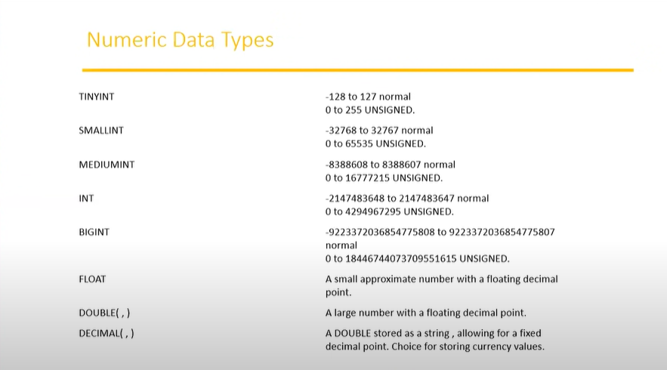

Slide 16
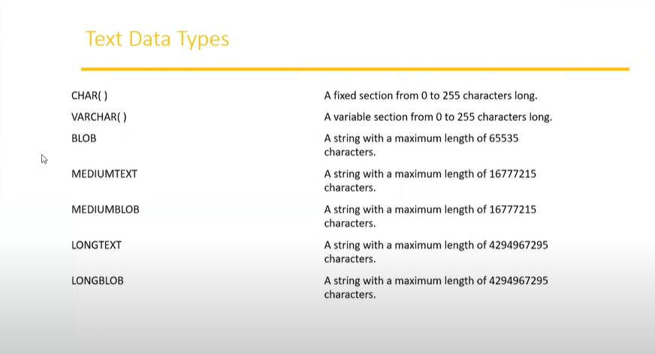

Slide 17
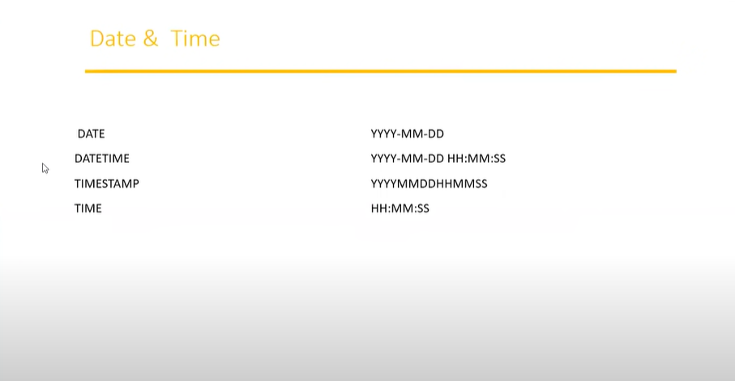

Slide 18
Created Database
Created Table confi
Inserted data in to confi table
Select / Retrieve the data from a table
Where (Filtering record base on conditions)
DISTINCT (Displays unique records)

Slide 19
Where clause
Used for selecting the rows based on condition.(Filtering the rows using where condition)
use world;
SELECT * from country;
SELECT * from country where Population>2000000;
SELECT * from country where Population<=2000000;
SELECT * from country where Code='AFG';
SELECT * from country where IndepYear<=1940;
SELECT * from country where IndepYear>=1940;
USE pd;
SELECT * from candi;
SELECT * from candi where SNO=null;
- This is not showing any records because null is not accepting any arithmetic operations
SELECT * from candi where SNO is null;
SELECT * from candi where SNAME = 'Geeta';

Slide 20
DISTINCT
use world;
SELECT * from country;
SELECT DISTINCT Continent from country;
- DISTINCT (Displays unique records)
SELECT DISTINCT * from country;

Slide 21
Logical Operators (AND,OR,NOT)
----------------------------------------------------------------------------------------------------------------------------------------------
use world;
SELECT * FROM world.city;
SELECT * FROM city WHERE Population<1700000 AND CountryCode='AFG';
SELECT * FROM city WHERE Population>1700000 OR CountryCode='AFG';
SELECT * FROM city WHERE NOT CountryCode='AFG’;
BETWEEN & IN Operators
----------------------------------------------------------------------------------------------------------------------------------------------
Between -> Used to display the row which is following in the range of values
Not Between
use world;
SELECT * FROM world.city;
SELECT * FROM city WHERE Population<1700000 AND CountryCode='AFG’;
SELECT * FROM city WHERE Population>=100000 AND Population<=150000;
-> we can write down this query like this using arithmetic operators
SELECT * FROM city WHERE Population>1700000 OR CountryCode='AFG';
SELECT * FROM city WHERE NOT CountryCode='AFG';

Slide 22
In -> IN operator returns the row when the values are matching in the list
Not IN
SELECT * FROM city WHERE Name='Kabul' OR Name='Herat' OR Name='Haag’;
we can write down the query as follows
SELECT * FROM city WHERE Name IN('Kabul','Herat','Haag');
SELECT * FROM city WHERE Name NOT IN('Kabul','Herat','Haag');

Slide 23
Pattern Matching Operators (whiled card characters)
----------------------------------------------------------------------------------------------------------------------------------------------
% --> many characters
_ --> single characters
SELECT * From city WHERE CountryCode LIKE 'N%’;
First Character Should be 'N’
SELECT * From city WHERE CountryCode LIKE '%G’;
Last character should be ‘G’.
SELECT * From city WHERE CountryCode LIKE 'N%R’;
Starting character is ‘N’ and Ending character is ‘R’
SELECT * From city WHERE District LIKE '%r%’;
Finds any values that have "r" in any position
SELECT * From city WHERE CountryCode NOT LIKE 'N%’;
Finds no one character starts from ‘N’
SELECT * From city WHERE CountryCode NOT LIKE ‘%O’;
Finds no one character ends from ‘O’
SELECT * From city WHERE CountryCode LIKE ‘%n_’;
Represents only those data which contains ‘n’ character and after ‘n’ only one character presents.
SELECT * From city WHERE District LIKE '___’;
It find only those data which contains only 3 characters.

Slide 24
DDL (Data Definition Language) Commands
----------------------------------------------------------------------------------------------------------------------------------------------
CREATE :-- is used to create database objects(Database,Views,Tables,synonymes,etc…)
ALTER
Adding a new column
Dropping the existing column
Modifying the existing column (Increase/Decrease size of the column & change the data type of the column)
Renaming the column
use pd;
DROP TABLE student;
CREATE TABLE STUDENT
(SID INT (4),SNAME VARCHAR (15));
DESCRIBE STUDENT;
INSERT INTO STUDENT VALUES (101,'David');
INSERT INTO STUDENT VALUES (102,'Rozer');
INSERT INTO STUDENT VALUES (103,'Adam');
COMMIT;
SELECT * FROM STUDENT;
ALTER TABLE STUDENT ADD(GRADE VARCHAR (2));
ALTER TABLE STUDENT DROP COLUMN GRADE;
ALTER TABLE STUDENT MODIFY COLUMN SNAME VARCHAR(25);
ALTER TABLE STUDENT RENAME COLUMN STUNAME TO STU_NAME;
ALTER TABLE STUDENT RENAME COLUMN STUID TO STU_ID;

Slide 25
DROP :-
It delete the table from database
DROP TABLE STUDENT;
TRUNCATE :-
It deletes all data permanentally from table but still data structure are present
TRUNCATE TABLE STUDENT;
DELETE :-
It will also deletes all data from table but still data structure are present but we can retrieve the data after using delete command
SET autocommit=0;
SET SQL_SAFE_UPDATES=0;
SELECT * FROM STUDENT;
DELETE FROM STUDENT;
COMMIT;
ROLLBACK; -- It use for retrieve deleted data

Slide 26
Rename
----------------------------------------------------------------------------------------------------------------------------------------------
RENAME THE COLUMN :-
ALTER TABLE STUDENT RENAME COLUMN STUNAME TO STU_NAME;
ALTER TABLE STUDENT RENAME COLUMN STUID TO STU_ID;
RENAME THE TABLE :-
RENAME TABLE student TO students;

Slide 27
Built-in Functions in MySQL
-------------------------------------------------------------------------------------------------------------------------------------------------------------
MySQL Functions
String Functions – operate on string data type
Numeric Functions – operate on numeric data type
Date Function – operate on date data type
Aggregate Functions – operate on all types of the data types and produce summarized result sets.

Slide 28
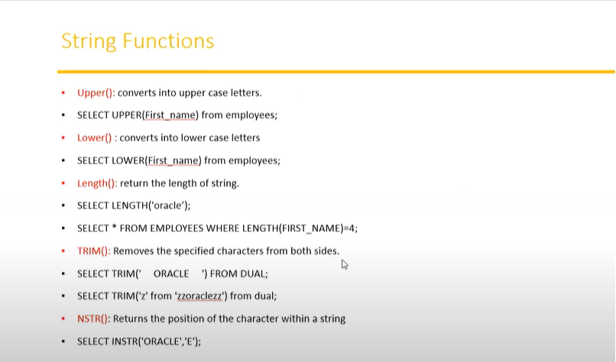

Slide 29
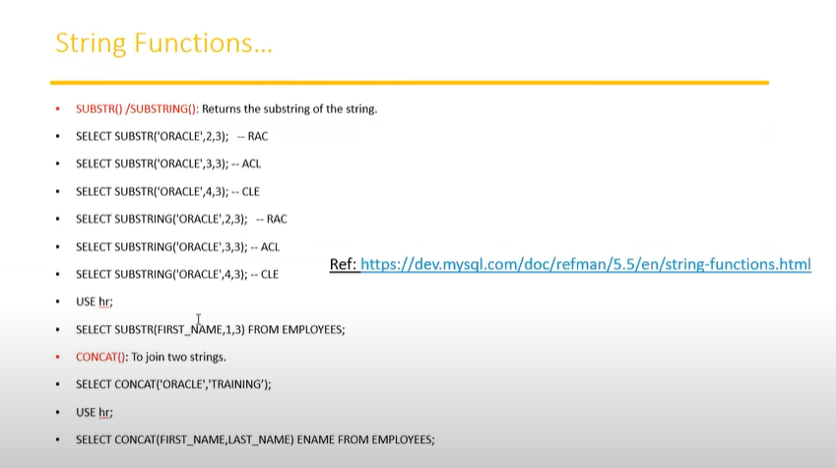

Slide 30
SELECT * FROM pd.student;
select * from student;
SELECT UPPER('David');
SELECT UPPER(STU_NAME) from student;
SELECT LOWER(STU_NAME) from student;
SELECT LENGTH('WELCOME BRO');
SELECT LENGTH(STU_NAME) FROM student;
-- Print name of students who’s name has 4 characters
SELECT * FROM student WHERE LENGTH(STU_NAME)=4;
SELECT TRIM(' WELCOME ');
SELECT TRIM('z' from 'zzoraclezz');
SELECT INSTR('SYNONYMES','M');
SELECT SUBSTR('ORACLE',2,4); -- RACL
SELECT SUBSTRING('ORACLE',2,3); -- RAC
SELECT SUBSTRING(STU_NAME,1,3) FROM student;
SELECT CONCAT('oracle','trainings'); -- oracletrainings
SELECT CONCAT(STU_ID,STU_NAME) FROM student;
SELECT CONCAT(STU_ID,STU_NAME)ENAME FROM student;

Slide 31
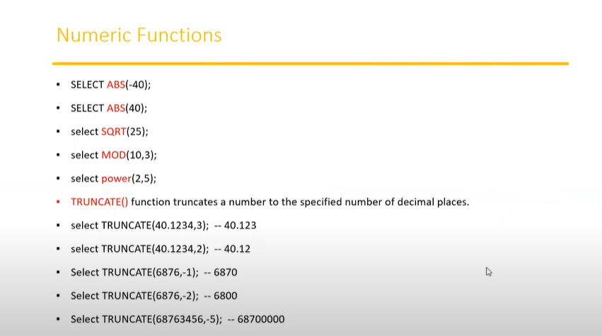

Slide 32
SQL Tutorial 6 20:00

