Slide 1
CYPRESS
Learn Step by Step

Slide 2
Introduction
For complete beginners
Will start from scratch
Go Step by Step
No prior experience required
Demo | Examples | Hands on
Quizzes

Slide 3
We will run step by step
What is Cypress
Getting Started
Installation & Setup
IDE & Prerequisites
Object Locators
Cypress with JavaScript
Cypress with TypeScript
Assertions
Page Object Model
App Actions
CLI
Package.json
File Handling
(Read, Write, Upload, Download)
Reporting
API Testing
Custom Commands
Cypress Studio
Cypress Dashboard
Cypress BDD Cucumber
Database Integration
Git
Jenkins

Slide 4
What is Cypress
Test Automation tool
Can test anything that runs on a Web Browser
Write tests in JavaScript or TypeScript
does not use Selenium
Open source
Website : cypress.io
Cypres tests run with JavaScript, so you can use JavaScript or any Language that transpiles down to javascript like TypeScript.

Slide 5
Does Cypress use Selenium / Webdriver?
No. In fact Cypress' architecture is very different from Selenium in a few critical ways:
Cypress runs in the context of the browser. With Cypress it's easier to inspect what is running in the browser, but harder to talk to the outside world. In Selenium it's the exact opposite. Selenium runs outside of the browser where your application is running (though Cypress is adding more commands every day that give you access to the outside world - like cy.request(), cy.exec(), and cy.task()).
With Selenium you get either 100% simulated events (with Selenium RC) or 100% native events (with Selenium WebDriver). With Cypress, you get both. For the most part we use simulated events. However we do use automation APIs for things like Cookies where we extend outside of the JavaScript sandbox and interact with the underlying browser APIs. This gives us flexibility to determine which type of event to use in specific situations. Native event support is on our roadmap.

Slide 6
How to use Cypress
Setup tests
Write tests
Run tests
Debug
Supported Browsers
Chrome, Firefox, Edge, Electrone, Brave.
Check the current supported browsers here:
http://docs.cypress.io/guiodes/launching-browsers

Slide 7
Cypress Features
Time Travel takes snapshots as your tests run.
Debugging readable errors and stack traces.
Automatic Waiting automatically waits for commands and assertions before moving on.
Consistent Results doesn’t use Selenium or Webdriver. Fast, consistent and reliable .
Screenshots and Videos get screenshots and videos.
Cross browser testing locally or remote (CI CD).

Slide 8
Cypress enables you to write all types of tests :
Cypress enables you to write all types of tests :
End-to-end tests
Integration tests
Unit tests

Slide 9
Cypress prerequisites :
Windows 7 or above (64-bit only)
macOS 10.9 and above (64-bit only)
Linux Ubuntu 12.04 and above, Fedora 21 and Debian 8 (64-bit only)
Nodejs 10 or 12 and above
Download Nodejs for windows
website : https://nodejs.org/en/download/
Can check the latest prerequisites here
website : https://docs.cypress .io/guides/getting-started/installing-cypress#System-requirements

Slide 10
IDE - Visual Studio Code
Step 1 : Download and open visual studio code
website : https://code.visualstudio.com/download
Step 2 : Explore GUI - Interface Overview
Step 3 : Command Palette – ctrl + shift + P
Step 4 : Open folder
Step 5 : Create file
Step 6 : Add Extensions
Step 7 : Create and run code
Activity bar
Menu
Editors
Status bar

Slide 11
Cypress project setup
Step 1 : Install Nodejs
Step 2 : Install Visual Studio Code (VS Code)
Step 3 : Create a new folder for Cypress project
Step 4 : Open folder in VS Code
Step 5 : Open VS Code terminal & run command npm init-y
Step 6 : Install Cypress npm install cypress npx cypress –v
npx cypress verify
Step 7 : Open cypress npx cypress open

Slide 12
Cypress 1st Test
Step 1 : Create a file under cypress folder
Step 2 : At the top mention /// <reference types=“cypress”/>
To write a test we need a test runner – mocha
mocha comes built-in with cypress
Step 3 : Write test function
it(‘google search’,() {
cy.visit(‘https://google.com/’)})
Step 4 : Run test npx cypress open
See what happens when you make any changes & save
Step 5 : Access the elements

Slide 13
Command we learned
cy.visit() cy.visit(‘https://google.com/’)
cy.get() cy.get(‘.class’)
type() cy.get(‘.class’).type(‘1234’)
click cy.get(‘.class’).click()

Slide 14
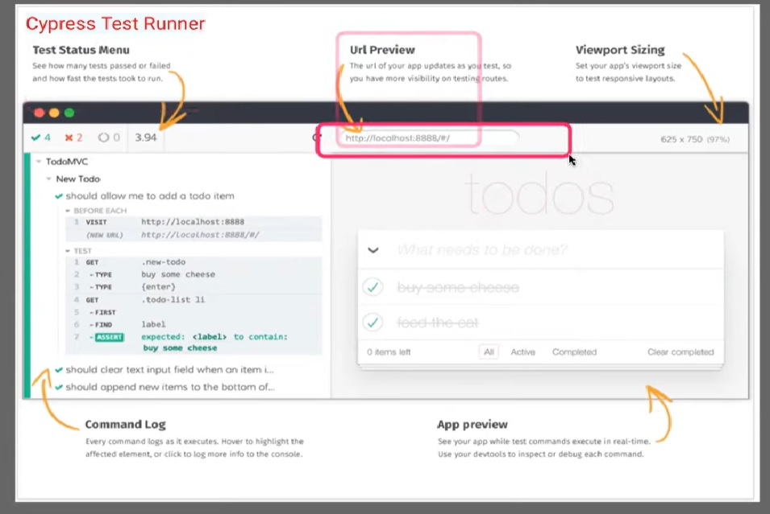

Slide 15
How to access elements
Step 1 : Run test
Step 2 : On the browser – App Preview – click Selector Playground
Step 3 : Copy the cy.get command and paste in the test script
Step 4 : Add custom timeouts – command level
cy.get(‘.className’,{timeout:5000}).type(‘1234{enter}’)
Step 5 : Add custom timeouts – global level - cypress.json
“defaultCommandTimeout”: 10000
Step 6 : Access element with text
cy.contains(‘Videos’).click()

Slide 16
We learned
Ways to access and interact with elements
Adding custom timeouts – command level
Adding Custom timeouts – global level
------------------------------------------------------------------------------------------------------------------------------------
cy.contains() cy.contains(‘Videos’).click()
cy.wait() cy.wait(5000)
Check more on Cypress.io – Interacting with Elements

Slide 17
Cypress with JavaScript
Cypress with TypeScript
Cypress run with JavaScript, so you can use JavaScript or any language that transpires down to JavaScript like TypeScript.
Cypress with TypeScript
https://youtube.be/1nuPwejrnJc
Cypress with JavaScript
https://www.youtube.com/playlist?list=PLhW3qG5bs-L8GliJi4SP5GVHl5YLSygJ9

Slide 18
Assertions in cypress
Implicit
In-built assertions
should()
and()
Explicit
Not in-built or referred
Have to use specific assertion commands like
assert() or expect()
Step 1 – Create a sample test for https://example.cypress.io
Step 2 – Test the following assertions
Implicit Assertions
should-contains .should(‘contain’,’Button’)
Should-have .should(‘have.class’,’query.Button’)
have.text
have.html
should-be .should(‘be.visible’)
be.selected
be.diasabled
be.focused

Slide 19
should-equal .invoke(‘attr’,’id’).should(‘equal’,’query-btn’)
and chained assertion
Explicit Assertions
expect : -
expect(true).to.be.true
let name=‘cypress’;
expect(name).to.be.equal(‘cypress’)
to.not.equal()
to.be.a(‘string’)
to.be.true
to.be.false
to.be.null
to.exist
-------------------------------------------------------------------------------------------------------------------------------------------------

Slide 20
assert :-
assert.equal assert.equal(4,5,’NOT EQUAL’)
assert.notEqual
assert.strictEqual
assert.isAbove
assert.isBelow
assert.exists
assert.notExists
assert.true
assert.false
assert.isString
assert.isNotString
assert.isNumber
assert.isNOtNumber

Slide 21
Page object model
A design principle
Keep the objects & methods separate from test script
Efficient reusability
Easier, efficient and faster changes & maintainance
Step 1 - Create a login test
Step 2 – Create a file and add a class for the page
Step 3 – Add objects and functions in the class
Step 4 – Import the class in the test spec
export class LoginPage{
}
loginPage_username = ‘#unname’
enterUsername(username: string)
{
cy.get(this.loginPage_username).type(username)
}
import {LoginPage} from “./pages/login_page”

Slide 22
Step 5 – Create object of the class
Step 6 – call the class functions
To validate text on alert box
Can pass the data from test script
const lp = new LoginPage()
lp.enterUsername(‘test’)
cy.on(‘window:alert’,(txt)=>{
expect(txt).to.be.equal(‘message’)
})
enterUsername(username) {
cy.get(':nth-child(2) > .oxd-input-group > :nth-child(2) > .oxd-input').type(username)
}
----------------------------------------------------------------------------------------------------------------------
lp.enterUsername(‘test’)

Slide 23
In the page class can create variables for object locators
loginPage_username = ‘#unname’
enterUsername(username){
cy.get(this.username_txtbox).type(username)
}

Slide 24
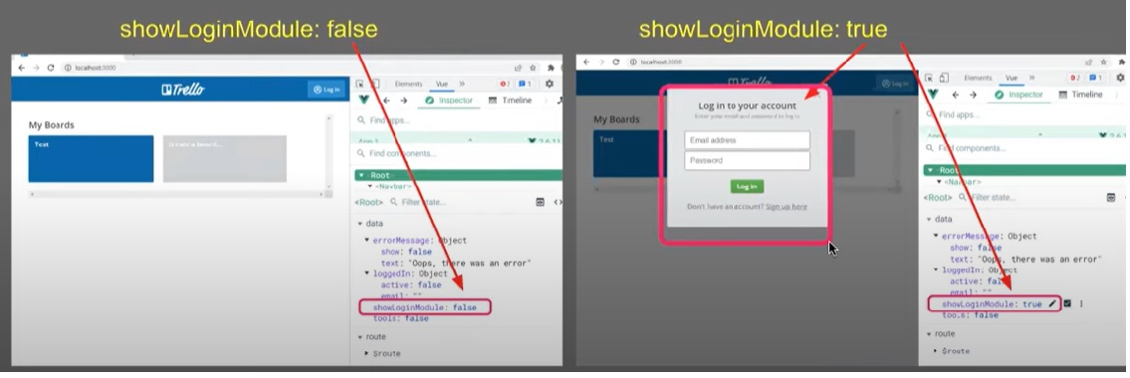
App Actions
What are app actions
How is it different from Page Objects
What are app actions
Shortcuts in the app
Provvide users with quick ways to navigate to specific activities in app
Change the state of your app without user interaction (GUI)

Slide 25
How to Group tests in Cypress
Step 1 - In the test file add 2 it blocks for login test & run
Step 2 – Have to login test with valid & invalid credentials
Step 3 – Group all tests (it blocks) in a describe block
If you have your tests under describe blocks you can use these annotations or text like
describe()
.only (it can run only particular test for that group)
.skip (it can skip only particular test for that group)
beforeEach (it can run the periucular command for every blocks whatever we had declared for testing)
within describe - Runs before each test in that describe group
beforeEach(() => {
lp.navigate(‘https://opensource-demo.orangehrmlive.com/web/index.php/auth/login’)
})
Outside describe - Run before each test in that specific file
in support files – Runs before every test in every spec file
index.js
e2e.js (ver 10+) – (our project folder => cypress folder => support folder => e2e.js)

Slide 26
How to run cypress tests from Cli ( command line interface )
Why CLI – So command line interface is very very important and you will find in all the automation tools and in all the projects and frameworks you will see there is always a option of running your tests or running your projects from command line. So command is very important because it makes executions very easy because there is no GUI , there is no huge memory consumptions. So command line uses very very less memory that’s why it makes it executions very faster, its easier, it is more efficient and whenever you have to integrate your project, your test executions with any third party or external processes command line will always for use.
Easier, faster, efficient
Less memory consumption
To integrate testing with external process
CI & CD
Step 1 – open terminal & run command npx cypress run
npx cypress run – help or -h
--spec or –s
--browser or –b
--headless
When we run command like npx cypress run – help or –h
Then we get options on terminal as follows :

Slide 27
PS C:\Program111\CypressProjects\Cypressprjt> npx cypress run -h
Usage: cypress run [options]
Runs Cypress tests from the CLI without the GUI
Options:
-b, --browser <browser-name-or-path> runs Cypress in the browser with the given name. if a filesystem path is supplied, Cypress will
attempt to use the browser at that path.
--ci-build-id <id> the unique identifier for a run on your CI provider. typically a "BUILD_ID" env var. this value is
automatically detected for most CI providers
--component runs component tests
-c, --config <config> sets configuration values. separate multiple values with a comma. overrides any value in
cypress.config.{js,ts,mjs,cjs}.
-C, --config-file <config-file> path to script file where configuration values are set. defaults to "cypress.config.{js,ts,mjs,cjs}".
--e2e runs end to end tests
-e, --env <env> sets environment variables. separate multiple values with a comma. overrides any value in
cypress.config.{js,ts,mjs,cjs} or cypress.env.json
--group <name> a named group for recorded runs in the Cypress Dashboard
-k, --key <record-key> your secret Record Key. you can omit this if you set a CYPRESS_RECORD_KEY environment variable.
--headed displays the browser instead of running heedlessly
--headless hide the browser instead of running headed (default for cypress run)

Slide 28
--no-exit keep the browser open after tests finish
--parallel enables concurrent runs and automatic load balancing of specs across multiple machines or processes
-p, --port <port> runs Cypress on a specific port. overrides any value in cypress.config.{js,ts,mjs,cjs}.
-P, --project <project-path> path to the project
-q, --quiet run quietly, using only the configured reporter
--record [bool] records the run. sends test results, screenshots and videos to your Cypress Dashboard.
-r, --reporter <reporter> runs a specific mocha reporter. pass a path to use a custom reporter. defaults to "spec"
-o, --reporter-options <reporter-options> options for the mocha reporter. defaults to "null"
-s, --spec <spec> runs specific spec file(s). defaults to "all"
-t, --tag <tag> named tag(s) for recorded runs in the Cypress Dashboard
--dev runs cypress in development and bypasses binary check
-h, --help display help for command
PS C:\Program111\CypressProjects\Cypressprjt>
npx cypress run –s .\cypress\integration\FirstTest.js
npx cypress run –s .cypress\integration\FirstTest.js –b chrome --headless

Slide 29
Step 2 – Open packge.json file
Step 3 – Add under script section
"scripts": {
"pretest": "echo I AM PreTEST",
"posttest": "echo I AM PostTEST",
"test": "echo I AM THE TEST",
"hello": "echo hello world",
"cy-test": "cypress run“
Every line under this section can be run with npm run command
PS C:\Program111\CypressProjects\Cypressprjt> npm run test
> cypressprjt@1.0.0 pretest
> echo I AM PreTEST
I AM PreTEST
> cypressprjt@1.0.0 test
> echo I AM THE TEST
I AM THE TEST
> cypressprjt@1.0.0 posttest
> echo I AM PostTEST
I AM PostTEST

Slide 30
Step 4 – Can set Configuration from command line
syntax: cypess run –config <config>.
cypress run --config pageLoadTimeout=100000,watchForFileChanges=false
or we can also declare configuration like this
cypress run –config ‘{“watchForFileChanges”:false, “pageLoadTimeout”:100000}’
cypress run Runs cypress tests from CLI
cypress open Open Cypress App
cypress Verify Verify cypress is installed correctly and is executable
cypress version Prints Cypress version
cypress info Prints information about Cypress & current environment
cypress cache Prints info about Cypress cache

Slide 31
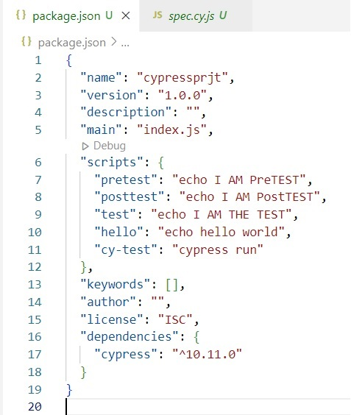
What is package.json
Every node.js project has package.json file located in the root folder
Information about node.js project
List of dependencies with version
How to create :
npm init
npm init --y
Package name
Version
Description
Entry point
test command:
Keywords:
Author:
Licence
Git repository:
Dependencies

Slide 32
name :- name of the project
Maximum 24 character
Can’t start with dot or a underscore
Must not have uppercase letter
Stored in npm registry
version :- version of your project or application
package name + version = unique package
description :- general description of your project helps to find your package no npm search
main :- Entry point of the project file to run at the start
scripts :- dictionary containing script commands run at various time in the lifecycle of your package
keywords :- array of strings that can be used to identify your package in npm search
author :- author information for example
licence :- Licence for people know how they are permitted to use by default – ISC (Internet System Consortium) permissive free software licence published by the Internet System Consortium.
dependencies :- key – value pair i.e. Key – name of the package value – version range
devDependencies :- use during dev or build phase
npm install :- install both dev & normal dependencies
npm install --dev :- installs only dev dependencies.
npm install --prod :- will not include dev dependencies.
~1.2.3 will match all 1.2.x versions but will miss 1.3.0
^1.2.3 will match any 1.x.x release including 1.3.0, but will hold off on 2.0.0
{
“name” : “Brian Gyle”
“email” : “example@gmail.com”
“url” : “http://demo.co.in/”
}

Slide 33
Package.json
Records the minimum version needed (with ^ and ~)
Is used for more than dependencies – like defining project info, author & licence, scripts, etc.
Package-lock.json
Record the exact version of each installed package which allows you to re-install them
Lock the dependencies with the installed version
When you run npm update packagename – it will update in package-lock.json file and not in package.json
npm install – will install dependencies as per package.json
npm ci - will install dependencies as per package-lock.json
Do you need both package-lock.json and package.json? No
Do you need both package.json? Yes
Can you have a project with only the package-lock.json? No

Slide 34
How to Read and Write file in Cypress
Read files using fixture()
Read files using readFile()
Write files using writeFile()
Read files using fixture() :-
Step 1 :- Create a new test spec file
Step 2 :- Add a file under fixtures folder
Step 3 :- Create a test and add command
it('Read files using Fixture', function(){
cy.fixture('example.json').then((data) => {
cy.log(data.name)
cy.log(data.email)
})
})
Step 4 :- To use data from file in all tests create a before function
before (function(){
cy.fixture('example.json').as('test_data')
})
Step 5 :- Now use data from file in tests
cy.log(this.test_data.name)

Slide 35
Notes :-
If the file in fixture folder it can be referenced directly by name without extension
For a JSON file its function can be used to access the values using keys
cy.fixture(‘filename’).its(‘name’).should(‘eq’,’hello’)
---------------------------------------------------------------------------------------------------------------------------------------------------
Read files using readFile() :-
Step 1 – Create a new test in spec file
Step 2 – Test commands
Step 3 – Use cy.readFile() function
cy.readFile('./cypress/fixtures/example.json').then((data) =>{
cy.log(data.name)
cy.log(data.email)
})
For JSON file can use its - .its(‘name’).should(‘eq’,’data’)

Slide 36
Write files using writeFile() :-
Step 1 – Create a new test in spec file
Step 2 – Test commands
cy.writeFile(‘sample.txt’, ‘Hello I am learniong Cypress\n’)
and
cy.writeFile(‘sample.txt’, ‘Hello I am Pratap’, {flag: ‘a+’})
If want to cursor next line then use after statement - \n
Relative file path can be used
cy.writeFile(‘./cypress/fixture/files/sample.txt’ , ’Hello, I am Pratap\n’)

Slide 37
File upload in Cypress
SETUP
Step 1 – Install plugin cypress-file-upload
npm install –save-dev cypress-file-upload
Step 2 – If you are using TypeScript, ensure your tsconfig.json contains
“compilerOptions”:{
“types”:[“cypress”, “cypress-file-upload”] }
Step 3 – Add to cypress/support/commands.js
import ’cypress-file-upload’;
Step 4 – check the commands.js is imported in cypress/support/index.js
(it might be commented)
// import command.js using ES2015 syntax:
import’./commands’;
----------------------------------------------------------------------------------------------------------------------------------------------------
TEST
Step 1 – Create a new test
Step 2 – Add command to visit the web page
cy.visit(‘…..’)
Step 3 – Add command to upload file
cy.get('#myfile').attachFile(‘filePath’);

Slide 38
File Download in Cypress
SETUP
Step 1 – Install plugin cypress-downloadfile
npm install cypress-download
Step 2 – Add to cypress\support\commands.js
require(‘cypress-downloadfile/lib/downloadFileCommand’)
Step 3 – Add to cypress/plugins/index.js
const {downloadFile} = require('cypress-downloadfile/lib/addPlugin’)
module.exports = (on, config) => {
on('task', {downloadFile})}
==============================================================================
TEST
Step 1 – Create a new test
Step 2 – If autocomplete does not work add at the top
/// <reference types=“cypress-downloadfile”/>
Step 3 – Add command to download file cy.downloadFile('https://upload.wikimedia.org/wikipedia/en/a/a9/Example.jpg','mydownloads’,’ example.jpg')

Slide 39
How to generate awesome HTML reports
How to install mochawesome library
How to configure the reporter
How to merge multiple json report file
How to generate single html report
Troubleshooting issue like
Unexpected token ? in JSON position ()
Unexpected end of JSON input
Step 6 – Run reports command automatically using pretest and posttest scripts in package.json
for that follow the video - https://www.youtube.com/watch?v=J9AHVKNDkDU&list=PLhW3qG5bs-L9LTfxZ5LEBiM1WFfvX3dJo&index=14
==============================================================================
Step 1 - How to install mochawesome library
npm install mochawesome --save-dev
also use command like - npm i mochawesome-report-generator
npm install -g mochawesome-report-generator
Step 2 – Install mochawesome –merge library
npm install mochawesome-merge –save -dev
npm i mochawesome –merge

Slide 40
Step 3 – Add report configuration in cypress.json
Step 4 – Run command to execute tests
npx cypress run --reporter mochawesome
Step 5 - Run command to merge multiple json reports into one
npx mochawesome-merge cypress/report/mochawesome-report/*.json > cypress/report/output.json
OR
npx mochawesome-merge cypress/report/mochawesome-report/*.json | out-file –encoding ascii cypress/report/output.json
Step 6 – Run command to generate html report
npx marge cypress/report/output.json --reportDir ./ --inline
https://www.youtube.com/watch?v=J9AHVKNDkDU&t=170s
{
“reporter”: ”mochawesome”,
“reporterOptions”:{
“charts”: true,
“overwrite”: false,
“html”: false,
“json”: true
“reportDir”: “cypress/report/mochawesome-report”
}
}

Slide 41
Add report generation commands in package.json scripts
When add all reports commands in package.json then have to add in script section as follows :
"scripts": {
"pretest": "echo I am inside pretest",
"test": "echo I am inside test.....",
"posttest": "echo I am inside posttest",
"sayhello": "echo Hello World.....!",
"merge-reports": "mochawesome-merge ./cypress/reports/*.json > ./report1.json",
"generate-htmlreport": "marge ./report1.json --reportDir ./cypress/reports“
After adding that have to run command on terminal as follows :
For merge-reports : - npm run merge-reports
For generating html report : - npm run generate-htmlreport
For deleting json reports from report directory then eun command : -
rm –r .\cypress\reports\.*json
We can also add this command as a pretest because when we run our script then that we have get the current reports not including old reports : - “pretest”: “rimraf –r .\cypress\reports\.*json”,
For that we have to install rimraf library : - npm install rimraf

