Slide 1
Jenkins
Step by Step

Slide 2
What is Jenkins
Jenkins is a CI CD tool
Free and open source
Written in java

Slide 3
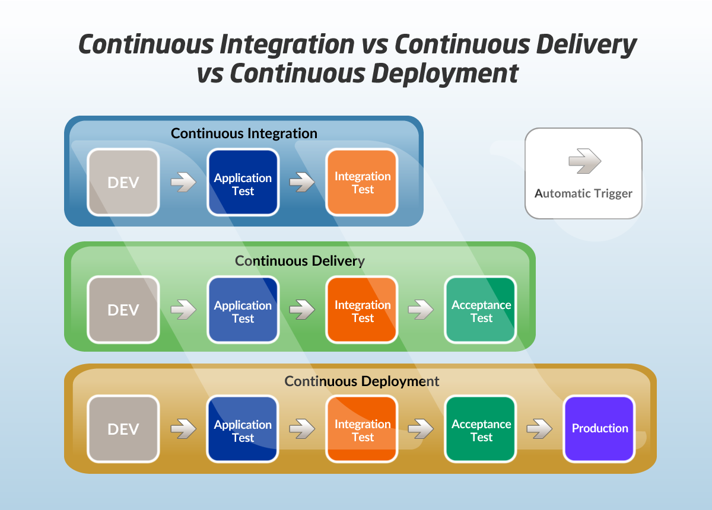

Slide 4
Installation
System Requirements
Requirements can check on
https://www.jenkins.io/doc/administration/requirements/java/
Step 1 – Check the Java installed in the system or not in CMD using Java –version
Step 2 – Download Jenkins.war file
Step 3 – Go to CMD prompt and set the path of Jenkins.war file saved location
Step 4 - Run command and start the jenkins
java –jar Jenkins.war --httpPort=9191
Step 5 – On browser go to http://localhost:9191
Step 6 – Provide admin password and complete the setup
Memory | 256 MB of RAM
Disk space | Depends on your project
OS | Windows, Mac, Ubuntu, Linux
Java | 8 or 11 ( JDK or JRE )

Slide 5
How to change Home Directory
Step 1 – Check your Jenkins Home > Manage Jenkins > Configure System
Step 2 – Create a new folder
Step 3 – Copy the data from old folder to new folder
Step 4 – Create/Update environment variables JENKINS_HOME
Step 5 – Restart Jenkins
(if the change not happened try system restart)

Slide 6
How to Setup Git on Jenkins
Step 1 : Goto Manage Jenkins > Manage Plugins
Step 2 : Check if git is already installed in installed tab
Step 3 : Else goto Available tab and search for git
Step 4 : Install Git
Step 5 : Check git option is present in Job Configuration
Create the first Job on Jenkins
Step 1 : Click on New Item
Step 2 : Enter field name
Step 3 : click on Freestyle Project

Slide 7
How to connect to Git Repository in Jenkins (GitHub)
Step 1 : Goto Jenkins Dashboard
Step 2 : Goto Manage Jenkins >> Manage Credentials >> Credentials select global
Step 3 : Add Credentials
Step 4 : Add user name , add password, add ID ant Apply then Save
If need to change directory
Step 1 : Goto Project >> Configure
Step 2 : General >> Advanced >> Use custom workspace
Step 3 : Copy the path of workspace and paste it into the “Directory” option
Step 4 : Also given name using option “Display Name”

Slide 8
How to use Command Line in Jenkins CLI
Faster, Easier, Integrate
Step 1 : Start Jenkins
Step 2 : Goto Manage Jenkins > Configure Global Security > Enable Security
Step 3 : goto – http://localhost:8080/cli/
Step 4 : Download jenkins-cli jar. place at any location
Step 5 : Tets the Jenkins commande line is working
If asking to authentication for access this Jenkins
Step 1 : Goto Dashboard >> Manage Jenkins
Step 2 : At the top user name >> goto user dropdown >> configure >> SSH Public Keys
Step 3 : delete it and save or use as password when ask for running cli command
If also getting this issue then use command
java -jar Jenkins-cli.jar -s http://localhost:9191/help --username <user name> --password<password>
We can also use like for forgetting password
Find config.xml >> open using WordPad >> useSecurity >> False >> save
Open
Jenkins UI >> Config Global Security >> Security Realm >> Jenkin’s own user database >> Apply >> Save
After that
Manage Jenkins >> Manage Users >> click on user as admin >> configure >> password >> change password >> Apply >> Save

Slide 9
Running job on CMD using cli
Command : java -jar jenkins-cli.jar -s http://localhost:9191/ -webSocket help
this command showing output in Jenkins not on CMD GUI
Command java -jar jenkins-cli.jar -s http://localhost:9191/ build TestJob –s
this command showing details on CMD GUI and all the result and details in Jenkins

Slide 10
How to crate Users + Manage + Assign Roles
How to create New Users
How to Configure Users
How to create New roles
How to assign users to roles
How to control user access on projects
Step 1 : Create new users
Dashboard > Manage Jenkins > Manage Users > Create User
Step 2 : Configure user
Step 3 : Create and manage user role Role Base Authorization Strategy plugin – download – restart Jenkins
Step 4 : Manage Jenkins > Configure Global Jenkins > Authorization > Role Base Strategy
Step 5 : Create Roles and Assign Roles to Users
Dashboard > Manage Jenkins >Manage and Assign Roles > Manage Roles
Dashboard > Manage Jenkins >Manage and Assign Roles > Assign Roles
Step 6 : Validate authorization and authentication are working properly

Slide 11
Chain Jobs
Projects for echo massage
Dashboard > Project > Configure > Build Step > Execute Windows batch command > echo <message>
For chaining the jobs using post Build action means Post Trigger
Dashboard > project > Post-Build Actions > Build other projects > <project name >
For chaining the jobs using post Build action means Pre Trigger
Dashboard > project > Build Triggers > Build After other projects are built > <project name >
How to create Pipeline
Manage Jenkins > Manage Plugins > Available > Build Pipeline
Goto Dashboard – click on + button – Build Pipeline – select build pipeline – create

Slide 12
Jenkins Pipeline Beginner Tutorial
How to create Jenkinsfile
What is Pipeline
What is Jenkins pipeline
What is Jenkinsfile
How to create Jenkinsfile
Build > Deploy > Test > Release
Jenkinsfile :- Pipeline as a code
Step 1 : Start Jenkins
Step 2 : Install Pipeline Plugin
Step 3 : Create a new job
Step 4 : Create or get Jenkinsfile in Pipeline section
Step 5 : Run & check the output
Step 6 :

Slide 13
Jenkins Pipeline
How to get jenkinsfile from Git SCM
Step 1 : Create a new job or use existing job (type : Pipeline)
Step 2 : Create a repository to GitHub
Step 3 : Add jenkinsfile in the repository
Step 4 : Under Jenkins job > Pipeline section > Select Definition Pipeline Script from SCM
Step 5 : Add repository & jenkinsfile in the job under Pipeline section
Step 6 : Save & Run

Slide 14
Jenkins Pipeline
How to clone a git repository using Jenkinsfile
Step 1 : Create a new job
Step 2 : Configuration > Pipeline > Pipeline Script > Hello World >
Step 3 : After groovy script
Step 4 : Pipeline Syntax > Sample Step > Git > Repository URL > Branch > Credentials
Step 5 : Select Include in Polling ? > Select Include in Changelog ? > Click on Generate Pipeline Script
Step 6 : After generating Script copy that > go back to job
Step 7 : Paste into the Steps section of script > Apply > Save
Step 8 : Build Now means its Run

