Slide 1
Project 3:create Database
By: Pratap Gurung

Slide 2
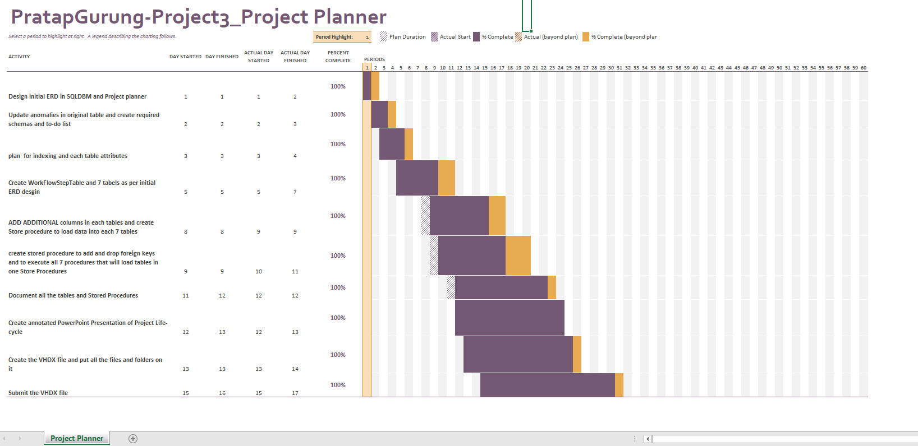

Slide 3
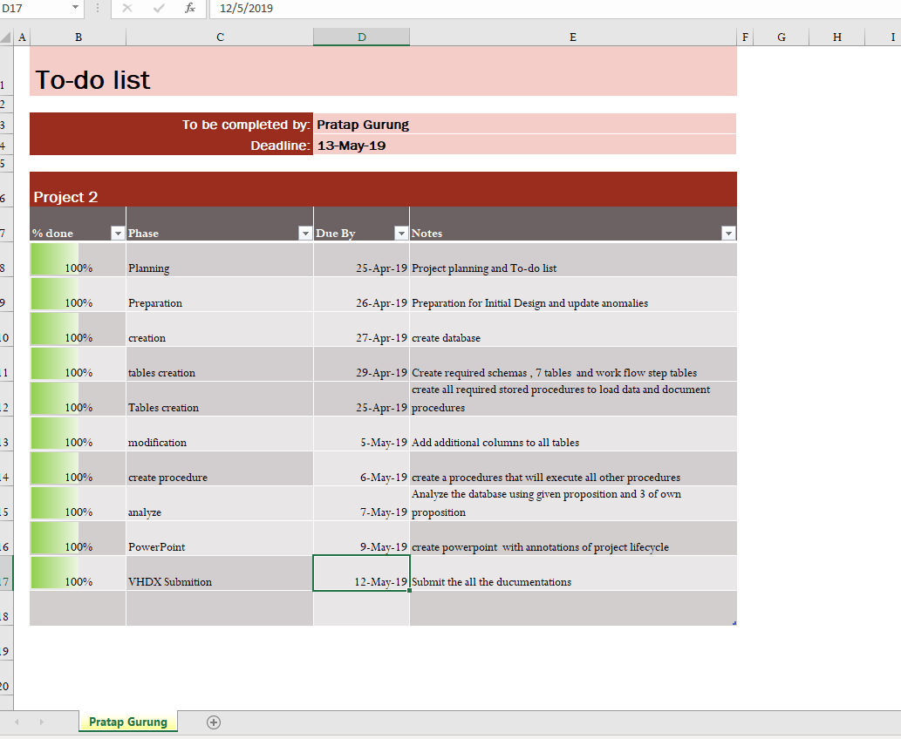

Slide 4
Table and Columns Naming Conventions
Department:
Department Name
Instructors
Department Id, Instructor Name
Building
Building Name
Room
Building Id, Room Number
Course
Department, Course Name, Credit, Hour
Class
Course id, mode id, instructor id, room id
Sec , section code, day, starting time, ending time, enrolled and limit
Mode of Instructions
Mode description

Slide 5
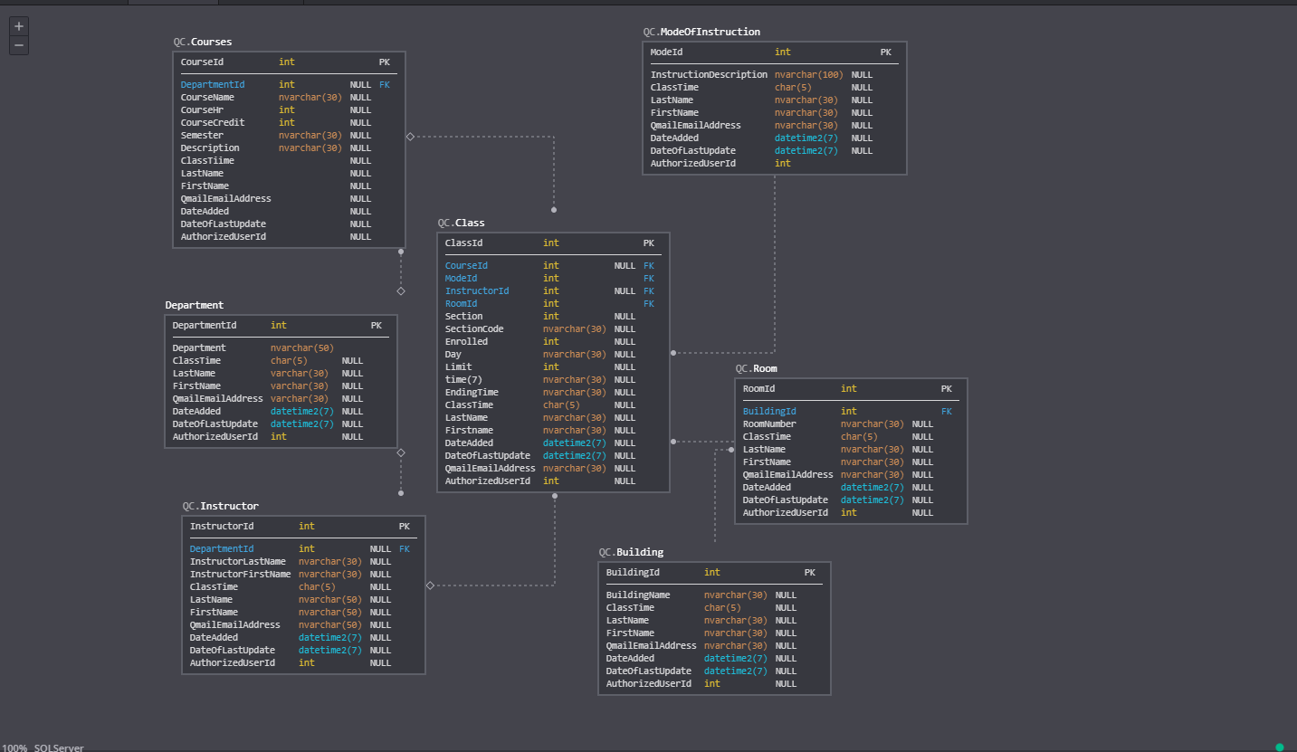
Initial ERD using SQLDBM

Slide 6
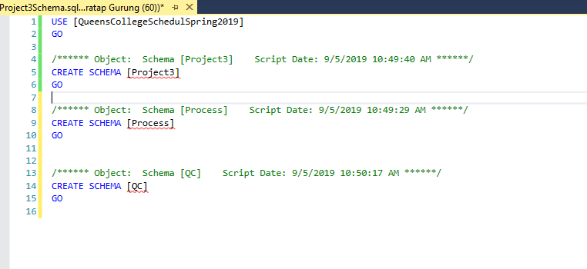
Schemas

Slide 7
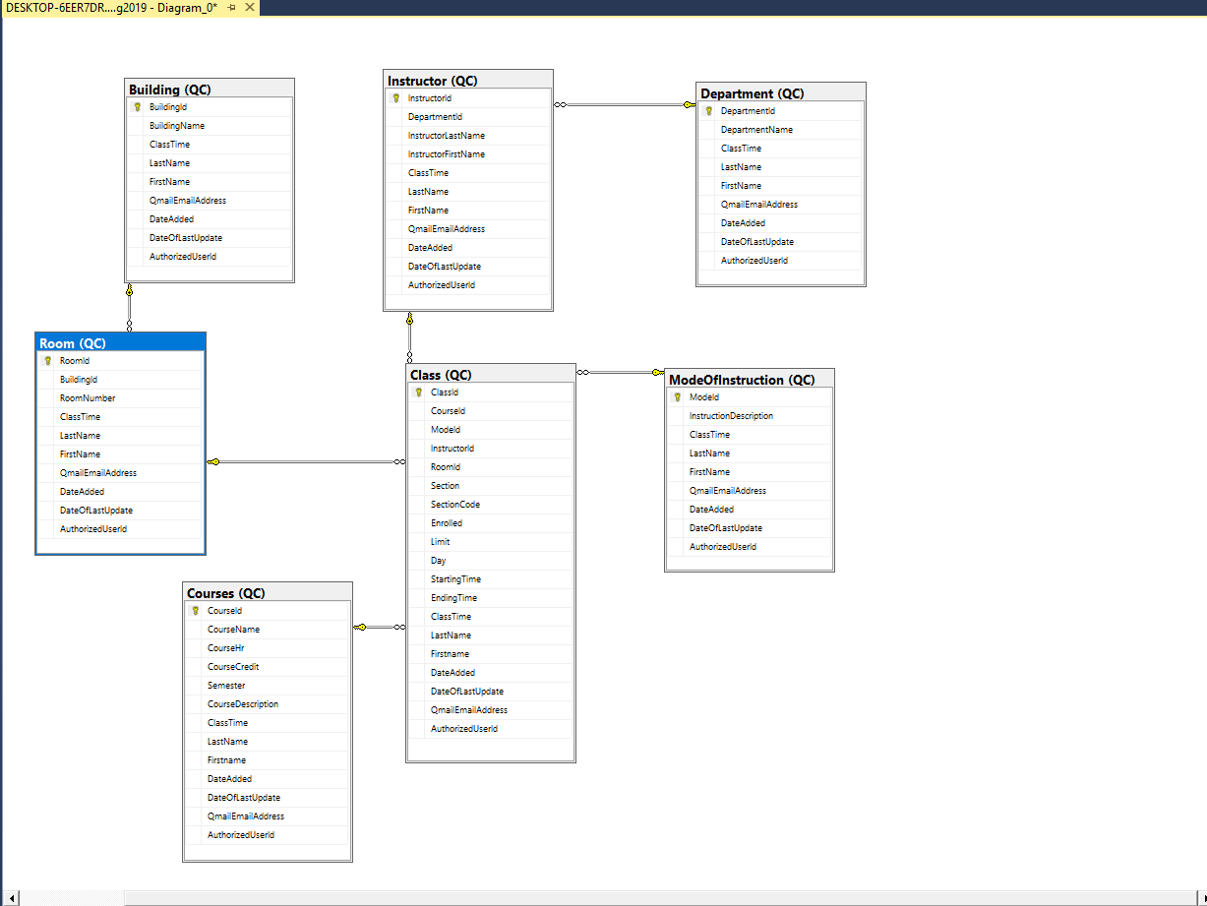
Final ERD

Slide 8
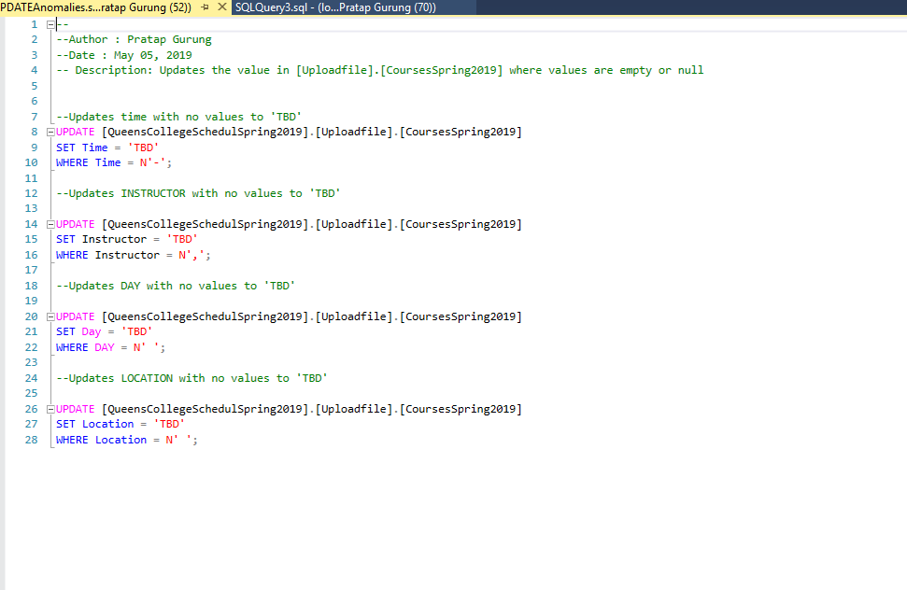
Updating Anomalies

Slide 9
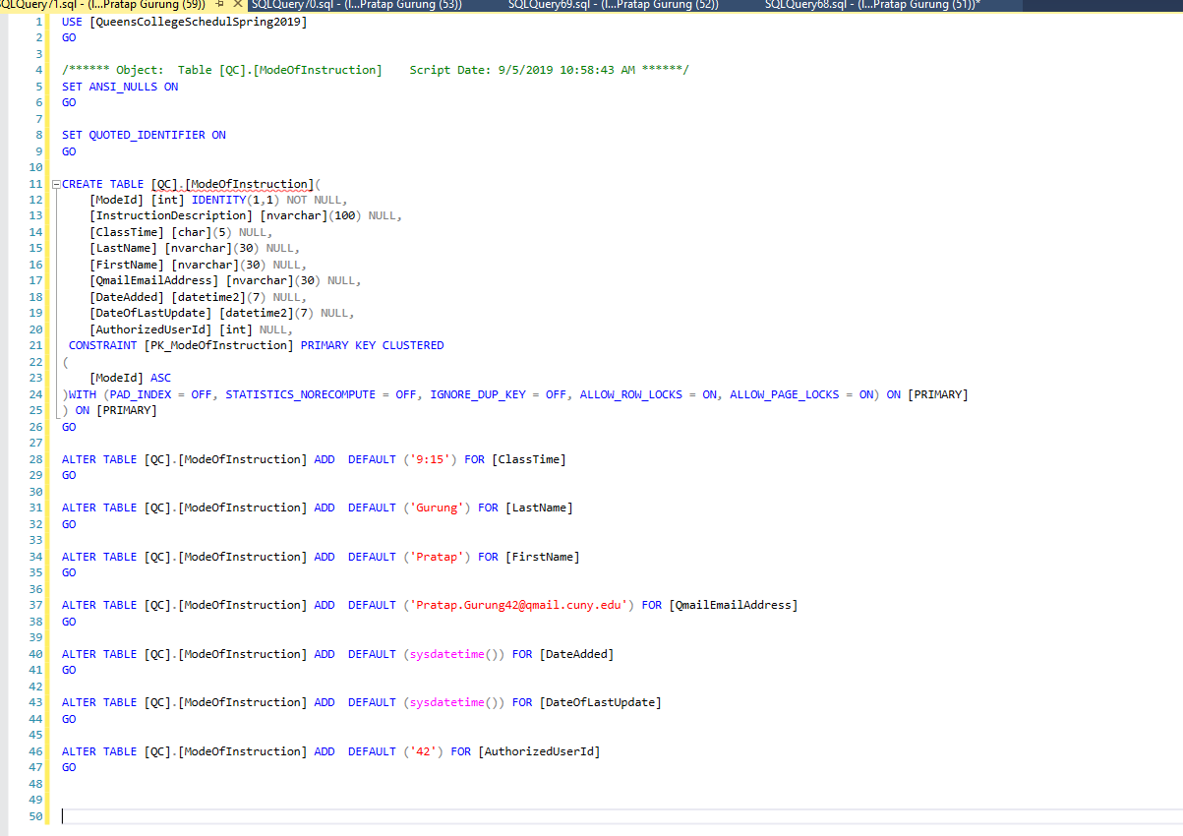
ModeOfInstructionTable

Slide 10
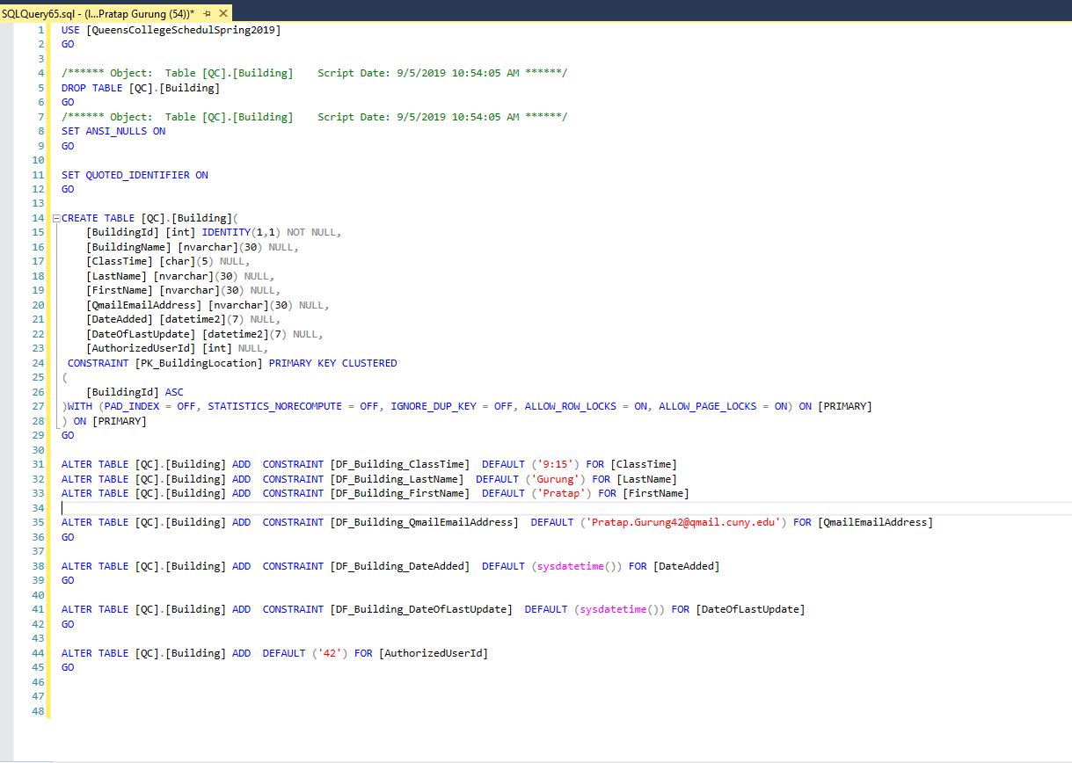
Building Table

Slide 11
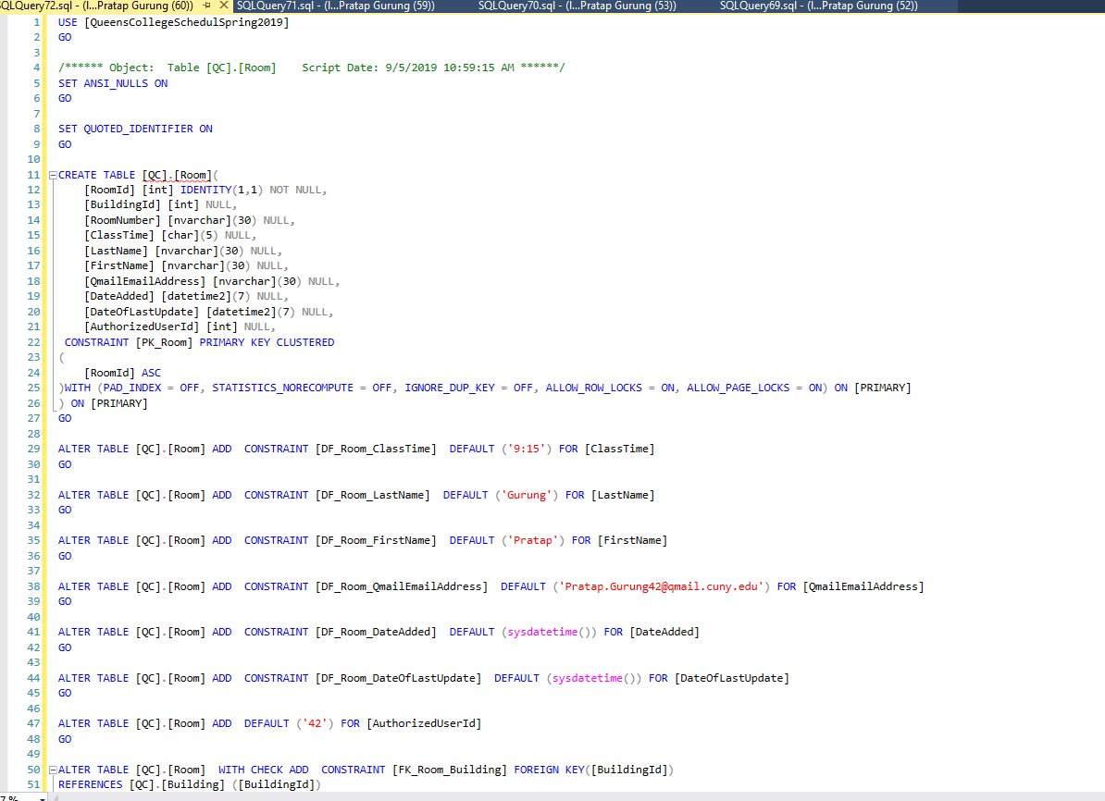
Room Table

Slide 12
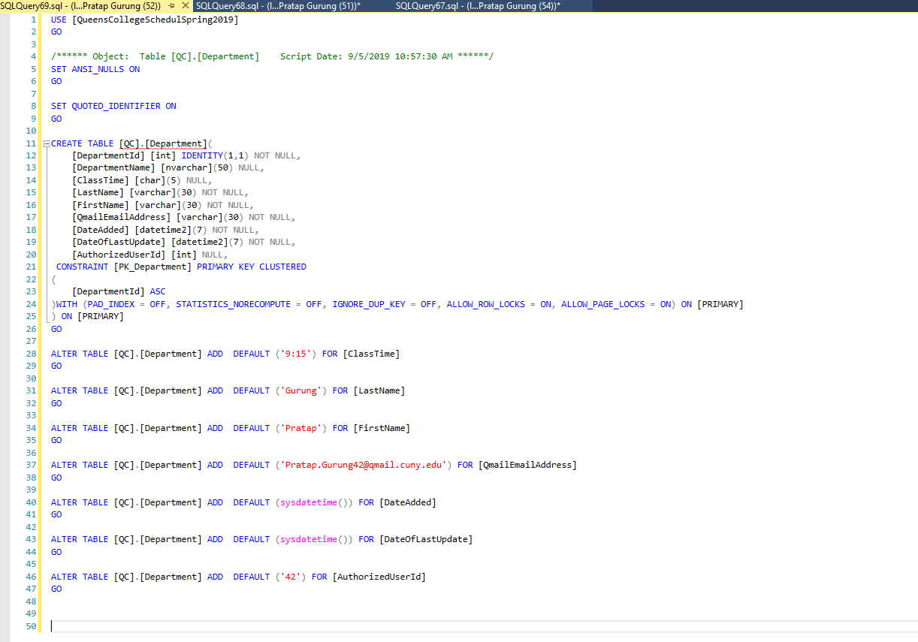
Department Table

Slide 13
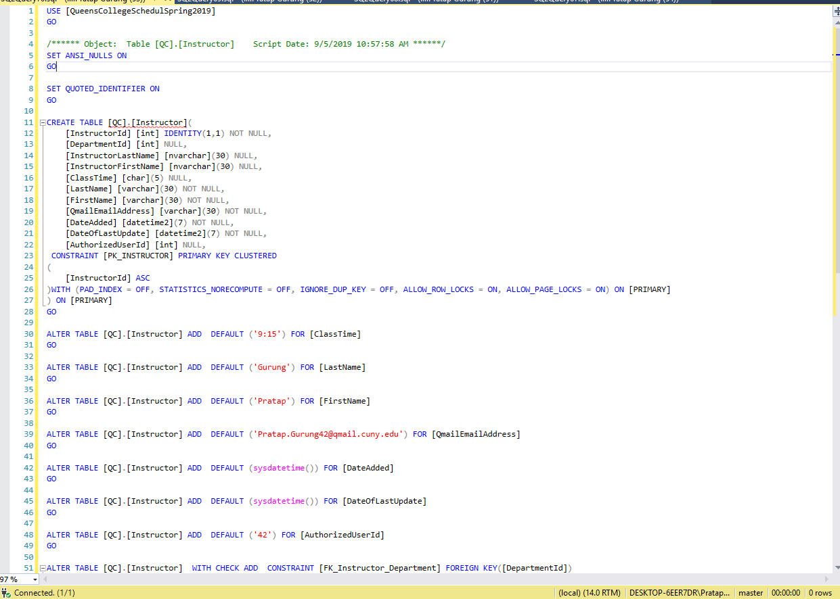
Instructor Table

Slide 14
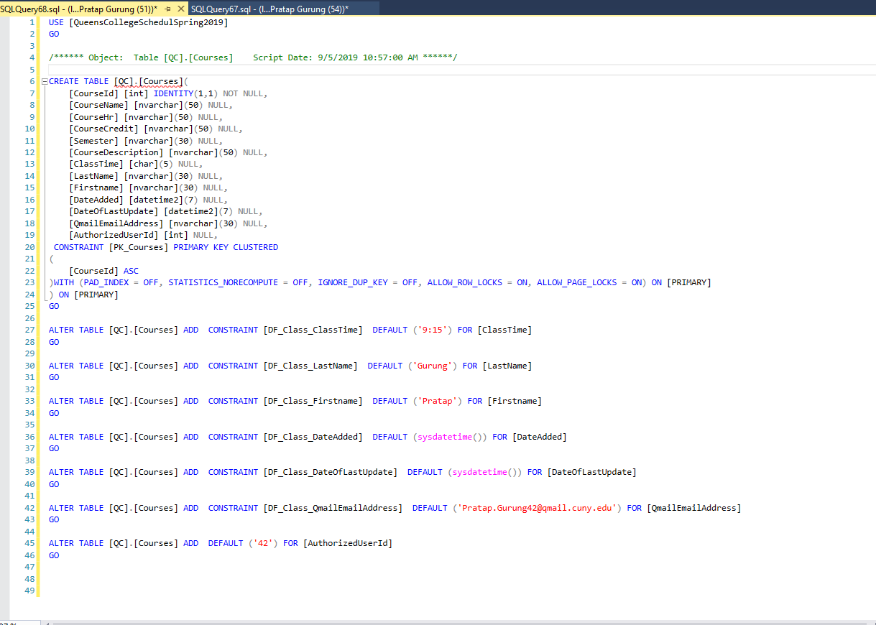
Course Table

Slide 15
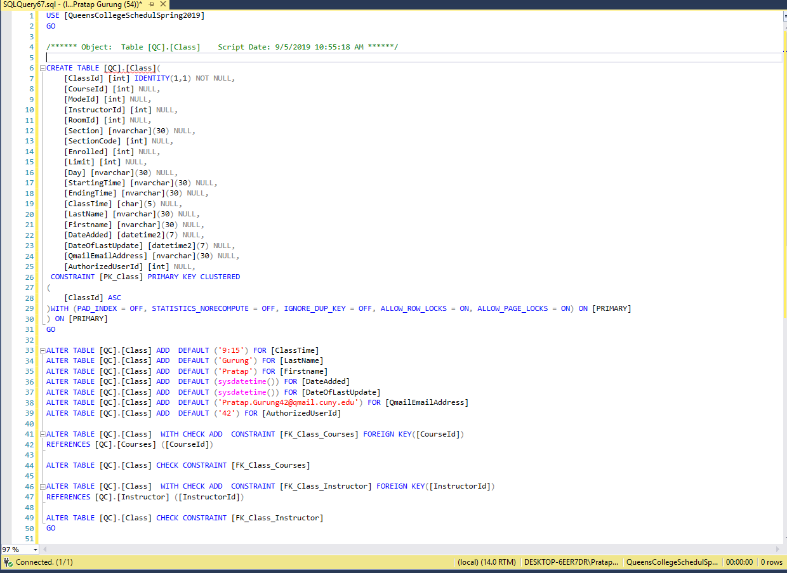
Class Table

Slide 16
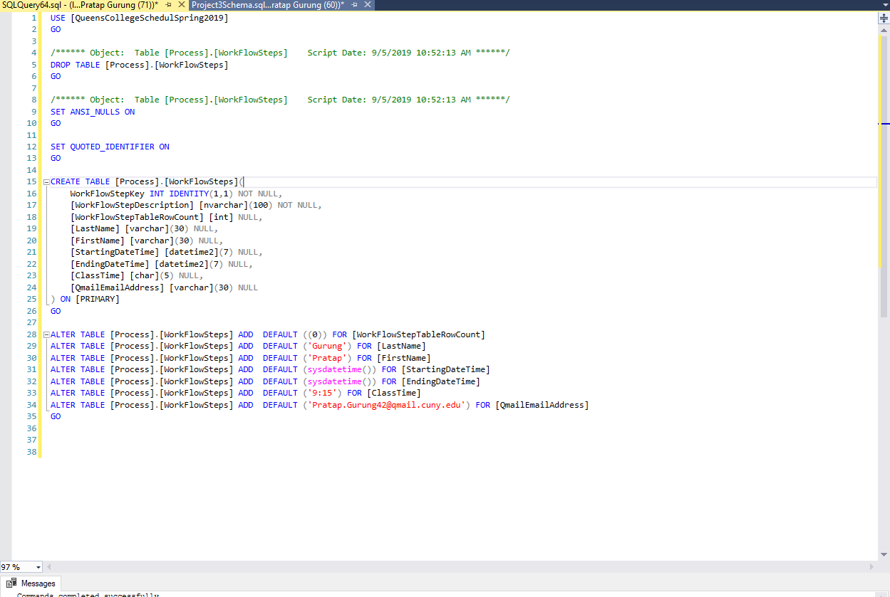
WorkFlowSteps

Slide 17
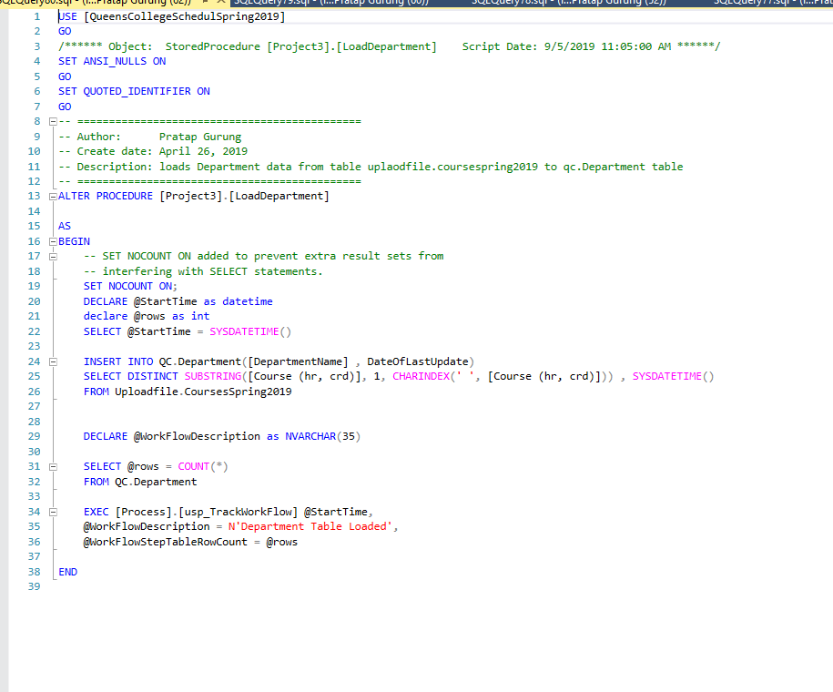
LoadDepartment

Slide 18
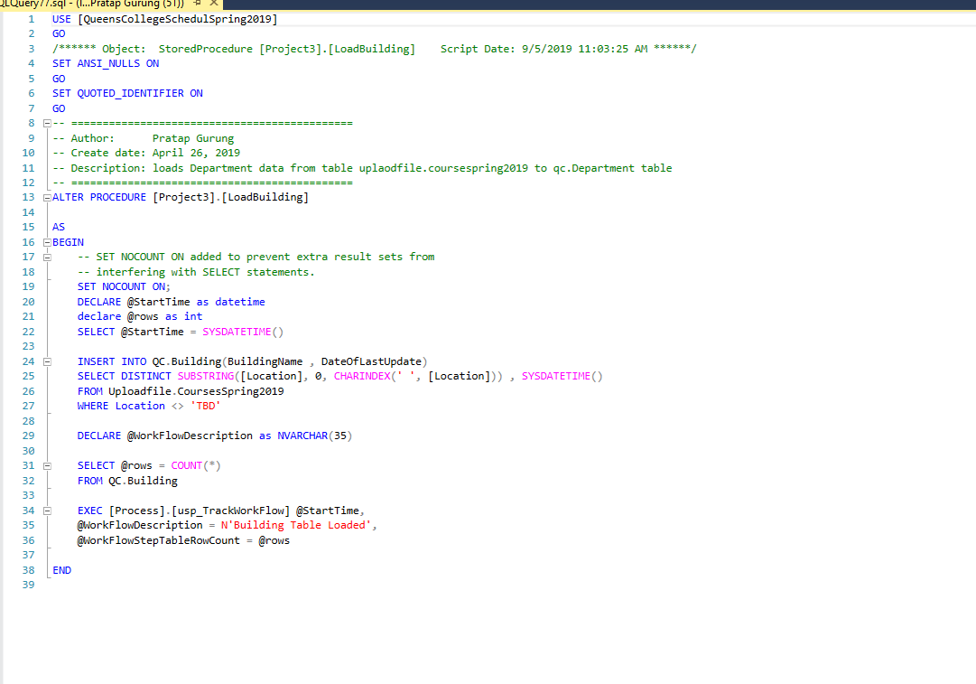
Load Building

Slide 19
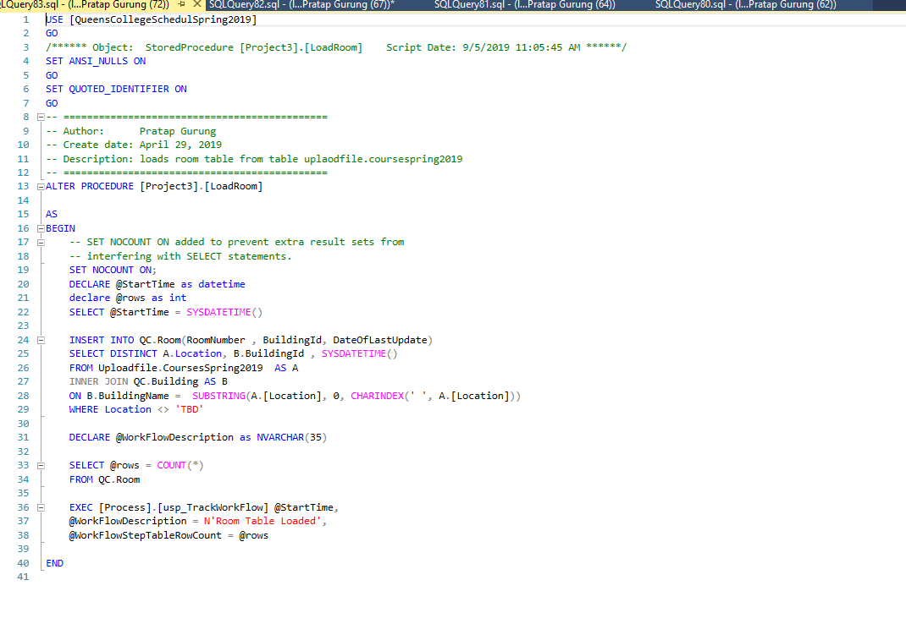
Load Room

Slide 20
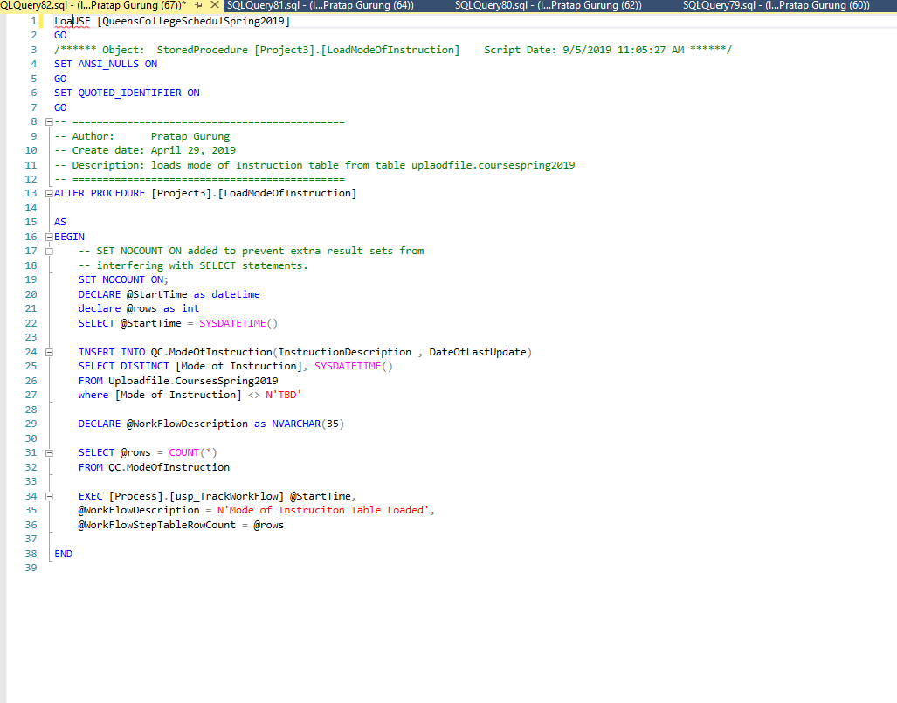
Load Mode of Instruction

Slide 21
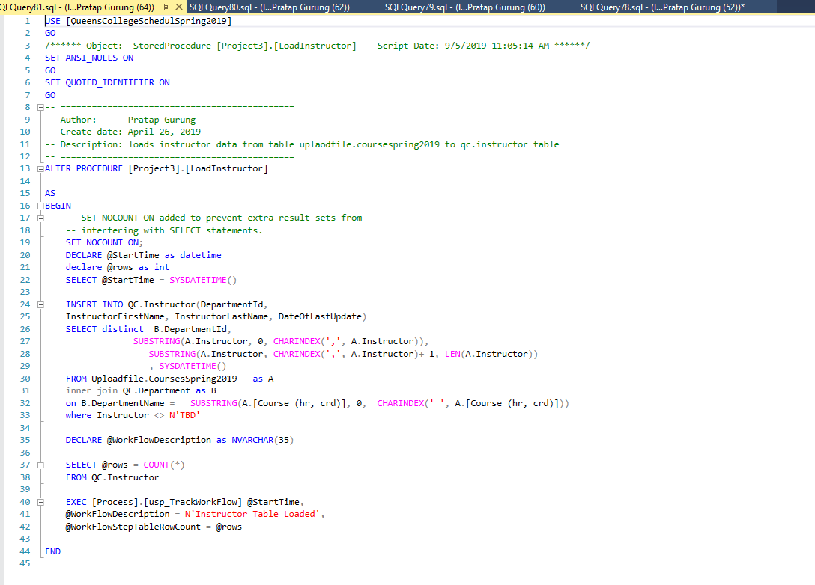
Load Instructor

Slide 22
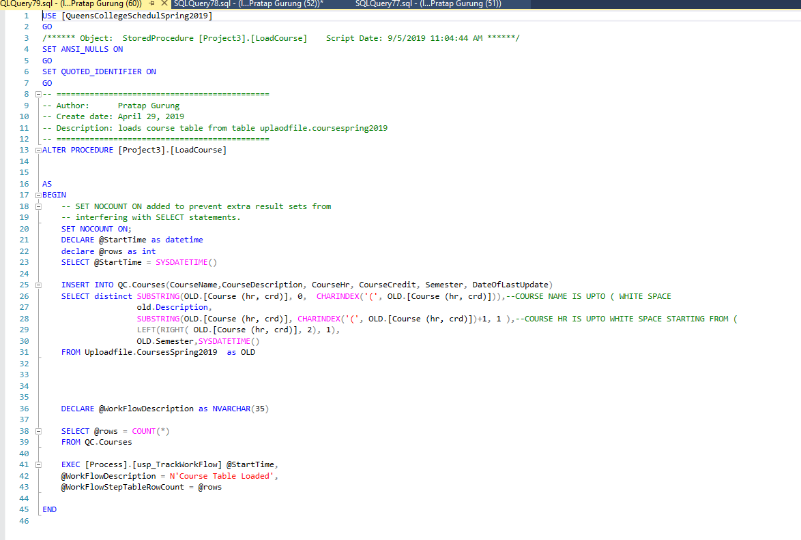
Load Course

Slide 23
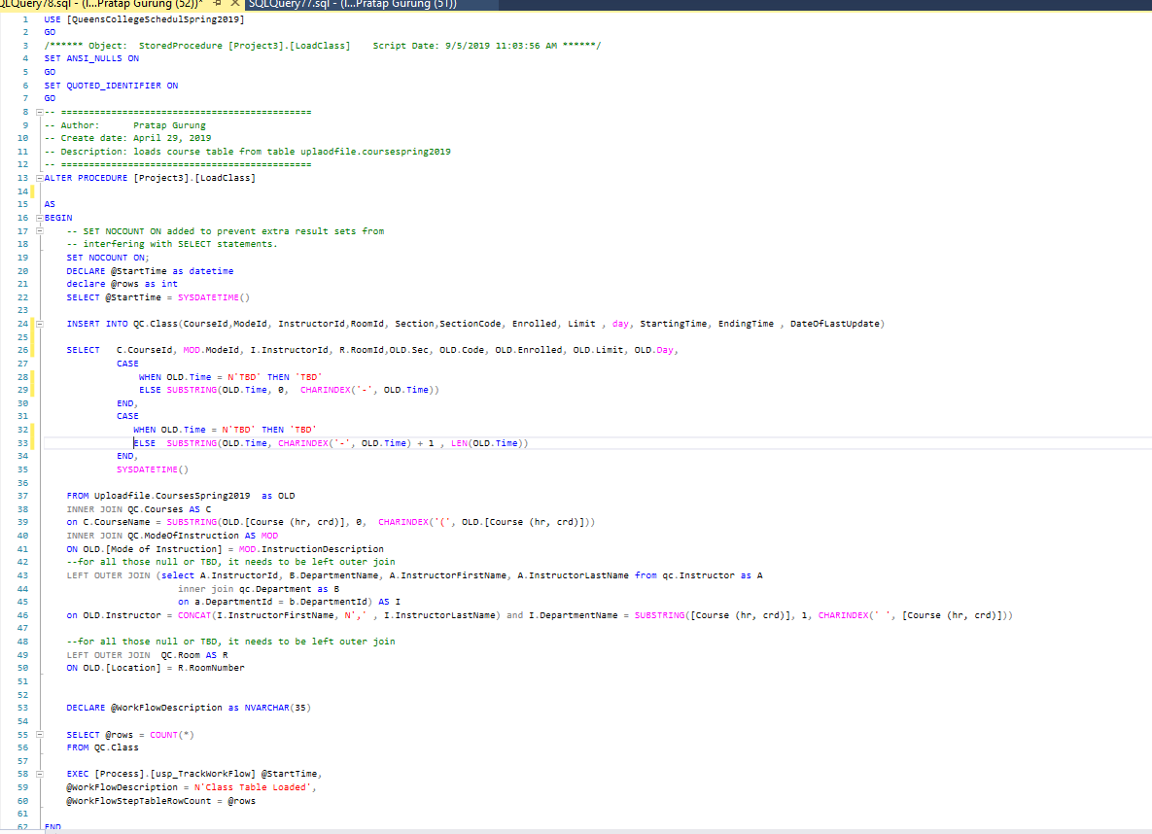
Load Class

Slide 24
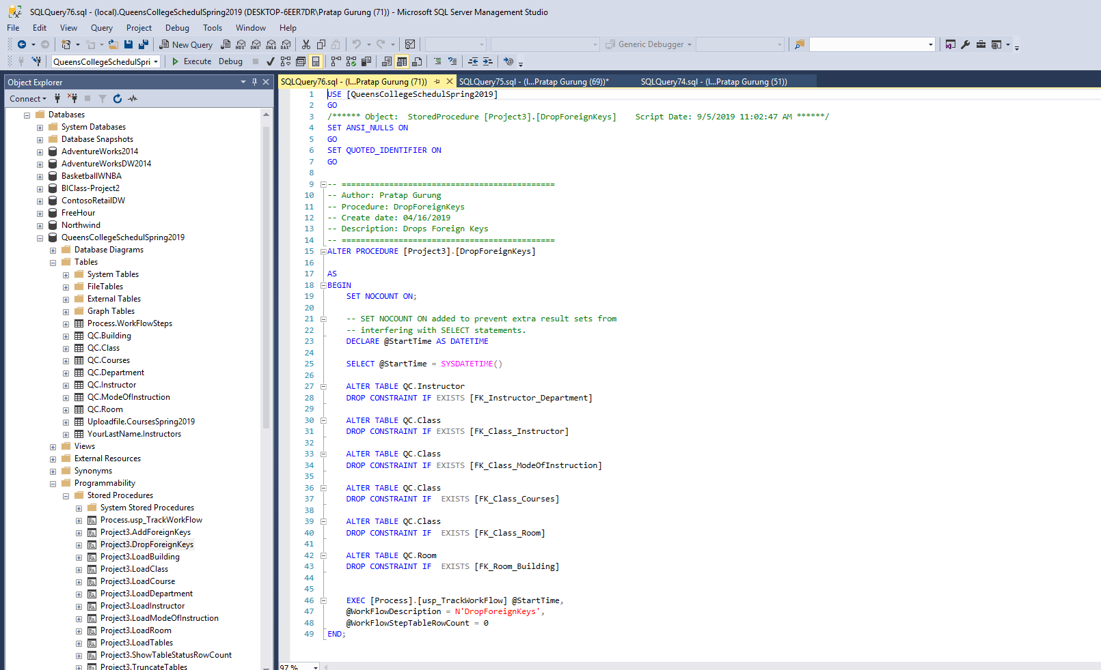
Drop Foreign Keys

Slide 25
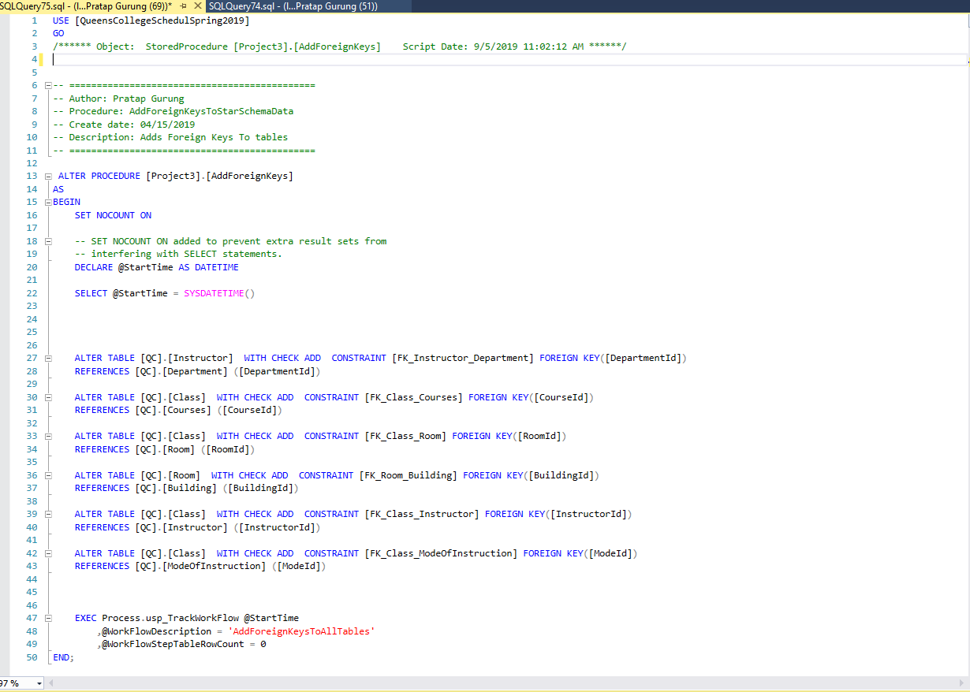
Add Foreign Keys

Slide 26
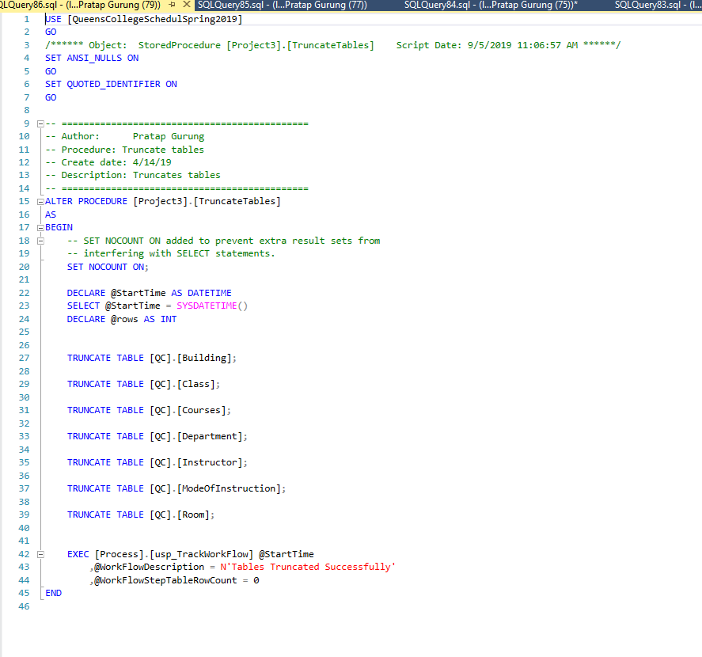
Truncate Tables

Slide 27
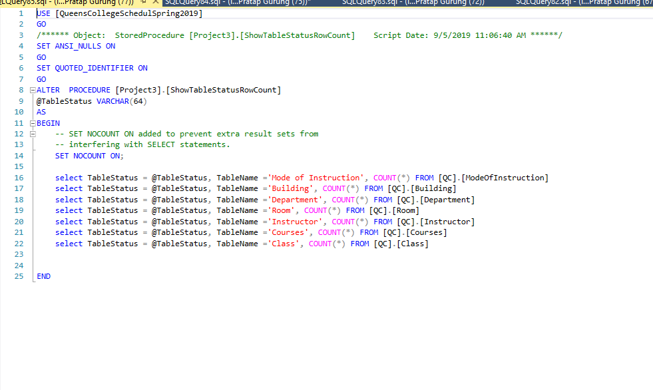
Show Tables Row Count

Slide 28
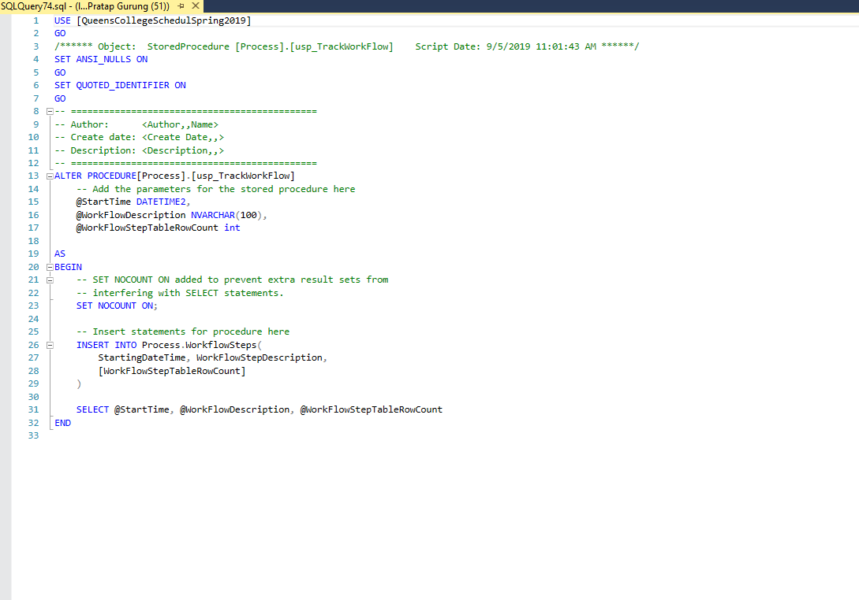
Work Flow Steps Procedure

Slide 29
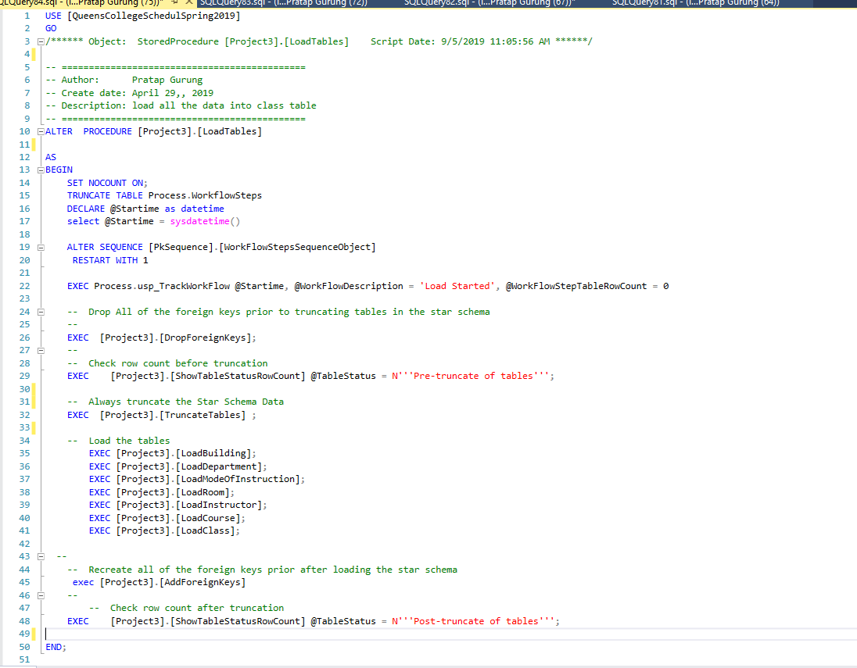
Load Tables

Slide 30
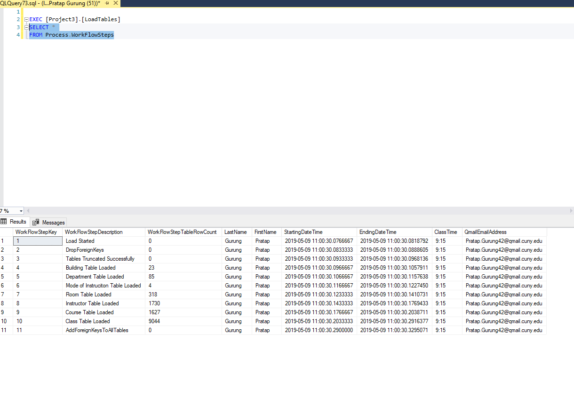
WorkFlowSteps Table

Slide 31
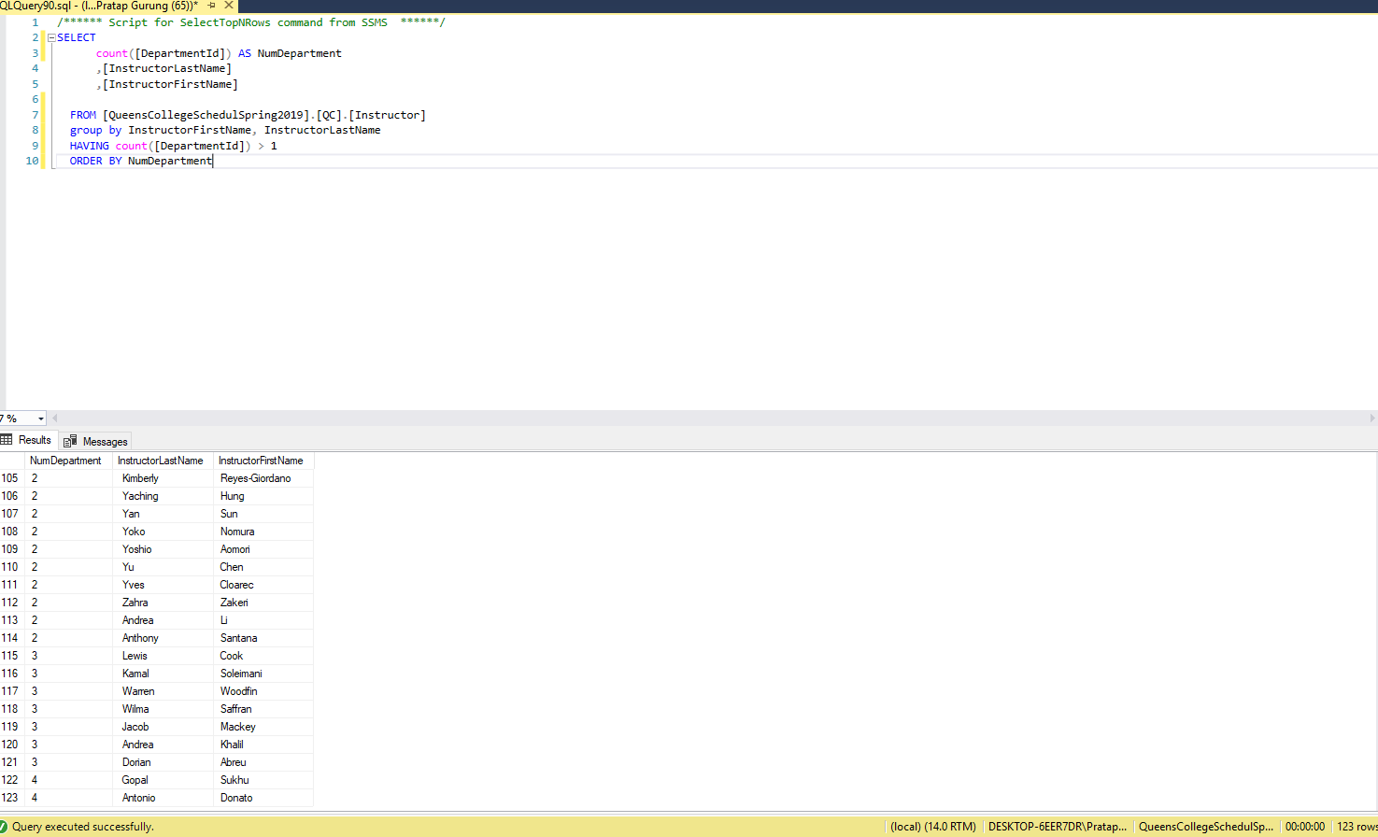
Analyzation: Proposition 1

Slide 32
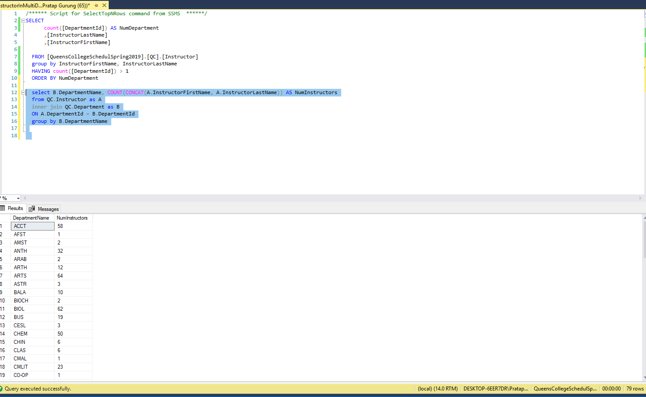
Analyzation: Proposition 2

Slide 33
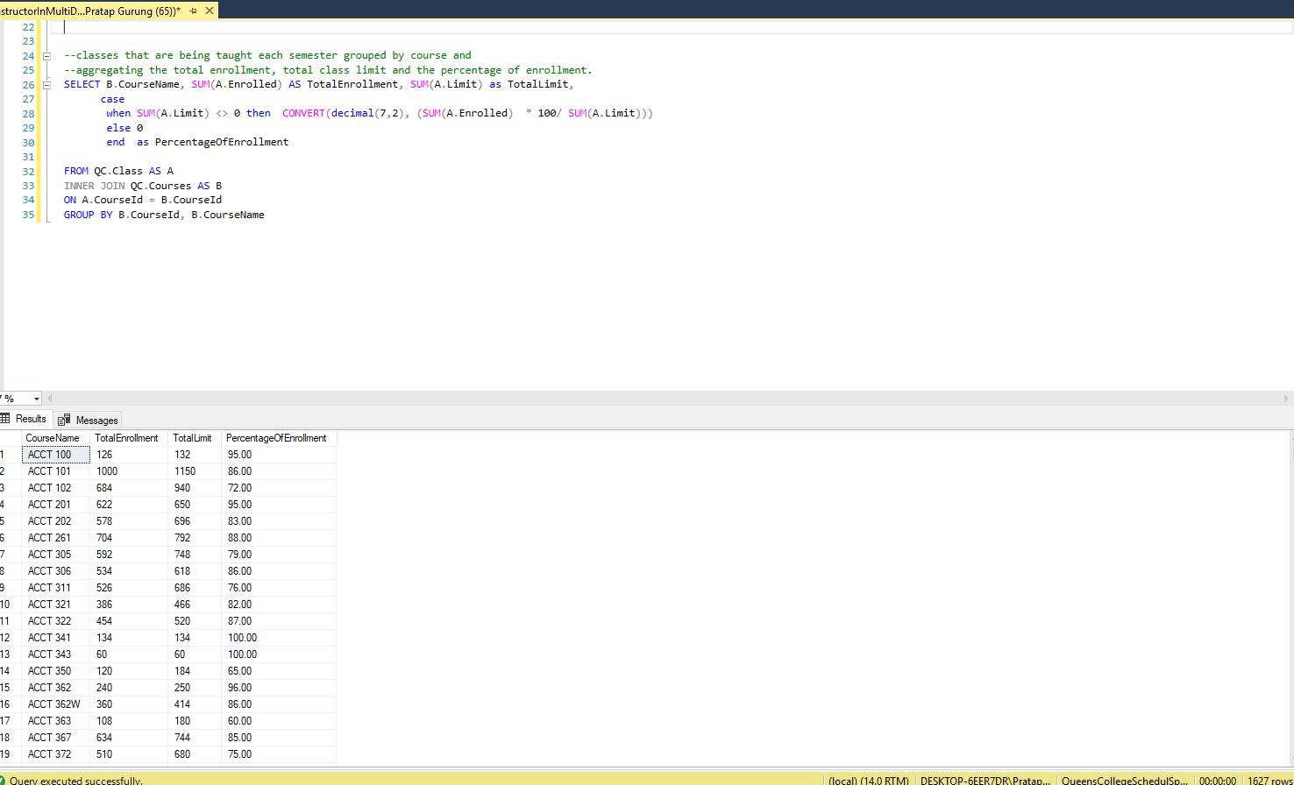
Analyzation: Proposition 3

Slide 34
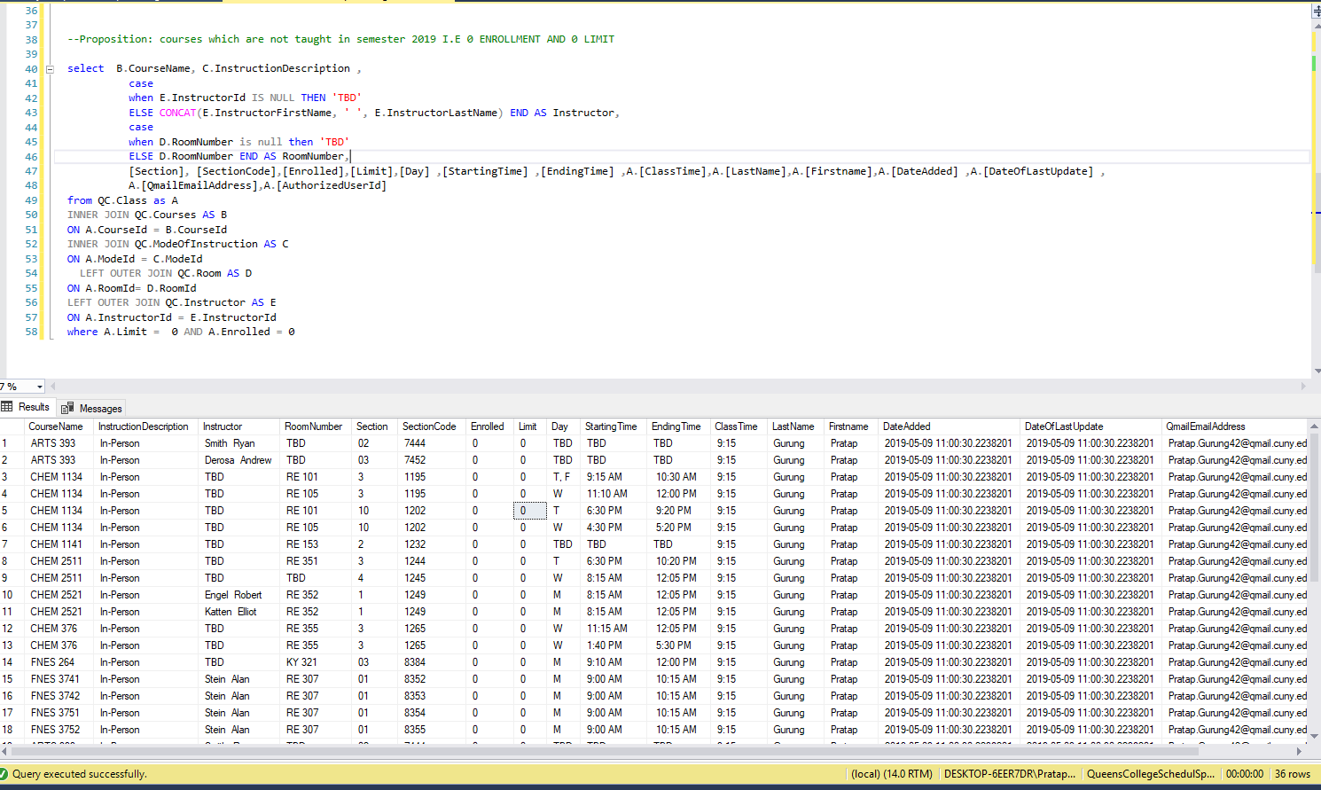
Analyzation: Proposition 4

Slide 35
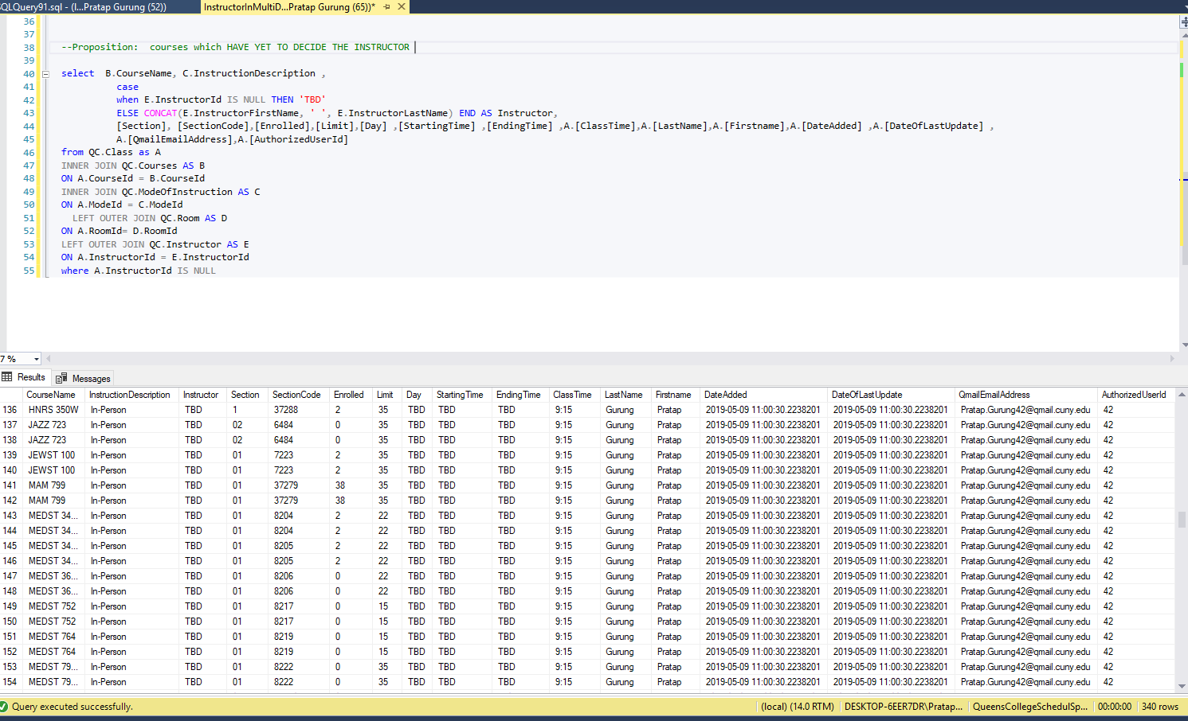
Analyzation: Proposition 5

Slide 36
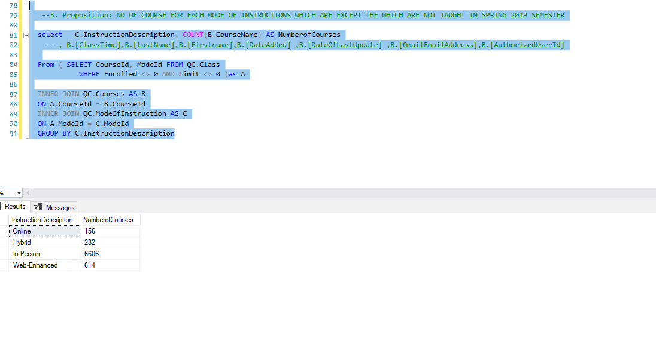
Analyzation: Proposition 6

