Slide 1

Data Mining Process
CRISP - DM
• Cross-Industry Standard Process for Data Mining (CRISP-DM)
• European Community funded effort to develop framework for
data mining tasks
• Goals:
Cross-Industry Standard Process for Data Mining
• Encourage interoperable tools across entire data mining process
• Take the mystery/high-priced expertise out of simple data mining
tasks
2
Why Should There be a Standard Process?
Process Standardization
• Framework for recording experience
• Allows projects to be replicated
•
Initiative launched in late 1996 by three “veterans” of data mining market.
•
Daimler Chrysler (then Daimler-Benz), SPSS (then ISL) , NCR.
•
•
•
•
Developed and refined through series of workshops (from 1997-1999)
Over 300 organization contributed to the process model
Published CRISP-DM 1.0 (1999)
• Aid to project planning and management
• “Comfort factor” for new adopters
• Demonstrates maturity of Data Mining
• Reduces dependency on “stars”
Over 200 members of the CRISP-DM SIG worldwide
•
•
•
DM Vendors - SPSS, NCR, IBM, SAS, SGI, Data Distilleries, Syllogic, Magnify, ..
System Suppliers / consultants - Cap Gemini, ICL Retail, Deloitte & Touche, …
End Users - BT, ABB, Lloyds Bank, AirTouch, Experian, ...
• Encourage best practices and help to obtain better results
3
4

Slide 2
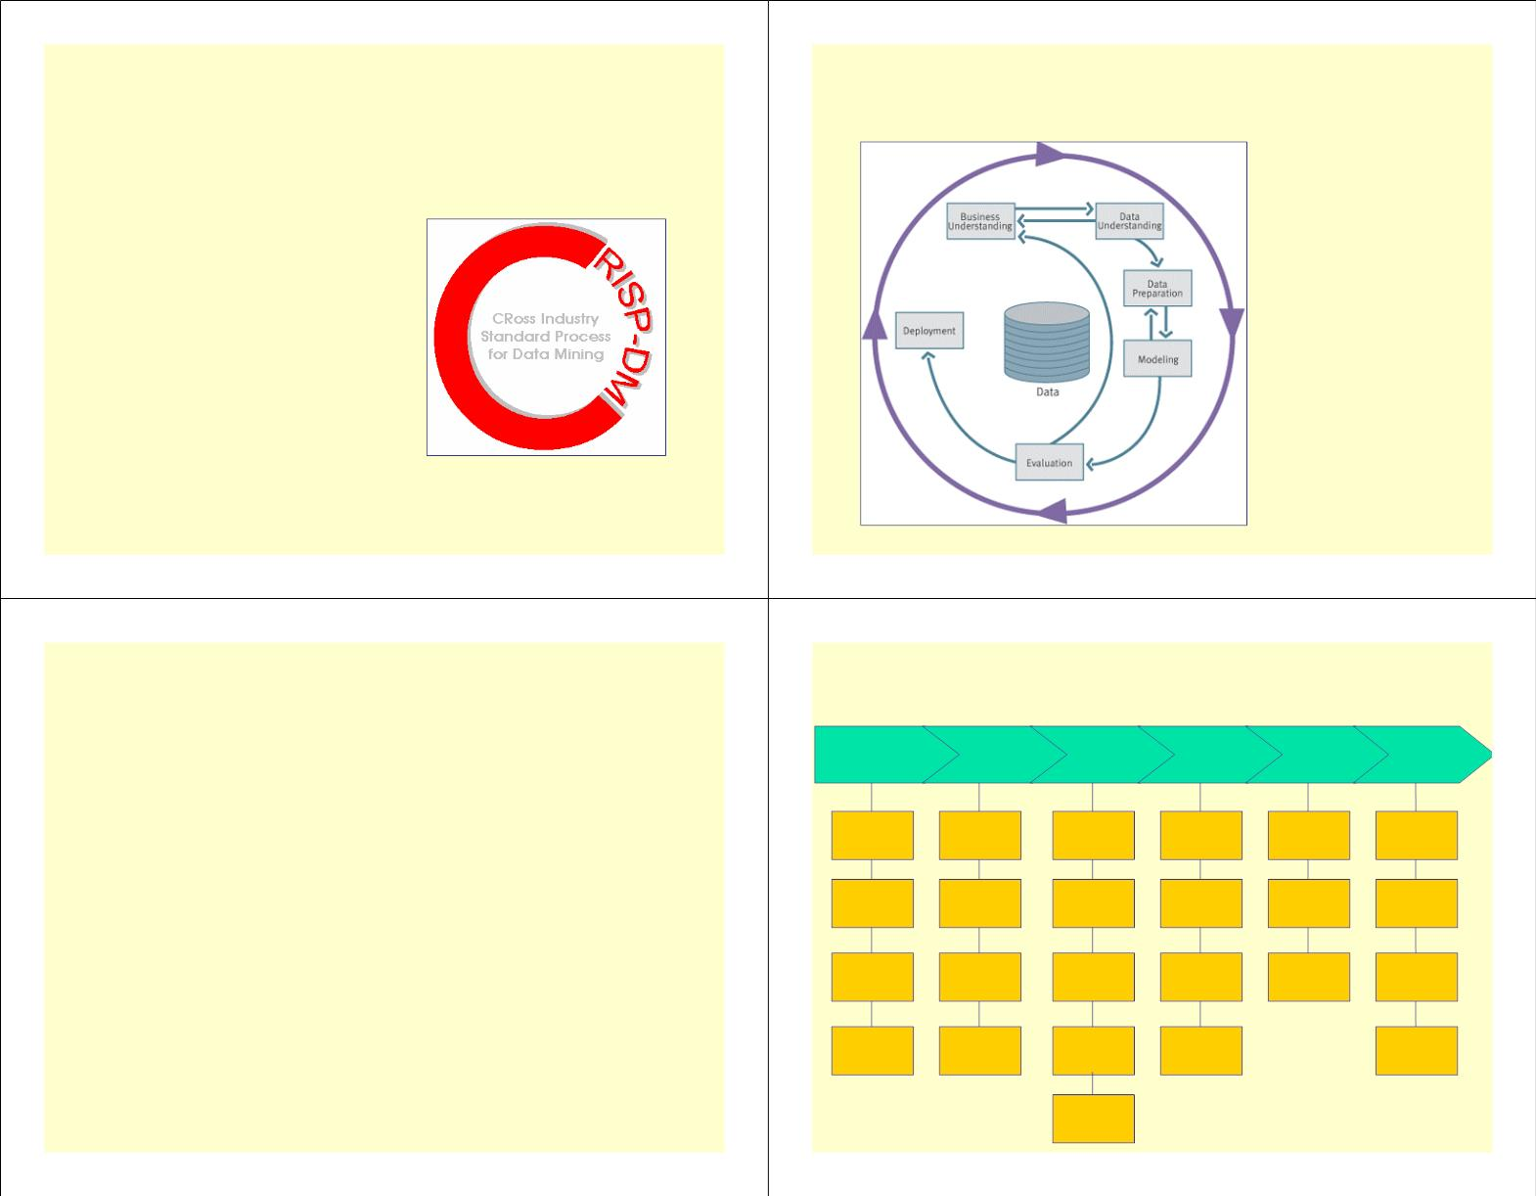
CRISP-DM
CRISP-DM: Overview
• Non-proprietary
CRISP-DM is a
comprehensive data
• Application/Industry neutral
• Tool neutral
mining methodology and
process model that
provides anyone—from
novices to data mining
experts—with a complete
blueprint for conducting a
data mining project.
• Focus on business issues
• As well as technical analysis
• Framework for guidance
CRISP-DM breaks down
the life cycle of a data
mining project into six
phases.
• Experience base
• Templates for Analysis
5
6
CRISP-DM: Phases
Phases and Tasks
• Business Understanding
Business
Data
Data
Preparation
Modeling
Evaluation Deployment
• Understanding project objectives and requirements; Data mining problem definition
• Data Understanding
Understanding Understanding
Determine
Business
Objectives
Collect
Initial
Data
Select
Data
Select
Evaluate
Results
Plan
Deployment
• Initial data collection and familiarization; Identify data quality issues; Initial,
obvious results
Modeling
Technique
• Data Preparation
Assess
Describe
Data
Clean
Data
Generate
Test
Review
Plan
• Record and attribute selection; Data cleansing
• Modeling
Situation
Design
Process
Monitoring &
Maintenance
• Run the data mining tools
• Evaluation
Determine
Data Mining
Goals
Explore
Data
Construct
Data
Build
Model
Determine
Next Steps
Produce
Final
Report
• Determine if results meet business objectives; Identify business issues that should
have been addressed earlier
Produce
Project
Plan
Verify
Data
Quality
Integrate
Data
Assess
Model
Review
Project
• Deployment
Format
Data
• Put the resulting models into practice; Set up for continuous mining of the data
7
8

Slide 3

Phase 1 - Business Understanding
Phase 1 - Business Understanding
• Determine business objectives
• Statement of Business Objective
• States goal in business terminology
• Statement of Data Mining objective
• States objectives in technical terms
• Statement of Success Criteria
•Key persons and their roles? Is there a steering committee. Internal
sponsor (financial, domain expert).
•Business units impacted by the project (sales, finance,...) ? Business success
criteria and who assesses it?
•Users’ needs and expectations.
•Describe problem in general terms. Business questions, Expected benefits.
• Assess situation
• Focuses on understanding the project objectives and
requirements from a business perspective, then converting this
knowledge into a data mining problem definition and a
preliminary plan designed to achieve the objectives
•Are they already using data mining.
•Identify hardware and software available. Identify data sources and their
types (online, experts, written documentation).
• What the client really wants to accomplish?
•Identify knowledge sources and types (online, experts, written documentation)
•Describe the relevant background.
• Uncover important factors (constraints, competing objectives).
9
10
Phase 1 - Business Understanding
Phase 2 - Data Understanding
• Determine data mining goals
• Translate the business questions to data mining goals
• Acquire the data
•
(e.g., a marketing campaign requires segmentation of customers in order to decide
whom to approach in this campaign; the level/size of the segments should be
specified).
• Explore the data (query & visualization)
• Verify the quality
• Specify data mining problem type
•
(e.g., classification, description, prediction and clustering).
• Specify criteria for model assessment.
• Produce project plan
• Define initial process plan; discuss its feasibility with involved personnel.
• Put identified goals and selected techniques into a coherent procedure.
• Estimate effort and resources needed; Identify critical steps.
• Starts with an initial data collection and proceeds with activities in
order to get familiar with the data, to identify data quality
problems, to discover first insights into the data or to detect
interesting subsets to form hypotheses for hidden information.
11
12

Slide 4

Phase 2 - Data Understanding
Phase 2 - Data Understanding
• Collect data
•Explore data
• Analyze properties of interesting attributes in detail
• List the datasets acquired (locations, methods used to acquire,
problems encountered and solutions achieved).
• Distribution, relations between pairs or small numbers of attributes, properties
of significant sub-populations, simple statistical analyses.
• Describe data
•Verify data quality
• Check data volume ans examine its gross properties.
• Identify special values and catalogue their meaning.
• Accessibility and availability of attributes. Attribute types, range,
correlations, the identities.
• Does it cover all the cases required? Does it contain errors and how
common are they?
• Understand the meaning of each attribute and attribute value in
business terms.
• Identify missing attributes and blank fields. Meaning of missing data.
• Do the meanings of attributes and contained values fit together?
• For each attribute, compute basic statistics (e.g., distribution,
average, max, min, standard deviation, variance, mode, skewness).
• Check spelling of values (e.g., same value but sometime beginning with a lower
case letter, sometimes with an upper case letter).
• Check for plausibility of values, e.g. all fields have the same or nearly the
same values.
13
14
Phase 3 - Data Preparation
Phase 3 - Data Preparation
• Select data
• Reconsider data selection criteria.
• Select and prepare data to be used
• Takes usually over 90% of the time
• Decide which dataset will be used.
• Collect appropriate additional data (internal or external).
• Consider use of sampling techniques.
• Explain why certain data was included or excluded.
• Clean data
• Covers all activities to construct the final dataset from the initial
raw data. Data preparation tasks are likely to be performed multiple
times and not in any prescribed order. Tasks include table, record
and attribute selection as well as transformation and cleaning of
data for modeling tools.
• Correct, remove or ignore noise.
• Decide how to deal with special values and their meaning (99 for
marital status).
• Aggregation level, missing values, etc.
• Outliers?
15
16

Slide 5

Phase 3 - Data Preparation
• Construct data
Phase 4 – Modeling
• Derived attributes.
• Select the modeling technique
• Background knowledge .
•
(based upon the data mining objective)
• How can missing attributes be constructed or imputed?
• Generate test design
• Integrate data
•
Procedure to test model quality and validity
• Integrate sources and store result (new tables and records).
• Build model
• Format Data
•
Parameter settings
• Rearranging attributes (Some tools have requirements on the order of the
attributes, e.g. first field being a unique identifier for each record or last field
being the outcome field the model is to predict).
• Assess model (rank the models)
• Reordering records (Perhaps the modeling tool requires that the records be
sorted according to the value of the outcome attribute).
•
Various modeling techniques are selected and applied and their
parameters are calibrated to optimal values. Typically, there are several
techniques for the same data mining problem type. Some techniques
have specific requirements on the form of data. Therefore, stepping
back to the data preparation phase is often necessary.
• Reformatted within-value (These are purely syntactic changes made to satisfy
the requirements of the specific modeling tool, remove illegal characters,
uppercase lowercase).
17
18
Phase 4 – Modeling
Phase 4 – Modeling
• Build model
• Select modeling technique
• Set initial parameters and document reasons for choosing those values.
• Select technique
• Run the selected technique on the input dataset. Post-process data mining
results (eg. editing rules, display trees).
• Identify any built-in assumptions made by the technique about the data
(e.g. quality, format, distribution).
• Compare these assumptions with those in the Data Description Report and
make sure that these assumptions hold.
• Record parameter settings used to produce the model.
• Describe the model, its special features, behavior and interpretation.
• Preparation Phase if necessary.
• Assess model
• Generate test design
• Evaluate result with respect to evaluation criteria. Rank results with
respect to success and evaluation criteria and select best models.
• Describe the intended plan for train, test and evaluate the models.
• How to divide the dataset into training, test and validation sets.
• Decide on necessary steps (number of iterations, number of folds etc.).
• Prepare data required for test.
• Interpret results in business terms. Get comments by domain experts.
Check plausibility of model.
• Check model against given knowledge base (discovered info. novel and useful?)
• Check result reliability. Analyze potentials for deployment of each result.
19
20

Slide 6

Phase 5 – Evaluation
Phase 5 – Evaluation
• Evaluation of model
•Evaluate results
• More thoroughly evaluate model
• Decide how to use results
• Understand data mining result. Check impact for data mining goal.
• Check result against knowledge base to see if it is novel and useful.
Evaluate and assess result with respect to business success criteria
• Rank results according to business success criteria. Check result impact on
initial application goal.
• Methods and criteria depend on model type:
• Are there new business objectives? (address later in project or new project?)
• State conclusions for future data mining projects.
• e.g., coincidence matrix with classification models, mean error rate with
regression models
• Interpretation of model: important or not, easy or hard depends on
algorithm
•Review of process
• Summarize the process review (activities that missed or should be repeated).
• Thoroughly evaluate the model and review the steps executed to construct
the model to be certain it properly achieves the business objectives. A key
objective is to determine if there is some important business issue that has
not been sufficiently considered. At the end of this phase, a decision on the
use of the data mining results should be reached
• Overview data mining process. Is there any overlooked factor or task? (did
we correctly build the model? Did we only use attributes that we are allowed to use
and that are available for future analyses?)
• Identify failures, misleading steps, possible alternative actions,
unexpected paths
21
• Review data mining results with respect to business success
22
Phase 5 – Evaluation
Phase 6 – Deployment
• Determine next steps
• Analyze potential for deployment of each result. Estimate potential for
improvement of current process.
• Determine how the results need to be utilized
• Who needs to use them?
• Check remaining resources to determine if they allow additional process
iterations (or whether additional resources can be made available).
• How often do they need to be used
• Recommend alternative continuations. Refine process plan.
• Deploy Data Mining results by:
• Decision
• Scoring a database, utilizing results as business rules, interactive
scoring on-line
• According to the results and process review, it is decided how to
proceed to the next stage (remaining resources and budget)
• The knowledge gained will need to be organized and presented in a
way that the customer can use it. However, depending on the
requirements, the deployment phase can be as simple as generating a
report or as complex as implementing a repeatable data mining
process across the enterprise.
• Rank the possible actions. Select one of the possible actions.
• Document reasons for the choice.
23
24

Slide 7
Phase 6 – Deployment
Phase 6 – Deployment
• Plan deployment
•Produce a final report
• How will the knowledge or information be propagated to users? How will
the use of the result be monitored or its benefits measured?
•Identify reports needed (slide presentation, management summary, detailed
findings, explanation of models, etc.). How well initial data mining goals have
been met.
• How will the model or software result be deployed within the
organization’s systems? How will its use be monitored and its benefits
measured (where applicable)?
•Identify target groups for reports. Outline structure and contents of
reports.
•Select findings to be included in the reports. Write a report.
• Identify possible problems when deploying the data mining results
•Review project
• Plan monitoring and maintenance
•Interview people involved in project. Interview end users. What could
have been done better? Do they need additional support? Summarize
feedback and write the experience documentation
• What could change in the environment? How will accuracy be monitored?
•Analyze the process (what went right or wrong, what was done well and what
needs to be improved.).
• When should the data mining model not be used any more? What should
happen if could no longer be used? (Update model, new data mining project)
•Document the specific data mining process (How can results and experience
of applying the model be fed back into the process?). Abstract from details to
make the experience useful for future projects.
• Will the business objectives of the use of the model change over time?
25
26
Why CRISP-DM?
•
•
The data mining process must be reliable and repeatable by people with
little data mining skills
CRISP-DM provides a uniform framework for
•
•
guidelines
experience documentation
•
CRISP-DM is flexible to account for differences
•
•
Different business/agency problems
Different data
27
28

Slide 8
•
Thank you !!!
29
30

