Slide 1
Information Retrieval using NLP
Project Group: P2_NLP_Group4
Mentors: Sri Vinod, Srinivas
Date: 20-Nov-19

Slide 2
Business Problem:
Problem:
Proper Information need to be retrieved based on text search
Objective:
Based on the text question, NLP algorithm should retrieve 5 most relevant responses from the corpus with rankings (Probabilities)

Slide 3
Project Architecture / Project Flow
Business Objective and Data Sources
Data Collection and Parsing
Data Cleaning
EDA
Feature Engineering
Model Building
Evaluation & Validation
Final Model Deployment

Slide 4
Exploratory Data Analysis (EDA) and
Feature Engineering

Slide 5
Data set details
Data Set File: QA_Electronics.JSON
Rows: 314263
Columns: 7
Datatype: 7 columns are object datatype
Missing values are identified in the below columns
Answer: 32
Answer Type: 148665
Unique values
answer – 274894 unique values and 39337duplicate values
answer Type – 3 unique values and Null values
question – 290872 unique values and 23391 duplicate values
question Type – 2
asin - 39371 unique values and 274860 duplicate values

Slide 6
Exploratory Data Analysis (EDA)
50% of the data has answer Type Null values
Unique Answer Type values are 'Y', 'N', and ‘?‘ apart from null values for open ended question Type.
question | answer | asin | Comment
5.1 | Whats the question? | B001KUSXXU | No proper question format for 28 records. Mostly question is numerical.
1. Is this fit for Nikon 18-140mm lens (18-140mm f/3.5-5.6G ED VR AF-S DX NIKKOR Zoom Lens)? 2. It is clear or has any tint? Thank you. | With a minimum focal length of 18mm you likely need a lower profile filter than this. A UV filter generally has no tint but is treated to reduce the effects of UV rays and will brighten colors. | B000BH5OUI | Question and Answer are same but the product IDs are different
1. Is this fit for Nikon 18-140mm lens (18-140mm f/3.5-5.6G ED VR AF-S DX NIKKOR Zoom Lens)? 2. It is clear or has any tint? Thank you. | With a minimum focal length of 18mm you likely need a lower profile filter than this. A UV filter generally has no tint but is treated to reduce the effects of UV rays and will brighten colors. | B000BH5OW6
1. Is this fit for Nikon 18-140mm lens (18-140mm f/3.5-5.6G ED VR AF-S DX NIKKOR Zoom Lens)? 2. It is clear or has any tint? Thank you. | With a minimum focal length of 18mm you likely need a lower profile filter than this. A UV filter generally has no tint but is treated to reduce the effects of UV rays and will brighten colors. | B000KZ5YWE
1. Is this fit for Nikon 18-140mm lens (18-140mm f/3.5-5.6G ED VR AF-S DX NIKKOR Zoom Lens)? 2. It is clear or has any tint? Thank you. | With a minimum focal length of 18mm you likely need a lower profile filter than this. A UV filter generally has no tint but is treated to reduce the effects of UV rays and will brighten colors. | B000KZ9916
"I wonder if in this player you can watch TV" | it says u can but i havent tried that yet or bought the extra equipment to do so. | B0058SJQD6 | Same Question is repeated for multiple products and answers.
"I wonder if in this player you can watch TV" | No you can't watch tv and I truly do not recommend you buy this device the cd quality makes it sound like the chipmonks and it freezes for no reason poor sound quality !!! I'm truly disappointed with this purchase! | B006WUPRU0
"I wonder if in this player you can watch TV" | You can, If you buy the addon device to watch TV. Out of the box, though, you can't | B0072LFAQE

Slide 7
Exploratory Data Analysis (EDA)
List out all your queries:
As per acceptance Criteria, We assume that we can only consider Q & A only and ignore the rest of the features?
We noticed 32 answers are unavailable in the provided data and assuming we can ignore those records.
Points to note:
13000+ question and answer duplicates are available when we consider subset data frame of questions and answers.

Slide 8
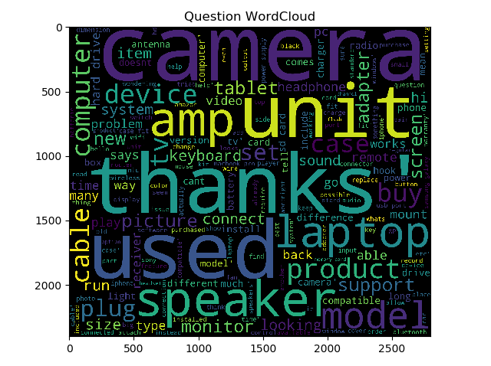
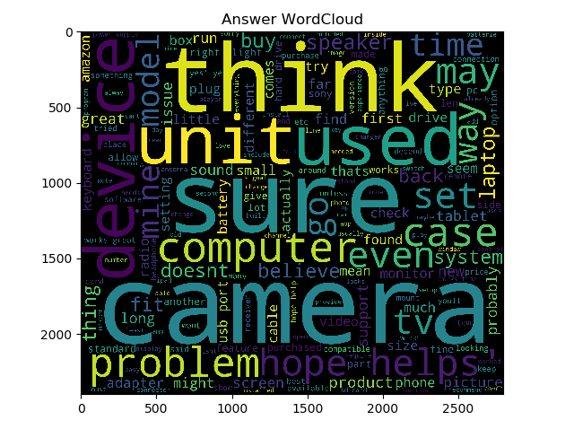
EDA
Below depicts the most frequent words of Corpus

Slide 9
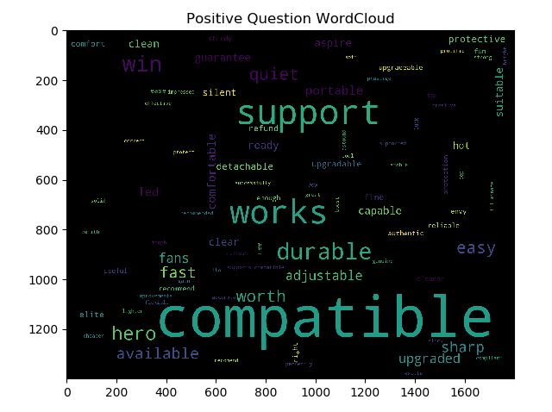
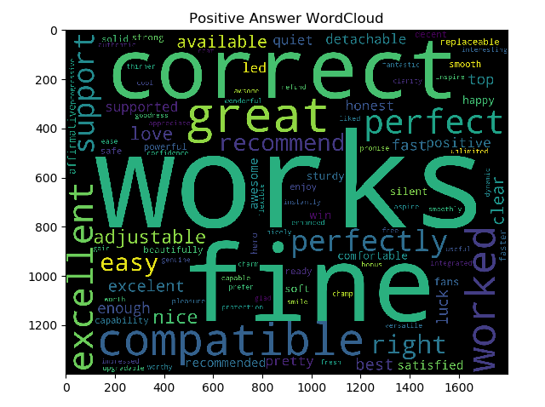
EDA
Below depicts the most frequent positiive words of Corpus

Slide 10
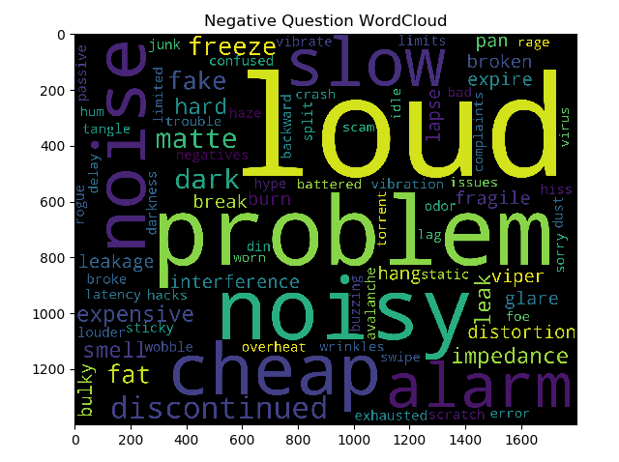
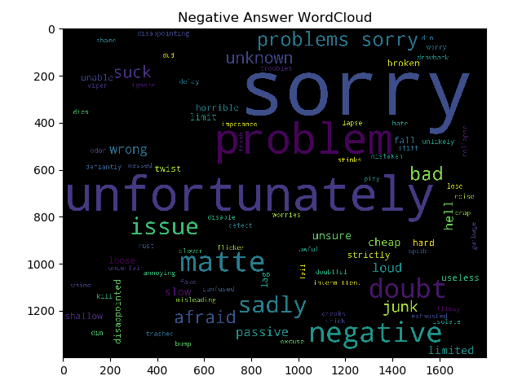
EDA
Below depicts the most frequent negative words of Corpus

Slide 11
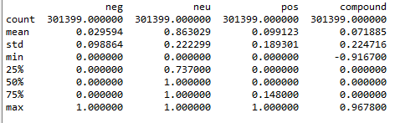
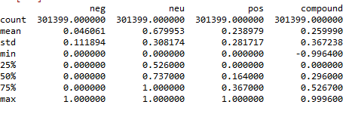
EDA
Sentiment Analysis
Below depicts the sentiment analysis of question and answers and noticed around 86% question are neutral questions and 7% are compound. Around 67% are neutral and 25% are compound answers.

Slide 12
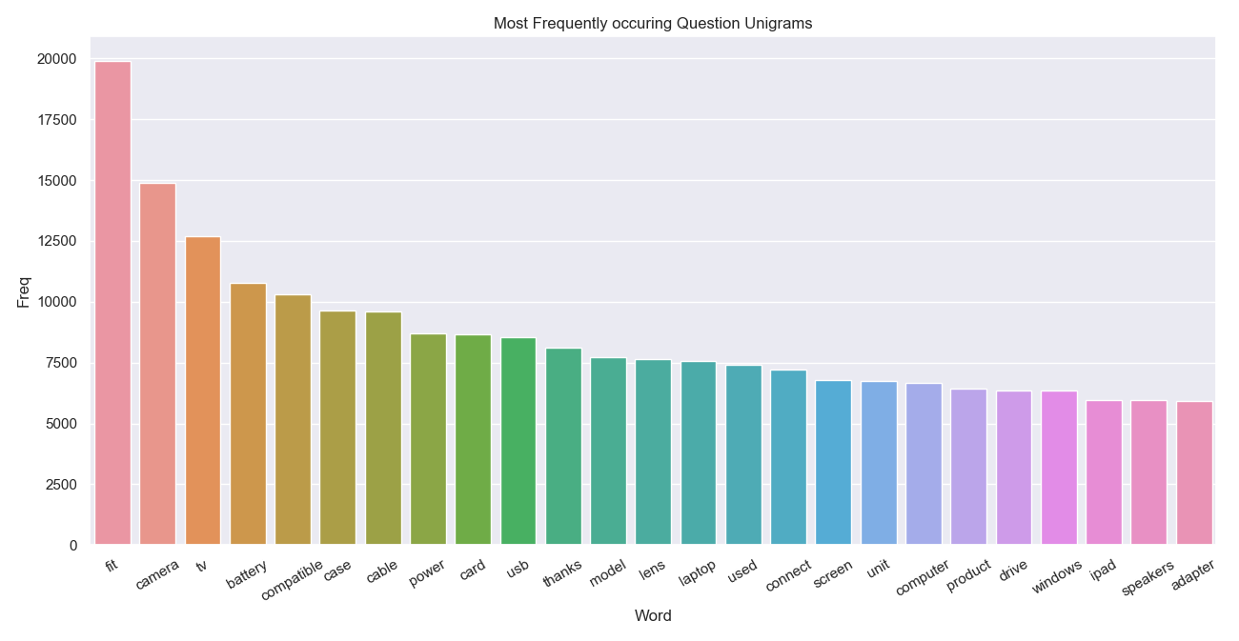
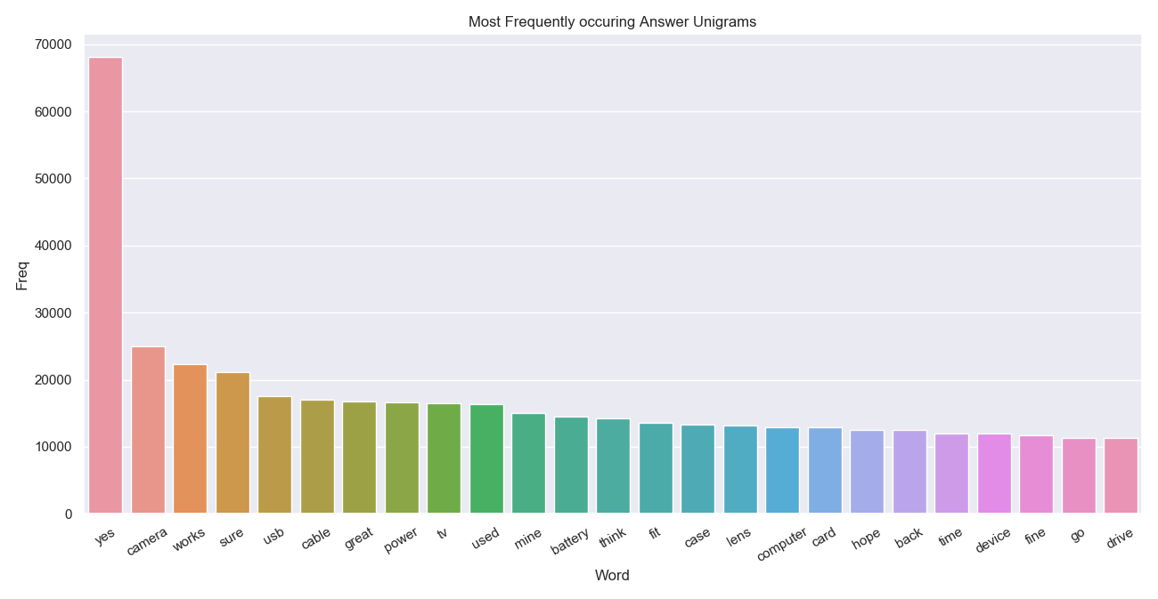
EDA

Slide 13
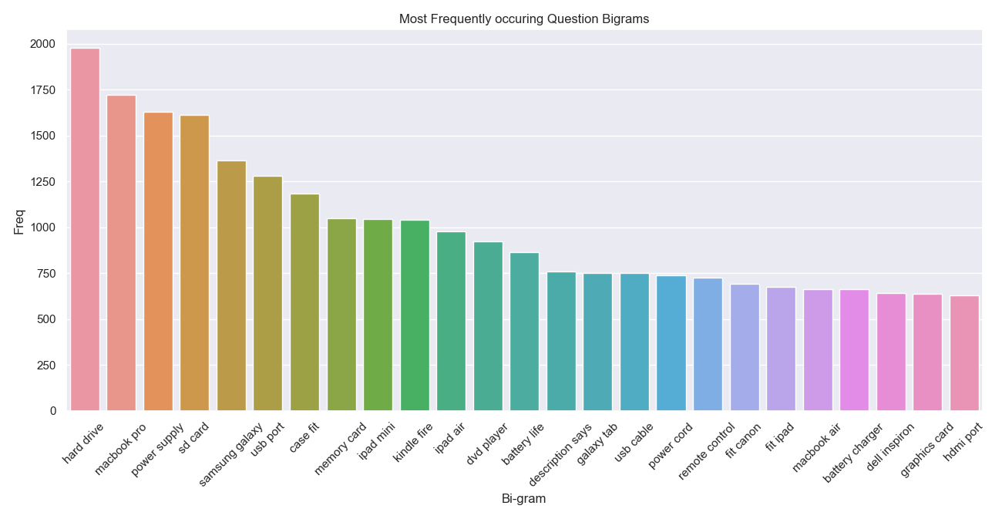
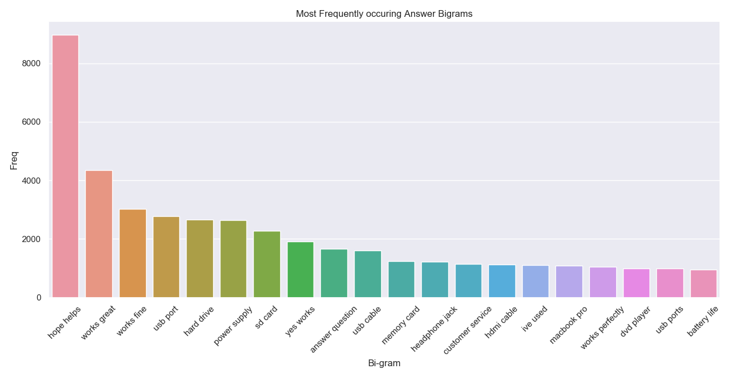
EDA

Slide 14
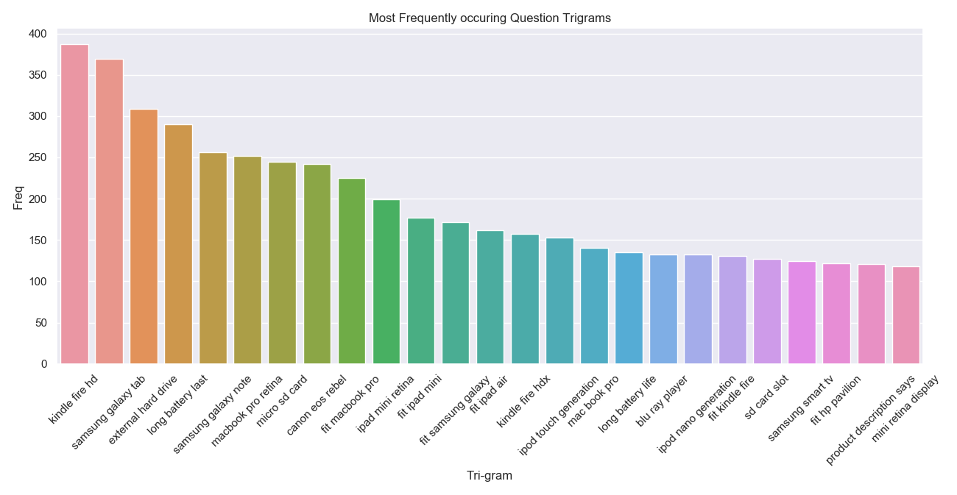
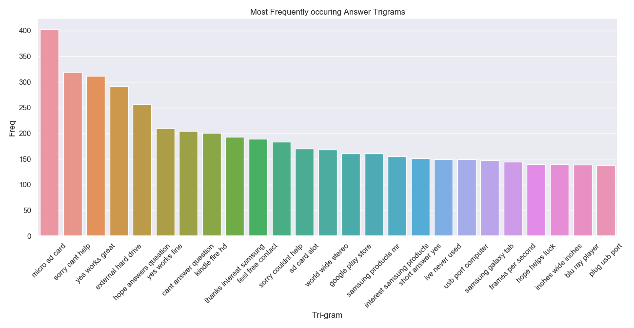
EDA

Slide 15
EDA
54928 Unique Unigram words after data cleaning are identified from Question field and below are Top 5 weights
91897 Unique Unigram words after data cleaning are identified from Answer field and below are Top 5 weights
Term | Weight
Fit | 0.019998484
Camera | 0.013475864
Compatible | 0.012613117
Battery | 0.01139906
Tv | 0.011006651
term | weight
yes | 0.08356
works | 0.015008
sure | 0.012438
camera | 0.011478
great | 0.010122
640407 Unique Bigram words after data cleaning are identified from Question field and below are Top 5 weights
1048575+ Unique Bigram words after data cleaning are identified from Answer field and below are Top 5 weights
term | weight
macbook pro | 0.001901
samsung galaxy | 0.001823
power supply | 0.001661
hard drive | 0.001605
sd card | 0.001572
term | weight
works great | 0.002895
hope helps | 0.002867
yes works | 0.00274
works fine | 0.00216
usb port | 0.001517
909598 Unique Trigram words after data cleaning are identified from Question field and below are Top 5 weights
1048575+ Unique Trigram words after data cleaning are identified from Answer field and below are Top 5 weights
term | weight
samsung galaxy tab | 0.000611
fit ipad air | 0.000401
samsung galaxy note | 0.000398
fit macbook pro | 0.00039
fit ipad mini | 0.000384
term | weight
yes works great | 0.00065
yes works fine | 0.000412
micro sd card | 0.00029
yes works perfectly | 0.000181
sorry answer question | 0.000165

Slide 16
Topic Modelling using LDA
Below depicts the top 6 topics and associated 10 words which are extracted using Latent Dirichlet allocation model.
Topic #0: card screen windows monitor Samsung camera memory support galaxy sd
Topic #1: fit case ipad pro keyboard sony macbook laptop hp mini
Topic #2: power battery speakers sound charge wireless speaker adapter iphone amp
Topic #3: tv cable usb hdmi port mount plug wall player version
Topic #4: drive play computer phone hard cable model video record wifi
Topic #5: camera lens buy canon nikon battery warranty fit thanks product

Slide 17
Summary of Inferences
In the whole dataset of 314263, we have identified there are 280303 questions and 269009 answers are available. Total available products are 39371
In the subset of question and answers we observed that 13000 + Questions and answers are duplicate after removing the duplicates we identified total no of records 301399.
Missed values are observed in answer and answer type fields (32 Answers -(Question exists but no answers), 148665 null values (Question type is open ended but no answer type)
In some cases there is repetition of same question and answer for different products, but in some cases there is repetition of same question but different answers for different products
In some cases even the questions and answers are incorrectly phrased, and it has been observed for 28 questions whose value is in floating data type.
As per the sentiment analysis on question and answers, it is been noticed around 86% question are neutral questions and 7% are compound. Around 67% answers are neutral and 25% are compound.
As per the topic model analysis majority of the questions and answers relevant to Camera, Computer, Laptop, Tablet,TV and phone.

Slide 18
Model Building

Slide 19
Model Implementation
Model – BM25F Algorithm from Whoosh Package
Whoosh is a fast, feature full-text indexing and searching library implemented in pure Python. BM25F is by default ranking function used by whoosh which is a probabilistic retrieval model. BM stands for best matching. It is based on tf-idf along with bunch of factors like length of document in words, average length of documents in the collection.
Below Steps involved in building the model.
Schema need to be defined for question and answer fields as the index need to be created based on those fields for fast retrieval based on text search.
Index will be populated based on schema fields by using index writer.
Each document is ranked according to a scoring function BM25F
Qparser module is used to parse the text search query and internally multifieldparser class is used as we need to search the text in question and answer fields.

Slide 20
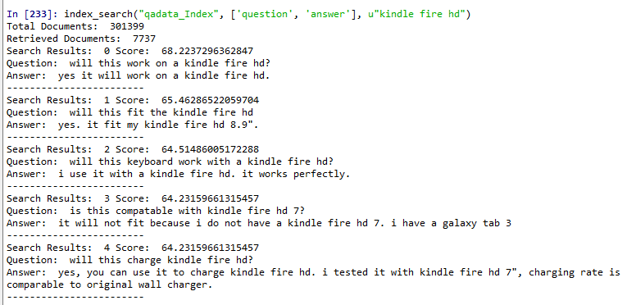
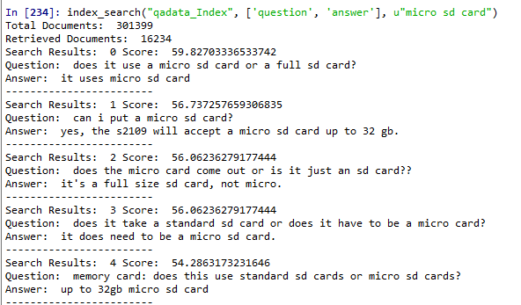
Model Results

Slide 21
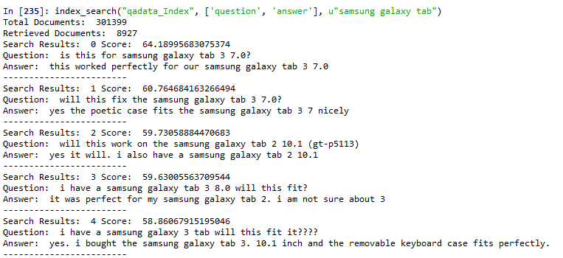
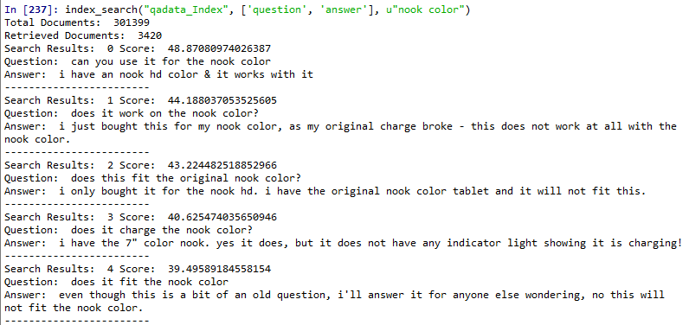
Model Results

Slide 22
Model Deployment using Flask

Slide 23
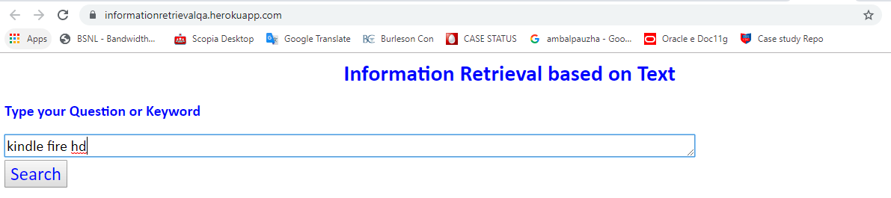
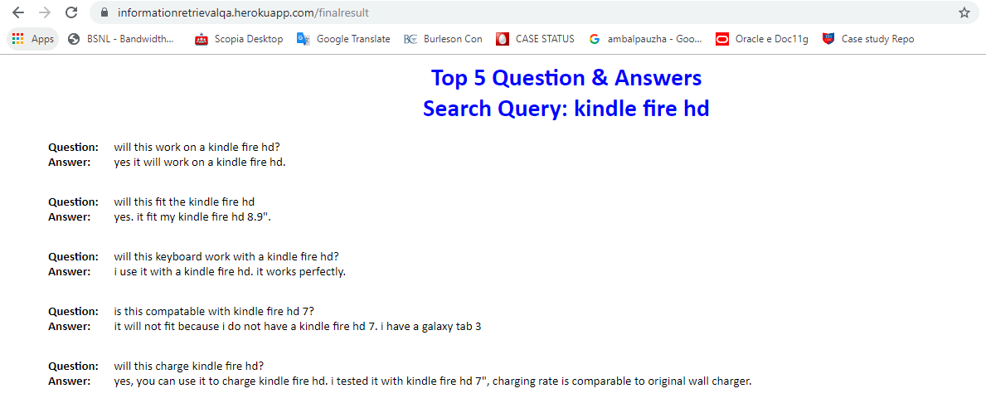
Model Deployment
Below is the app link for Heroku App by using Flask and respective screenshots of sample are shown below.
https://informationretrievalqa.herokuapp.com/

Slide 24
Challenges faced?
Lot of difference is noticed between actual learning experience and project implementation process.
Faced issues in converting the JSON file to csv file.
We are unable to achieve the evaluation metrics (Accuracy, Mean Average Precision) for the consider model BM25F algorithm.
How did you overcome?
To overcome the variation of learning and project implementation we did enough research and gone through various blogs, workspaces and team meetings.
Corrected the JSON File by converting single quotes to double quotes and combined the dictionaries in JSON file as single string and then converted corrected json file to dataframe using read_json function after referring few blogs.

Slide 25
Thank you

