Slide 1
BIG DATA COMPUTING IN HEALTHCARE ANALYTICS
TEAM: SPARTANS
PRATEECHI SINGH UTKARSH MAHESHWARI

Slide 2

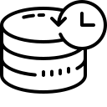
Big Data in healthcare
Healthcare Big Data refers to collecting, analyzing and leveraging following data:
Consumer
Patient
Claims
Clinical
The rise of healthcare big data comes in response to the digitization of healthcare information and the rise of value-based care, which has encouraged the industry to use data analytics to make strategic business decisions
Increasing Volume of Healthcare Data
Growing Healthcare Costs
Desire for Personalized Care

Slide 3

Applications in Big Data HealthCare
Patients Predictions For An Improved Staffing
Enhancing Patient Engagement
Predictive Analytics In Healthcare
Reduce Fraud And Enhance Security
Telemedicine
Integrating Big Data With Medical Imaging
ER Visits Prevention
Predicting Disease Progression

Slide 4

Tools in Big Data Analytics
DATA TOOLS:
Apache Hadoop
Apache Spark
Apache Kafka
SQL and NoSQL
PROGRAMMING TOOLS:
PYTHON
JAVA
SCALA
JULIA

Slide 5


Tools in Big Data Analytics
SPARK: It is an open source framework for data analytics, machine learning algorithms, and fast cluster computing. this is written in SCALA, JAVA, Python, and R.
Spark core is the heart of the project, and it facilitates many things like :
Distributed Task Transmission, Scheduling and i/o functionality
HADOOP: It is a software framework employed for clustered file system and handling of big data.
Hadoop is an open-source framework that is written in Java and it provides cross- platform support. It has 4 parts: HDFS, MapReduce, YARN and other libraries
Notes:
Hadoop consists of four parts:
Hadoop Distributed File System: Commonly known as HDFS, it is a distributed file system compatible with very high scale bandwidth.
MapReduce: A programming model for processing big data.
YARN: It is a platform used for managing and scheduling Hadoop’s resources in Hadoop infrastructure.
Libraries: To help other modules to work with Hadoop.

Slide 6


COMPARATIVE ANALYSIS
Technology | Features
Hadoop | HDFS, YARN, MapReduce Hive, a SQL-like interface allowing users to run queries on HDFS Mahout for machine learning. Hadoop can also now be configured to use S3 buckets or Azure blobs as input. The MapReduce algorithm sits on top of HDFS and consists of a Job Tracker.
Spark | Processes data in RAM using a concept known as an RDD, Resilient Distributed Dataset. Spark can run either in stand-alone mode, with a Hadoop cluster serving as the data source, or in conjunction with Mesos. Spark is structured around Spark Core, the engine that drives the scheduling, optimizations, and RDD abstraction, as well as connects Spark to the correct filesystem (HDFS, S3, RDBMs, or Elasticsearch). Initially, Spark reads from a file on HDFS, S3, or another filestore, into an established mechanism called the Spark Context.
Notes:
The MapReduce algorithm sits on top of HDFS and consists of a JobTracker. Once an application is written in one of the languages Hadoop accepts the JobTracker, picks it up, and allocates the work (which could include anything from counting words and cleaning log files, to running a HiveQL query on top of data stored in the Hive warehouse) to TaskTrackers listening on other nodes.
Sqoop is a command-line interface application for transferring data between relational databases and Hadoop. Has Sqoop, which moves relational data into HDFS
YARN allocates resources that the JobTracker spins up and monitors them, moving the processes around for more efficiency. All the results from the MapReduce stage are then aggregated and written back to disk in HDFS.
There are several libraries that operate on top of Spark Core, including Spark SQL, which allows you to run SQL-like commands on distributed data sets, MLLib for machine learning, GraphX for graph problems, and streaming which allows for the input of continually streaming log data.
Spark has several APIs. The original interface was written in Scala, and based on heavy usage by data scientists, Python and R endpoints were also added. Java is another option for writing Spark jobs.

Slide 7


Technology | Performance Measure
Spark | Spark has been found to run 100 times faster in-memory and 10 times faster on disk. It’s also been used to sort 100TB of data 3 times faster than Hadoop MapReduce. Spark is not bound by input-output concerns every time it runs a selected part of a MapReduce task. It’s proven to be much faster for applications. Spark’s DAGs enable optimizations between steps.
Hadoop | Hadoop doesn’t have any cyclical connection between MapReduce steps, meaning no performance tuning can occur at that level If Spark is running on YARN with other shared services, performance might degrade and cause RAM overhead memory leaks. For this reason, if a user has a use-case of batch processing, Hadoop has been found to be the more efficient system

Slide 8

PROBLEM STATEMENT
We have a healthcare stroke dataset and we aim to predict whether a person will get a stroke or not.
We will perform the task using both Python and PySpark using 2 algorithms: Logistic Regression and Decision Trees and then will compare time taken to train the data.
Decide whether Scikit-learn Python or ML Lib of PySpark is better for Machine Learning.

Slide 9
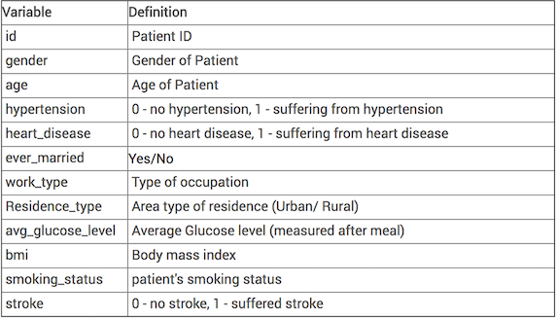
Implementation
We have a medical dataset having following columns (364,807 rows):

Slide 10
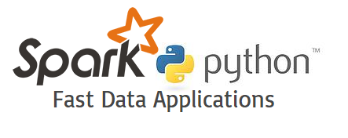
TOOLS WE WORKED WITH
Python
PySpark
Spark SQL

Slide 11
Install spark and spark context
To install Spark on your local machine, a recommended practice is to create a new conda environment. The new environment will install Python 3.6 and above, Spark and all its dependencies
Spark Context is the internal engine that allows the connections with the clusters. If you want to run an operation, you need a Spark Context.
Step 1: Initiate Spark Context:
import pyspark
from pyspark import SparkContext
sc = SparkContext()
sqlContext = SQLContext(sc)
Step 2: Build a RDD (Resilient Distributed Dataset)
Computation in RDD is automatically parallelized across the cluster.
rdd = sc.paralleize(list_a)

Slide 12
DATA PREPROCESSING With SPARK
Step 3: Read the data
Train_data = sqlContext.read.csv(SparkFiles.get(“data.csv” , header=True, inferSchema=True)
Step 4: Basic Operation with PySpark
Step 5: Data Preprocessing
Step 6: Build a Data Preprocessing Pipeline
Index String to numerical 4. Index label features
Create one hot encoder 5. Add Continuous Variable
Transform the data 6. Assemble the steps

Slide 13
Machine LEARNING WITH SPARK
Step 7: Create Test/Train Set
Step 8: Build the Logistic Regressor/Decision Trees
Step 9: Evaluate the Model
Step 10: ROC Metrics

Slide 14
RESULTS
Time taken to train the data :
ML Algorithms | PYSPARK | SCIKIT
Logistic Regression | 170.489 seconds | 1.869 seconds
Decision Trees | 746.231 seconds | 0.474 seconds

Slide 15

CONCLUSION
SCIKIT CODE:
The ML use case involves a supervised learning model to combine model training and prediction generation.
The job executing this code was run manually, required download of raw feature data from data lake, and upload of generated results to the application.
SPARK CODE:
Apache Spark allows us to overcome shortcomings of single server operating environment. The cluster has direct access to data lake for immediate retrieval of input features and final storage of generated recommendations.
The availability of multiple server nodes in cluster has the promise for distributing tasks within the job. In addition, the job can be injected into a schedule for automated daily execution.

Slide 16

CONCLUSION
Scikit-learn is better library for Machine Learning algorithms than ML Lib of PySpark
Spark is good for big data processing but not for small datasets

Slide 17
REFERENCES
Torres, Hugo, Filipe Portela, and Manuel Filipe Santos. "An Overview of Big Data Architectures in Healthcare." World Conference on Information Systems and Technologies. Springer, Cham, 2018.
Gui, Hao, et al. "An architecture for healthcare big data management and analysis." International Conference on Health Information Science. Springer, Cham, 2016.
El Morr, Christo, and Hossam Ali-Hassan. "Healthcare Analytics Applications." Analytics in Healthcare. Springer, Cham, 2019. 57-70.
Popovic, Jennifer R. "Distributed data networks: a blueprint for Big Data sharing and healthcare analytics." Annals of the New York Academy of Sciences 1387.1 (2017): 105-111.
Wang, Yichuan, LeeAnn Kung, and Terry Anthony Byrd. "Big data analytics: Understanding its capabilities and potential benefits for healthcare organizations." Technological Forecasting and Social Change 126 (2018): 3-13.

Slide 18
GRAZIE

