Slide 1
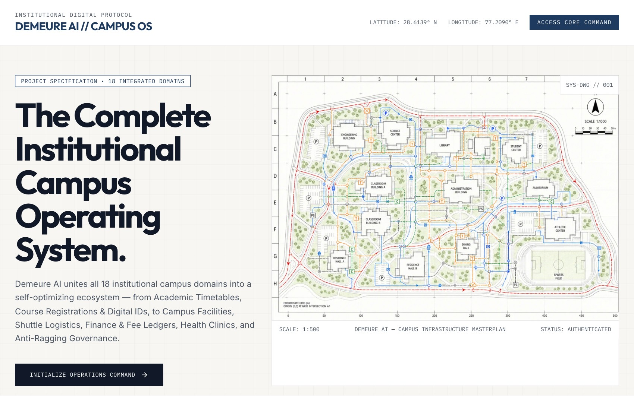
Demeure AI
FINAL REVIEW · OCTOBER 2026
Intelligent campus operating system for hostel and campus life
TEAM
Pratik Kumar · 24BML0027
Thakur Chand Choudhary · 24BML0012
Nikunj Goydani · 24BEC0338
FACULTY GUIDE
Dr. Rajalaxmi S
Assistant Professor Sr. Grade 1
School of Electronics Engineering (SENSE), VIT Vellore
Live product screenshots throughout
Notes:
Demeure AI is a single platform that runs hostel and campus operations end to end. Every screen in this deck was captured from the running application, using real flows across four signed-in roles.

Slide 2




Campus operations still run on paper
THE PROBLEM
Paper registers
Leave and visitor passes signed on paper; no audit trail for wardens or parents.
Lost complaints
Maintenance issues buried in chat threads with no priority or owner.
Unused surveys
Roommate preferences collected in spreadsheets, then allocated by hand.
Manual billing
Electricity and mess dues calculated by hand and paid by screenshot.
Result: slow approvals, unsafe incidents missed, and no single source of truth.
Notes:
Each of these is a real bottleneck in Indian hostels: paper outpass registers, complaints scattered across WhatsApp, surveys collected in spreadsheets nobody reads, and dues reconciled by hand.

Slide 3
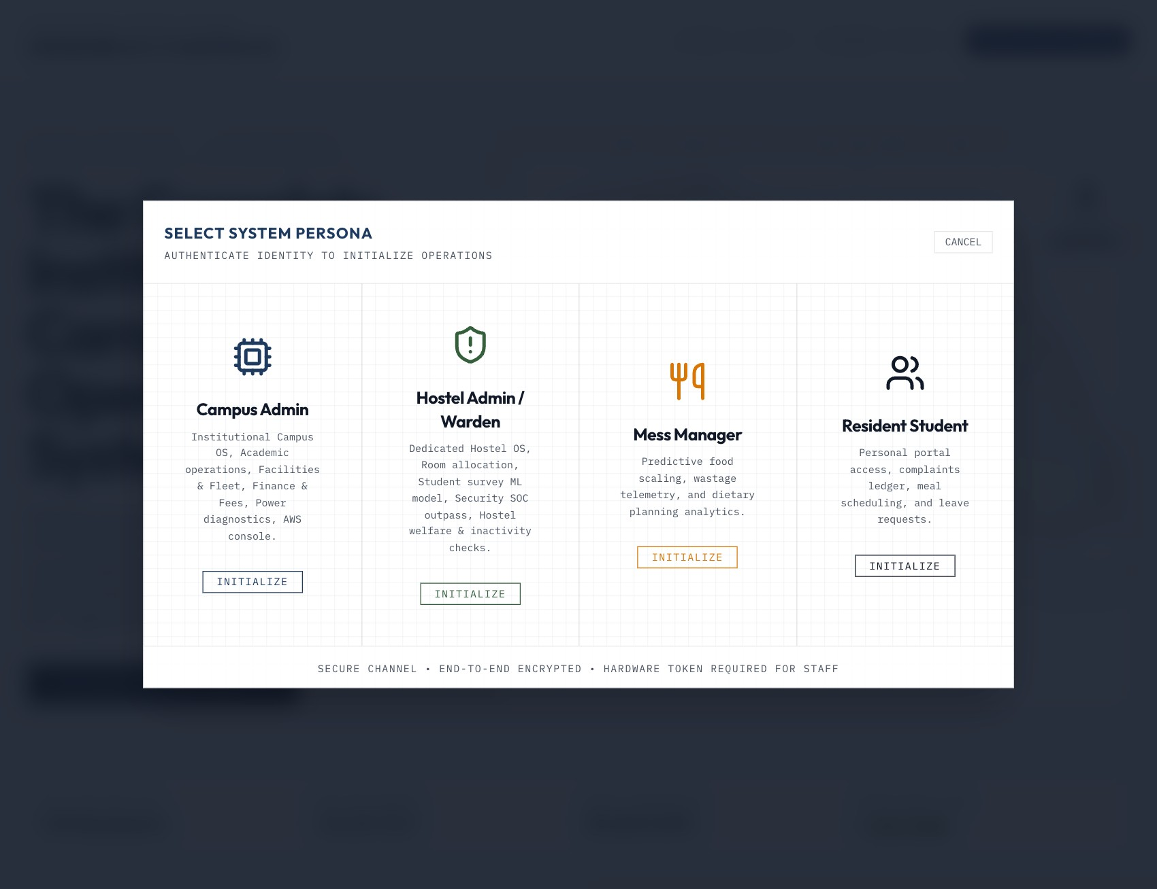
One platform, four roles, one source of truth
THE SOLUTION
Campus Admin
Finance, facilities, power billing, AWS hub
Hostel Warden
Residents, rooms, surveys, gate, welfare
Mess Manager
Weekly menu publishing, food feedback
Resident Student
Dues, leave, visitors, complaints, AI help
Persona picker on the landing page
Notes:
Each persona signs in to a workspace scoped to their job. The server enforces the same scoping, so a student can never call an admin API.

Slide 4
What ships today
AT A GLANCE
14
4
100
operational modules across hostel and campus
role-scoped personas with server-side access control
residents with encrypted personal records
41
57
76 kB
automated API and domain tests
browser checks across 4 roles, all passing
first-load JavaScript (gzip), down from 386 kB
Notes:
Numbers are from this build: 13 modules in the sidebar, the 100-student survey dataset seeded at first start, 31 automated backend tests, 8 scripted end-to-end scenarios, and the gzipped first-load JavaScript.

Slide 5
Hybrid by design: runs locally or on AWS
ARCHITECTURE
Data
SQLite | DynamoDB · PII encrypted
FastAPI service
auth · hostel · campus
billing · aws · chat
signed session cookie
role guards · validation
Files
Local disk | S3 (private)
React 19 SPA
Vite · code-split
Email
Log | SES
Speech
Browser | Polly
AI
MiniLM retrieval + Groq LLM
Same code, two modes: no AWS keys means durable local mode; add keys and it switches to AWS.
Notes:
The React app talks only to the FastAPI service. Each adapter has a local implementation and an AWS one, chosen at start-up from the environment: SQLite or DynamoDB, local disk or S3, logged email or SES, browser speech or Polly.

Slide 6
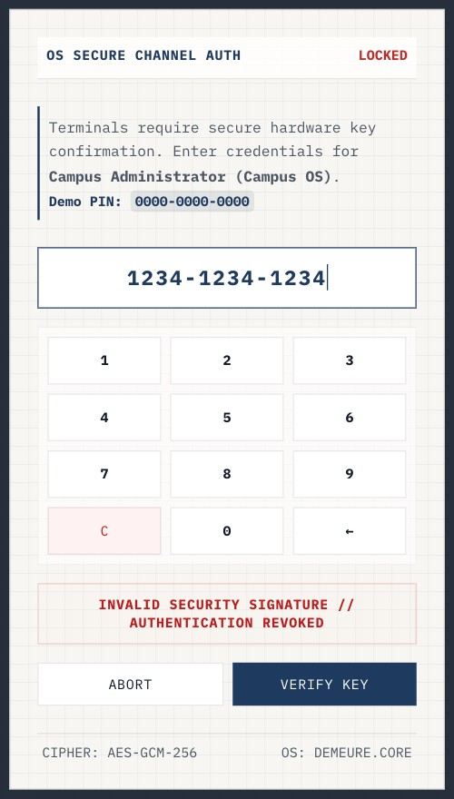
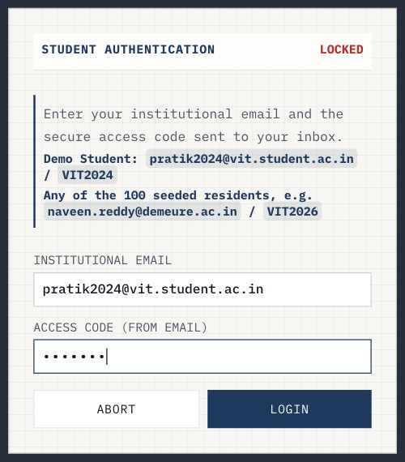
Every sign-in is checked by the server
SECURE ACCESS
Server-verified
PBKDF2-hashed PINs and codes; signed, expiring sessions
Role-scoped APIs
A student calling an admin endpoint gets 403
Brute-force throttle
10 failures in 5 minutes blocks the client
Student sign-in
Safe by default
Demo hints only in dev; prod requires real secrets
Wrong PIN rejected
Notes:
Credentials are verified server-side against salted hashes. The session lives in an HttpOnly, SameSite=Strict cookie. Ten failed attempts in five minutes lock the client out. Production refuses demo PINs and weak secrets at start-up.

Slide 7
Twelve flows, captured live
USE-CASE SCENARIOS
Each scenario crosses roles: a student acts, staff respond, and both see the same persisted record.
Notes:
Every screenshot comes from an automated Chrome run against the real backend, so the flows shown are exactly what users get.

Slide 8
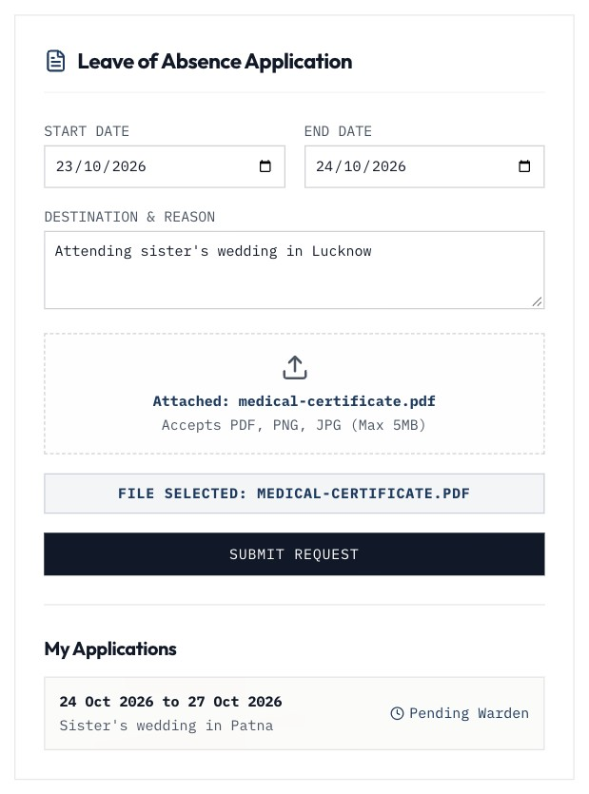
Leave request with medical proof
SCENARIO 1 · STUDENT
1
Fill dates and reason
Past dates and end-before-start are blocked
2
Attach the certificate
PDF/PNG/JPG, checked by content, kept private
3
Submit
Guardian is emailed automatically (SES)
Notes:
The student picks dates, gives a reason and attaches a PDF. The file is validated (type, content, 5 MB) and stored privately. The leave is saved with the student's identity taken from the session, not from the form.

Slide 9
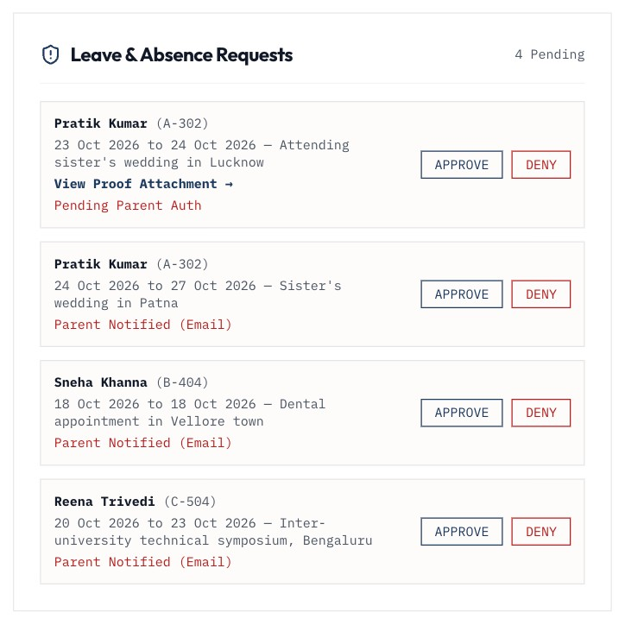
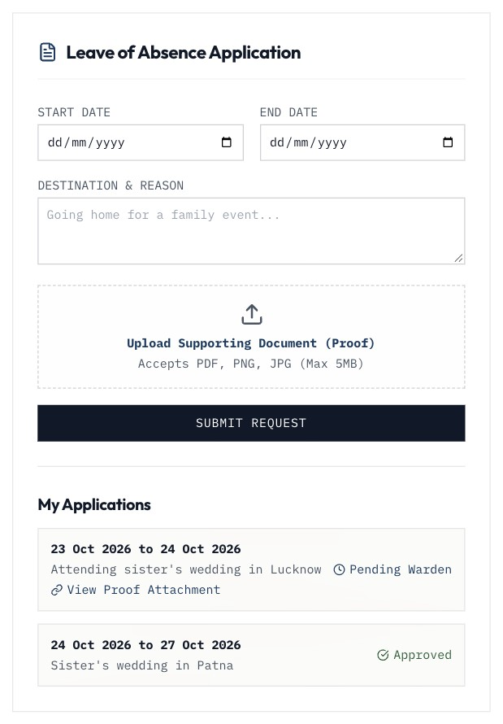
Warden reviews the proof and approves
SCENARIO 1 · WARDEN
Pending queue with the private attachment link
The student sees "Approved" instantly
Notes:
Only the uploader and hostel or campus staff can open the attachment. Approval is a one-way state change; acting twice returns a conflict instead of silently overwriting.

Slide 10
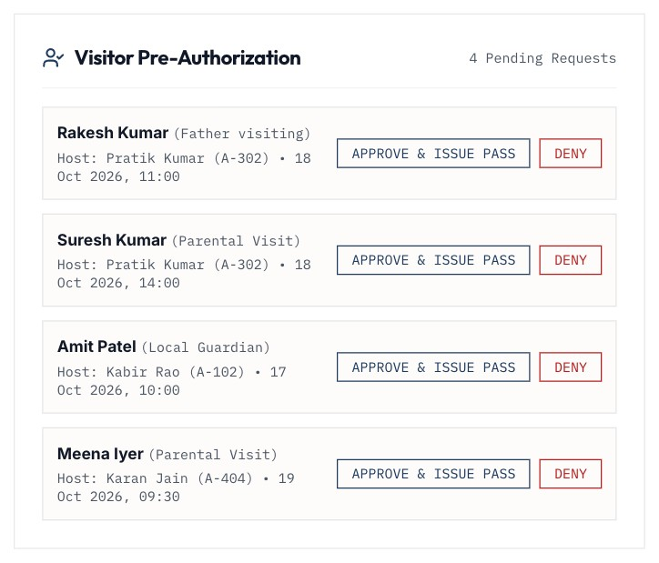
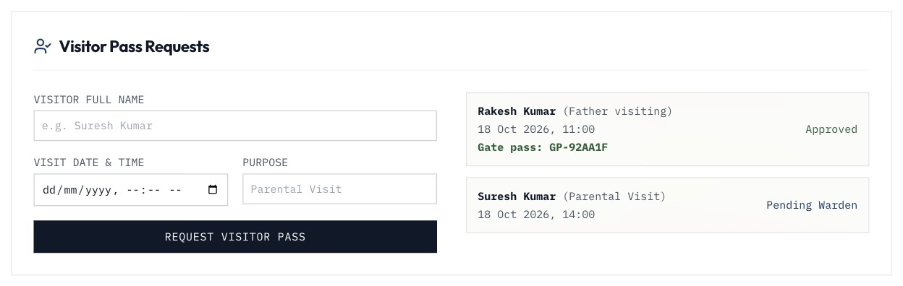
Visitor pass in two clicks
SCENARIO 2
Student receives a gate pass code on approval
Warden approves the pending request
Notes:
Students can now request visitor passes themselves; this flow was missing before. On approval the server issues a gate pass code and emails the student.

Slide 11
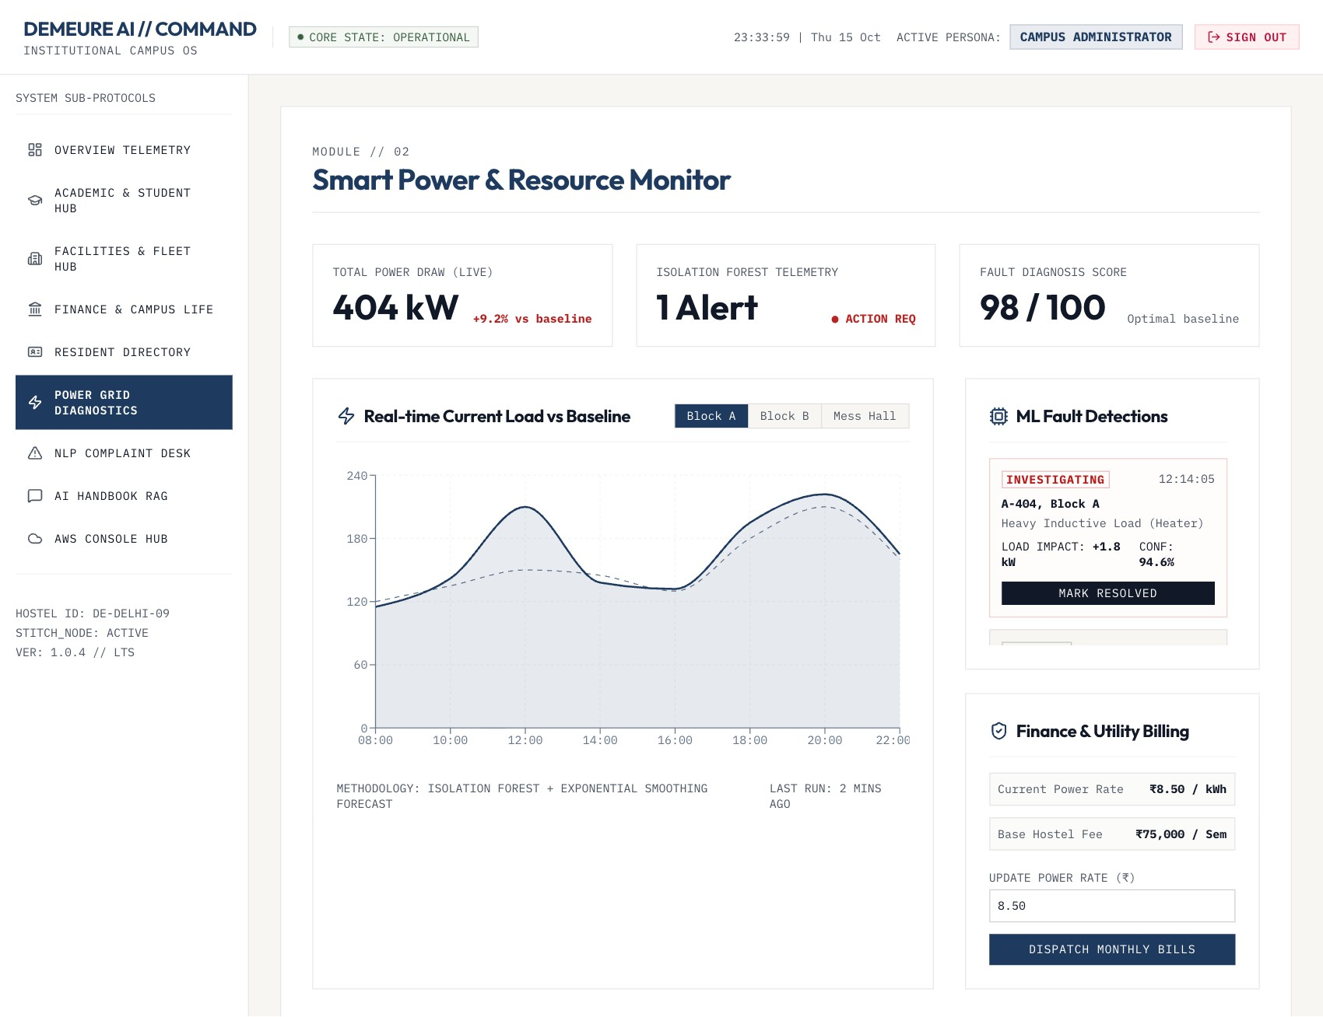
New billing cycle from the power monitor
SCENARIO 3 · ADMIN
1
Inspect the load
Per-zone consumption vs. baseline
2
Set the rate
Validated between ₹0.01 and ₹100 per kWh
3
Dispatch
A new cycle ID is pushed to every student portal
Notes:
The admin sets the per-unit rate and dispatches. This opens a new billing cycle, so every student owes for the new cycle even if they paid the last one. The chart switches between three metered zones.

Slide 12
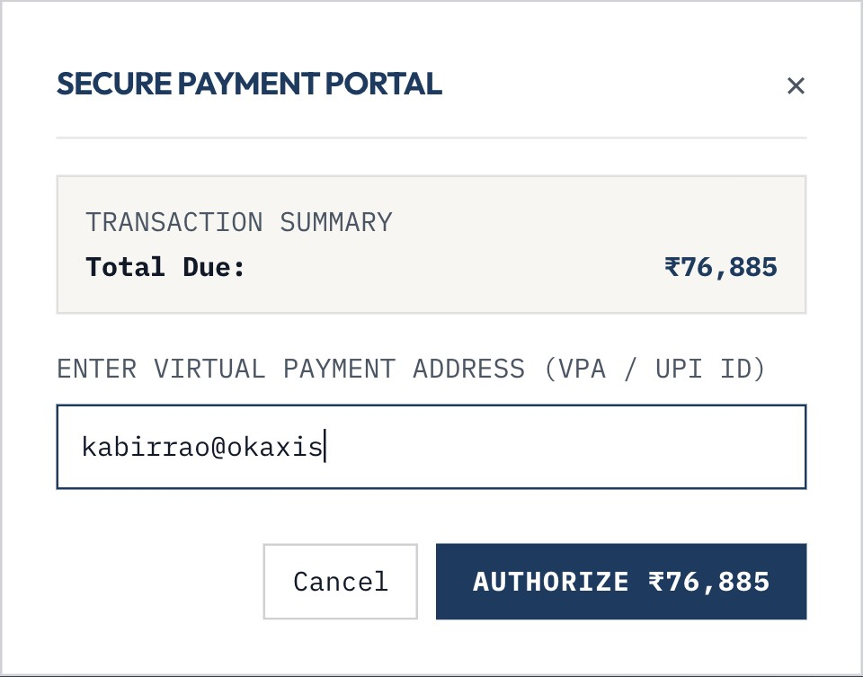
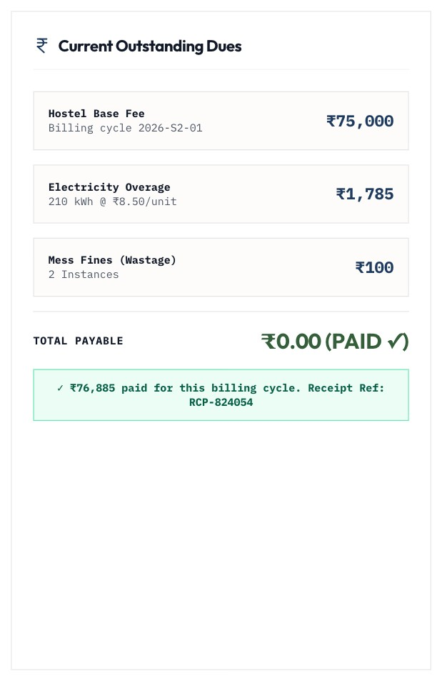
Dues calculated on the server, paid by UPI
SCENARIO 3 · STUDENT
UPI authorisation for the server-computed total
Receipt stored against the billing cycle
Notes:
The statement is computed on the server from the current rate, so the browser cannot change the amount. The UPI ID is validated, and paying twice in one cycle is refused. Note: the payment gateway itself is simulated in this build.

Slide 13
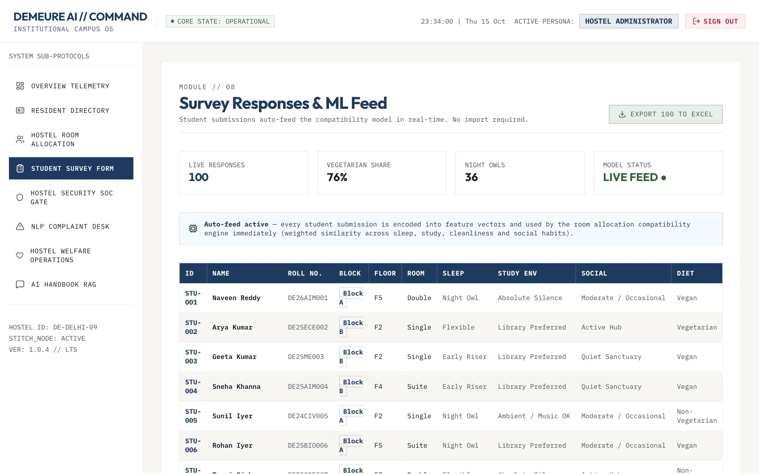
100 seeded students feed the allocation engine
SCENARIO 4 · WARDEN
100
survey responses from the seeded residents
1-click
Excel export with the ML feature matrix
Notes:
The 100-student dataset in the repo is seeded at first start and normalised to the survey form's vocabulary. New student submissions join it immediately; here the total is 101 after Pratik submitted.

Slide 14
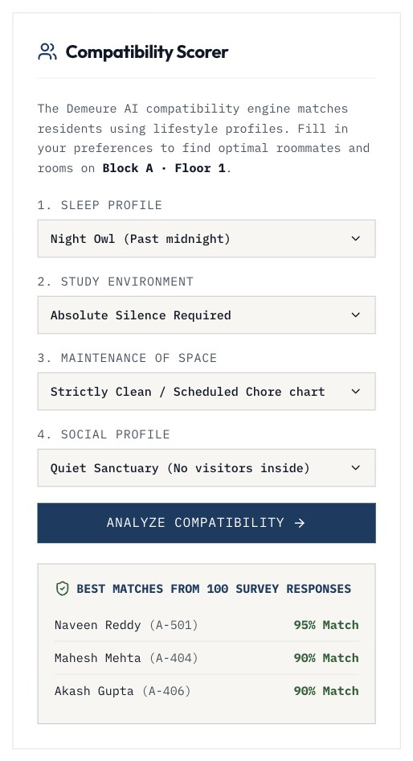
Compatibility ranks real roommates
SCENARIO 4 · MATCHING
Similarity weights used for every match
Sleep cycle
30%
Study environment
25%
Cleanliness
25%
Social preference
20%
Search a Night Owl / silent / strictly clean / quiet profile in Block A: the best residents score 95%, 90% and 90%. Single-gender blocks only rank residents of that block.
Notes:
Each habit maps to a 0-2 scale and is compared with the warden's inputs, weighted as shown. Same-block preference adds a small bonus. Before this release the results were hard-coded.

Slide 15
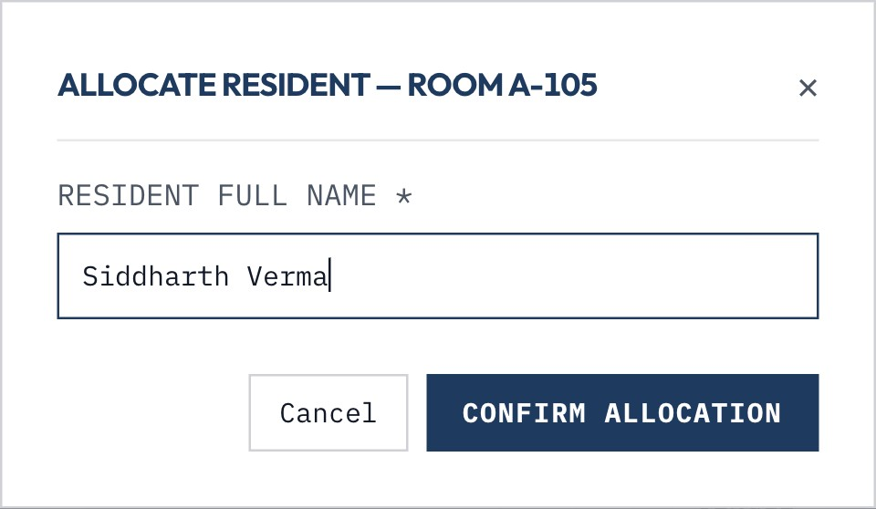
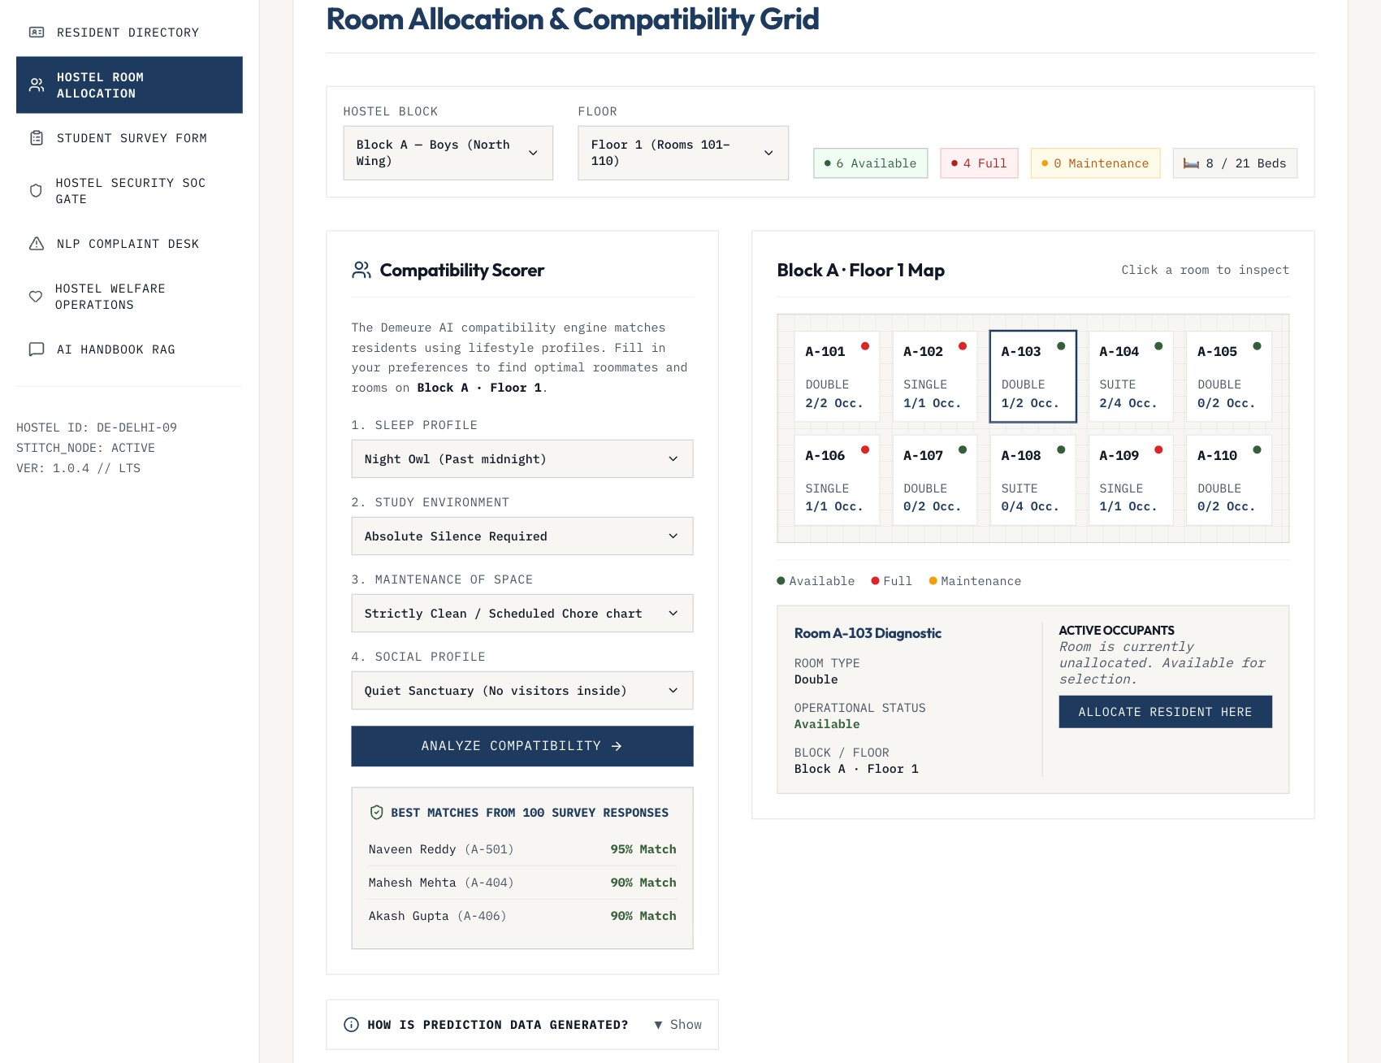
Capacity-checked room allocation
SCENARIO 4 · ALLOCATION
Allocating a resident to a room with a free bed
Occupancy updates and persists
Notes:
Allocations are saved centrally and checked on the server: no overfilling and no duplicate names. Every warden session sees the same occupancy.

Slide 16
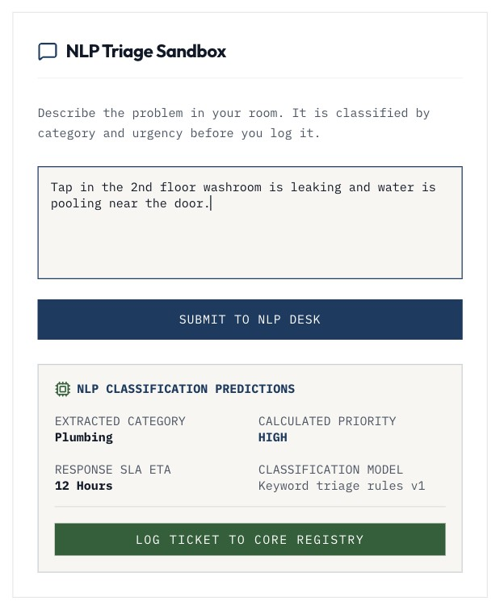
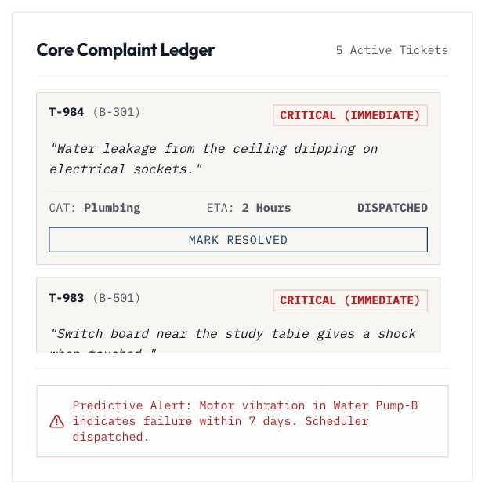
Complaints triaged by severity
SCENARIO 5
Washroom leak: Plumbing, high priority, 12 h SLA
Seeded hazards escalated to critical, 2 h target
Notes:
Triage runs on the server. The category with the most keyword hits wins, with safety-critical categories winning ties, and terms like sparks or socket escalate to a 2-hour SLA. Staff move tickets from Open to Dispatched to Resolved.

Slide 17
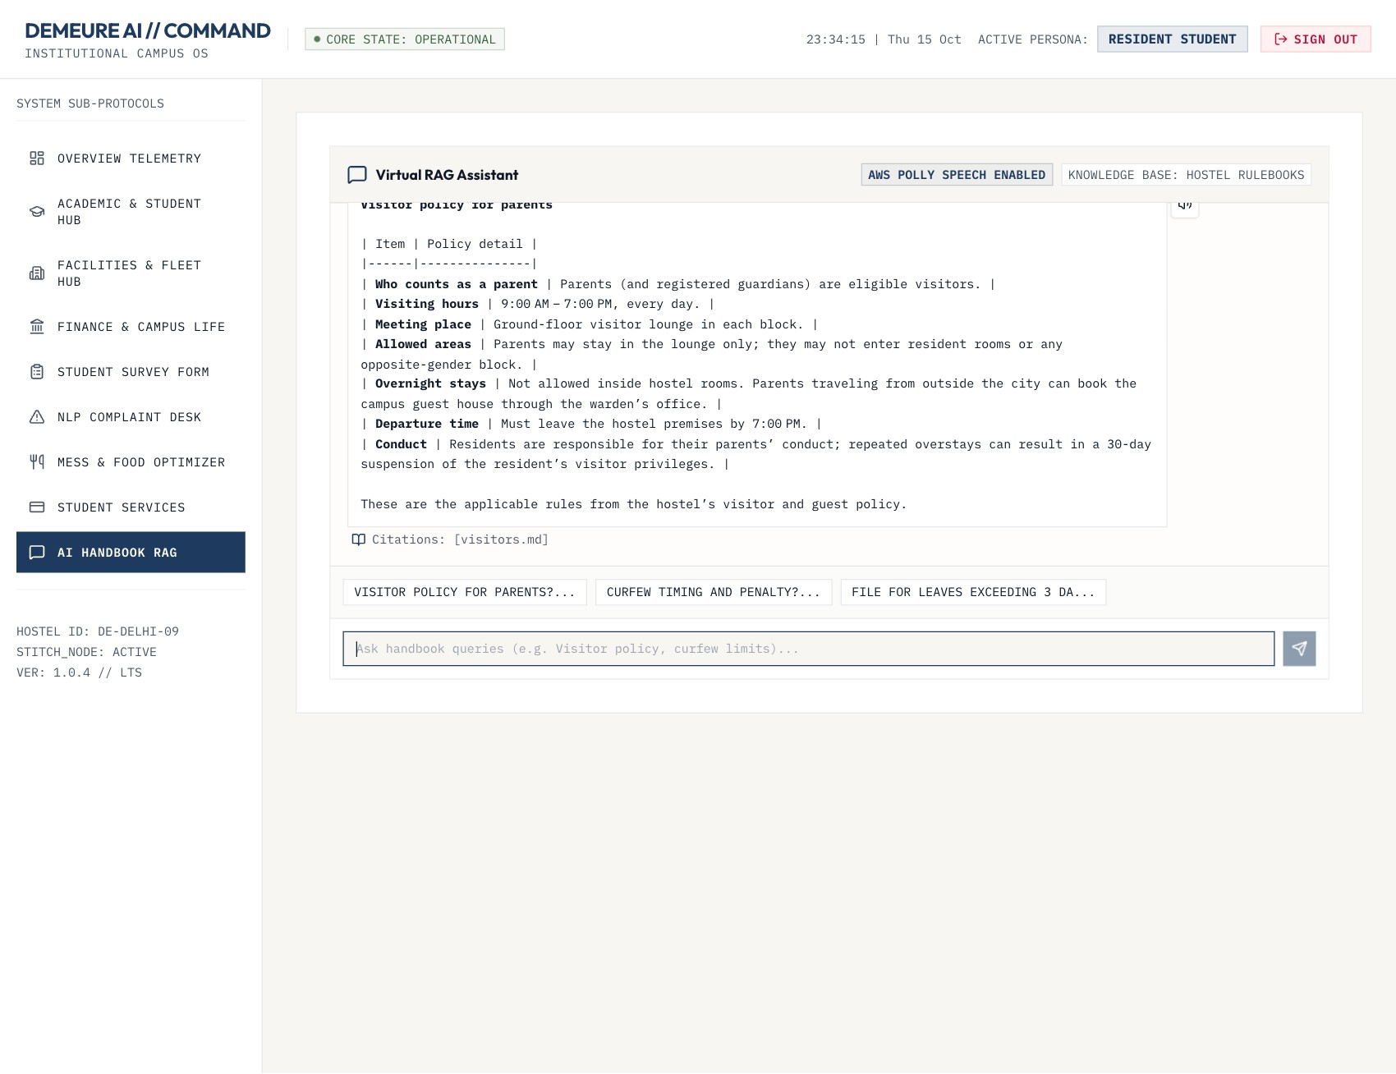
Handbook assistant answers with citations
SCENARIO 6
1
Retrieve
MiniLM embeddings over eight rulebooks
2
Ground
LLM answers only from the retrieved text
3
Cite and speak
Source files listed; Polly or browser voice
Notes:
Questions are embedded with MiniLM and matched against the hostel rulebooks. The top passages go to a Groq-hosted LLM, which must answer only from them. Answers show their source files, and the speaker icon reads them aloud.

Slide 18
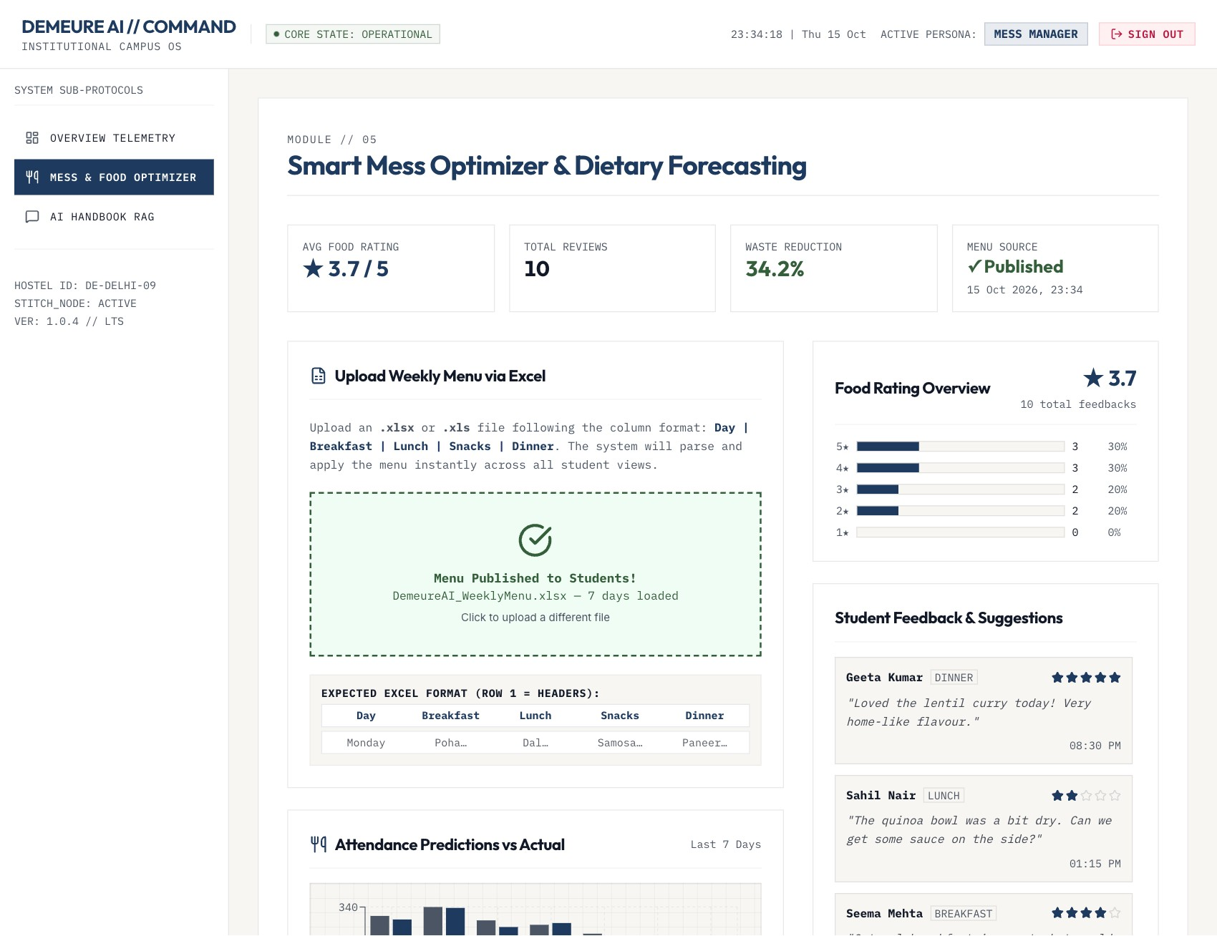
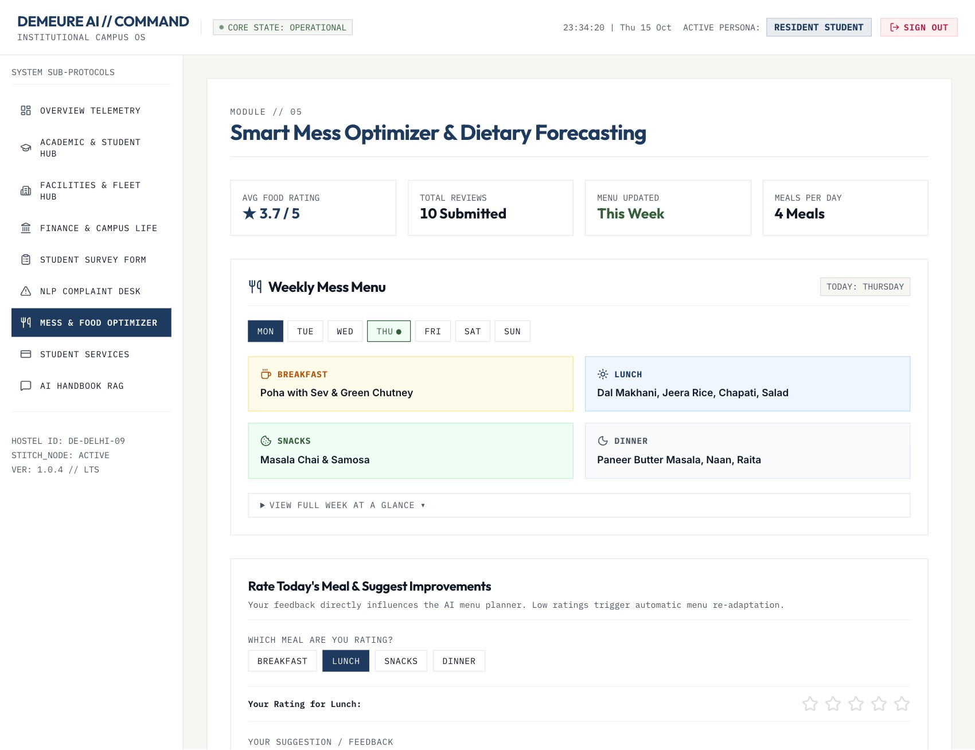
Weekly menu published from Excel
SCENARIO 7 · MESS MANAGER
Upload and publish the weekly menu
Students see the published menu
Notes:
The manager uploads the weekly menu sheet. It is parsed in the browser, validated (7 days, sane lengths), and published on the server, so every student sees it at once.

Slide 19
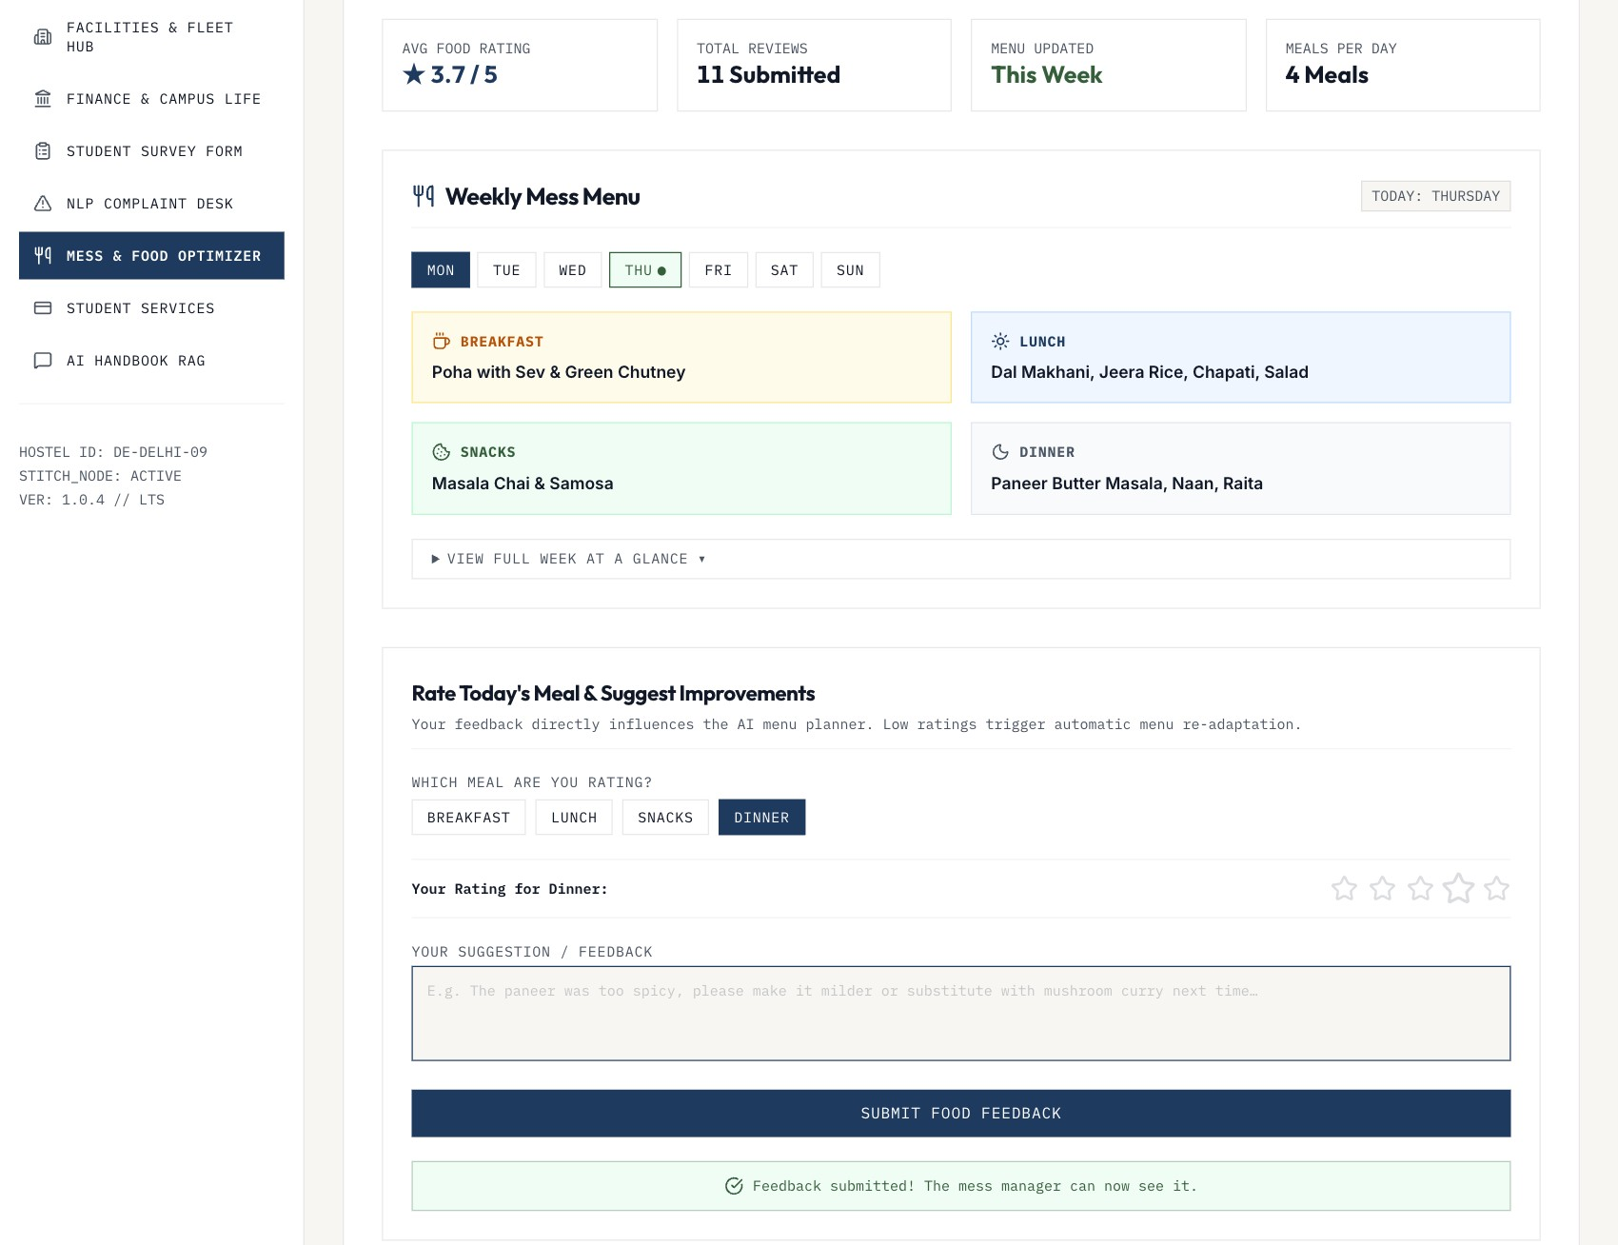
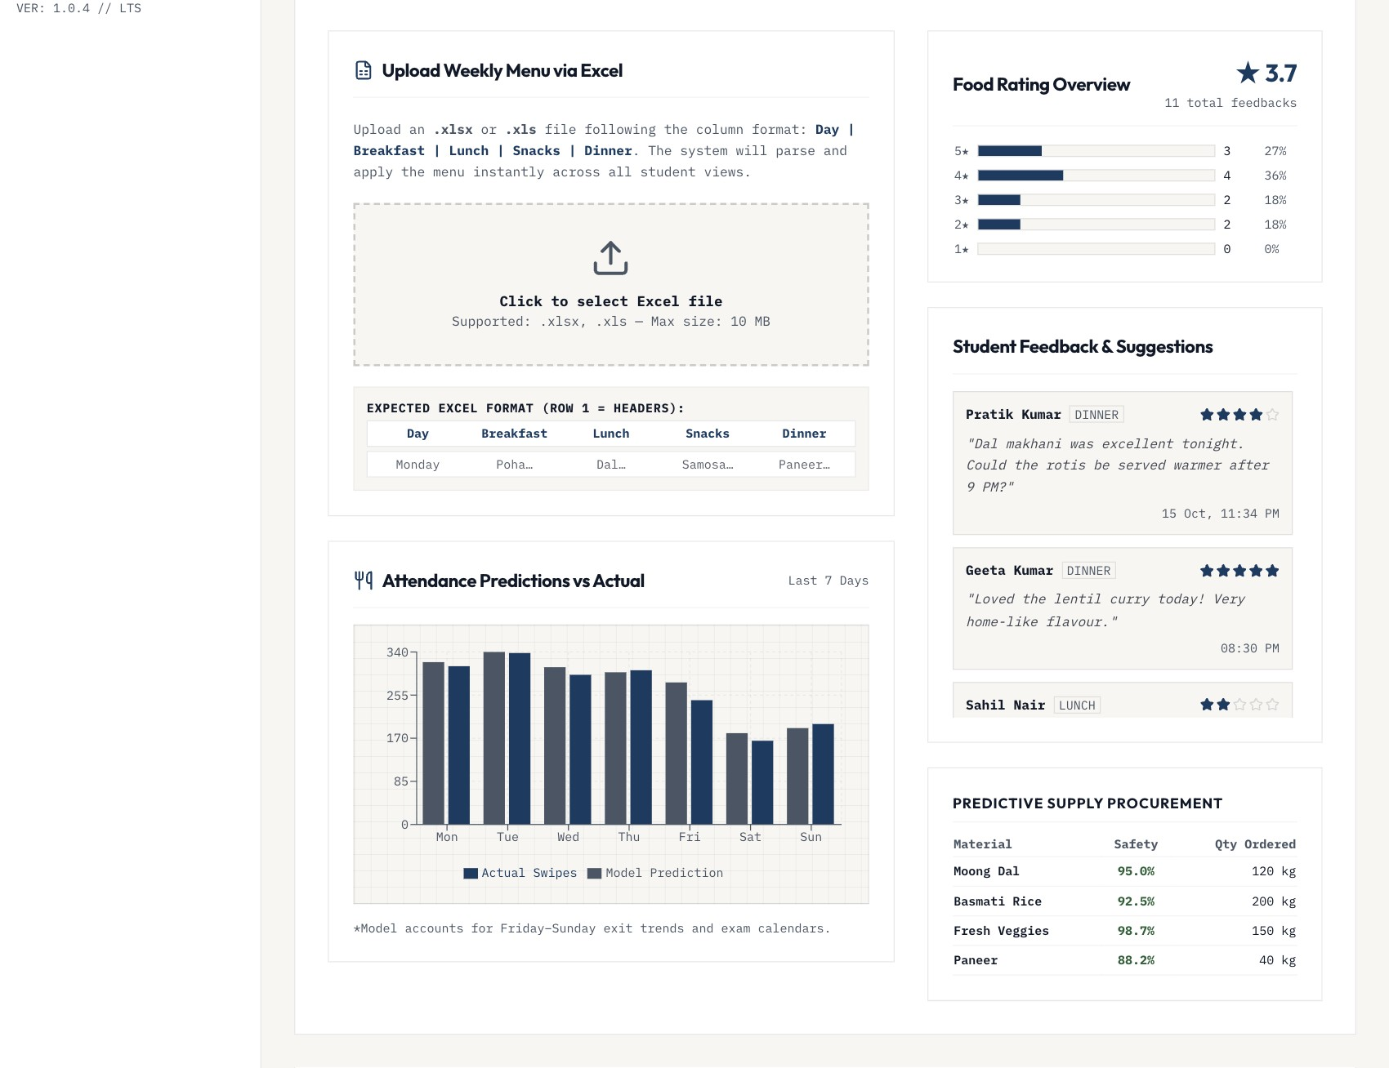
Student ratings reach the kitchen
SCENARIO 7 · FEEDBACK LOOP
Student rates dinner and suggests a change
The manager sees it in the feedback feed
Notes:
Ratings are stored with the student's real name from the session, and the manager's rating distribution updates at once.

Slide 20
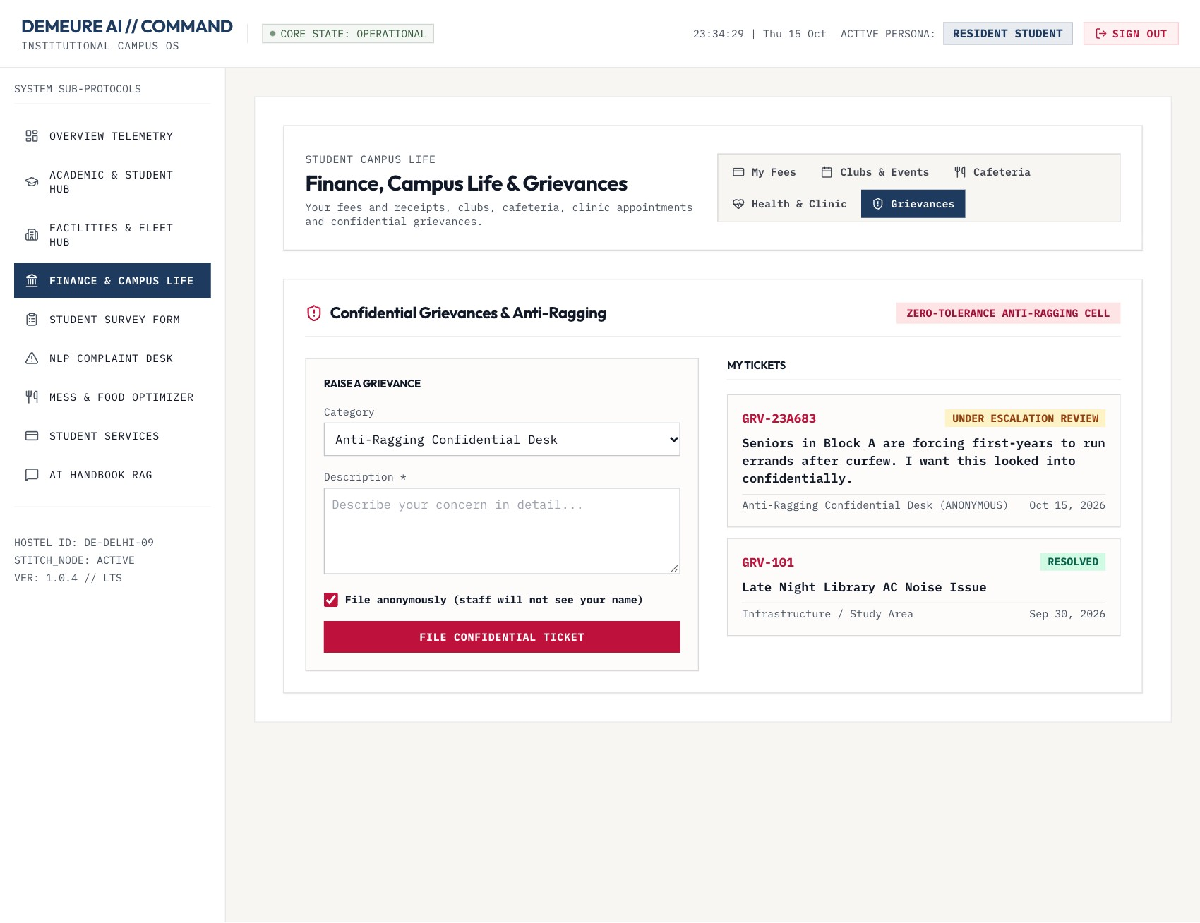
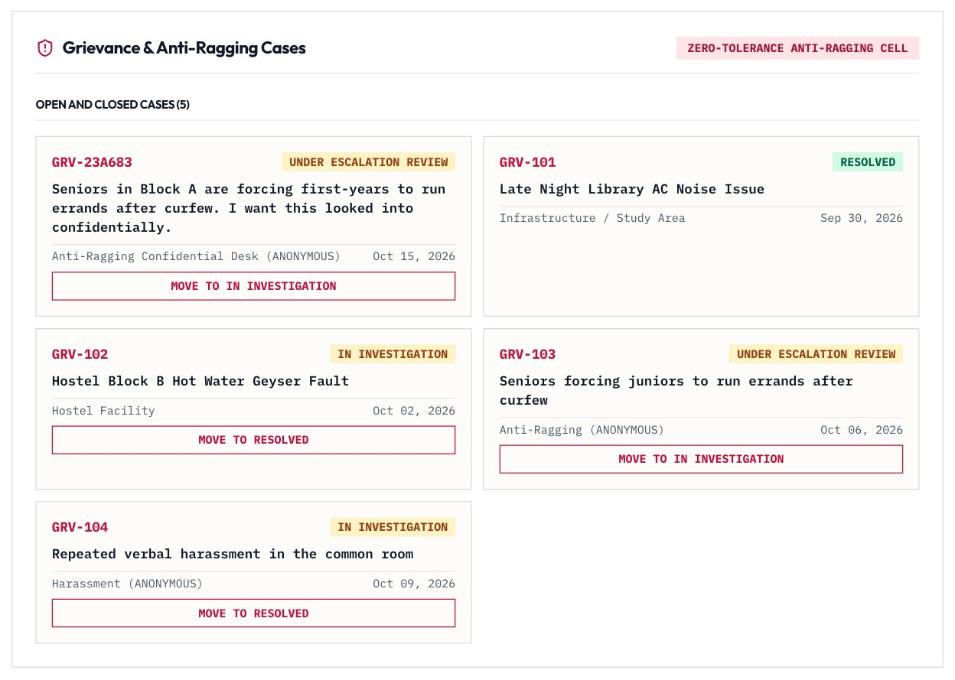
Anonymous grievances, accountable process
SCENARIO 8
Admins triage it without seeing the filer
Student files an anti-ragging ticket anonymously
Notes:
Anonymous tickets keep the filer so they can track their own case, but staff responses never include who filed it. Staff can still escalate it to investigation and resolution.

Slide 21
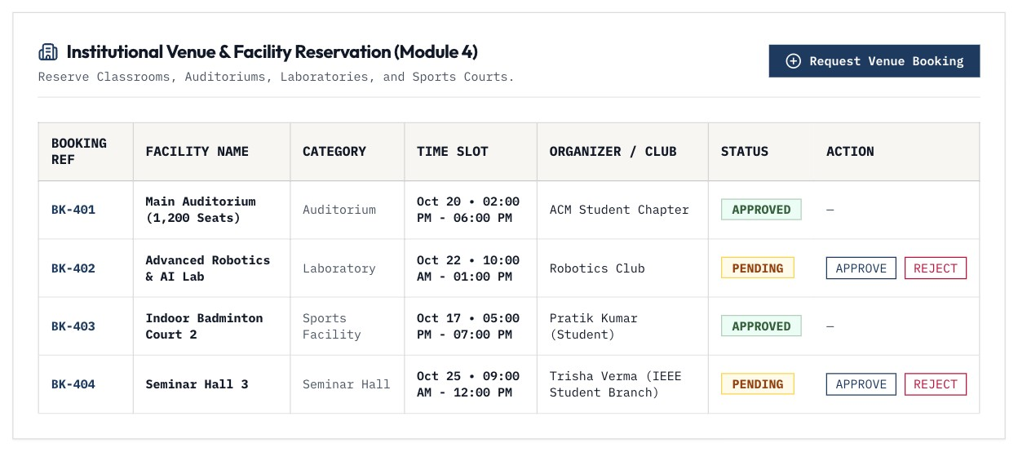
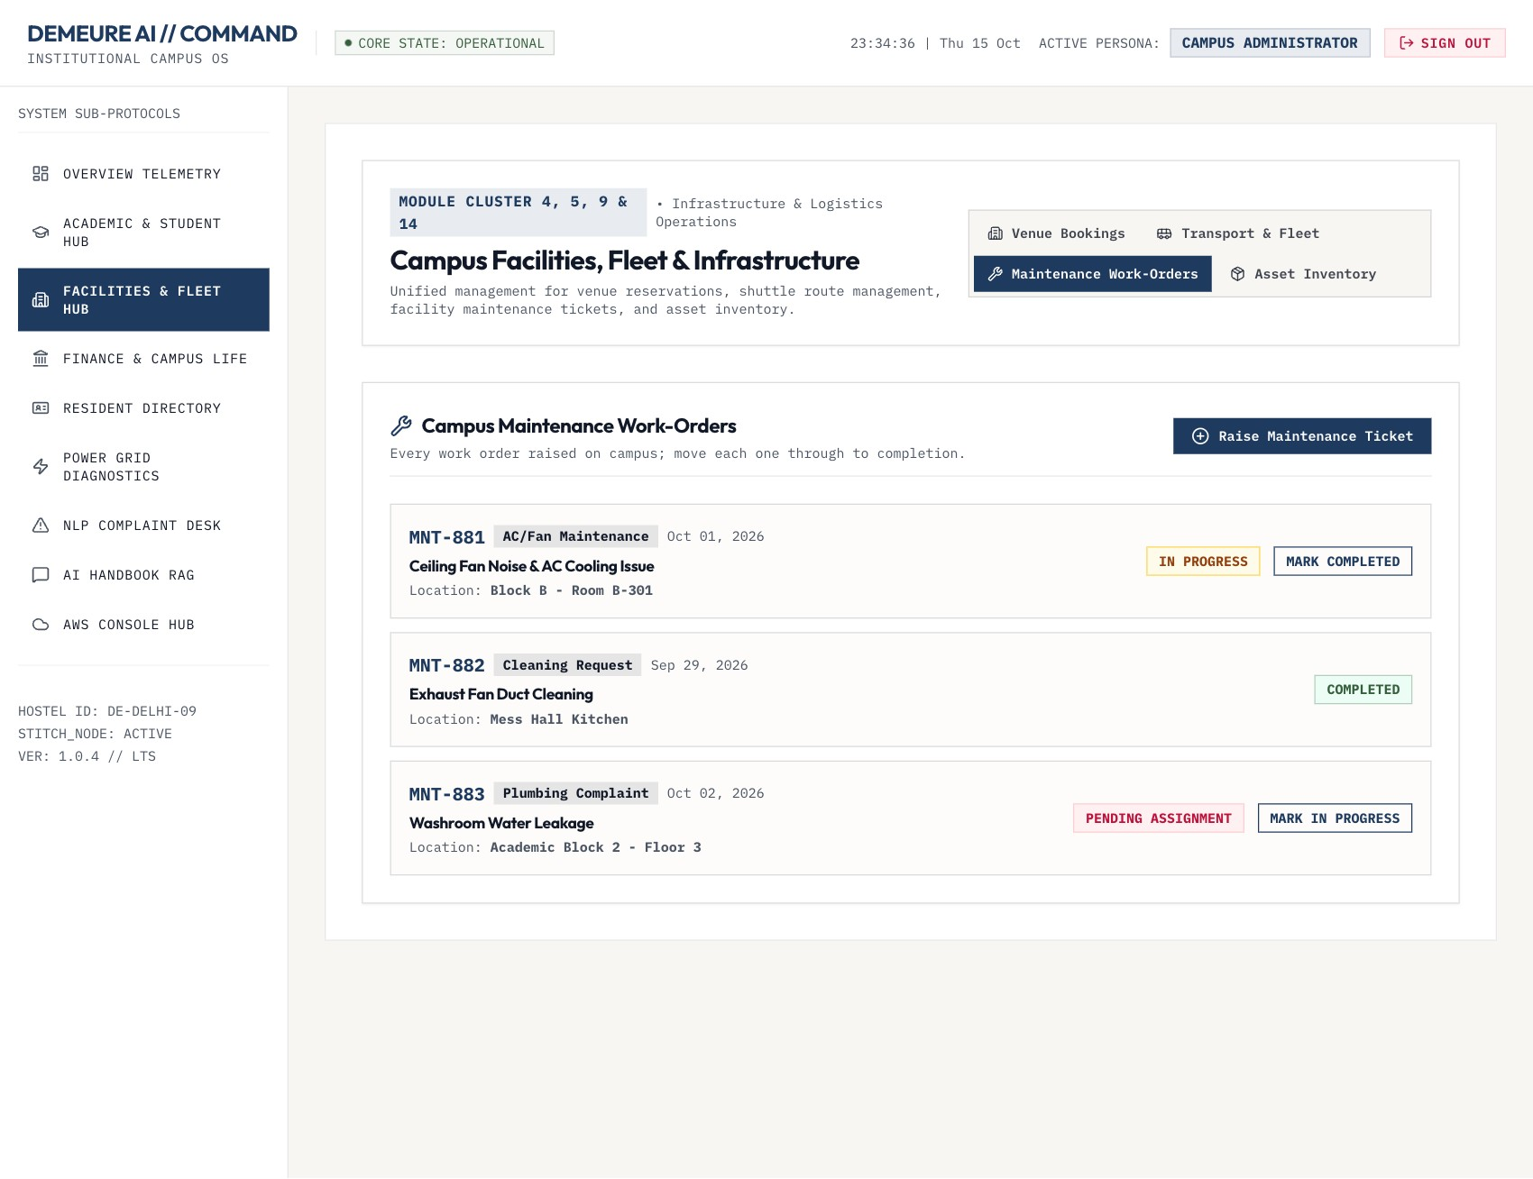
Facility bookings and work orders
SCENARIO 9
Admin approves or rejects venue bookings
Work orders move from pending to completed
Notes:
Booking and ticket IDs now come from the server, so the screen and the database agree. Admins gained approve/reject and status-advance controls that were missing.

Slide 22
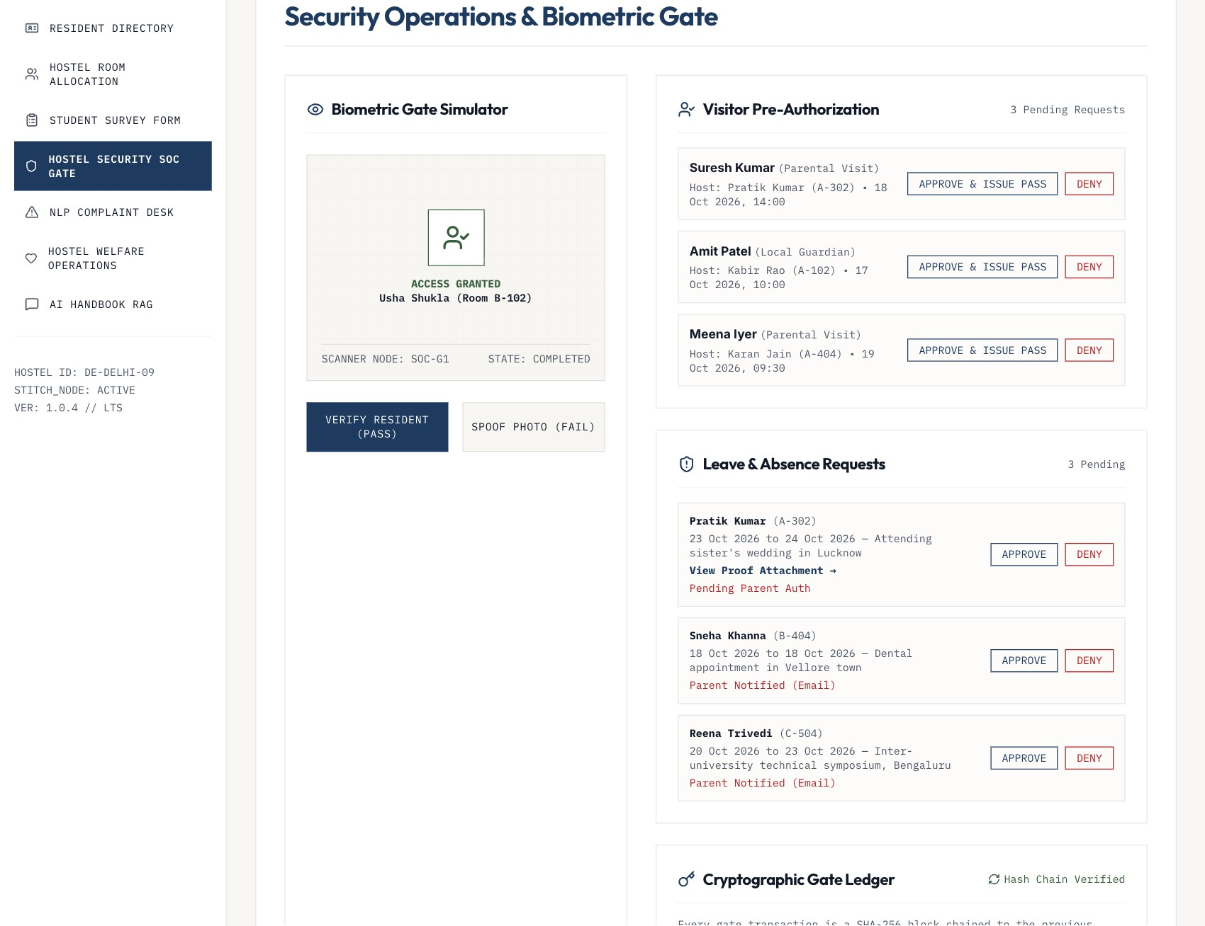
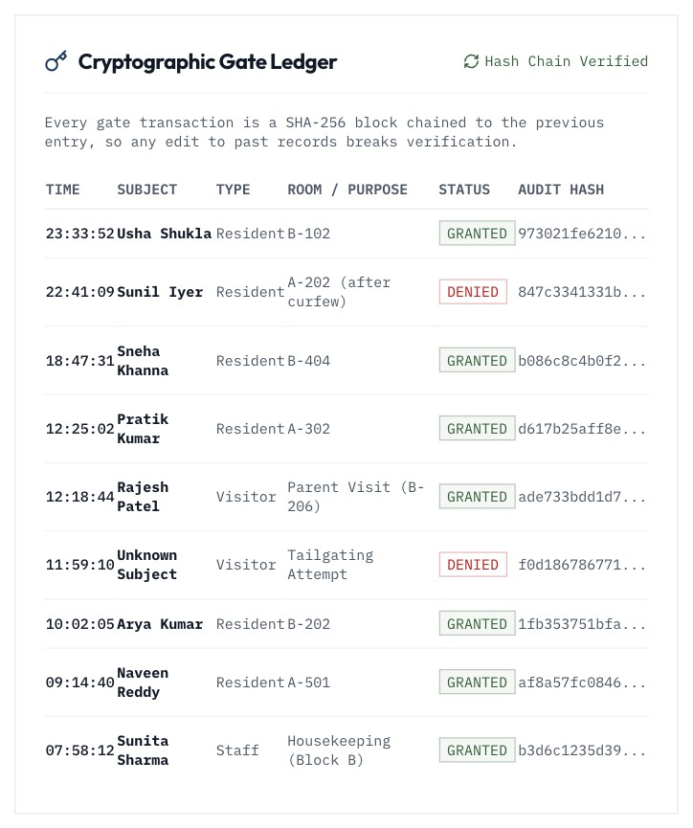
Gate security with a tamper-evident ledger
SCENARIO 10
Hash chain verified on every read
Resident verified at gate SOC-G1
Notes:
Each gate event is a SHA-256 block chained to the previous one. The server re-verifies the whole chain on every read, and editing any past record flips the badge to an integrity failure.

Slide 23
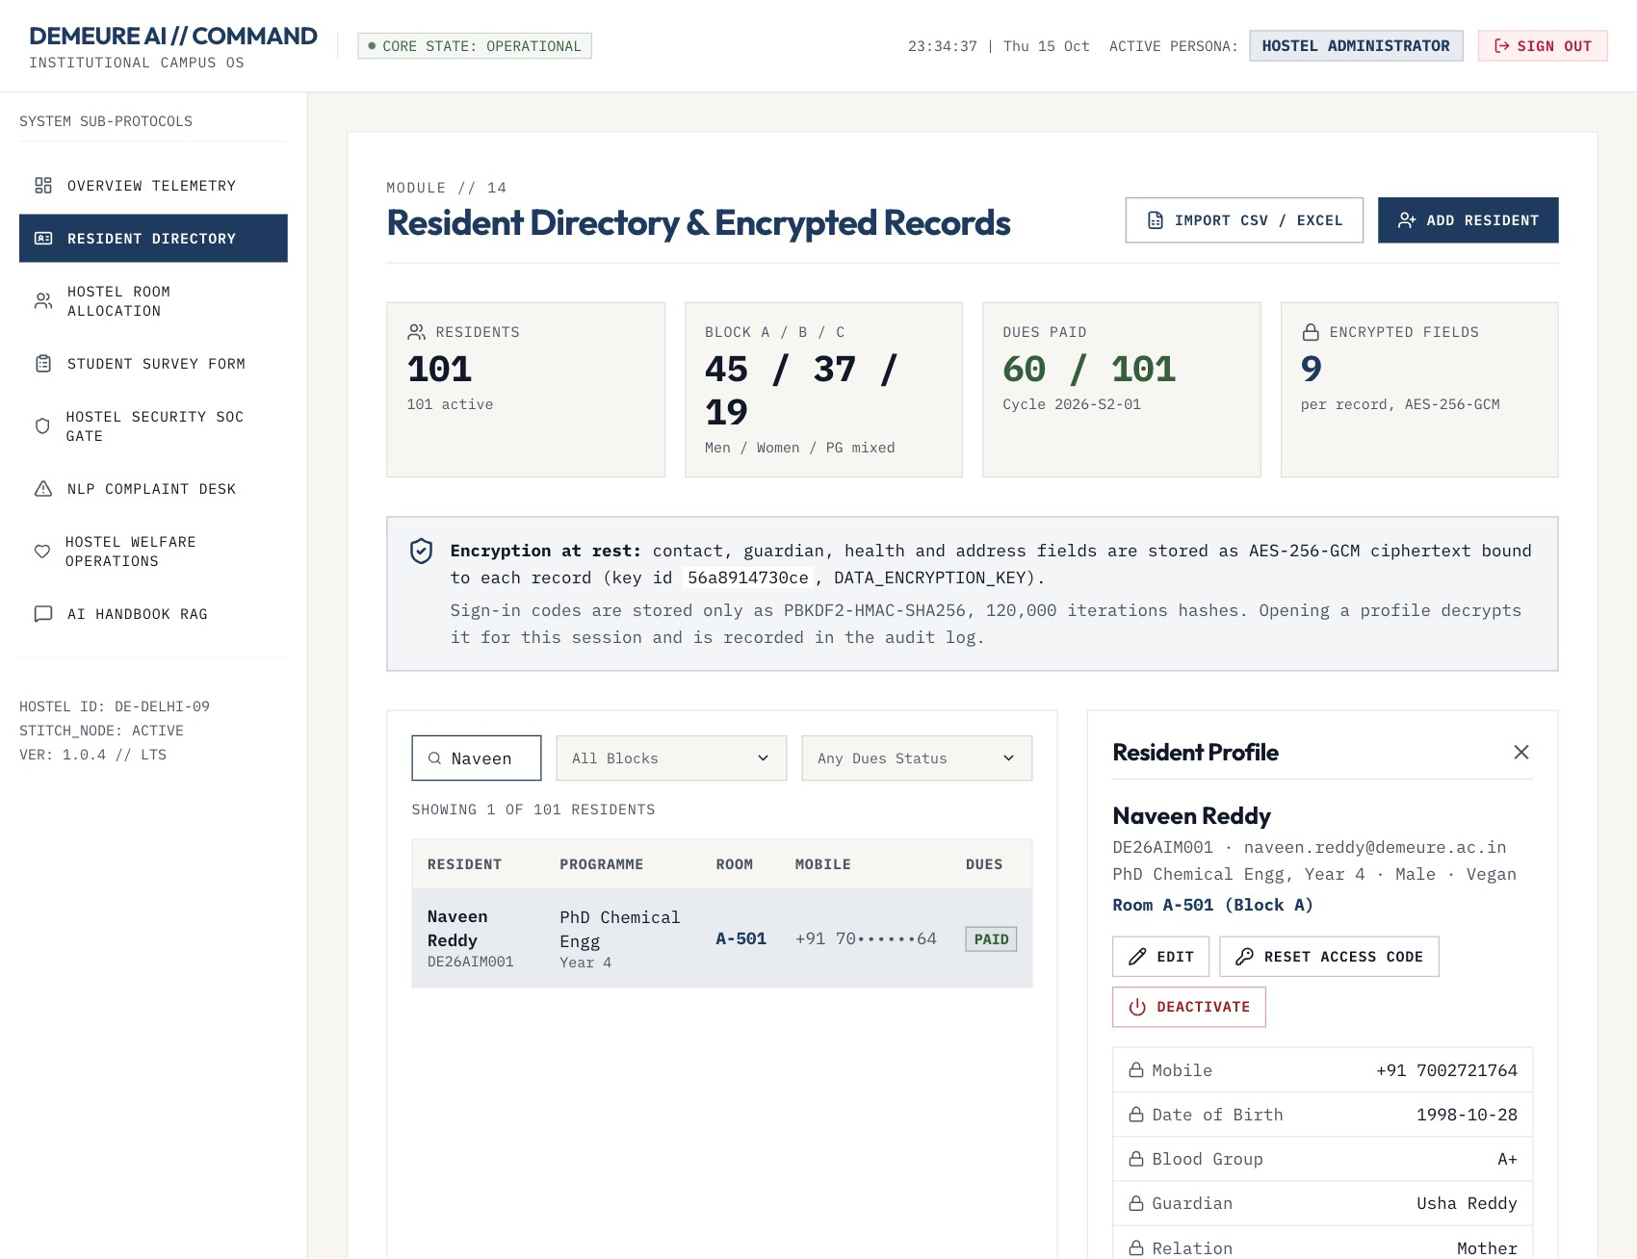
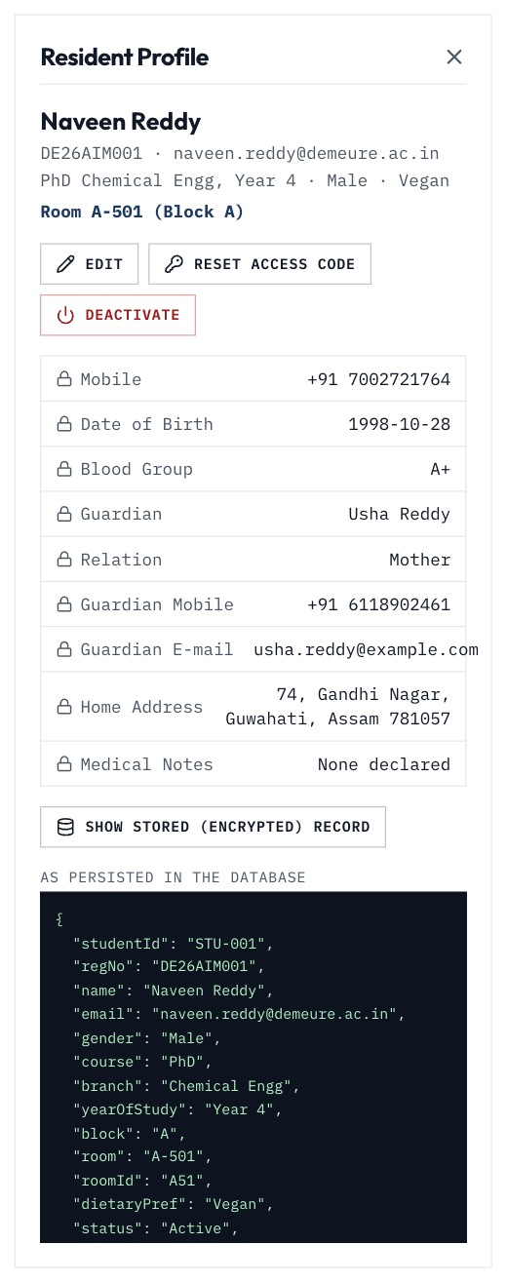
100 residents, personal data encrypted
SCENARIO 11 · RESIDENT RECORDS
1
Encrypted at rest
9 personal fields per record, AES-256-GCM
2
Bound to the record
Ciphertext moved to another record fails
3
Masked and audited
Full view logged; codes stored as hashes
Directory with a decrypted profile (audited)
As stored
Notes:
The directory lists all residents with masked phone numbers and current dues status. Opening a profile decrypts it for that session and writes an audit entry. The campus admin can show the record exactly as stored: contact, guardian, health and address fields are AES-256-GCM ciphertext.

Slide 24
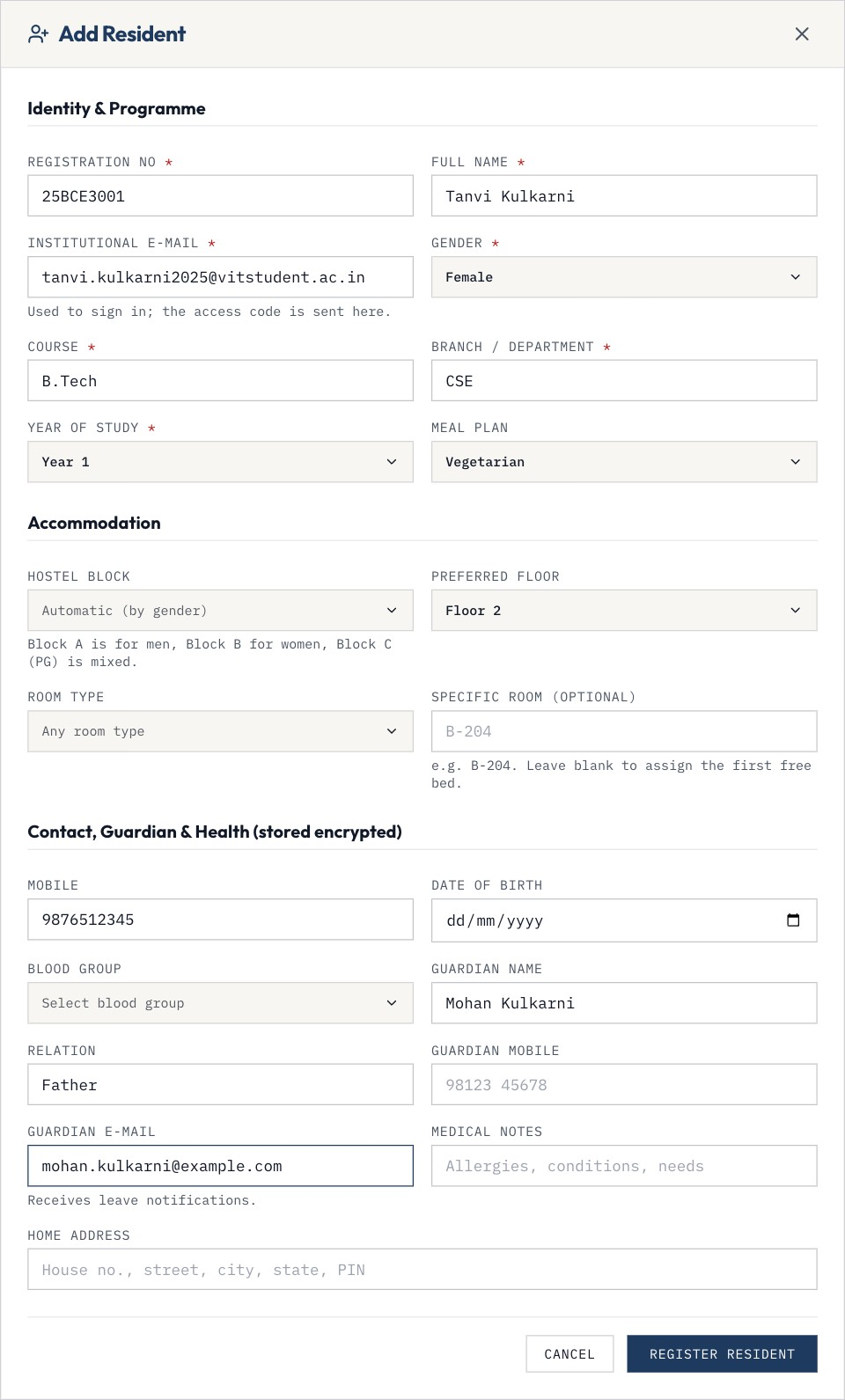
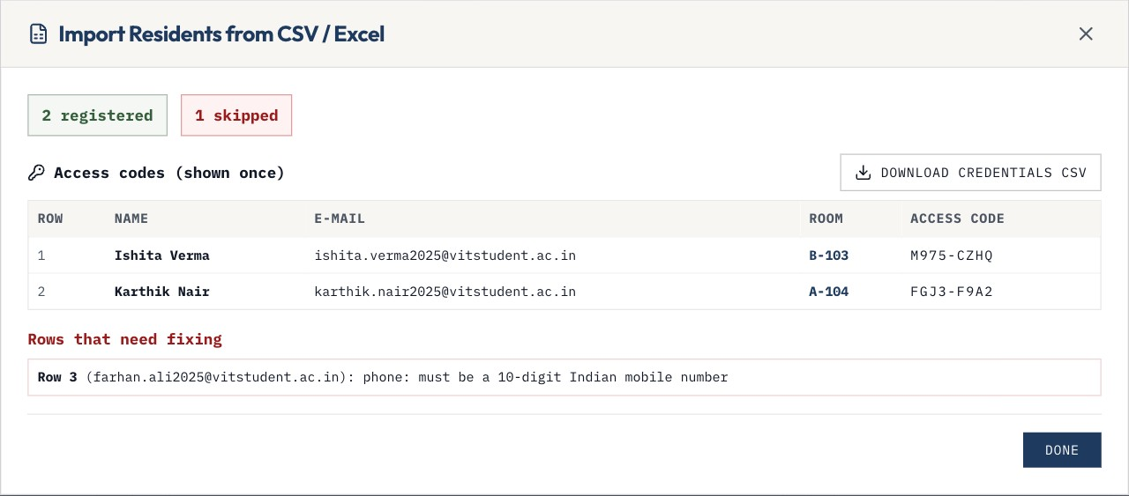
Register one resident or import a whole batch
SCENARIO 12 · ONBOARDING
CSV import: 2 registered, 1 row reported
1
Bed assigned automatically
By block, floor and room type; never mixes genders in a room
2
One-time access code
E-mailed to the resident; stored only as a PBKDF2 hash
Validated registration form
Notes:
Staff add a resident through a validated form or import a CSV/Excel sheet. Each resident gets a bed in a block that matches their gender, an encrypted record and a one-time access code that is e-mailed to them. Rows with errors are reported and skipped; codes can be downloaded as a CSV.

Slide 25
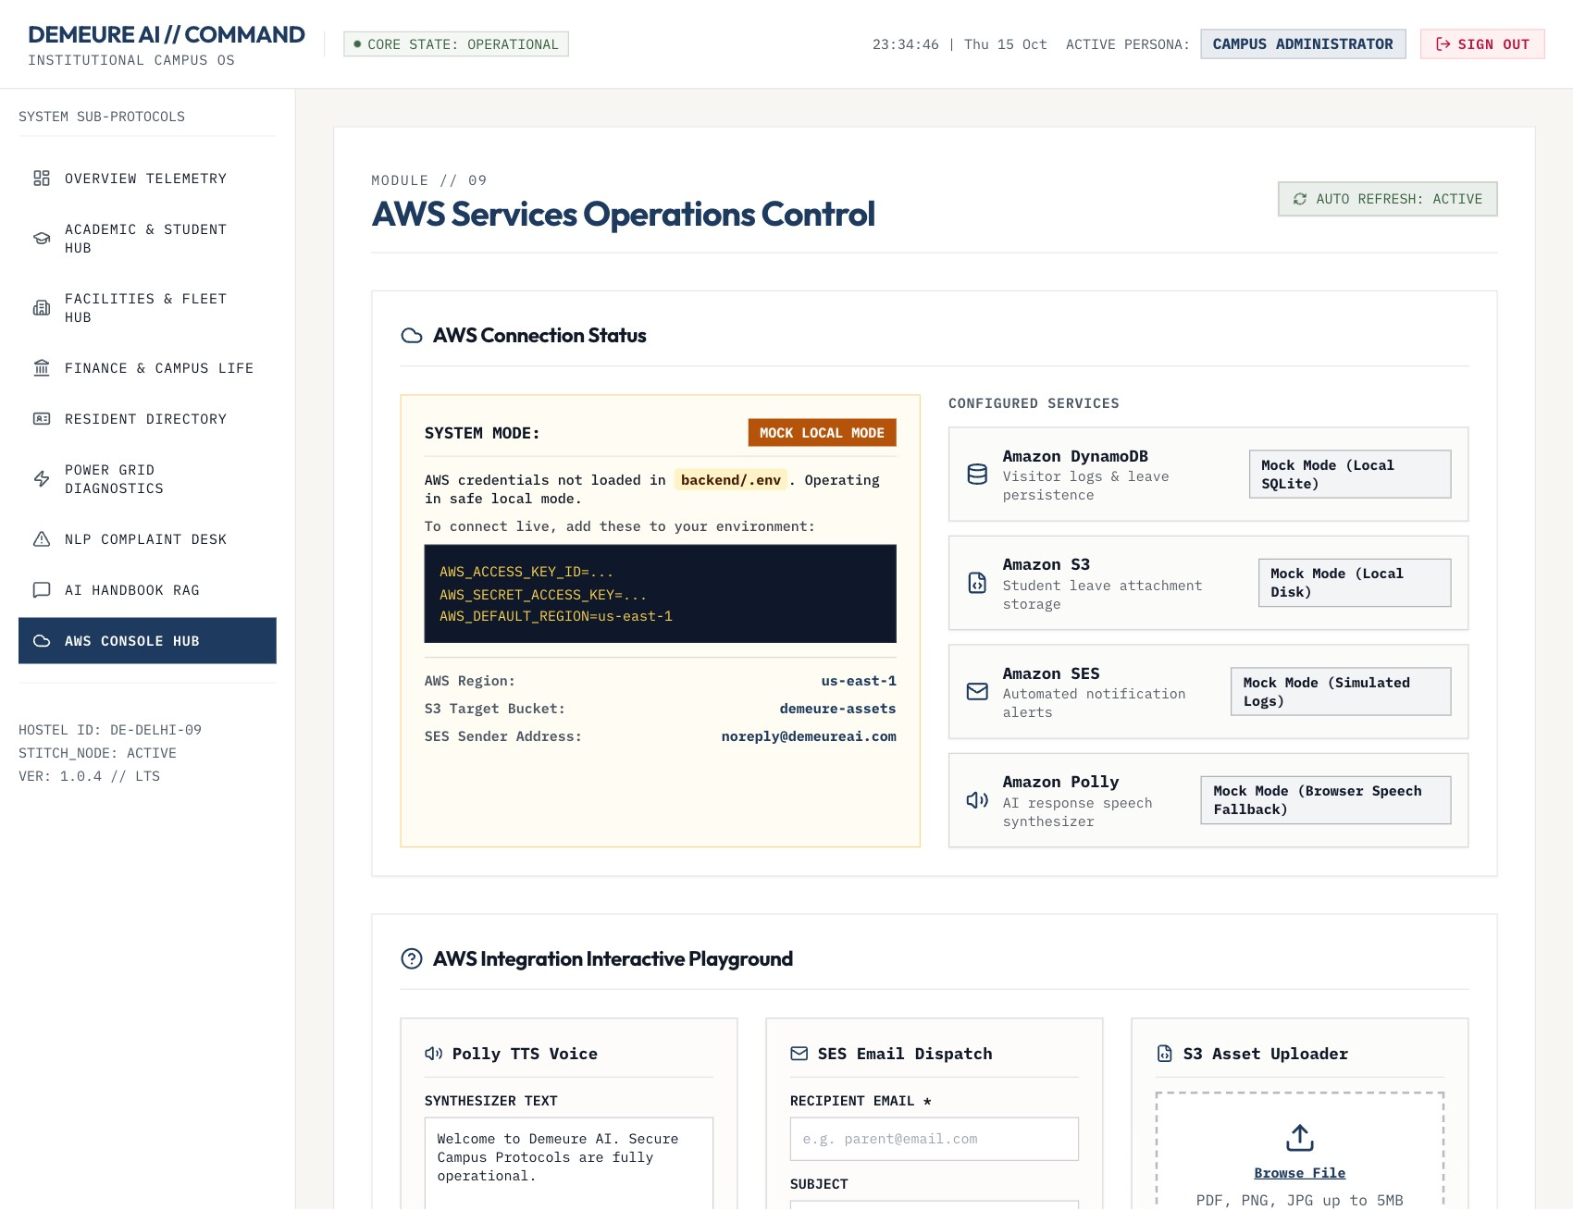
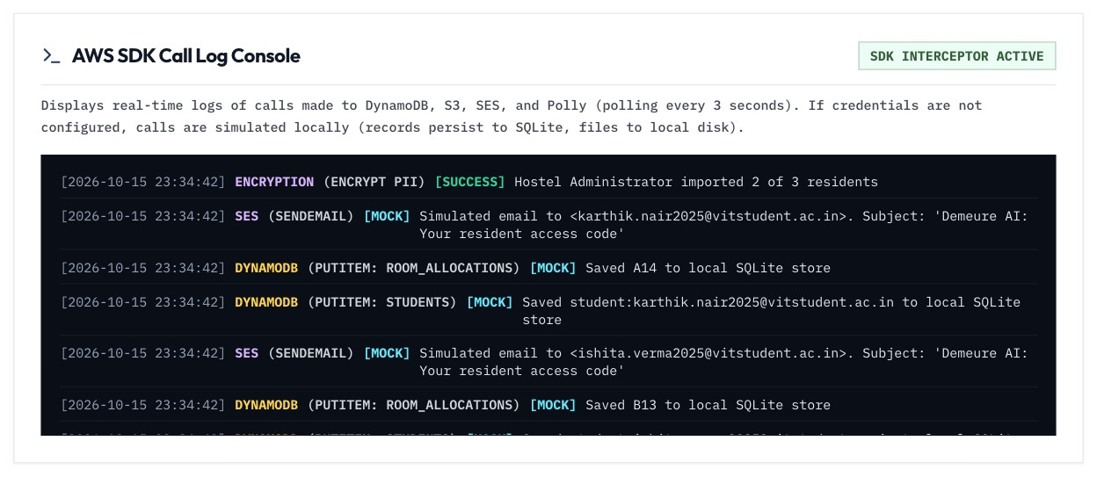
AWS hub: live or mock, always observable
OPERATIONS
Every write, email and upload in the log feed
Service status and test console
Notes:
Admins can test SES, S3 and Polly from one screen. Every data write, email and upload appears in the SDK log console, whether the system is on real AWS or in local mode.

Slide 26
From prototype to deployable
PRODUCTION READINESS
What changed under the hood to make Demeure safe to run for a real campus.
Notes:
This section covers the engineering work: security, persistence, validation, testing and deployment.

Slide 27








Built to be operated, not just demoed
HARDENING
Real authentication
Hashed secrets, signed sessions, throttling
Role guards
Every endpoint checks the caller's role and ownership
Encrypted records
AES-256-GCM personal fields; SQLite or DynamoDB
Private files
Type, content and size checks; owner/staff access only
Secure headers
CSP, HSTS, frame-deny; docs hidden in production
Tested
41 API tests, 57 browser checks, readability audit
CI pipeline
Lint, build, audit and tests on every push
One-step deploy
Single Docker image, health check, data volume
Notes:
Each tile is a concrete change in this release, covered by the automated test suite or the end-to-end runs.

Slide 28




Where Demeure goes next
NEXT STEPS
Live payments
Razorpay or PayU UPI gateway in place of the simulated collection
SIS integration
Real timetables, grades and library holdings
Gate hardware
Connect real biometric scanners to the ledger API
Campus SSO
Google Workspace or Azure AD sign-in for staff and students
Notes:
These are the honest gaps. Payments are simulated, academics use sample data until a student information system is connected, and the gate scanner needs real hardware.

Slide 29
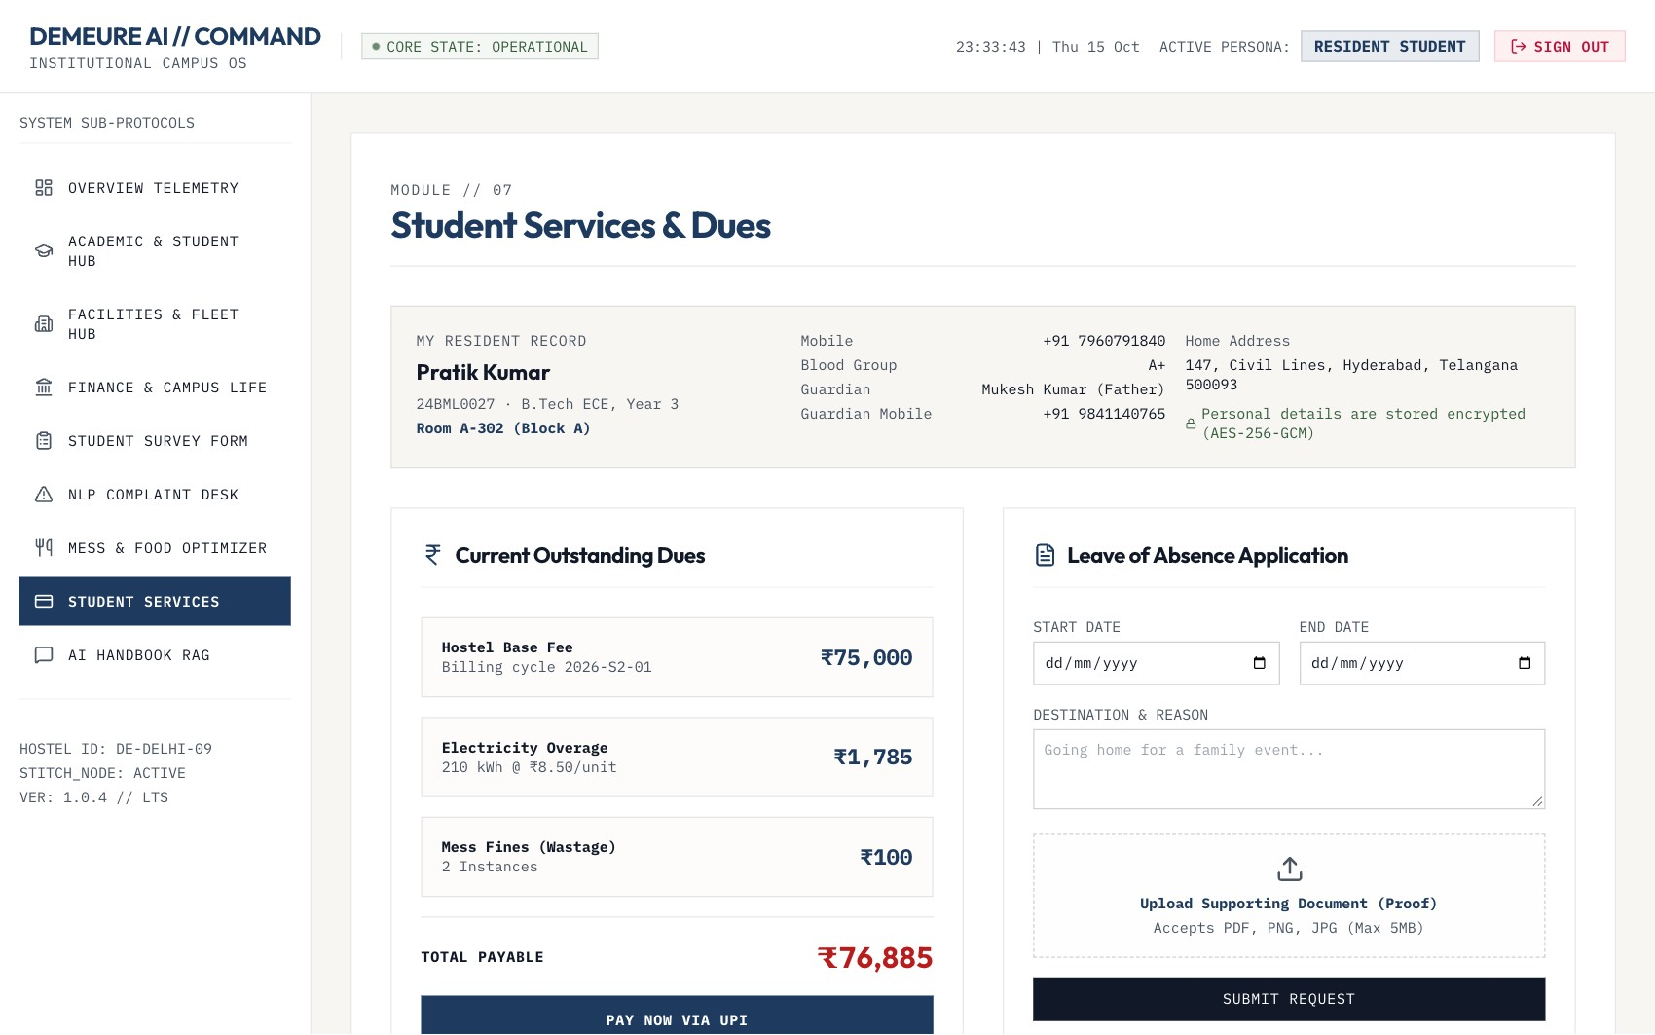
Demeure AI
THANK YOU
Questions, and a live walkthrough of any scenario.
Notes:
Close with a live demo: sign in as the student, submit a leave, switch to the warden and approve it.

