Slide 1
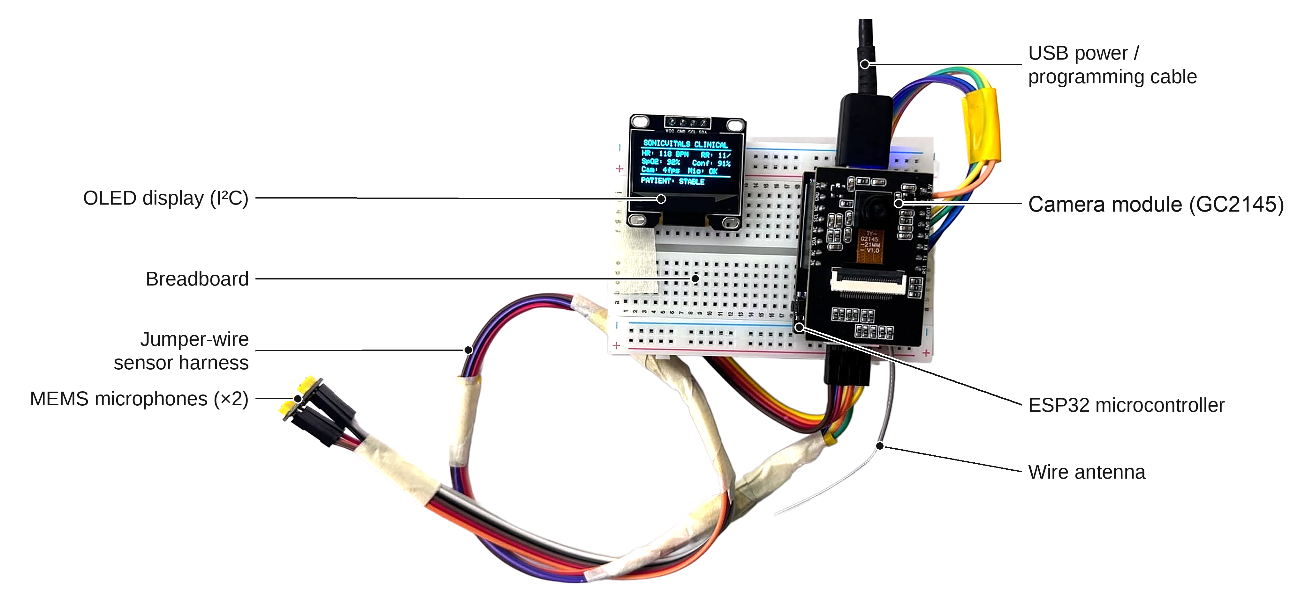
SonicVitals
Contactless heart-rate and breathing monitoring with a low-cost camera + microphone node
ESP32-S3 · rPPG · Heart sounds · Sensor fusion
SEM 5 Project · VIT · October 2026
Notes:
Introduce the project in one line: we measure heart rate and breathing without touching the person, using a cheap ESP32 node with a camera and a microphone. The photo is the actual prototype: ESP32-S3 with GC2145 camera, INMP441 MEMS microphones and an OLED display.

Slide 2



Some people can't wear a sensor
Elderly and bedridden patients
What already exists
People with dementia pull clips and straps off; nobody re-attaches them at night.
Option | Cost | Limitation
Finger pulse oximeter | ₹500–1,500 | Needs contact
Smartwatch / band | ₹2,000+ | Must be worn and charged
Face-scan phone apps | App / licence | Closed; someone holds the phone
Radar / under-mattress | ₹10,000+ | Single purpose, closed
Fragile skin
Newborns and burn patients: adhesive sensors can injure the skin.
Shared screening
Health rooms and kiosks: quick checks for many people without a shared finger clip.
The gap: a cheap, open, fixed node that measures without contact and says when its reading can't be trusted.
Notes:
Be honest: for one healthy person a ₹800 oximeter is better. Contactless matters when contact is the problem: people who won't or can't wear sensors, fragile skin, and shared screening. Existing contactless options are closed phone apps or expensive radar devices.

Slide 3




What we built
Low-cost sensor node
Two sensors, one clock
ESP32-S3 + GC2145 camera + INMP441 microphone + OLED, about ₹1,500 of parts, streaming over Wi-Fi.
Every frame and audio block carries a microsecond timestamp from the same ESP32 clock, so camera and sound line up.
Fusion with an agreement check
Honest quality gating
Camera HR and heart-sound HR are averaged by quality only if they agree within 8 BPM.
A reading is shown only if its signal clearly beats noise; otherwise the display shows "--".
Notes:
Four contributions. The algorithms themselves are published (CHROM, Welch, PCG envelopes); our contribution is the integration: a cheap synchronised two-sensor node, fusion with an agreement gate, and quality gating that refuses to show noise.

Slide 4



System architecture
EDGE NODE · ESP32-S3
HOST · Python (Flask, OpenCV, SciPy)
Camera task (core 1)
Wi-Fi TCP :3333
Optical rPPG engine
GC2145 · 8 fps fixed rate
software JPEG · 3 s PSRAM ring
face gate · CHROM · Welch spectrum
video + audio
Acoustic PCG engine
Web dashboard
Audio task (core 0)
HTTP JSON + MJPEG
video · vitals · waveforms · diagnostics
Shannon envelope · autocorrelation
INMP441 I²S 16 kHz
63-tap FIR → 4 kHz
Fusion + quality gates
SSD1306 OLED
agree ≤ 8 BPM · SNR ≥ 0 dB
HR · RR · status · IP
VITALS every 1.5 s
Session recorder
CSV + WAV for offline evaluation
Each packet: µs timestamp + sequence no.
Notes:
Three parts. The node captures at a fixed 8 fps on core 1 and audio on core 0, timestamps everything with the same clock and streams over Wi-Fi TCP. The host does all signal processing in Python and serves the dashboard; it also sends the result back to the OLED every 1.5 s.

Slide 5




Engineering the node: problems we hit
Mic pins = USB-serial pins
GPIO43/44 carry both → stream over Wi-Fi instead
No hardware JPEG on GC2145
Capture RGB565, compress in software, fixed 8 fps
Auto-exposure hides the pulse
Lock exposure, gain, white balance after 3 s
ESP32-S3: 2 cores at 240 MHz, 8 MB PSRAM, Wi-Fi
GC2145: 2 MP camera, used at 240×160
INMP441: 24-bit I²S MEMS microphone
SSD1306: 128×64 OLED over I²C
Hotspot gives only ~70 kB/s
Audio 16 → 4 kHz (FIR), 3 s PSRAM frame buffer
Notes:
Real problems from building it. The mic's I2S pins were the USB-serial pins, so USB streaming died with the mic on: we moved to Wi-Fi. The GC2145 has no JPEG encoder, so we compress in software at a fixed 8 fps. Auto-exposure changes are bigger than the 0.1-1% pulse, so we lock them. Bandwidth forced audio decimation and a PSRAM buffer.

Slide 6
From pixels and sound to heart rate
OPTICAL · camera
Face gate
Skin colour
Resample
CHROM
Band-pass
HR
Haar cascade + 5 checks
forehead + cheeks mean R,G,B
timestamps → 15 Hz grid
S = X − αY cancels motion
0.75–2.5 Hz (45–150 BPM)
Welch peak, tracked
shown if SNR ≥ 0 dB
ACOUSTIC · chest microphone
Band-pass
Resample
Envelope
HR
Breathing
25–400 Hz heart sounds
1 kHz
Shannon energy −x² log x²
autocorrelation, 60/τ
shown if ρ ≥ 0.3
camera green 0.15–0.40 Hz → RR
Fusion
If camera and sound agree within 8 BPM: HR = (w_cam·HR_cam + w_snd·HR_snd) / (w_cam + w_snd), weighted by signal quality. If they disagree, use the better channel and flag a conflict. Brief disturbances (≤ 2 s) are bridged; longer ones hold the last value for 15 s.
Notes:
Camera: each heartbeat changes skin colour by 0.1-1%. We average thousands of skin pixels, put samples on a uniform time grid, use CHROM to cancel motion and lighting, band-pass to the heart-rate range and pick the Welch spectral peak. Sound: band-pass the heart sounds, take the Shannon energy envelope and find its period by autocorrelation. Each channel has a quality gate; fusion averages them only when they agree.

Slide 7
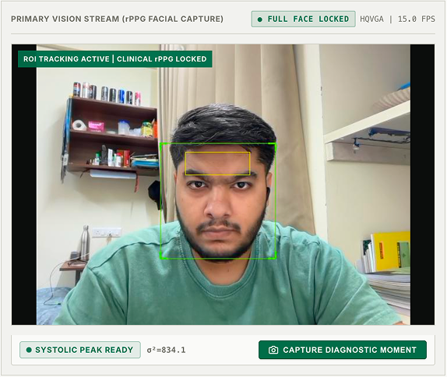
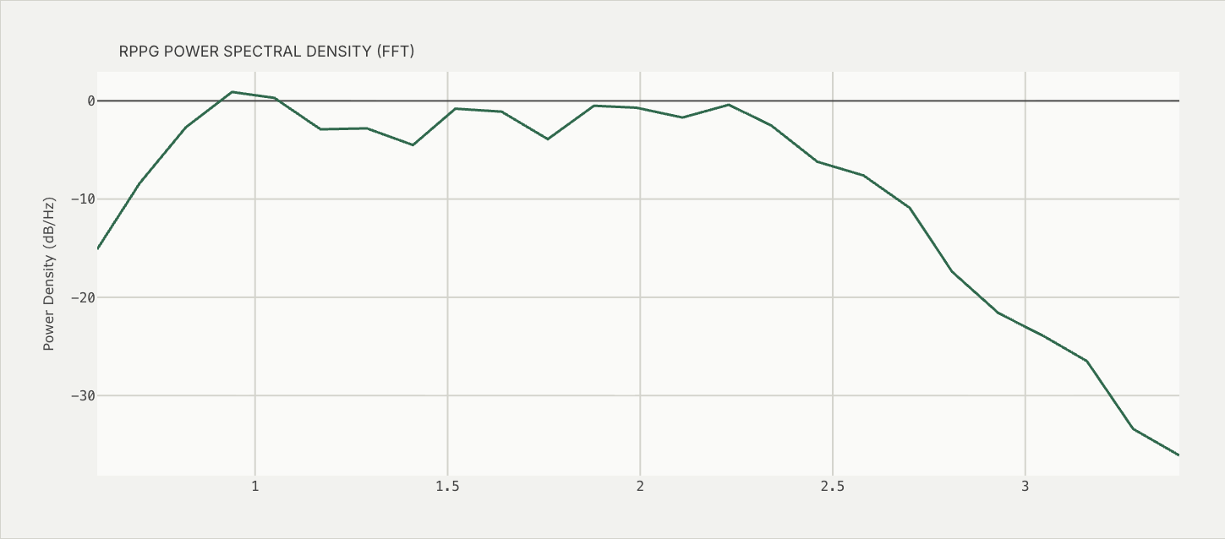
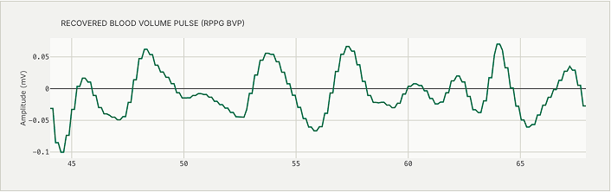
The live dashboard
1
Face gate + skin ROI
2
Recovered pulse wave
3
Pulse spectrum
Green box = face passed all 5 checks; yellow = skin patch used for the pulse.
Band-passed CHROM signal; each hump is one heartbeat.
Highest peak in 0.75–2.5 Hz gives HR = 60 × f₀.
Notes:
Screenshots from the prototype. Left: the camera view with the face box and the skin region, and the recovered pulse waveform. Right: the pulse spectrum; the highest peak in the heart-rate band gives HR. These screenshots are from an earlier build; the current one also shows SNR and displays '--' when the signal is weak. Best: show the live demo here.

Slide 8
What we measured
Frame-timing jitter (SD) — lower is better
8.0
0
Wi-Fi, first firmware
frames / s received
frames or audio blocks lost
310 ms
evenly spaced, Wi-Fi
30 s run, checked by sequence no.
USB-serial 1 Mbaud (mic off)
15.5 ms
±2 BPM
≈5 %
Wi-Fi, fixed-rate capture
HR on synthetic signals
noise passing the gate
0.4 ms
at 52, 78 and 128 BPM
pure-noise test, so "--" not fake HR
775× steadier after moving capture into a fixed-rate camera task with timestamps taken at capture.
Not yet measured: HR accuracy against an ECG chest strap (planned study).
Notes:
Engineering results we actually measured. Timing jitter fell from 310 ms with the first Wi-Fi firmware to 0.4 ms after moving capture into a fixed-rate task. 30 s run: 8.0 fps, no lost frames or audio. 31 automated tests: synthetic HR within 2 BPM; pure noise passes the quality gate about 5% of the time. Gap bridging cut buffer restarts from 16 to 6 on a recorded session. Clinical accuracy against an ECG strap is the next step; we do not claim a number we haven't measured.

Slide 9





Limitations and next steps
LIMITATION
NEXT STEP
No reference validation yet
Compare with an ECG chest strap: Bland–Altman, AAMI ±5 BPM
Needs light
Add an IR LED + IR-sensitive camera for night monitoring
Motion and lighting changes
Landmark face tracking; colour means computed on the node before JPEG
Heart sounds weak through air
Contact or stethoscope-coupled microphone on the chest
Colour indices uncalibrated
Colour reference card and fixed lighting; exploratory only
Notes:
Say the limitations before the examiners do. The biggest is that HR accuracy hasn't been validated against a reference yet. An ordinary camera needs light, so bedside night use needs IR. Motion, lighting and weak heart sounds through air are the other limits. Each has a concrete next step.

Slide 10

Takeaways
Contactless HR and breathing from a ≈₹1,500 open node, with no phone or wearable.
Camera and heart-sound data on one clock, fused only when the two agree.
Quality gates show "--" instead of a confident wrong number.
Thank you · Questions?
Notes:
Close with the three takeaways and invite questions. If there is time, run the live demo.

