Slide 1
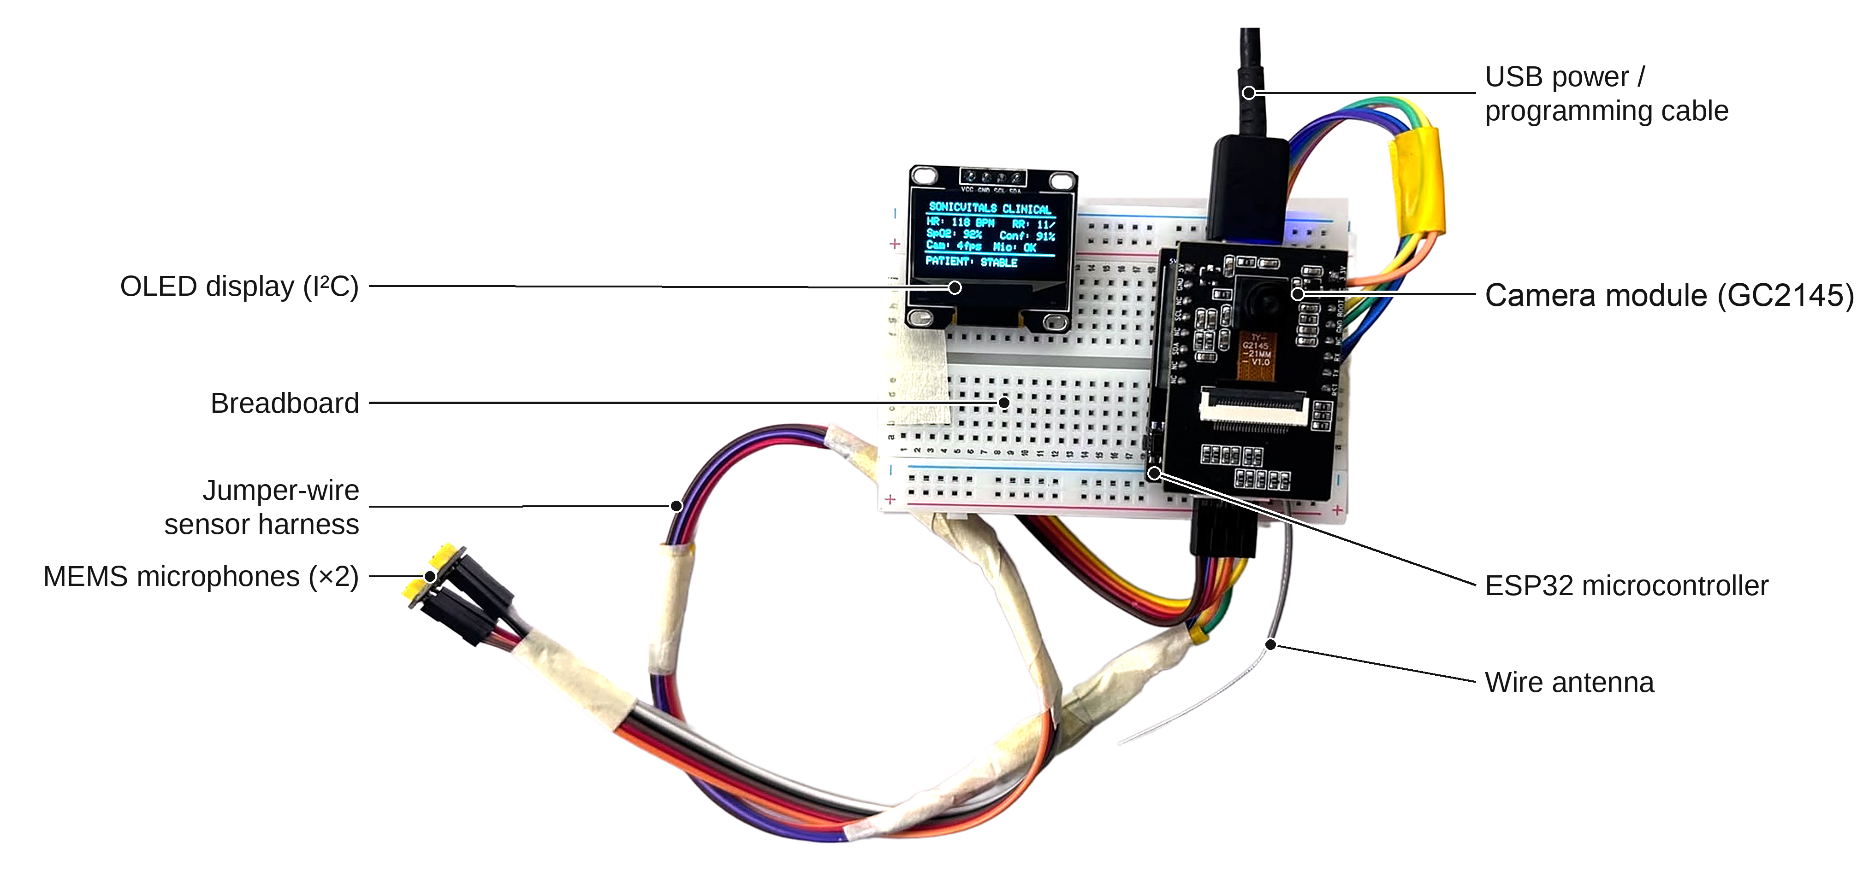
SonicVitals: A Low-Cost ESP32-S3 Platform for Synchronized Camera-Based Photoplethysmography and Acoustic Cardiac Sensing
FINAL PROJECT REVIEW
Team
Faculty Guide
Pratik Kumar
Uday Krishan Khandelwal
Janvhee Dhote
Jeeva J. B.
Bench prototype: ESP32-S3 + GC2145 camera + INMP441 microphones + SSD1306 OLED
School of Electronics Engineering (SENSE), Vellore Institute of Technology, Vellore · October 2026
Notes:
Introduce the team and the guide. One-line summary: a low-cost ESP32-S3 node that captures camera video and heart sounds on one clock, and a host pipeline that estimates heart rate and breathing without contact.

Slide 2
Outline
1
Introduction
9
Methodology: acoustic, respiration, fusion
2
Problem statement and motivation
10
Software and dashboard
3
Literature survey
11
Exploratory colour screening
4
Research gap and objectives
12
Results: system performance
5
System architecture
13
Results: algorithm verification
6
Hardware and pin mapping
14
Comparison with existing work
7
Firmware design
15
Limitations and future work
8
Methodology: optical rPPG
16
Conclusion and references
Notes:
Walk through the structure briefly.

Slide 3



Introduction
Heart rate (HR) and respiratory rate (RR) are the most frequently recorded vital signs.
They are normally measured with contact sensors: ECG electrodes, finger PPG clips, chest belts.
Contact sensing is reliable, but uncomfortable for long recordings, unsuitable for fragile or burned skin, and a cross-infection risk.
This motivates contactless measurement using a camera and sound.
Remote photoplethysmography (rPPG)
Each heartbeat pushes blood into skin capillaries; haemoglobin absorbs green light, so skin colour changes by 0.1–1 %. Averaging thousands of skin pixels in video recovers the pulse.
Phonocardiography (PCG)
Heart valves closing produce the S1 ("lub") and S2 ("dub") sounds at 20–150 Hz; their period gives the heart rate.
Key idea: one cheap node captures both signals on the same clock, and the host estimates and cross-checks the vital signs.
Why combine both
Camera and sound fail for different physical reasons (motion and light vs. noise), so they can check each other.
Notes:
Explain rPPG and PCG in one sentence each, and why combining them helps: they fail for different reasons.

Slide 4



Problem statement and motivation
Problem: Monitor HR and RR without touching the person, using low-cost hardware, and know when a reading cannot be trusted.
Who needs contactless monitoring
What exists today
Elderly and bedridden
Option | Cost | Limitation
Finger pulse oximeter | ₹500–1,500 | Needs contact
Smartwatch / band | ₹2,000+ | Must be worn and charged
Face-scan phone apps | App / licence | Closed; someone holds the phone
Radar / under-mattress | ₹10,000+ | Single purpose, closed
People with dementia pull clips and straps off.
Fragile skin
Newborns and burn patients: adhesive sensors can injure skin.
Shared screening
Health rooms and kiosks without a shared finger clip.
Notes:
Be honest: for one healthy person an oximeter is better. Contactless matters where contact is the problem. Existing contactless options are closed apps or expensive radar devices.

Slide 5
Literature survey
Work | Method | Contribution | Limitation
Verkruysse et al., 2008 | Green-channel rPPG, ambient light | First pulse signal from a consumer camera | Sensitive to motion and light changes
Poh et al., 2010 | ICA blind source separation | Automated webcam HR | Needs a still subject
de Haan & Jeanne, 2013 | CHROM chrominance projection | Cancels motion/specular component | Assumes standard skin-tone model
Wang et al., 2017 | POS projection | Unified algorithmic principles of rPPG | Desktop processing; camera only
Chen & McDuff, 2018 | DeepPhys CNN | Learned motion-robust pulse | Needs training data and a GPU
Villarroel et al., 2019 | Video monitoring in NICU | Clinical feasibility in neonates | Costly camera setup
Liang 1997; Springer 2016 | Shannon envelope; HSMM | Robust S1/S2 heart-sound segmentation | Needs a chest-contact stethoscope
Mariakakis et al., 2017 | BiliScreen scleral colour | Phone-based jaundice screening | Needs a calibration accessory
McDuff 2017; Nowara 2020 | Compression; skin-type meta-analysis | Compression and darker skin lower rPPG SNR | Known limits for low-cost cameras
Notes:
Optical methods progressed from green channel to ICA to CHROM/POS to deep learning, all camera-only and mostly desktop. Heart-sound processing assumes a chest stethoscope. Colour screening needs calibration. Compression and skin type limit low-cost cameras.

Slide 6
Research gap and objectives
Research gap
Objectives
rPPG systems are camera-only: no independent check when motion or light corrupts the signal.
Multimodal studies use separate devices with unsynchronised clocks, on desktop or GPU platforms.
Few systems report when a reading is unreliable; many display a number regardless.
Little documentation of what a very low-cost embedded camera can and cannot do.
1
Design an ESP32-S3 node that captures video and audio with one microsecond time base.
2
Stream both reliably to a host over Wi-Fi with integrity checks.
3
Estimate HR and RR by CHROM rPPG with a face-validity gate.
4
Estimate HR from heart sounds and fuse both with an agreement gate.
5
Build a live dashboard with recording and exploratory colour screening.
6
Verify algorithms and the link quantitatively; define a validation protocol.
Notes:
The gap: camera-only, unsynchronised multimodal setups, and no reliability reporting. Our six objectives map directly onto the system we built.

Slide 7


Proposed system architecture
EDGE NODE · ESP32-S3
HOST · Python (Flask, OpenCV, SciPy)
Camera task (core 1)
Wi-Fi TCP :3333
Optical rPPG engine
GC2145 · 8 fps fixed rate
software JPEG · 3 s PSRAM ring
face gate · CHROM · Welch spectrum
video + audio
Acoustic PCG engine
Web dashboard
Audio task (core 0)
HTTP JSON + MJPEG
video · vitals · waveforms · diagnostics
Shannon envelope · autocorrelation
INMP441 I²S 16 kHz
63-tap FIR → 4 kHz
Fusion + quality gates
SSD1306 OLED
agree ≤ 8 BPM · SNR ≥ 0 dB
HR · RR · status · IP
VITALS every 1.5 s
Session recorder
CSV + WAV for offline evaluation
Each packet: µs timestamp + sequence no.
Notes:
Three tiers: node, host, browser. The node timestamps everything with one clock and streams over Wi-Fi TCP; the host processes and serves the dashboard and sends results back to the OLED every 1.5 s.

Slide 8

Hardware components and pin mapping
Component | Key specifications | Role
ESP32-S3 (camera board) | 2 × Xtensa LX7 @ 240 MHz, 512 KB SRAM, 8 MB PSRAM, Wi-Fi | Acquisition, timestamps, streaming
GC2145 camera | 2 MP CMOS, DVP 8-bit, used at 240×160 RGB565 | Facial video for rPPG
INMP441 microphone | I²S MEMS, 24-bit, 61 dBA SNR | Heart sounds (chest)
SSD1306 OLED | 0.96", 128×64, I²C 400 kHz | Local readout of vitals and IP
Host laptop | Python 3, Flask, OpenCV, NumPy/SciPy | Signal processing, dashboard
Signal | GPIO
Camera XCLK / PCLK | 15 / 13
Camera VSYNC / HREF | 6 / 7
Camera SCCB SDA / SCL | 4 / 5
Camera D0–D7 | 11, 9, 8, 10, 12, 18, 17, 16
Mic I²S SCK / WS / SD | 43 / 44 / 0
OLED SDA / SCL (0x3C) | 47 / 48
Pin conflict found during integration: the mic's I²S lines (GPIO43/44) are also UART0, wired to the board's only USB-serial chip (CH340). With the mic on, the USB link dies, and GPIO0 is a boot-strapping pin. Solution: stream over Wi-Fi and use USB only for power and flashing.
Notes:
Components and their roles; camera pins follow the ESP32-S3-EYE map. The key hardware finding is the pin conflict between the mic and the USB-serial bridge, which forced Wi-Fi streaming.

Slide 9




Firmware design
FreeRTOS tasks
Engineering problems solved
Core 0 · audio task
No hardware JPEG on GC2145
I²S DMA read → 63-tap FIR anti-alias → decimate 16 → 4 kHz → queue (2 s)
Driver rejects JPEG mode → capture RGB565, compress in software
Core 1 · camera task
Auto-exposure hides the pulse
Capture at fixed 8 fps → software JPEG (q 60) → 24-slot PSRAM ring (≈3 s)
Lock exposure, gain, white balance after 3 s of settling
Main loop
Hotspot throughput ≈ 70 kB/s
Send frames/audio, parse host commands, refresh OLED, OLED hot-plug check
8 fps target, audio decimated to 4 kHz, PSRAM buffer for stalls
Line protocol (v2)
Uneven frame timing
Fixed-rate capture task; timestamp taken at capture, not on send
<<HELLO:SonicVitals,2,wifi,mic,...>>
<<FRAME_START:seq,t_us,len>> base64 JPEG <<FRAME_END>>
<<AUDIO:seq,t_us,n,base64 PCM>>
<<STAT:fps,frames,drops,...>>
host → node: <<VITALS:HR,RR,SpO2,Q,STATUS>>
Board reset while flashing
Host never toggles DTR/RTS; Wi-Fi-only link mode
Notes:
Two cores split audio and video so neither blocks the other. The text protocol carries sequence numbers and microsecond timestamps; the length field and sequence numbers detect corrupt or missing data. Five real problems and their fixes.

Slide 10
Methodology I: optical rPPG
Face gate
Skin colour
Resample
CHROM
Band-pass
HR
Haar cascade + 5 checks
forehead + cheeks mean R,G,B
timestamps → 15 Hz grid
S = X − αY cancels motion
0.75–2.5 Hz Butterworth, zero-phase
Welch peak, tracked; shown if SNR ≥ 0 dB
CHROM (de Haan & Jeanne, 2013)
Parameters and quality control
Rₙ, Gₙ, Bₙ = channel ÷ its window mean
X = 3Rₙ − 2Gₙ
Y = 1.5Rₙ + Gₙ − 1.5Bₙ
S = X − α·Y, α = σ(X) / σ(Y)
HR = 60 · f₀ (Welch peak in 0.75–2.5 Hz)
Face gate: edge clearance, size 20–88 %, aspect 0.65–1.30, ROIs in frame, light ≥ 15 and balanced.
Welch: 256-sample Hann segments, 50 % overlap, FFT 4096, parabolic peak interpolation.
SNR (de Haan): power at f₀ and 2f₀ vs. rest of 0.5–4 Hz; gate 0 dB (noise passes ≈ 5 %).
Warm-up 10 s, buffer 30 s, update 0.5 s; gaps ≤ 2 s bridged.
Peak tracking ±12 BPM around last accepted HR.
X and Y both carry the motion/specular term; subtracting αY cancels it and leaves the pulse.
Notes:
Explain the pipeline left to right, then CHROM. Mention resampling because Wi-Fi frames arrive unevenly, filtfilt for zero phase, Welch for a low-variance spectrum, and the SNR gate that shows '--' instead of noise.

Slide 11



Methodology II: acoustic, respiration and fusion
ACOUSTIC · heart sounds
Band-pass
Resample
Shannon envelope
Autocorrelation
HR = 60/τ
25–400 Hz, 4th order
to 1 kHz
−x² log x², 20 ms smoothing
lag τ in 0.4–1.33 s
shown if ρ ≥ 0.3
Respiration (camera)
HRV (heart sounds)
Green channel band-passed 0.15–0.40 Hz (9–24 breaths/min); Welch peak f_r → RR = 60·f_r. Needs a 15 s segment and ≥ 50 % of low-frequency power at the peak, else "--".
S1 peaks on the Hilbert envelope → inter-beat intervals → RMSSD = √mean(ΔIBI²). Needs ≥ 20 clean intervals.
Quality-weighted fusion
Display stabilisation
If |HR_cam − HR_snd| ≤ 8 BPM: HR = (w_cam·HR_cam + w_snd·HR_snd)/(w_cam + w_snd), w_cam = Q, w_snd = ρ. Otherwise use the better channel and flag a conflict.
Median of last 3 fused values, then EMA; last value held ≤ 15 s while re-acquiring; "--" when no channel passes its gate.
Notes:
Shannon energy emphasises medium-intensity sounds; autocorrelation uses the periodicity of the whole window so it is robust to missed beats. Fusion only averages when both channels agree within 8 BPM.

Slide 12
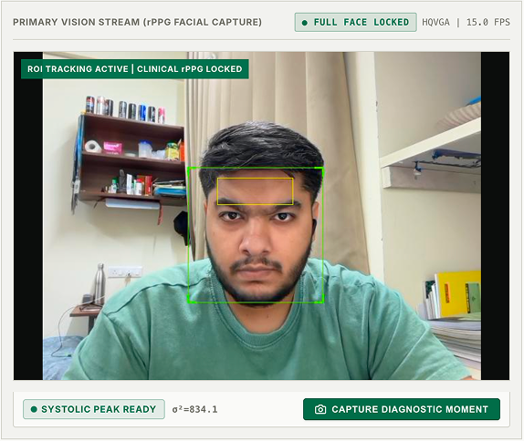
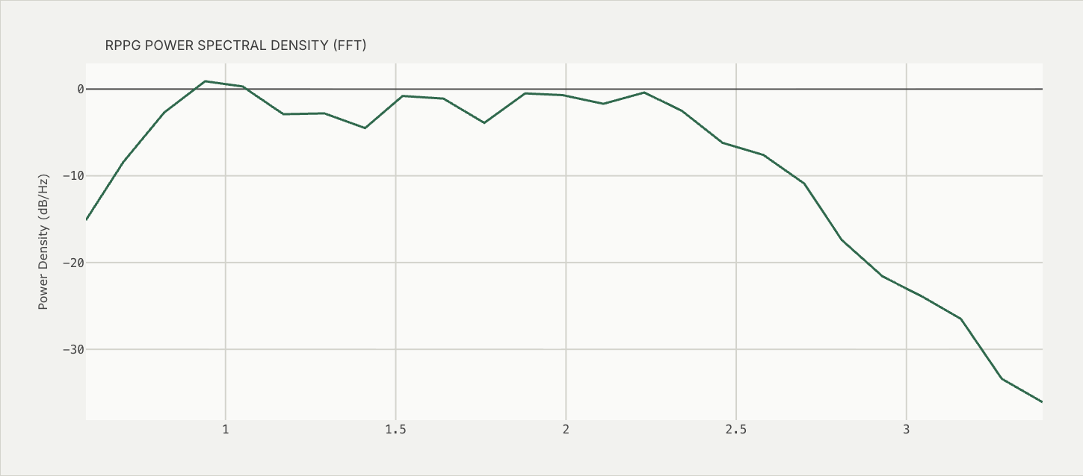
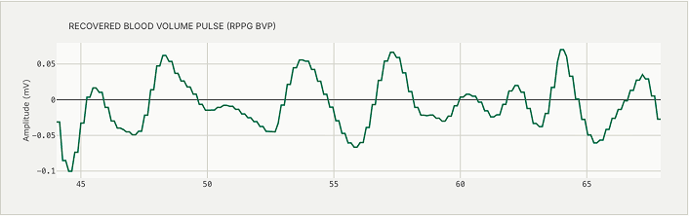
Software implementation and dashboard
Modules
usb_streamer.py: link, Flask API
rppg_engine.py: face gate, ROI
vitals_dsp.py: shared DSP
acoustic_engine.py: PCG
recorder.py: sessions
evaluate.py: offline stats
Frontend: HTML/JS + Plotly
Live camera view with face gate (green) and skin ROI; recovered pulse wave (below); pulse spectrum (right).
Dashboard: live vitals, waveforms
Signal analysis: PSD, spectrogram, bands
Diagnostics: colour indices (exploratory)
31 automated tests (pytest) + a node simulator
Experiments: session recording
Notes:
The host software is modular; the same DSP code runs live and offline. The dashboard has four main tabs. Screenshots are from the prototype; a live demo is best here.

Slide 13
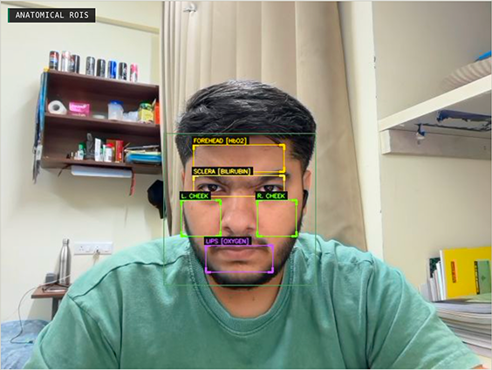
Exploratory colour screening (Diagnostics Studio)
Index | ROI | Formula | Indicates
Erythema EI | Forehead | 100 (log R − log G) | Perfusion
Pallor PI | Cheeks | (G + B) / 2R | Low haemoglobin
Yellowness YI | Eye band | 100 (R + G − 2B) / (R + G + B) | Bilirubin (jaundice)
Cyanosis CR | Lips | B / R | Deoxygenation
Symmetry HFI | Both cheeks | 100 |G_L − G_R| / (G_L + G_R) | Perfusion asymmetry
Sharpness | Whole frame | Variance of Laplacian | Frame selection
Exploratory only. Uncalibrated RGB indices depend on lighting, white balance and skin tone (e.g. warm light raises YI). Reliable use needs a colour reference card and validation against blood tests.
Notes:
The sharpest gated frame is analysed in five facial regions. These are screening indicators, not diagnoses; the main limitation is calibration.

Slide 14
Results I: system performance
Configuration | Host fps | Jitter SD | Frame loss | Audio loss
Wi-Fi, first firmware (3-min session) | 5.1 | 310 ms | 0 % | 0.66 %
USB-serial 1 Mbaud, mic off | 7.4 | 15.5 ms | 1.0 % rejected | mic off
Wi-Fi, fixed-rate capture (final, 30 s) | 8.0 | 0.4 ms | 0 | 0
775×
steadier frame timing
310 ms → 0.4 ms
8.0 fps
evenly spaced at host
Frame-timing jitter (SD)
> 5 fps Nyquist for 150 BPM
First Wi-Fi firmware
310 ms
0
USB-serial 1 Mbaud
15.5 ms
Fixed-rate capture
0.4 ms
frames or audio blocks lost
verified by sequence numbers
Notes:
Measured on the real hardware. Moving capture into a fixed-rate task with timestamps at capture cut jitter from 310 ms to 0.4 ms. Final link: 8 fps evenly spaced, zero frames or audio blocks lost.

Slide 15

Results II: algorithm verification
±2 BPM
≈ 5 %
Clinical validation: planned protocol
Optical HR on synthetic signals
Noise passing the SNR gate
52, 78 and 128 BPM with irregular 6–11 fps frame timing
pure-noise test, 10–30 s windows; target ≤ 6 %
References: chest-strap ECG (HR, R–R), finger pulse oximeter, metronome-paced breathing.
Conditions C1–C5: rest, talking, small motion, low light, distance.
30 s windows; development and test participants kept separate.
Metrics: MAE, RMSE, Pearson r, Bland–Altman bias and 95 % limits (repeated measures).
Acceptance: AAMI EC13, error ≤ 5 BPM or 10 %.
Tooling ready: session recorder + analysis/evaluate.py.
16 → 6
31 / 31
Buffer restarts in 3 min
Automated tests pass
replay of a recorded session after 2 s gap bridging
DSP, PCG, protocol, engine, server, recorder
Findings on real recordings
First-firmware optical estimates had SNR −6 to −3 dB, i.e. at noise level, which motivated the SNR gate.
Heart sounds through air were weak (ρ ≤ 0.18; 99.5 % of power < 25 Hz): the mic must touch the chest.
HR / RR accuracy against references has not been measured yet.
Notes:
What is verified: algorithms on synthetic signals with known answers, the noise gate, and gap bridging. Clinical accuracy is not yet measured; the protocol and tools are ready. Do not claim accuracy numbers until the study is done.

Slide 16
Comparison with existing work
System | Contactless | Heart sounds | Synchronised single node | Open source | Quality gate shown | Validated accuracy
Finger pulse oximeter | ✗ | ✗ | — | ✗ | ~ | ✓
Smartwatch / chest strap | ✗ | ✗ | — | ✗ | ~ | ✓
Face-scan phone apps | ✓ | ✗ | ✗ | ✗ | ~ | vendor claims
rPPG research (CHROM, POS, DeepPhys) | ✓ | ✗ | ✗ | ✓ | ~ | on datasets
Electronic stethoscope | ✗ | ✓ | — | ✗ | ✗ | ✓
SonicVitals (this work) | ✓ | ✓ | ✓ | ✓ | ✓ | planned
✓ yes ✗ no ~ partial — not applicable
Positioning: not a replacement for an oximeter, but a low-cost open platform for contactless, cross-checked monitoring.
Notes:
Our distinguishing features are the synchronised two-sensor node, openness and quality reporting. The honest weakness versus commercial devices is validated accuracy, which is our next step.

Slide 17




Limitations and future work
LIMITATION
FUTURE WORK
No reference validation yet
ECG-strap study with Bland–Altman and AAMI EC13
Needs ambient light
IR LED + IR-sensitive camera for night monitoring
Motion and lighting changes
Landmark face tracking; ROI colour means on the node before JPEG
Weak heart sounds through air
Contact or stethoscope-coupled microphone
Skin tone and uncalibrated colour
Diverse participants; colour reference card
Processing on a laptop
Edge processing on the ESP32 and battery power
Notes:
State the limitations before the panel does; each has a concrete next step.

Slide 18


Conclusion
Built a low-cost ESP32-S3 node that captures camera video and heart sounds on one microsecond clock and streams them over Wi-Fi with 0 frames or audio blocks lost.
Implemented CHROM rPPG (HR, RR) and Shannon-envelope PCG (HR, RMSSD) with a five-test face gate and quality-weighted fusion with an agreement gate.
Added honest quality gating: readings that do not clearly beat noise are shown as "--".
Verified the link (8 fps, 0.4 ms jitter) and the algorithms (31 tests); the clinical validation protocol and tools are ready.
Notes:
Summarise the four outcomes. Close with: next step is the ECG-referenced validation study.

Slide 19
References
[1] W. Verkruysse, L. O. Svaasand, J. S. Nelson, "Remote plethysmographic imaging using ambient light," Opt. Express, 2008.
[2] M.-Z. Poh, D. J. McDuff, R. W. Picard, "Non-contact, automated cardiac pulse measurements using video imaging and blind source separation," Opt. Express, 2010.
[3] G. de Haan, V. Jeanne, "Robust pulse rate from chrominance-based rPPG," IEEE Trans. Biomed. Eng., 2013.
[4] W. Wang, A. C. den Brinker, S. Stuijk, G. de Haan, "Algorithmic principles of remote PPG," IEEE Trans. Biomed. Eng., 2017.
[5] W. Chen, D. McDuff, "DeepPhys: Video-based physiological measurement using convolutional attention networks," ECCV, 2018.
[6] M. Villarroel et al., "Non-contact physiological monitoring of preterm infants in the NICU," npj Digit. Med., 2019.
[7] H. Liang, S. Lukkarinen, I. Hartimo, "Heart sound segmentation algorithm based on heart sound envelogram," Comput. Cardiol., 1997.
[8] D. B. Springer, L. Tarassenko, G. D. Clifford, "Logistic regression-HSMM-based heart sound segmentation," IEEE Trans. Biomed. Eng., 2016.
[9] A. Mariakakis et al., "BiliScreen: Smartphone-based scleral jaundice monitoring," Proc. ACM IMWUT, 2017.
[10] D. J. McDuff, E. B. Blackford, J. R. Estepp, "The impact of video compression on remote cardiac pulse measurement," IEEE FG, 2017.
[11] E. M. Nowara, D. McDuff, A. Veeraraghavan, "A meta-analysis of the impact of skin type and gender on non-contact PPG," CVPRW, 2020.
[12] P. Viola, M. Jones, "Rapid object detection using a boosted cascade of simple features," CVPR, 2001.
[13] P. D. Welch, "The use of FFT for the estimation of power spectra," IEEE Trans. Audio Electroacoust., 1967.
[14] J. M. Bland, D. G. Altman, "Statistical methods for assessing agreement between two methods of clinical measurement," Lancet, 1986.
[15] AAMI EC13, "Cardiac monitors, heart rate meters, and alarms."
Notes:
Full list in the project report.

Slide 20
Thank you
Questions?
Team
Faculty Guide
Pratik Kumar
Uday Krishan Khandelwal
Janvhee Dhote
Jeeva J. B.
School of Electronics Engineering (SENSE), Vellore Institute of Technology, Vellore
Notes:
Thank the guide and panel; invite questions; offer a live demo.

