Slide 1
Background Job Monitor Framework
15th March 2021

Slide 2
Process Flow
Step 1
Users will register their data collector programs in a configuration table along with other information like, Variant name, Spool Output structure, Start date, End Date
Step 2
Background framework caller program will read the configuration table and schedule the jobs for the data collector programs
Step 3
Background framework caller program will schedule another step within the same job to read the spool output data of the data collector program and update in monitor table
Step 4
Jobs and their output can be monitored on the Fiori Screen created using RAP

Slide 3
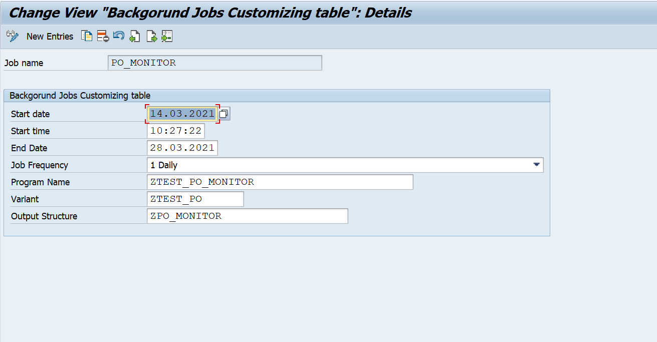
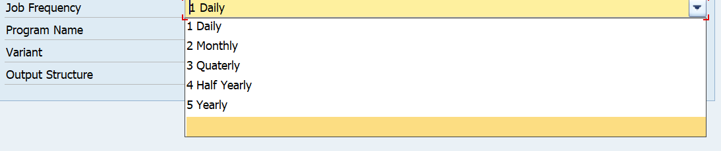
Step 1
Users will register their data collector programs in a configuration table along with other information like, Variant name, Spool Output structure, Start date, End Date
Key Points
Program name and variant should be provided for the data collector program Job Frequency can be selected as Daily, Monthly, Quarterly… A spool structure is required to read the spool output data and update in the monitor table

Slide 4
Step 2 & 3
Background framework caller program will read the configuration table and schedule the jobs for the data collector programs and read the spool output.
No | Class | Description
1 | ZBCJ_MONITOR_FRMWKR | Class to read the configuration table and schedule the background jobs for data collector programs
2 | ZPO_MONITOR_CLASS | Data Collector class to read the purchase orders created in last 30 days with more than 100 days of payment terms
3 | ZREAD_SPOOL_DATA | Class to read the spool outputs and update in the monitor table

Slide 5
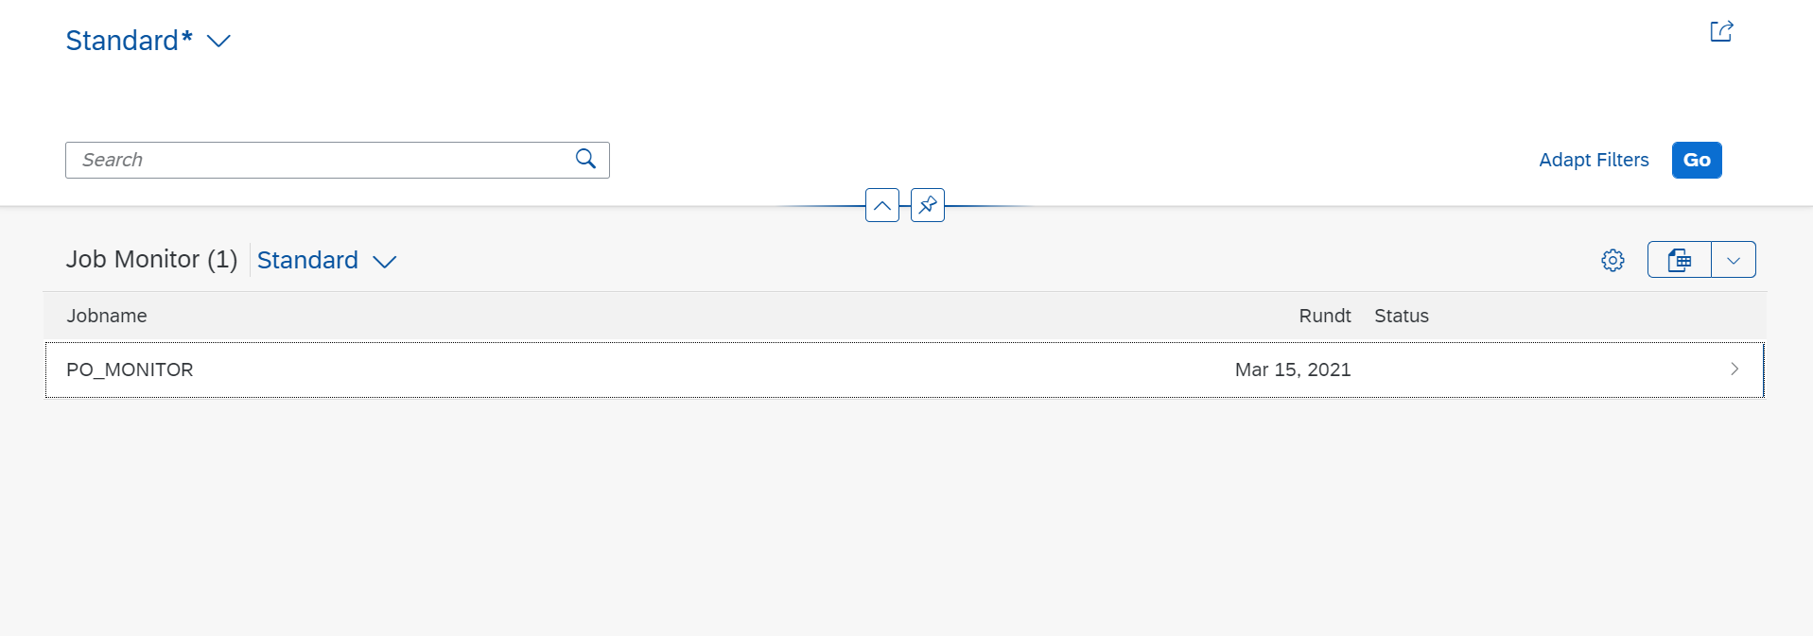
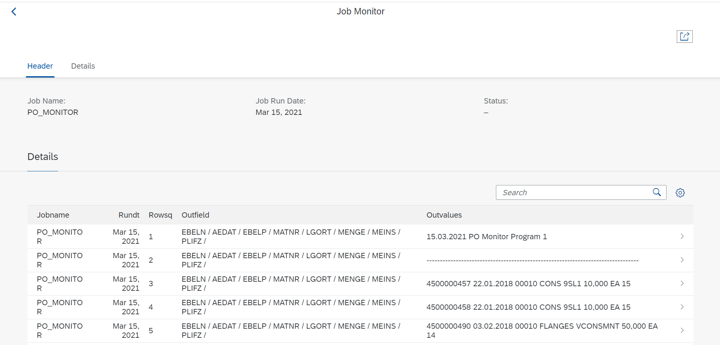
Step 4
Jobs and their output can be monitored on the Fiori Screen created using RAP

Slide 6
Q&A
Notes:
•

