Slide 1
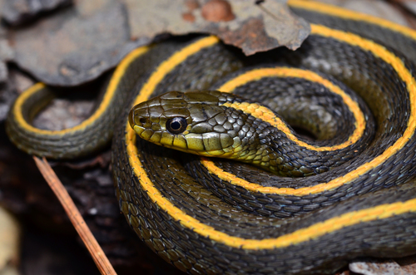
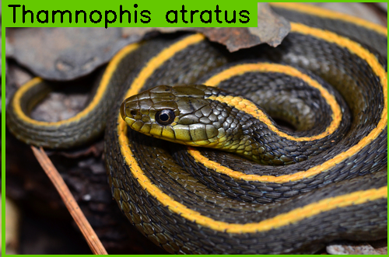
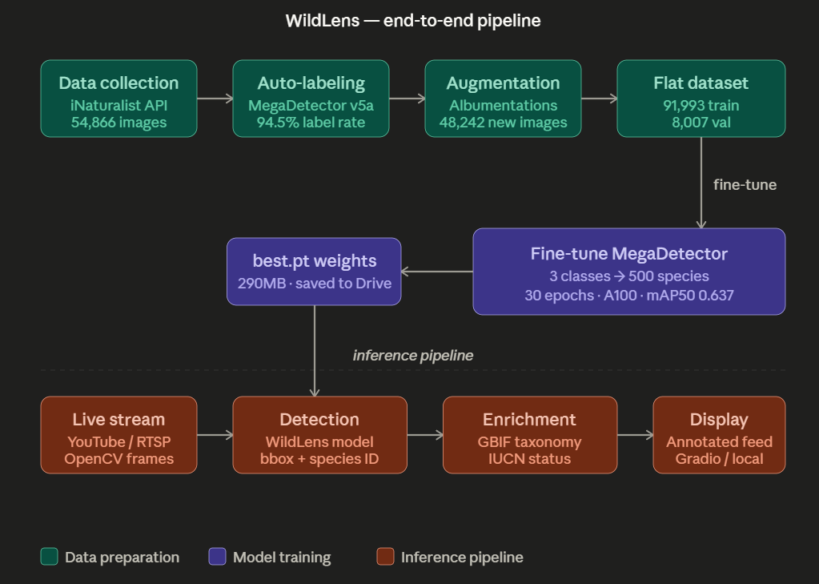
WildlifeWatch
An Application of MegaDetector (YOLOv5) in specialized Species Detection and Identificiation
Prateek Ghosh
Introduction
Wildlife monitoring traditionally relies on static camera trap images processed offline — results arrive hours or days after capture.. These images are often analyzed by humans making it a painstaking manual process.
We are utilizing Vision Intelligence to analyze frames, photos to identify scientific species.
Data Pipeline
Applications
With future improvements in accuracy through deeper training and stronger data collection strategies, the project shows promise for the following:
Camera Trap Feed Detection: Automating Camera Trap Feed analysis and live identification
Visual Education: This model can be deployed on videos used in education of species and scientific names
Drone Feed Detection: Drone are often employed in animal detection. On-board hard-wired AI can be used for live feed detection
Data Collection
01
iNaturalist API
500 vertebrate species
54,866 research-grade images
Mammalia · Aves · Reptilia
Amphibia · Actinopterygii
02
Auto-Labelling
iMegaDetector v5a
51,603 bbox labels (94.5%)
vs 36,544 with YOLOv8 (65%)
Conf threshold: 0.3
03
Augmentation
Albumentations library
Bbox-aware transforms
48,242 new images
Target: 200 images/species
Methods
We fine-tune MegaDetector v5a - a YOLOv5x6 model pretrained on millions of wildlife camera trap images - expanding it from 3 generic classes to 500 fine-grained vertebrate species.
This is the first known fine-tune of MegaDetector for species-level detection, paired with a video inference pipeline and IUCN conservation enrichment.
Fig 3 A sample of Albumentation (augmentation)
Accuracy Metrics plot
Results
Key Contributions
• First fine-tune of MegaDetector for species-level detection (3 to 500 classes)
• 94.5% auto-label rate vs 65% with COCO-trained YOLO on wildlife images
• mAP50 of 0.637 across 500 species trained on 100K image dataset
• End-to-end live stream detection pipeline with IUCN enrichment
Limitations
• Visually similar species confused (leopard/jaguar)
• Context-dependent errors (oxpecker learned from host animals)
• ~110 images/species on average — more data would help
Future Work
Expand to 2,000+ species
Lightweight YOLOv8n variant for edge deployment
SpeciesNet benchmark comparison
Training Set
04
640×640 resolution
A100 GPU · 30 epochs
91,993 train / 8,007 val
100,000 total pairs
Fig 4 mAP50 progression over epochs
Fig 2 (a) Original Inaturalist Data
Fig 2 (b) Labelled Training Set Data
References
Google SpeciesNet: Visual Intelligence in species identication
Microsoft MegaDetector YOLOv5
YOLOv8n for object detection
Inaturalist Species Observation
BBC Earth and National Geographic youtube streams
Albumentations: Data Augmentation
Accuracy Metrics
mAP50 | 0.637
mAP50 - 95 | 0.593
Precision | 0.610
Recall | 0.599
Box Loss | ~68%
Label rate vs YOLOv8 | +29.5%
Why MegaDetector over YOLO? MegaDetector was pretrained on 4.5M wildlife camera trap images. COCO-trained YOLO struggles with camouflaged animals, unusual angles, and rare species. Fine-tuning MegaDetector gave us a 94.5% auto-label rate vs 65% with YOLOv8 on the same images
Fig 1 What our pipeline looks like zoomed in.
School of Engineering and Applied Sciences University at Buffalo, The State University of New York
buffalo.edu

