Slide 1
STRATEGIC SUPPLY CHAIN ANALYTICS
Multi-Echelon Supply Chain
Network Optimization
A Python MILP model for facility location & inventory routing — with a stakeholder-ready financial business case (NPV, ROI, sensitivity analysis)
Facility Location · Inventory Routing · NPV & ROI · Sensitivity Analysis

Slide 2
EXECUTIVE SUMMARY
A re-optimized network cuts logistics cost 17.8% and clears its investment hurdle
ANNUAL SAVINGS
5-YEAR NPV
IRR
PAYBACK
$2.76M
$0.55M
11.5%
Year 4
17.8% below legacy network cost
@ 9% WACC, after tax
vs. 9% cost of capital
of a 5-year horizon
MILP model jointly optimizes which distribution centers to open and how to route product + inventory through them — not just a network-design exercise, but an integrated location + routing solution.
Savings come primarily from better facility siting and true landed-cost customer assignment, not from cutting headcount or footprint — an easier, lower-risk story to take to stakeholders.
Sensitivity analysis shows the business case is most exposed to demand-forecast accuracy and capex execution, and comparatively insensitive to discount-rate movement.
Multi-Echelon Supply Chain Network Optimization
2

Slide 3
BUSINESS CONTEXT
A network that grew city-by-city, not by design
A mid-market distribution network expanded organically as regions came online, rather than being periodically re-evaluated against current demand and freight-lane economics. This creates three quantifiable inefficiencies:
01
02
03
Misaligned Footprint
Sub-Optimal Assignment
Un-Pooled Inventory Risk
Legacy DCs sit where regions happened to be added, not where today's demand and freight lanes make them cheapest to operate.
Customers are routed to the nearest facility by distance alone, ignoring handling cost and inbound plant-to-DC economics.
Each DC carries safety stock independently, forfeiting the statistical risk-pooling benefit a well-designed network provides.
Multi-Echelon Supply Chain Network Optimization
3

Slide 4
METHODOLOGY
A multi-echelon facility-location & inventory-routing MILP
open[i] ∈ {0,1} — facility-open decision
Candidate
DC 1
Objective
Minimize: facility fixed cost + inbound transport + outbound transport + DC handling + cycle-stock (EOQ) cost + safety-stock cost
Plants
(fixed)
Customer
Zones
Candidate
DC N
Constraints
• Demand satisfaction at every customer zone
• DC and plant capacity limits (only if open)
• Flow conservation: inbound = outbound at each DC
• Minimum open-DC count (service resilience rule)
Inventory-Routing Linearization
EOQ cycle-stock cost is priced at each DC's design throughput; safety stock scales linearly with realized flow. This keeps the network's classic risk-pooling trade-off — fewer, larger DCs need less aggregate safety stock — while remaining an exact, fast-solving MILP (PuLP + CBC, open-source, no license required).
Multi-Echelon Supply Chain Network Optimization
4

Slide 5
DATA
A realistic, ready-to-swap synthetic dataset
No proprietary company data was available for this exercise, so the network below was synthesized to be realistic in scale, geography and cost structure. Every script reads from these files — swapping in real ERP/TMS extracts requires no change to the model logic.
Dataset | Records | Key Fields
Plants | 3 | Capacity, unit production cost, location
Candidate DCs | 8 | Capacity, fixed cost, handling cost, location
Customer demand zones | 24 | Annual demand, growth rate, service priority
Transport cost matrices | 264 | Distance-derived $/unit, plant→DC and DC→customer
Financial parameters | 10 | WACC, holding cost rate, tax rate, capex, EOQ inputs
Dataset
Records
Key Fields
TOTAL ANNUAL DEMAND MODELED
660,449
units / year across 24 U.S. metro demand zones
Includes NYC, LA, Chicago, Houston, Phoenix and 19 other major U.S. metros, spanning all major freight corridors.
Multi-Echelon Supply Chain Network Optimization
5

Slide 6
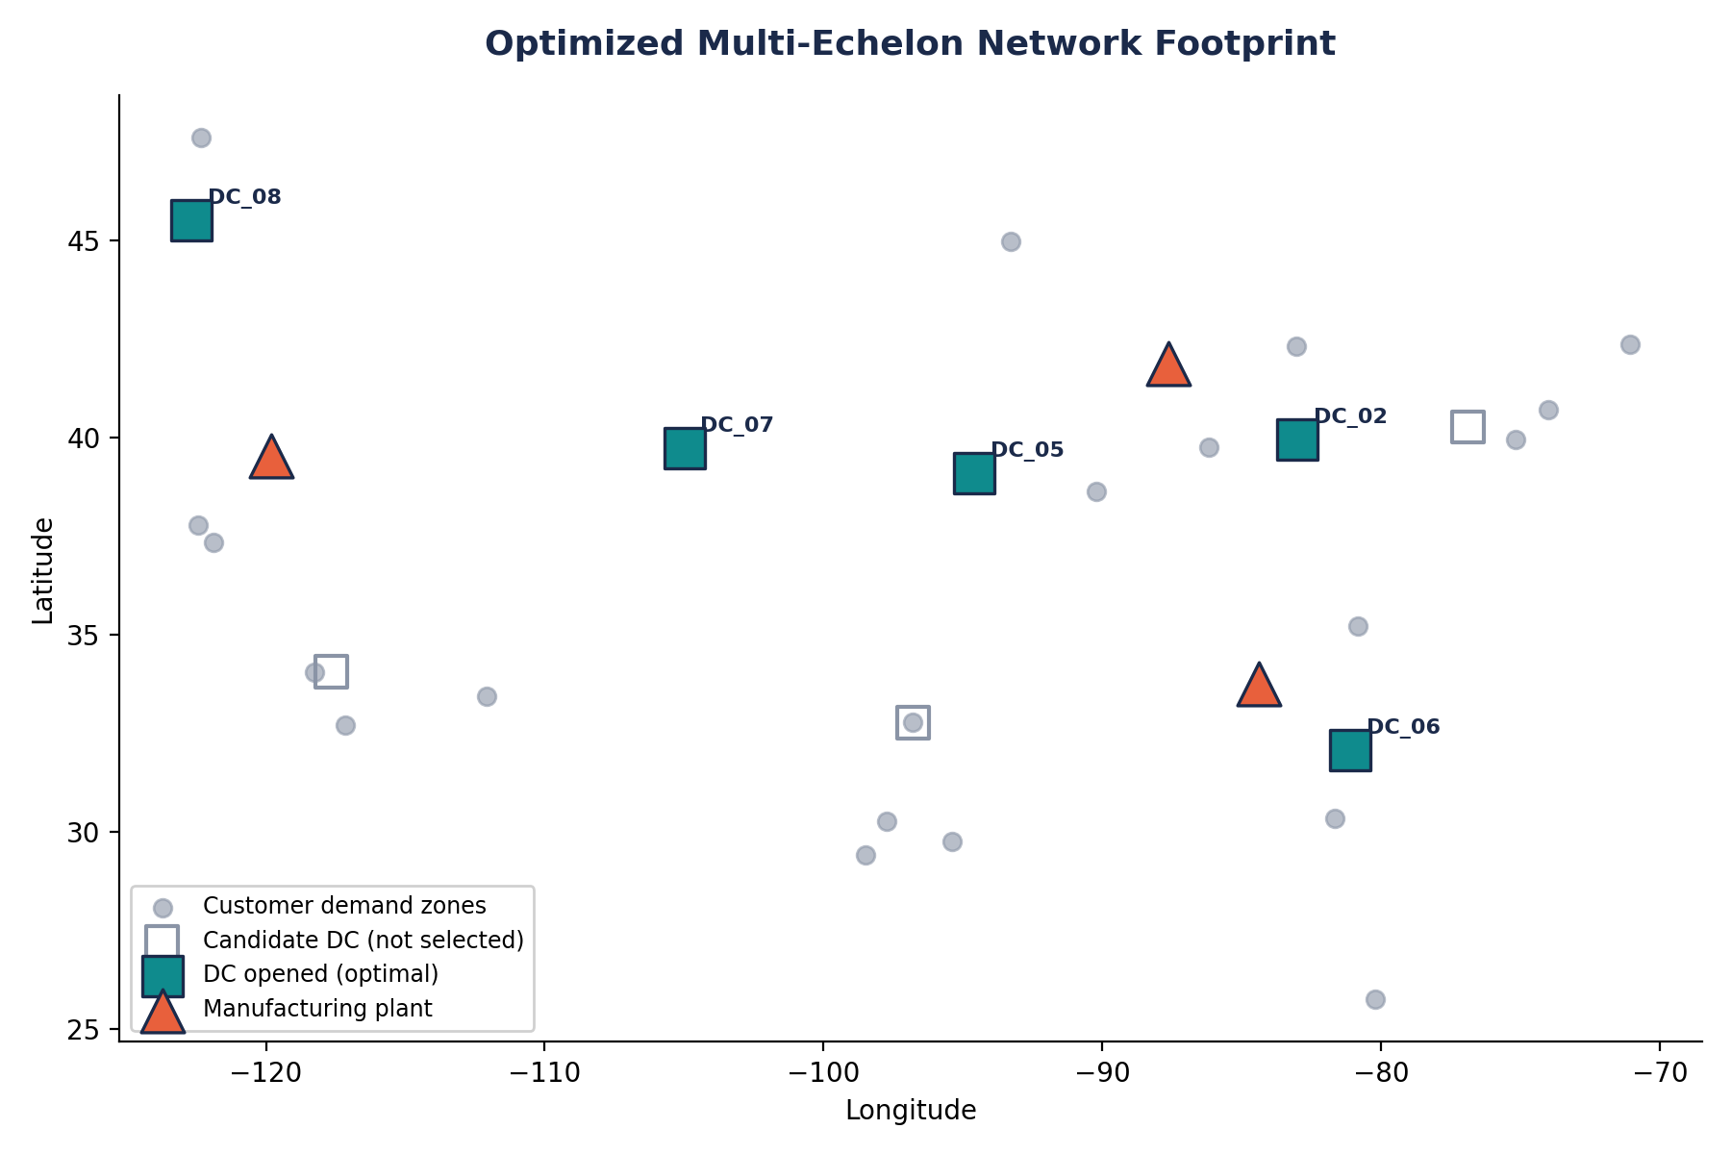
OPTIMIZATION RESULT
The model selects 5 of 8 candidate DCs to serve the network
Multi-Echelon Supply Chain Network Optimization
6

Slide 7
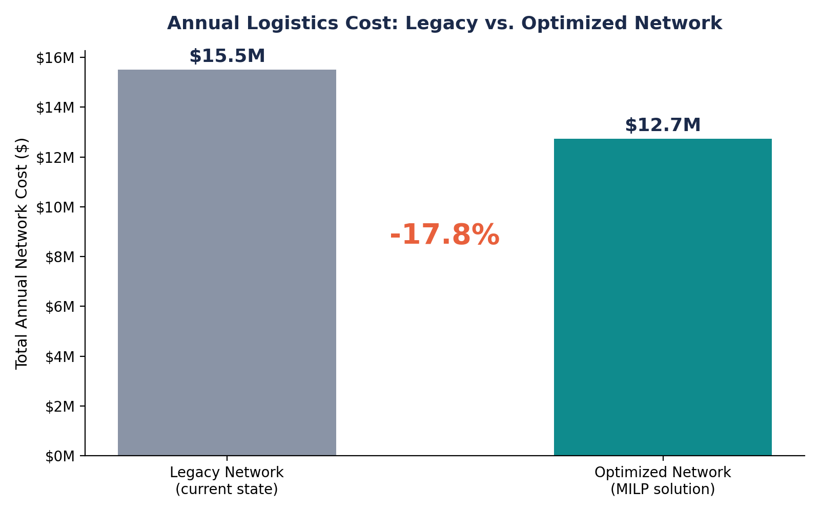
OPTIMIZATION RESULT
17.8% lower annual logistics cost vs. the legacy network
What's driving the gap
Re-sited DCs cut average shipping distance to customers
True landed-cost assignment replaces nearest-distance heuristics
Consolidated inventory pooling lowers aggregate safety stock
Facility count held constant (5) — gains are from siting, not cuts
Multi-Echelon Supply Chain Network Optimization
7

Slide 8
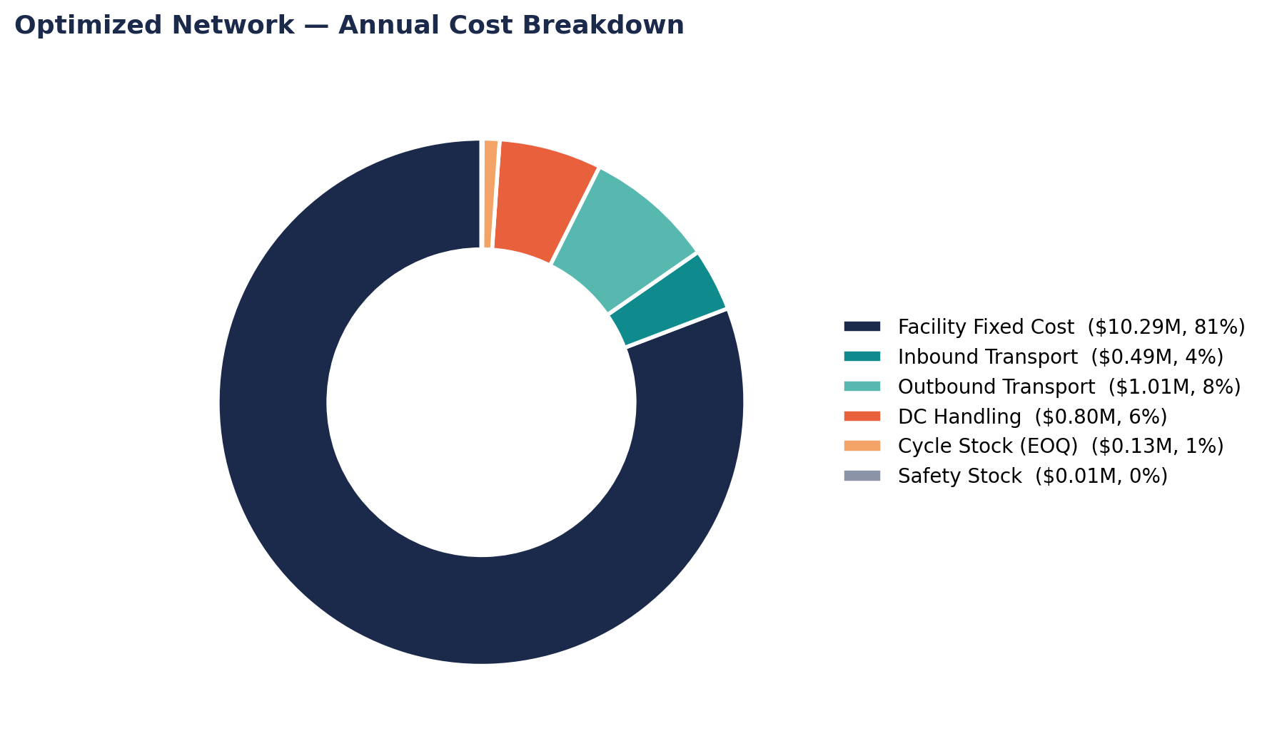
OPTIMIZATION RESULT
Facility fixed cost is 81% of the optimized cost stack
Multi-Echelon Supply Chain Network Optimization
8

Slide 9
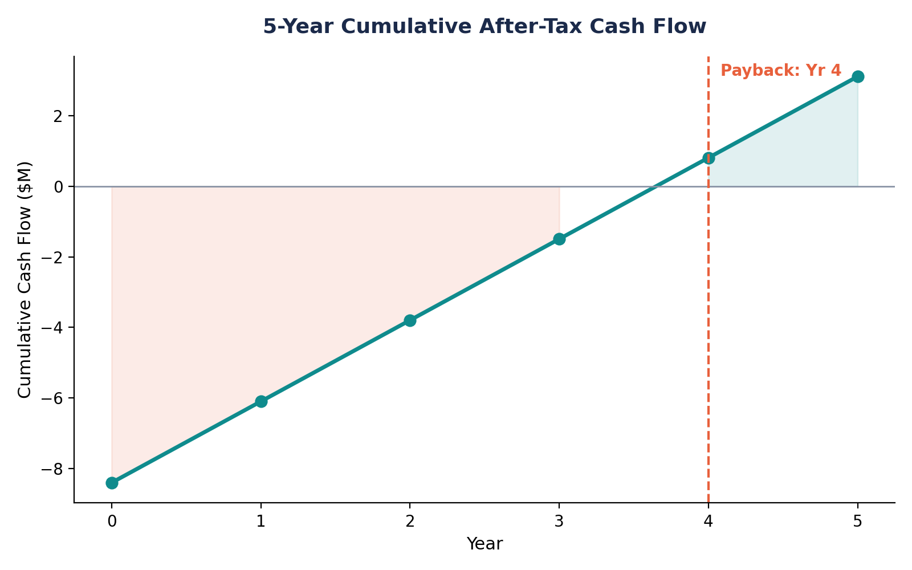
FINANCIAL BUSINESS CASE
Investment clears its hurdle rate with a Year-4 payback
Capex
$8.4M
2 DC transitions
5-yr NPV
$0.55M
@ 9% WACC
IRR
11.5%
vs. 9% hurdle
ROI (5-yr)
37%
cumulative
Multi-Echelon Supply Chain Network Optimization
9

Slide 10
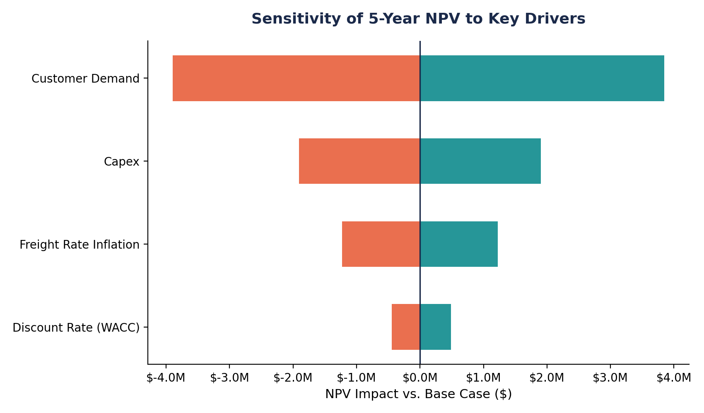
FINANCIAL BUSINESS CASE
NPV is most sensitive to demand growth, least to discount rate
Multi-Echelon Supply Chain Network Optimization
10

Slide 11
STRATEGIC GROWTH ROADMAP
Key insights & recommended actions for stakeholders
01
02
Re-site, don't just resize
Fixed cost is the lever
Savings come from better placement, not facility cuts — a lower-risk story internally.
81% of cost is facility fixed cost. Prioritize lease-timing decisions over freight-rate negotiation.
03
04
Phase the capex
De-risk the demand forecast
Sequence the two highest-value DC transitions first to pull the 4-year payback forward.
NPV is most sensitive to demand growth — invest in a rolling S&OP feed before final sign-off.
Multi-Echelon Supply Chain Network Optimization
11

Slide 12
LIMITATIONS & NEXT STEPS
What this model does well, and where it should go next
Current Scope
Recommended Extensions
Single product, deterministic demand
Multi-SKU model with stochastic demand & chance constraints
Static, single-period network design
Rolling multi-period model to phase DC transitions
Synthetic dataset (illustrates methodology)
Swap in live ERP/TMS extracts — schema is ready
Multi-Echelon Supply Chain Network Optimization
12

