Slide 1

SUMMER INTERNSHIP REPORT
Junior Web Developer
E-Governance & Digital Services • YuvaIntern
Prateek Dwivedi | 4 Weeks, Summer 2026 | Certificate No. YI/2026/152773/359638

Slide 2
About the Internship
I spent four weeks interning with YuvaIntern as a Junior Web Developer on the E-Governance & Digital Services team — working on the content and testing side of a public-facing government portal.
4
Before this, I had little exposure to how government digital platforms are actually built and maintained behind the scenes — this internship was my chance to learn that firsthand.
WEEKS OF HANDS-ON WORK
ORGANIZATION
YuvaIntern
Focused on content quality and QA testing for an E-Governance portal used by the general public.
ROLE
Junior Web Developer
DURATION
4 Weeks · Summer 2026
Prateek Dwivedi | YuvaIntern • Junior Web Developer, E-Governance & Digital Services
2

Slide 3



What I Set Out to Learn
How a Public Portal Works
Hands-On Testing Experience
Get a real sense of how a government-facing site is structured, maintained, and kept up to date.
Practice testing a live web platform directly, rather than just reading about QA in theory.
Team Coordination
Better Documentation
Understand how a small remote team coordinates and communicates on day-to-day work.
Build the habit of documenting work clearly — easy to skip, but genuinely useful.
Prateek Dwivedi | YuvaIntern • Junior Web Developer, E-Governance & Digital Services
3

Slide 4
What I Actually Worked On
Two focus areas: content review and hands-on portal testing
Content Review
Portal Testing
Went through portal pages line by line for accuracy
Checked wording was clear for a general audience
Ensured consistency with the rest of the site's voice
Small fixes that add up on a public-facing platform
Tested forms and navigation flows end to end
Checked behavior across browsers and screen sizes
Logged bugs — broken links, formatting, unclear wording
Ran basic accessibility checks for non-technical users
Prateek Dwivedi | YuvaIntern • Junior Web Developer, E-Governance & Digital Services
4

Slide 5

Inside the QA Workflow
1
2
3
4
Explore & Observe
Log the Issue
Flag to the Team
Verify the Fix
Navigate forms, links and pages the way a real visitor would, watching closely for anything off.
Write it up clearly in a shared spreadsheet — broken links, formatting quirks, confusing copy.
Hand it off with enough detail that a developer can act on it without guessing.
Follow up once resolved to confirm the fix actually held under re-testing.
Prateek Dwivedi | YuvaIntern • Junior Web Developer, E-Governance & Digital Services
5

Slide 6


Tools & Day-to-Day
Nothing too heavy on the tooling side — the value came from consistent, careful habits repeated every day.
Browser DevTools
Shared Spreadsheet
Team Check-ins
Cross-Device Checks
Used to inspect how pages were built and diagnose issues on the spot.
A running, structured log to track every issue found and its status.
Regular syncs to talk through findings and align on priorities.
Verified layouts and flows across browsers and screen sizes.
Having to explain a bug clearly enough for someone else to fix it turned out to be a skill in itself.
Prateek Dwivedi | YuvaIntern • Junior Web Developer, E-Governance & Digital Services
6

Slide 7


What I Took Away From It
Testing Really Matters
Writing for Everyone
Careful QA is the difference between a portal people trust and one that quietly frustrates them.
Learned what "clear" writing means for a general audience, not just for yourself.
Useful Bug Logging
Remote Team Habits
Got comfortable logging issues in a way a dev team can actually act on.
Built stronger organization and follow-through, without needing reminders.
Prateek Dwivedi | YuvaIntern • Junior Web Developer, E-Governance & Digital Services
7

Slide 8
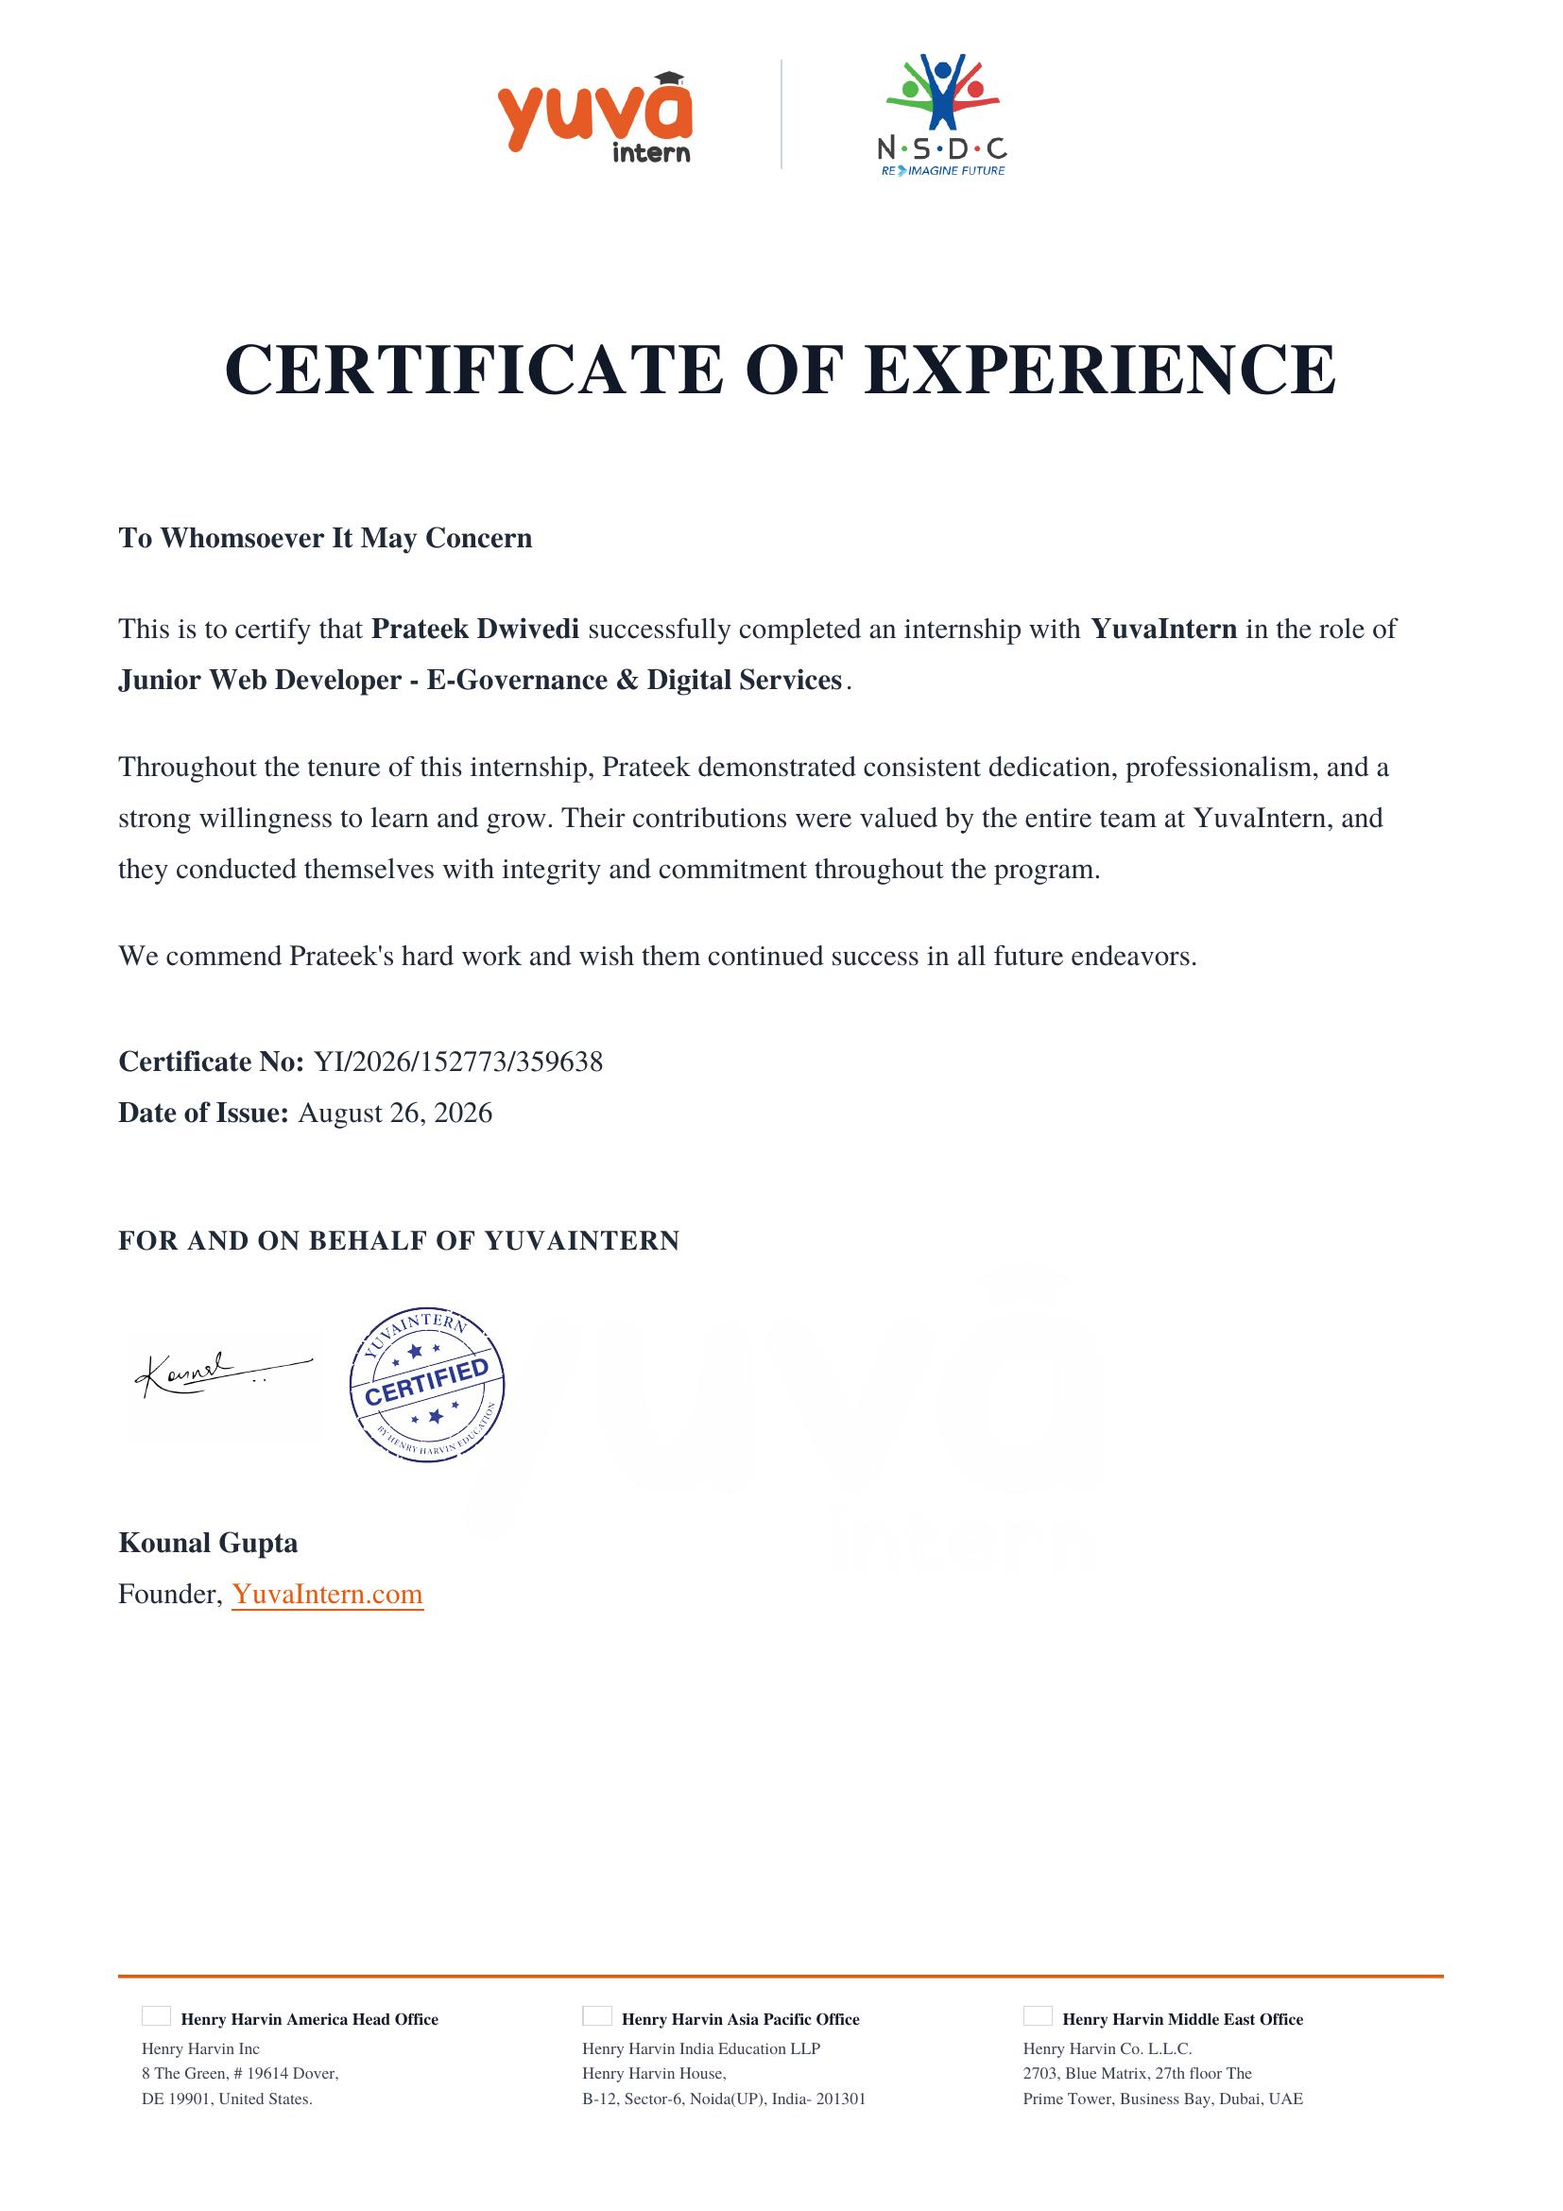
Certificate of Experience
Prateek Dwivedi | YuvaIntern • Junior Web Developer, E-Governance & Digital Services
8

Slide 9

Closing Thoughts
This internship gave me exactly the kind of practical, close-to-the-ground experience I was hoping for. It's one thing to know that testing and content quality matter for a public platform — another to spend four weeks actually doing that work.
I'm taking a fair number of habits — logging things properly, double-checking before flagging, thinking about the actual user — into whatever I work on next.
Thank you.
Prateek Dwivedi • Junior Web Developer, YuvaIntern

