Slide 1

Navigating Data: An Introduction to Databases
Welcome to our brief introduction to databases, designed for business professionals new to Power BI. This presentation will cover the fundamentals of what databases are, why they are essential, and how they power modern applications.

Slide 2



What is a Database?
Organized Data Storage
A structured place to store and retrieve information.
Digital Filing System
Like a neat cupboard for digital files.
Everyday Example
Your phone's contacts list is a simple database.

Slide 3

Why Do We Need Databases?
Store Large Data Securely
Manages vast amounts of information safely.
Quick Search & Update
Enables rapid data retrieval and modification.
Eliminate Redundancy
Avoids duplicate data entries.
Easy Data Sharing
Facilitates access across applications and users.

Slide 4

Common Database Types
Relational (RDBMS)
Organizes data in structured tables. Examples: MySQL, Oracle.
NoSQL Databases
Handles unstructured or semi-structured data. Example: MongoDB.
Cloud Databases
Hosted online for scalability and accessibility. Examples: AWS RDS, Firebase.

Slide 5
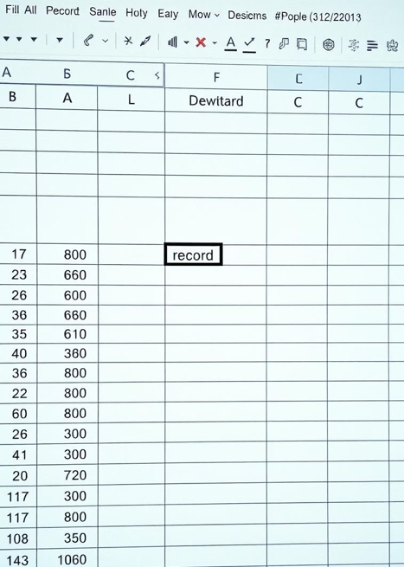
Understanding Database Tables
A table is the fundamental unit of data storage in relational databases.
1 | Raju | 20
2 | Sita | 21
Think of it as a spreadsheet with rows (records) and columns (fields).

Slide 6
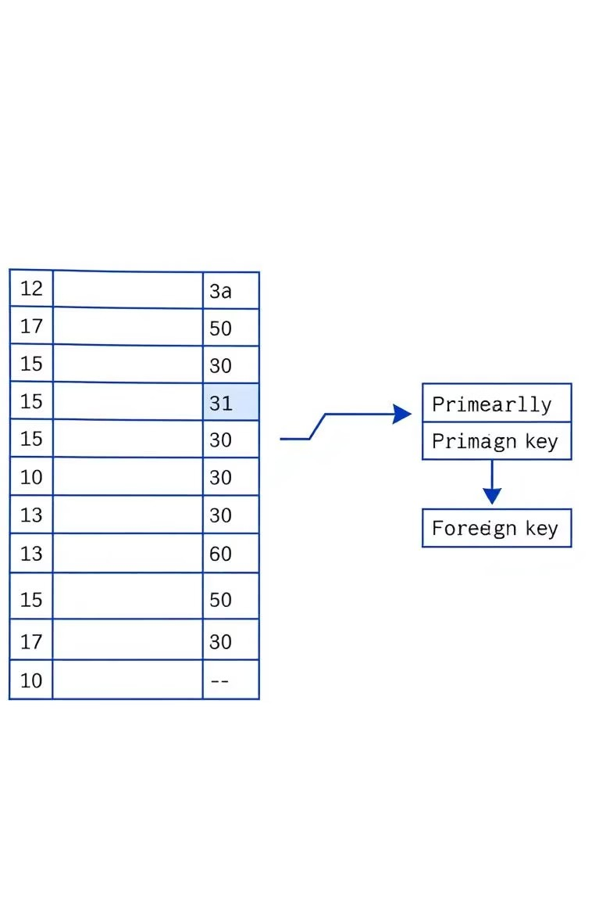
Key Database Terminology
Record
A single row in a database table.
1
Field
A column in a database table.
2
Primary Key
Unique identifier for each record.
3
Foreign Key
Links records between different tables.
4

Slide 7


Introducing SQL
Structured Query Language
SQL is the universal language for interacting with databases.
Database Communication
Used to retrieve, insert, update, and delete data.
Query Examples
SELECT * FROM students; (Show all students) INSERT INTO students VALUES (3, 'Ram', 22);

Slide 8





Databases in Action: Real-World Use
Databases are the backbone of almost every modern industry, enabling efficient data management across various sectors.

