Slide 1
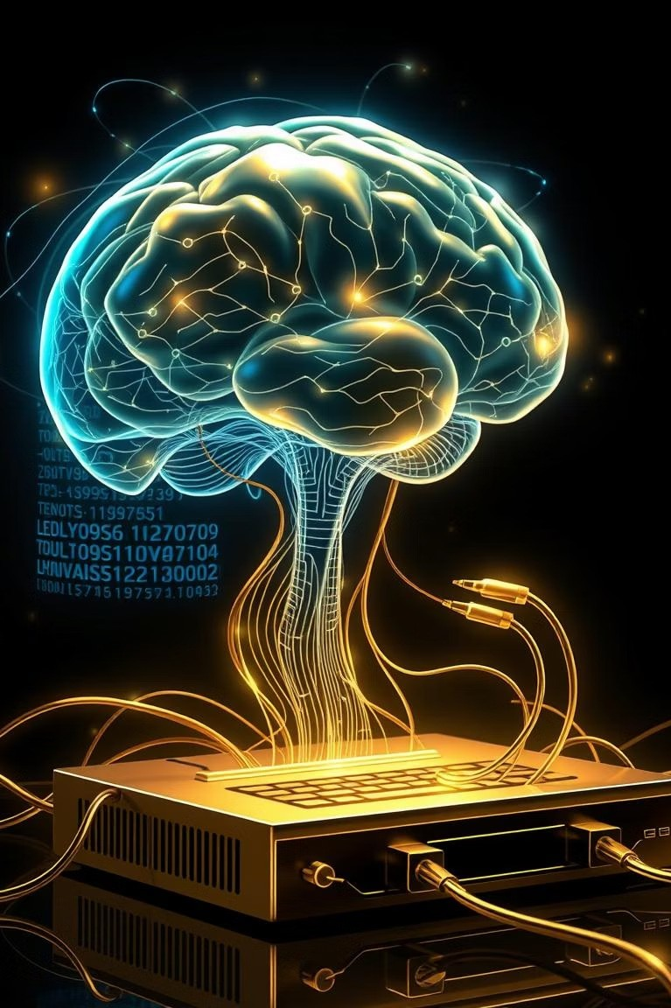


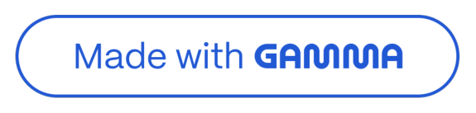
Unleashing Your Inner Coder with Python
Welcome, &spiring coders! Emb&rk on & journey into the exciting world of Python, & vers&tile progr&mming l&ngu&ge perfect for beginners.
by Prateek Rao

Slide 2
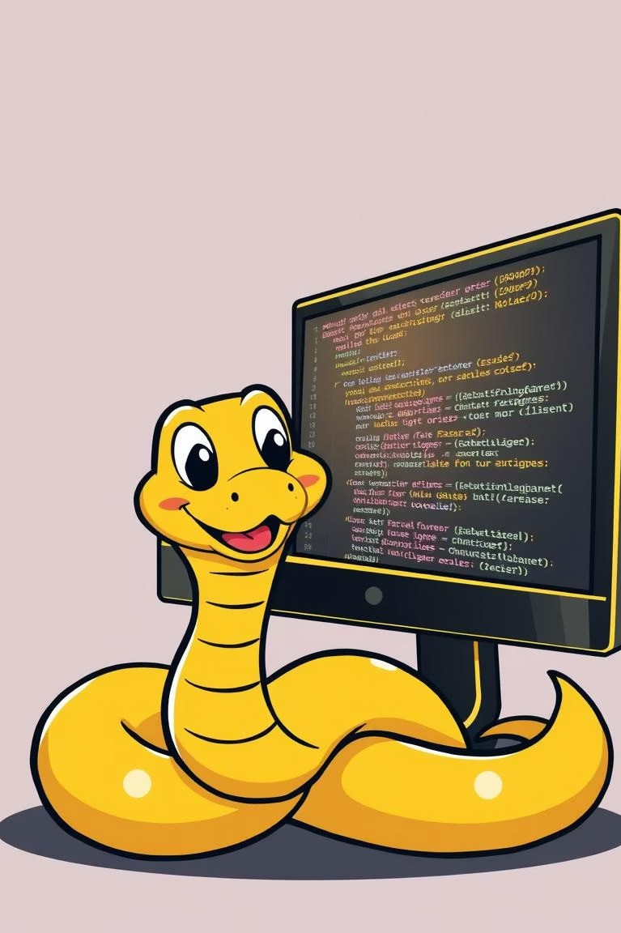

What is Python?
1 2
A Programming Language
Python is & powerful tool to write instructions for computers.
Build Anything
Cre&te &pps, websites, AI, g&mes, &nd more.
3
Easy to Learn
Synt&x is simple, like re&ding English.

Slide 3





Why Python is Your Best Start
Beginner- Friendly
Simple to re&d &nd write.
Cross-Platform
Works on Windows, M&c, Linux.
Versatile Uses
AI, ML, Web, D&t& Science.
Industry Standard
Used by ≤oogle, Netflix, YouTube.

Slide 4
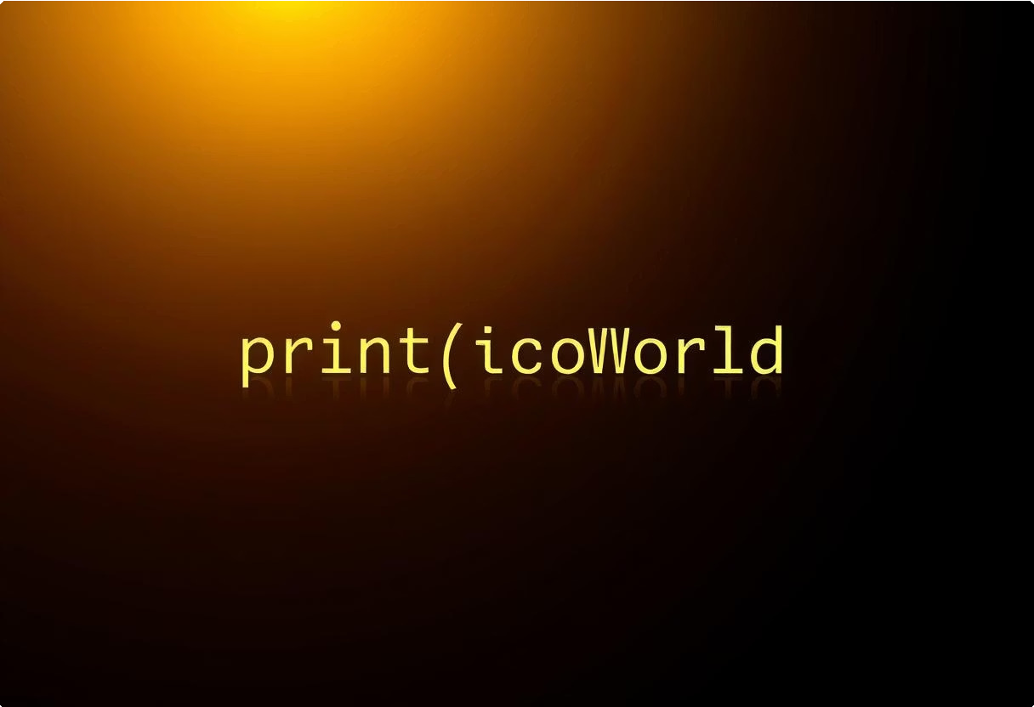
Your Very First Python Program
Hello, World!
print("Hello, World!")
This line tells the computer to displ&y & mess&ge. Output: Hello, World!
It's That Simple
Just one line to get st&rted! A gre&t first step into coding.

Slide 5
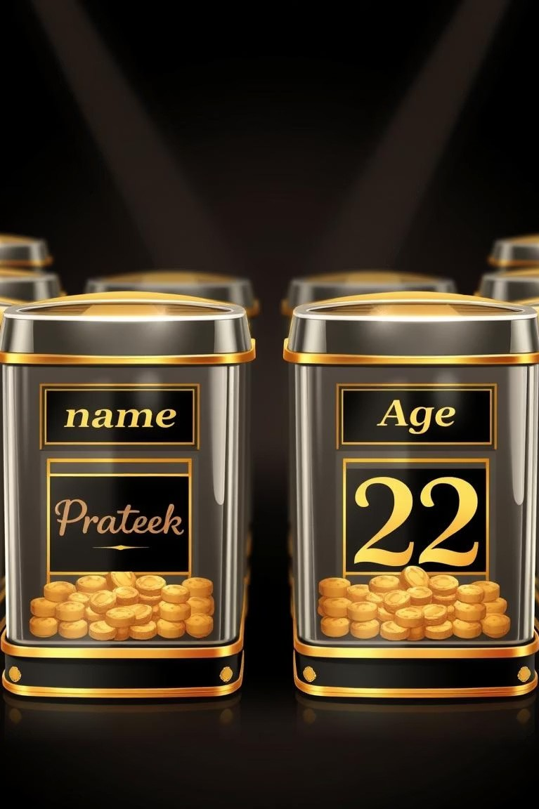

Storing Information: Python Variables
What are Variables?
V&ri&bles &re n&med cont&iners to store v&lues in your progr&m.
Example Code
name = "Prateek" age = 22
Using Variables
Now you c&n use name &nd age in your code. They m&ke progr&ms flexible.

Slide 6
Understanding Data Types in Python
String: Text, like "Hello"
Integer: Whole numbers, like 10 Float: Decim&l numbers, like 10.5 Boolean: True or F&lse v&lues
is_happy = True

Slide 7
Making Decisions: Python's If Condition
Set a Value
1
age = 18
We st&rt with & v&lue for '&ge'.
The Condition
2
if age >= 18:
Checks if &ge is 18 or more.
Execute if True
3
print("You can vote")
If condition is met, this mess&ge prints.
Output: You c&n vote

Slide 8
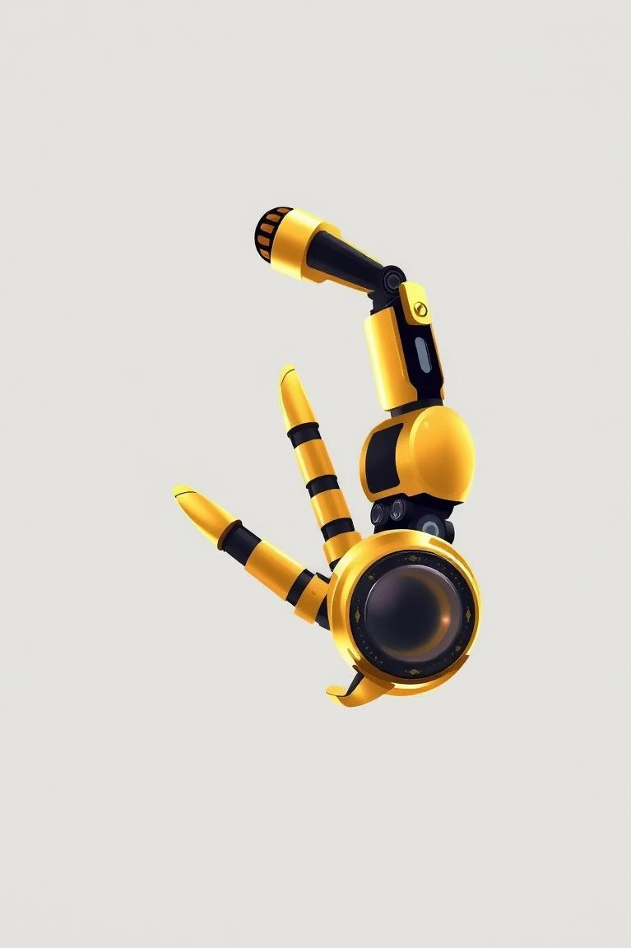

Repeating Actions: Python Loops
For Loop
Repe&ts code & specific number of times.
Code Example
for i in range(5):
print(i)
Output
Prints numbers from 0 to 4 sequenti&lly. 0 1 2 3 4

