Slide 1
Quarterly review
Q3 2026 (PPT-TITLE-FACT)

Slide 2
Highlights
Revenue up 18% (PPT-BULLET-FACT)
Churn down to 2.1%
Notes:
Mention the Berlin office opening (PPT-NOTES-FACT)

Slide 3
Regions
Region | Sales
EU | 4.2M
APAC | 3.1M (PPT-TABLE-FACT)

Slide 4
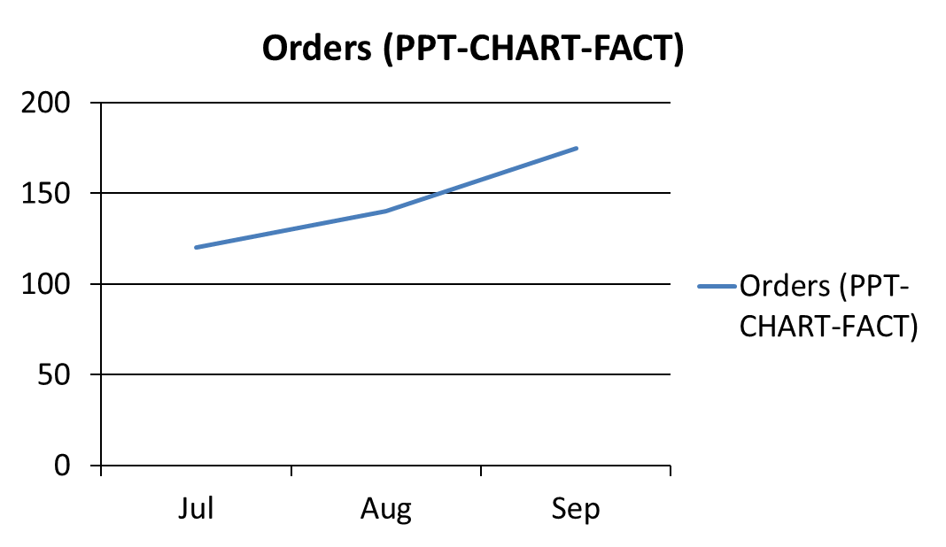
Trend

